Slide 1







THEATRE SPONSORED BY
AI Ready Data: Envitia’s experience of helping public sector customers get their data into shape so that AI can be used effectively
Richard Griffith
Chief Technology Officer, Envitia
SPONSORED BY
DigiGov Expo
DIGIGOVEXPO

Slide 2

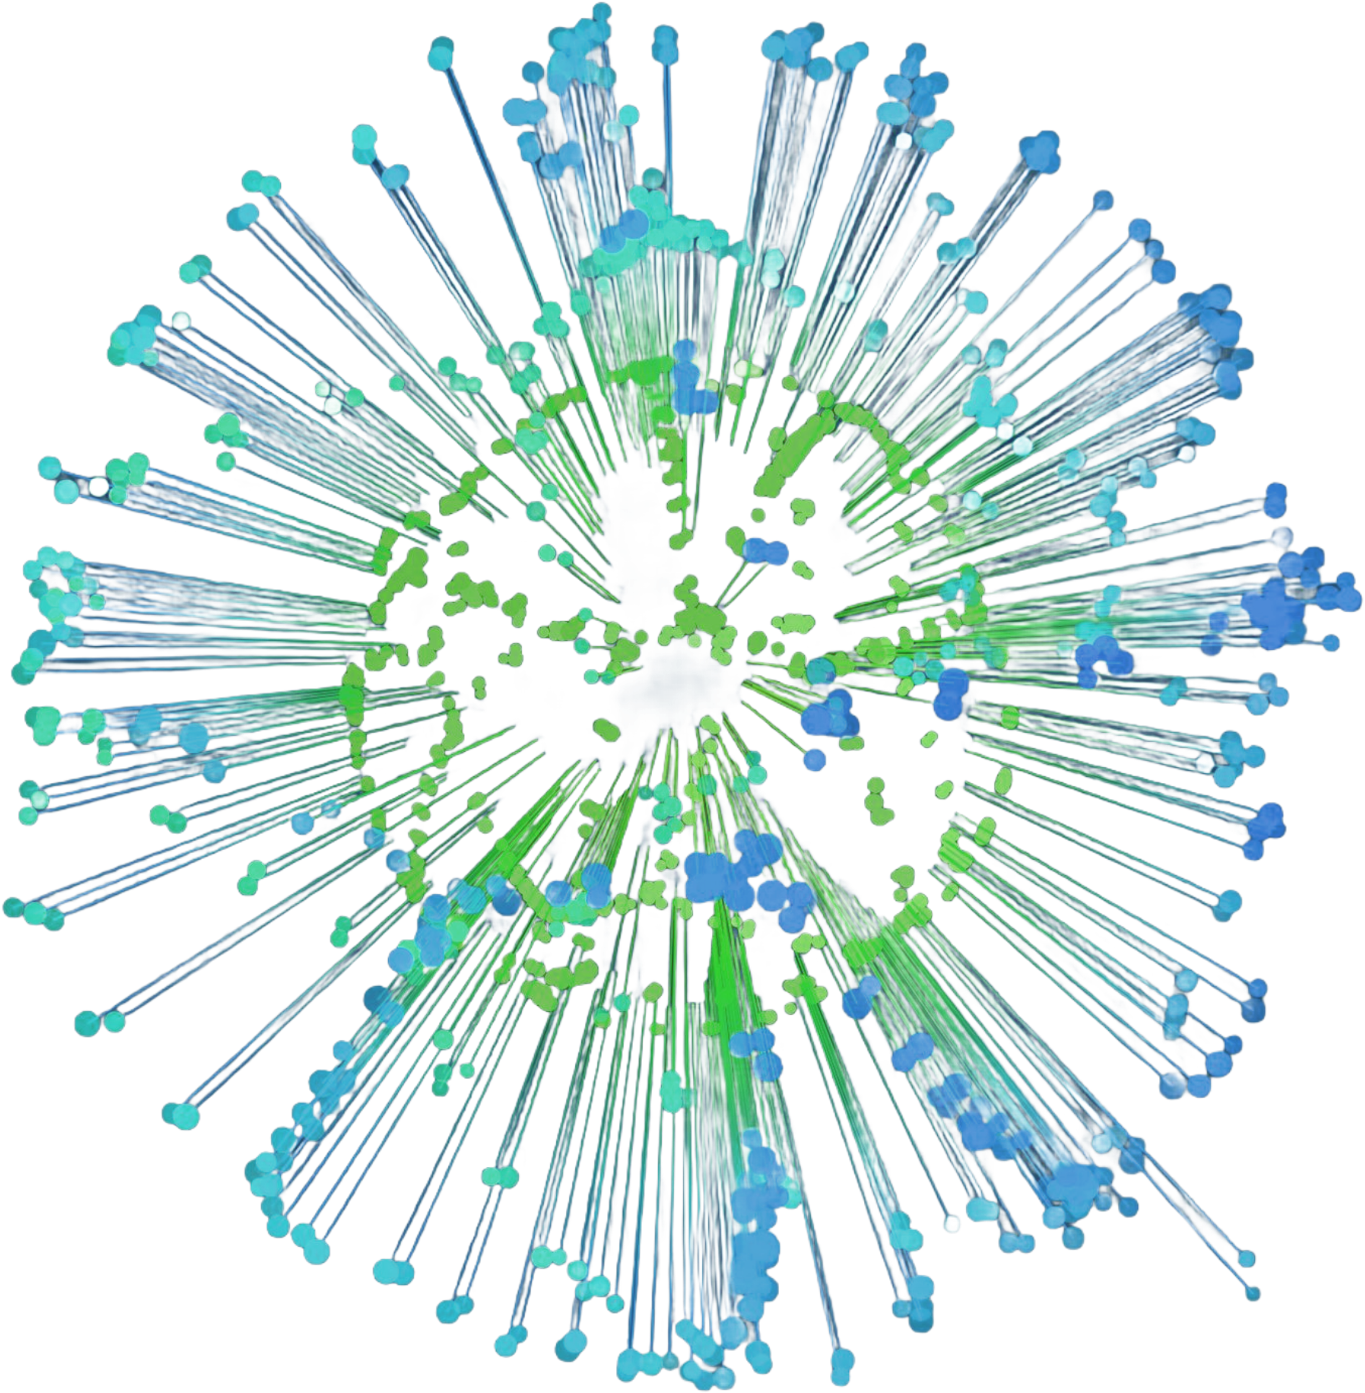

DigiGov 2024
Your Trusted AI Data Advisors
Envitia’s view on the critical role of data in AI transformation
AI Ready Data
www.envitia.com

Slide 3


DigiGov 2024
Chief Technology Officer
Richard Griffith
About Richard
Richard is responsible for the business’s technology strategy
whilst ensuring the quality of our customer solutions. A seasoned technologist with over 20 years of working in the digital sector.
With a focus on solving customer challenges, Richard leverages a wide range of technologies and extensive expertise to deliver innovative solutions. His deep knowledge and strategic approach ensure tailored results that drive customer success.
www.envitia.com
Slide 02
Notes:
Chief Strategic architect for Navy

Slide 4

DigiGov 2024
About Envitia
35+ Years
of Expertise
Complex
Data Specialists
Trusted
Delivery Partner
Innovative
Technology
www.envitia.com
Slide 03
Notes:
About Envitia
35+ Years of Expertise: Envitia has over 35 years of experience solving complex data problems in high-trust environments.
Trusted by Government & Defence: Envitia serves clients across defence, central government, and the public sector, including the Environment Agency, Ministry of Defence, and Royal Navy.
complex Data Specialists: Envitia is a leader in data analytics, offering solutions for data discovery, analysis, and visualisation across various domains.
Innovative Technology: Envitia provides cutting-edge solutions like MapLink Pro, a world-leading mapping and geospatial analysis SDK, and the Data Discovery Platform for enterprise-wide data management.

Slide 5









DigiGov 2024
About Envitia
AI & Machine
Learning
Architecture
Cloud Services
Data Analytics &
Visualisation
Data Quality &
Management
Digital &
Data Strategy
Geospatial
Software
Engineering
www.envitia.com
Slide 04
Notes:
Services to extract business value from data (envitia.com)

Slide 6

DigiGov 2024
Why are we all talking about AI?
01
How AI adoption amplifies potential outcomes
(both positive and negative)
02
Plus ça change: when it comes to data, everything changes yet stays the same
03
The increasing importance of data half life
04
How to get started: the importance of modern Enterprise Architecture
Slide 03
www.envitia.com
Slide 05

Slide 7


DigiGov 2024
AI and Data: The Big Disruptor
Predictive Analytics
AI can be used to analyse large datasets and generate predictions about future events or trends, enabling businesses to make better decisions and maximise their profits
Process Automation
AI can be used to automate routine tasks and free up human resources for more complex and creative work, leading to increased efficiency and productivity
Performance Optimisation
AI can be used to optimise performance by analysing data and detecting patterns
or anomalies, leading to improved outcomes and reduced costs
www.envitia.com
Slide 06

Slide 8





DigiGov 2024
The Consequences of AI:
Amplification of Outcomes
-$304 million
-2000 staff
01
Zillow's Housing Market Misstep
Zillow's AI-driven home price predictions led to purchasing 27,000 houses, resulting in massive inventory writedowns and layoffs
02
iTutorGroup's Discriminatory Hiring
iTutorGroup's AI recruiting software automatically rejected older applicants, leading to a $365,000 settlement for age discrimination
-$365,000
Settlement
www.envitia.com
Slide 07
Notes:
What can go wrong in a company if apply AI incorrectly – data impacts – safety of HR for example, chatbot that sells cars,
Zillow – algorithm predicting home processes aiming to buy/flip houses in the company - Zillow bought 27,000 – was out by up to 7% causing massive inventory writedown and workforce reduction
itutor group – discrimination in recruitment screening – settlement
TAY – the chatbot from Microsoft that went racist almost immediately causing huge backlash

Slide 9




DigiGov 2024
The Consequences of AI:
Amplification of Outcomes
40% Coding
Productivity Boost
03
Goldman Sachs: AI Supports Developers
Goldman Sachs uses AI to complement developers, automating up to 40% of coding with generative AI, boosting efficiency without replacing humans
04
Moderna: AI Accelerates mRNA Success
Moderna's AI platform boosts drug development success rates from 15% to 50%, drastically reducing time to market and cutting costs significantly
50% Faster
Drug Development
www.envitia.com
Slide 08

Slide 10
DigiGov 2024
Plus ça change: AI Data foundations
When it comes to data, everything changes yet stays the same in
the AI Age.
Building robust and secure data foundations is crucial for successfully leveraging AI's benefits and achieving desired business outcomes.
Insights
AI/ML
Analytics
Infrastructure
Security
Foundations
Metadata
Quality
Modelling
Maturity
www.envitia.com
Slide 09
Notes:
Although the outward appearance may change, fundamentals are constant.
Data Quality
AI been added to the top
Data Foundations: This stage involves establishing the basics of data management, including data collection, storage, and governance.
Data Infrastructure: At this stage, organisations build robust systems for data processing, integration, and accessibility.
Data Analytics: This phase focuses on developing the capability to analyse and interpret data to drive insights.
Data Visualisation: Here, the emphasis is on presenting data in visual formats that make it easier to understand and interpret, enabling better communication of insights across the organisation.
Data Solutions: At this stage, organisations begin to implement more sophisticated data-driven solutions, often tailored to specific business problems or opportunities.
AI Realisation: At this most advanced stage, AI is fully embedded across an organisation's operations, delivering measurable business value and driving strategic decisions.

Slide 11

DigiGov 2024
The increasing importance of data half-life
Organisations and processes value data differently
Data half-life: the time that data retains its value
To company A
Data is only useful in the 5 minutes after capture
To company B
Data is useful for years
Identifying the types of processes allows
data half-life to be established
www.envitia.com
Slide 10
Notes:
For example – whilst everything changes nothing changes, this is a good example where taking humans out the loop speeds up the data exploitation thus the time criticality becomes more important

Slide 12

DigiGov 2024
The increasing importance of data half-life
Tactical processes – need near real time data
Operational process – data a week old is usually okay
Strategic processes – data can be months or years old
Processes need to be modelled around this half-life otherwise AI decisions can be made with stale or invalid data. Do you know how old your data is?
www.envitia.com
Slide 11
Notes:
For example – whilst everything changes nothing changes, this is a good example where taking humans out the loop speeds up the data exploitation thus the time criticality becomes more important

Slide 13




DigiGov 2024
How to get started with AI
Business focus
We prioritise business needs over technology, optimising systems and using AI to determine essential actions
System Integration Processes
Effectively integrating AI with existing systems and processes is crucial for successful implementation
Architecture of AI Systems
Understanding the unique structure and technological impacts of AI systems is vital for architects
www.envitia.com
Slide 12
Notes:
This is the modern approach to Enterprise Architecture - the home office DDAT strategy is well written and accessible and the principles all align to this process
Our principles:
Converge technologies where possible
Create shared technology products
Be product-centric over programme-centric
Become data-driven to improve our decisions
Deliver effectively at scale
Embrace innovation

Slide 14


DigiGov 2024
Solving Complex Data Challenges
Maritime Digital
Architecture
Framework
The Next Generation
digital standard for
maritime vessels
www.envitia.com
Slide 13
Notes:
Some people here will have very complex environments

Slide 15


DigiGov 2024
Thank You !
Name: Richard Griffith
Mobile: +44 7585 608 927
Email: richard.griffith@envitia.com
Web: www.envitia.com
Slide 03
www.envitia.com

