Slide 1
Cross government Secure by Design Approach
Fotini Tsekmezoglou
Notes:
email to Leah.Hayward@govnet.co.uk by the 1st November 2023.

Slide 2
The mandate
Secure by Design will be mandatory across central government and ALBs
Mission 4, Commitment 11
All new services shall comply with the common approach to Secure By Design
Outcome 9: Government adopts a common approach to ‘secure by design’ to ensure that appropriate and proportionate cyber security measures are embedded within the technology government uses, and that the security of digital services is continually assured throughout their lifecycle.
Notes:
BH

Slide 3
Objectives
Support project teams to deliver secure digital services from the start (shift left security)
Stress to risk owners that ‘security risk’ is ‘delivery risk’ and ‘business risk’
Encourage project teams and security / GRC functions move to carrying out security assurance little and often
Help organisations achieve the outcomes in their respective GovAssure profile
Improve cross-organisational trust as services are built on same baseline

Slide 4
10 Principles
These provide key outcomes to be achieved, linked to the specific security challenges faced by government organisations.
Appoint a business risk owner - ensure appropriate oversight from senior owners.
Perform security due diligence - secure your dependencies and 3rd party risks.
Design risk-driven security - mitigations should be proportionate to risk.
Create usable security - controls should be easy for end-users to use.
Implement end-to-end security - security should be baked in from start to finish.
Design flexible architectures - services should be easily updated and configured.
Minimise the attack surface - use the minimum components the service needs.
Defend in depth - assume that other components could be compromised.
Embed continuous assurance - conduct frequent assurance activities.
Secure changes - implement security processes in live service.
Culture
Tech, build monitor and run
Continuous change

Slide 5
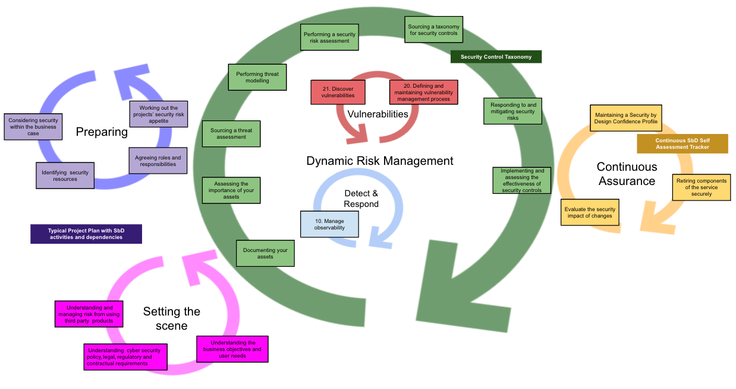
Activities

Slide 6
Approach
Discovery
Development
Piloting / Testing
Finalise & Publish
Established Working Group
Agreed ToR
Agreed goals and outputs
Drafted the 10 principles
Drafted activities, templates, examples and tools
Establish Industry Panel
Iterated the principles
Tested outputs with 6 pilots
Run user research / workshops
Presented at boards, committees and forums
Published blogs
Update the outputs based on feedback
Obtain approvals
Awareness sessions
Publish on security.gov.uk
Launch at Govt Cyber Security Conf
What
Led by CDDO
GSG and NCSC
Gov organisations
Led by CDDO
GSG and NCSC
Gov organisations
Suppliers
Led by CDDO
GSG and NCSC
Gov organisations
Suppliers
Led by CDDO
GSG and NCSC
Gov organisations
Suppliers
Digital Government eXchange
Who

Slide 7
Benefits
Ensures security is better integrated into digital delivery
Improves trust and data sharing between organisations through consistent application of security
Provides practical guidance targeting challenging areas aimed at non-security SMEs
Drives consistency across government with the adoption of the same core principles and how-to guidance, tools, templates and examples
Clarifies responsibilities for roles and encourage better collaboration

Slide 8
If you would like to find out more, email us at
secure-by-design@digital.cabinet-office.gov.uk
Thank you

