Slide 1
GovNet Conference
How DWP is utilising a two-pronged offensive against cyber attacks
15 November 2023

Slide 2
UK Department for Work and Pensions
The Department for Work and Pensions (DWP) is responsible for welfare, pensions and child maintenance policy.
As the UK’s biggest public service department it administers the State Pension and a range of working age, disability and ill health benefits to around 20 million claimants and customers.
DWP is a ministerial department, supported by 15 agencies and public bodies.

Slide 3
What we do
DWP exists to contribute towards fair, safe and fulfilling lives, reducing poverty supported by reducing dependency on welfare support whilst providing choice, personalisation and a high quality of service for all our customers.
Working Age
Encouraging work
and making work pay.
Retirement
Helping people meet the challenges of an
ageing society and maintain standards of
living in later life.
WHAT WE DO
Sickness & Disability
Enabling work, independence
and participation in society.
Child Maintenance
Supporting separated families to play an active
role in the lives of their children.

Slide 4








What we do
DWP exists to contribute towards fair, safe and fulfilling lives, reducing poverty supported by reducing dependency on welfare support whilst providing choice, personalisation and a high quality of service for all our customers.
>100 products
and services
7.4m
benefit claims processed
£244 bn
paid in benefits and pensions
12k IT changes each year
1B
lines of code
20m
customers
130k desktops and 1 virtual desktop
812 buildings including 720 Jobcentres
4k
Digital Staff

Slide 5

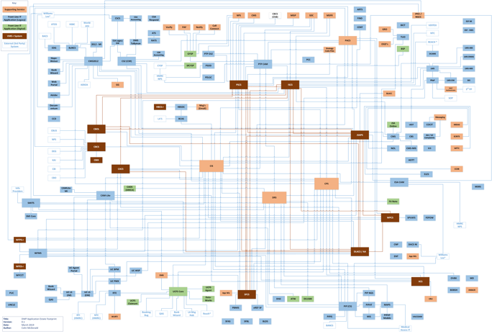
Our IT estate is very complex…
Each box is a major IT system.
Each line is connectivity between the systems.
The diagram is not complete – e.g. it only shows the major operational systems.
It's constantly changing
Broadly it shows the complexity we deal with.
Children
Retirement
OGDs
Labour
Market
JSA
Carers
ESA
Core Systems
Winter Fuels
SMI
Winter
Fuel
DLA
Social
Fund
PIP
Access To
Work
Industrial
Injuries
Universal Credit
More than 60% of DWP Digital’s run and maintenance costs can be attributed to ensuring that our IT services remain price performant, effective and secure.

Slide 6





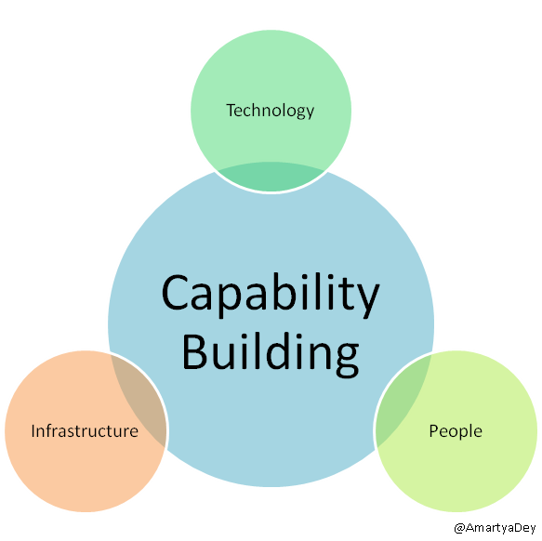
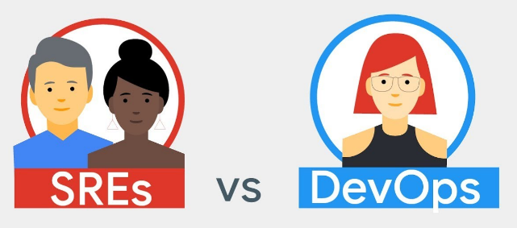
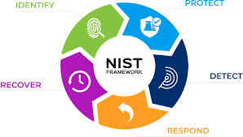

My Role(s) @DWP
2016-2019:Head of Infrastructure Services (interim)
Design, Engineering, Service, Delivery, and Finance
Networks, Hosting, Cloud, Enterprise Tools, Security, and Software.
Build capability – 40 x Infrastructure Engineer role(s)
2019-2020:Head of Reliability Engineering (interim)
Design, Engineering, Service, Delivery, and Finance
Established Reliability Engineering capability.
Build capability - Site Reliability Engineer (SRE) role(s)
Transition of function into Hybrid Cloud Services
2020-2023:Head of Adaptive Security Programme / Digital Security (interim/perm)
Design, Engineering, Service, Delivery, and Finance
NIST-CSF, CIS 18 Critical controls, Tools and services
Build capability - CSRM, CSRA, CSVM role(s)
24

Slide 7
Problem Statement
Internal or external cyber security threats is still a significant risk to DWP service
Cyber Security remains one of the biggest risks to both the Public and Private Sector, with the risk increasing;
Financially motivated attacks are increasing, >80% of financially motivated attacks involving the deployment of ransomware or a precursor to ransomware activities*
Technology alone is not enough — people, process, configuration, coverage and management matters.
Intrusions should not be thought of as a one-time event, requirement is for continuous monitoring and response.
DWP needs to evolve to stay ahead of the inherent risk, with continuous work needed to continue to stay ahead.
* SOURCE: https://go.crowdstrike.com/rs/281-OBQ-266/images/Report2020CrowdStrikeServicesCyberFrontLines.pdf

Slide 8
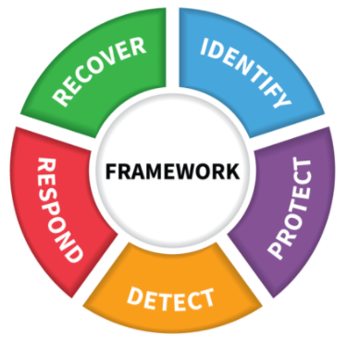
NIST-Cyber Security Framework
Background: A DWP wide decision has been taken to adopt the NIST Cyber Security Framework (NIST-CSF) as a benchmark for security controls (i.e. wider than digital). Technology Services has initiated an initial assessment across digital to establish the current levels of compliance against the Tier-4 “Adaptive” level to create a gap-analysis, and roadmap, followed by programme will follow to implement roadmap of appropriate controls across Digital Services. This framework helps define a quantitate set of controls that are continuously evolving and validated to mitigate security threat to the department.
The thing DWP is doing is implementing improved security controls, NIST-CSF provides a reference framework to validate the capability level.
This framework establishes a common language across 5 core areas. NIST alone isn’t the answer, what it will do is provide a framework to work against and establish appropriate security controls.

Slide 9
NIST-Cyber Security Framework
1. Understand the assets we need to protect
Understand
Environment
IDENTIFY
2. Reduce the likelihood of successful attacks by prioritising work within the Protect function
Good Cyber Hygiene
Improving Control Coverage
Reduce
Likelihood
PROTECT
DETECT
RESPOND
3. Reduce the impact of attacks by
Improving our ability to detect, respond and recover to attacks
Using automation to provide instant response and recovery
Reduce
Impact
RECOVER
Notes:
The Adaptive Security Programme is a collaborative effort between Security and Digital to drive forward the delivery of cyber security objectives
It’s based around the 5 NIST pillars, Identify, Protect, Detect, Respond and Recover.
The aim is to reduce the likelihood of a successful attack (PROTECT) and minimise the Impact (Detect, respond recover).
I’ll run through the broad strategy behind our approach and then update you on progress made against specific elements
Identify
Identify underpins the whole framework and is about understanding our assets and the risks posed to them. Only with a complete view of everything we own will we be able to provide assurance that our assets are adequately protected. The two main focuses in this area have been the movement of digital risk from S&DP into digital and the visibility and control project
Protect
The protect function remains our strategic priority. Given the importance of the services we deliver to the public our primarily focus is to reduce the likelihood of a successful attack to close to zero thereby protecting the services we deliver for the public. Stopping malicious activity on our estate before it starts.
Examples of some of the protect work The work we’ve done in the Protect pillar includes
Detect, Respond Recover
But in recognition that we cannot stop every single attack we are also focussing on Increasing our current profile against DETECT RESPOND AND RECOVER, focussing on areas which are weakest and where we can get deliver greatest effect
We may not always be able to PROTECT against a ransomware attack, for example, but our ability to recover at pace will be key to ensuring we continue to deliver services to the public.
So we’ve been focussing on two things. The first is to increase our capability across the detect, respond and recover functions. The second is to start to automate processes so that we can respond and recover from an attack before its had a major impact on services.
If we can automatically detect malicious processes running on a machine and automatically remove that machine from the network then we reduce the impact to close to zero.

Slide 10
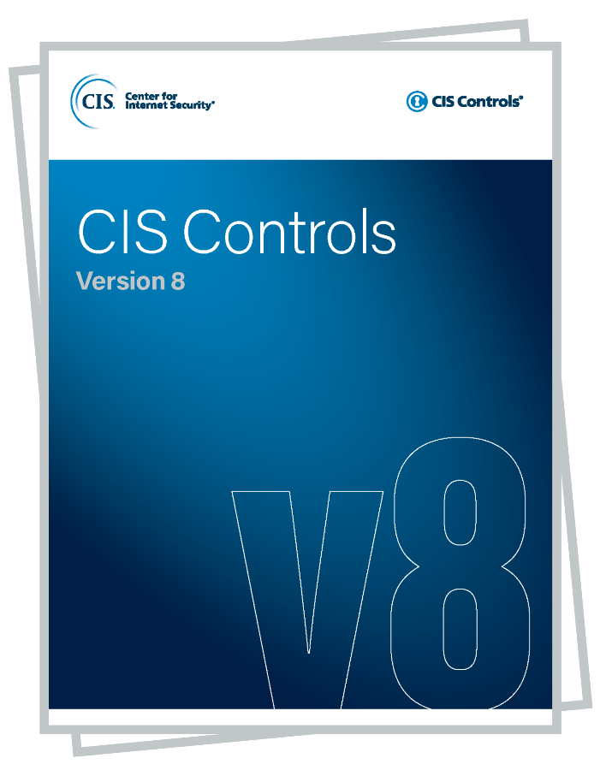
  Cyber Security Risk
“Internal or external cyber threats could result in breaches in data confidentiality, integrity and availability, disruption to DWP systems and services”
CIS Critical Security Controls Version 8
The CIS Critical Security Controls (CIS Controls) are a prioritized set of Safeguards to mitigate the most prevalent cyber-attacks against systems and networks. They are mapped to and referenced by multiple legal, regulatory, and policy frameworks. CIS Controls v8 has been enhanced to keep up with modern systems and software. Movement to cloud-based computing, virtualization, mobility, outsourcing, Work-from-Home, and changing attacker tactics prompted the update and supports an enterprise’s security as they move to both fully cloud and hybrid environments.

Slide 11
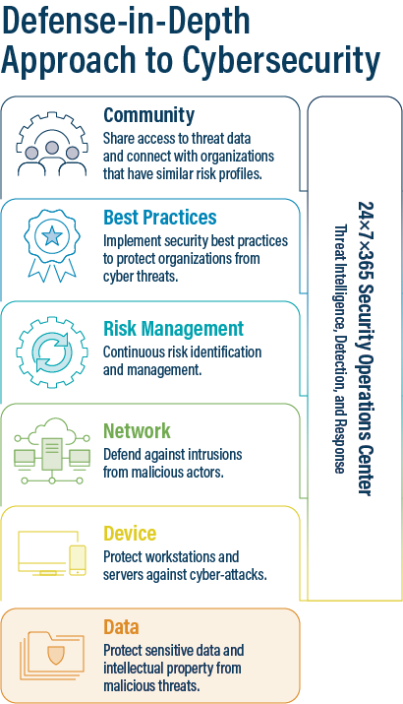
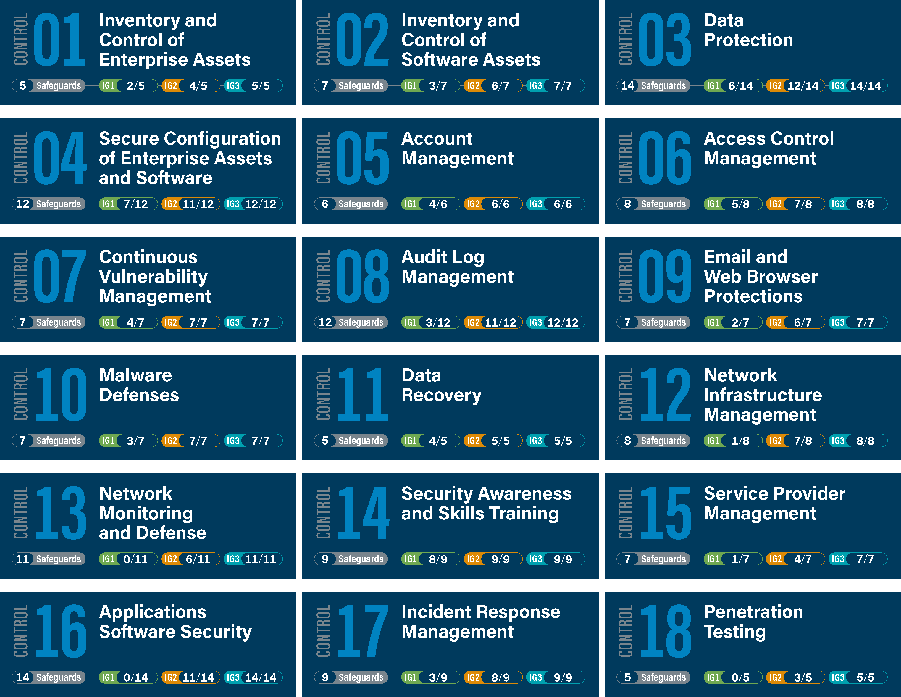
  Centre for Internet Security (CIS) Critical Controls v8
Source: SLTT Organizations and the Defense-in-Depth Strategy (cisecurity.org)
Source: www.cisecurity.org/controls/implementation-groups/ig3

Slide 12




Understanding Our Environment - Identify
Underpins the whole of NIST
Need to fully understand our environment in order to protect it
This includes;
  Our assets, their status and criticality
  Our network and how it connects our assets
  Our current controls and their effectiveness
  An understanding of our risks
Risks
Controls
Assets
Network

Slide 13


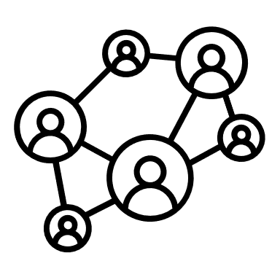

Reducing Likelihood - Protect
Reducing the likelihood of successful attack is our strategic priority
We do this by protecting our assets through security controls
Designed to prevent unauthorised access to our systems
Examples include access controls, perimeter & network defences and end point protections
Access Controls
Perimeter Defences
Network Defences
Endpoint Protections

Slide 14

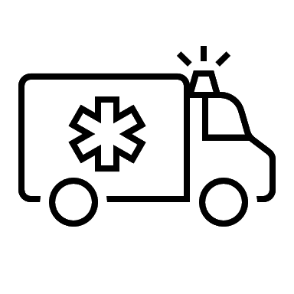

Reducing Impact – Detect, Respond, Recover
Some attacks might get through
Must be able to detect, respond and recover at pace to maintain service to the public
By automating we can minimise the impact
Rapid Breach Detection
Automated
Response
Automated Recovery

Slide 15





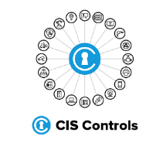

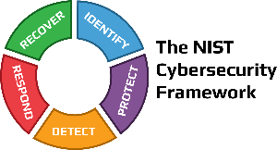
Target Architecture
Protection
&
Detection
Correlation
Analytics
CMDB
Automation
Orchestration
User Reported Phish
Workflows
IT Connection
Machine Learning
Vulnerability
Integrated Risk Management (IRM) Vulnerability Management & Configuration Compliance
Threat
Intelligence
Vulnerability Exploit & Solutions Intelligence

Slide 16


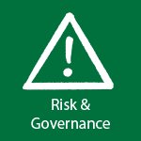



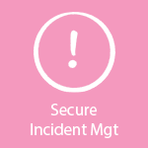


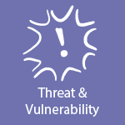

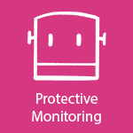

Adaptive Security – 22 Security Controls
Understand Environment (IDENTIFY)
I1. Integrated Security Risk Management (ISRM) - End to End Controls based Risk Management
I2. Digital Certificates – Centralised Certificate Authority and PKI, with automated certificate lifecycle management
Reduce Impact (DETECT)
D1. Digital Vulnerability Management and Mitigation – End to End process and controls for vulnerability management (find it – fix it)
Reduce Impact (RESPOND)
Reduce Impact (RECOVER)
P8. Firewalls & Gateways – CIA Ingress and Egress Controls
R1. Secure Place – Security Operations systems with automation (IRM, SIR & VR )
DR1. Data Recovery – Processes and tools including immutable backup
P7. Firewall & Gateways – Email - Ingress and Egress Controls
P6. End Point Protection – Server - End point protection to proactively block and detect cyber threats, and detect and protect vulnerabilities & malware
P5. Gold Operating Systems Build – Ever-Green security hardened operating systems with build in controls
P4. Purple Team – Offensive testing of security controls
P2. Role Based Access Management (RBACS) – Role based access based on job function for all users and services
D2. Security Information and Event Management (SIEM) – Aggregation of security events and information
D3. Enterprise Immune Systems (AI) – Learns normal ‘patterns of life’ to detect unpredictable cyber-threats.
P3. Privileged User Access Management (PUAM) – Enhanced controls and audit, just in time privileged access
P9. Firewalls & Gateways – Networks Ingress and Egress Controls
P10. AWS Native Security Controls - End to End visibility of assets and data to underpin security controls
P11. Microsoft Native Security Controls - End to End visibility of assets and data to underpin security controls
R2. Security Automation – Security Operations systems with automation
I3. Operational Security data – New
I4. AD Tech Debt & Controls – New
P1. Secure Code and Automation – Secure development and maintenance of application code, Policy based enforcement of controls
Reduce Likelihood (PROTECT)
D4. Server Security Tools - New
Adaptive Security Programme Domains
Governance Policy
& Culture
Cyber Security Risk Management
Secops
& SecureNow

Slide 17





IDENTIFY: 1. Integrated Risk Management (IRM)
Q: What is IRM?
New way of working, with Accountability for all Cyber Risks & Controls, new platform and Data
Q: What will it change/do ?
Controls approach is much faster, only need to asses and mitigate new application specific residual risks.
Data and controls in one place.
Software Vulnerability Data
Assets / CMDB
Digitals Risk & Controls Register (CISv8)
Digital Product
Managers Accountability
1st Line Cyber Security Risk Managers
Aligned to LoBs
Digital Subject Matter Experts (SME’s) consult
Digital Security Risk Management (DSRM)

