Slide 1
Networking with the enemy
Understanding the Psychology of Social Engineering
Javvad Malik

Slide 2
Javvad Malik
Lead Security Awareness Advocate
20 years in information / IT / cyber security
Security Operations
Consultant
Industry Analyst
Security Advocate
YouTuber
Podcaster
Blogger
JavvadMalik.com
@J4vv4D

Slide 3
Over
About Us
60,000
The world’s largest integrated Security Awareness Training and Simulated Phishing platform
We help tens of thousands of organizations manage the ongoing problem of social engineering
CEO & employees are industry veterans in IT Security
Global Sales, Courseware Development, Customer Success, and Technical Support teams worldwide
Offices in the USA, UK, Netherlands, India, Germany, South Africa, United Arab Emirates, Singapore, Japan, Australia, and Brazil
Customers

Slide 5
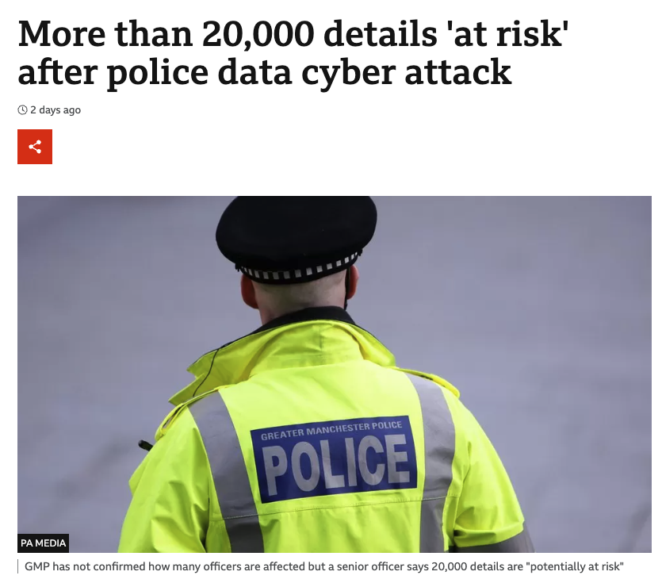

Slide 6
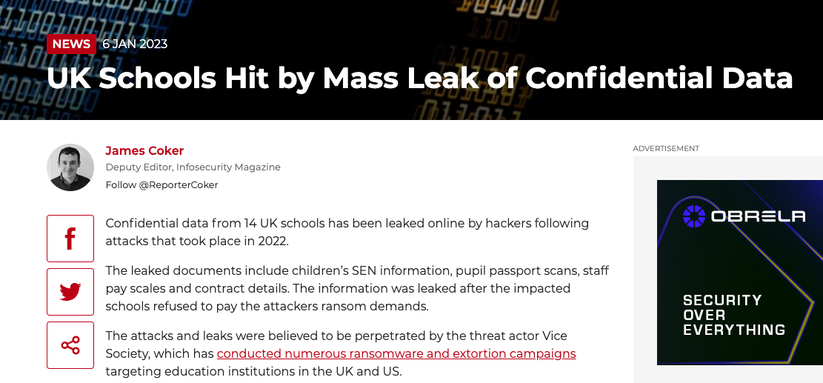

Slide 7
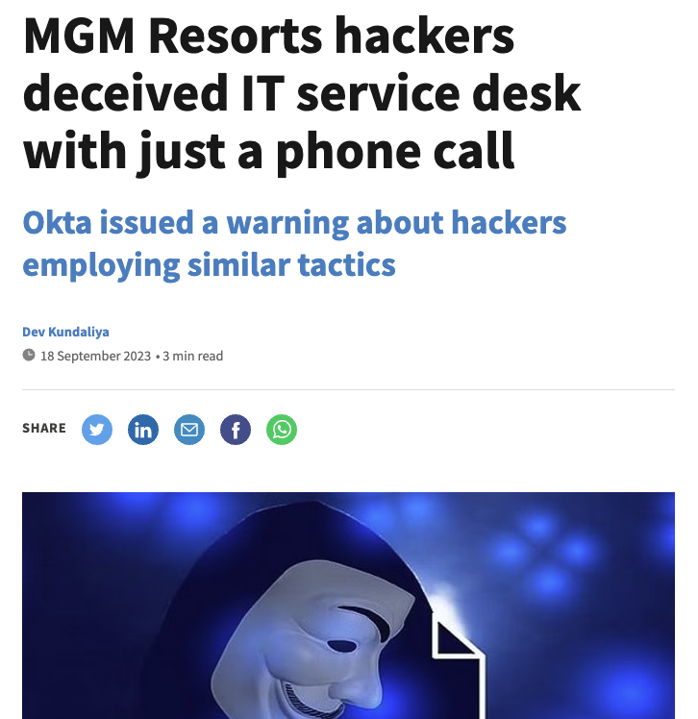

Slide 8
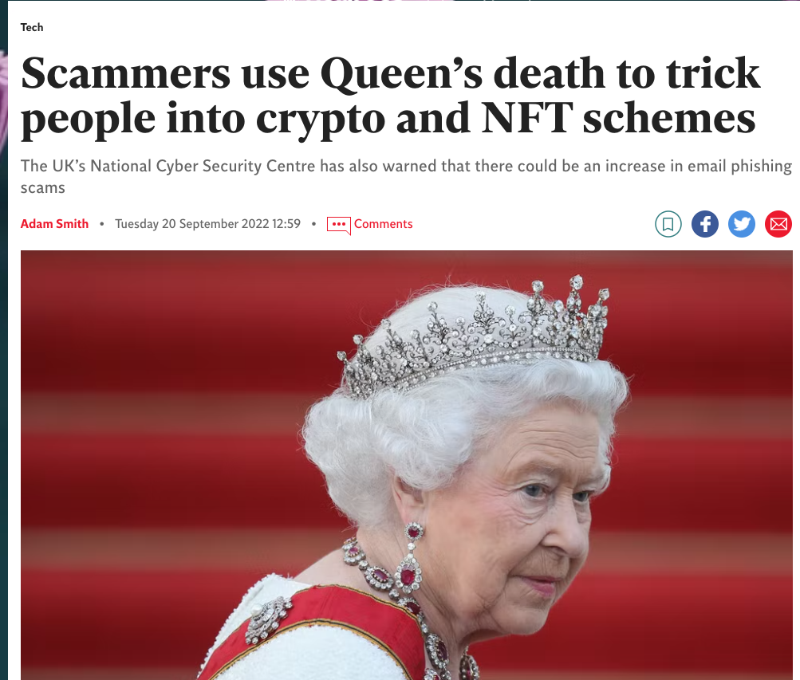

Slide 9
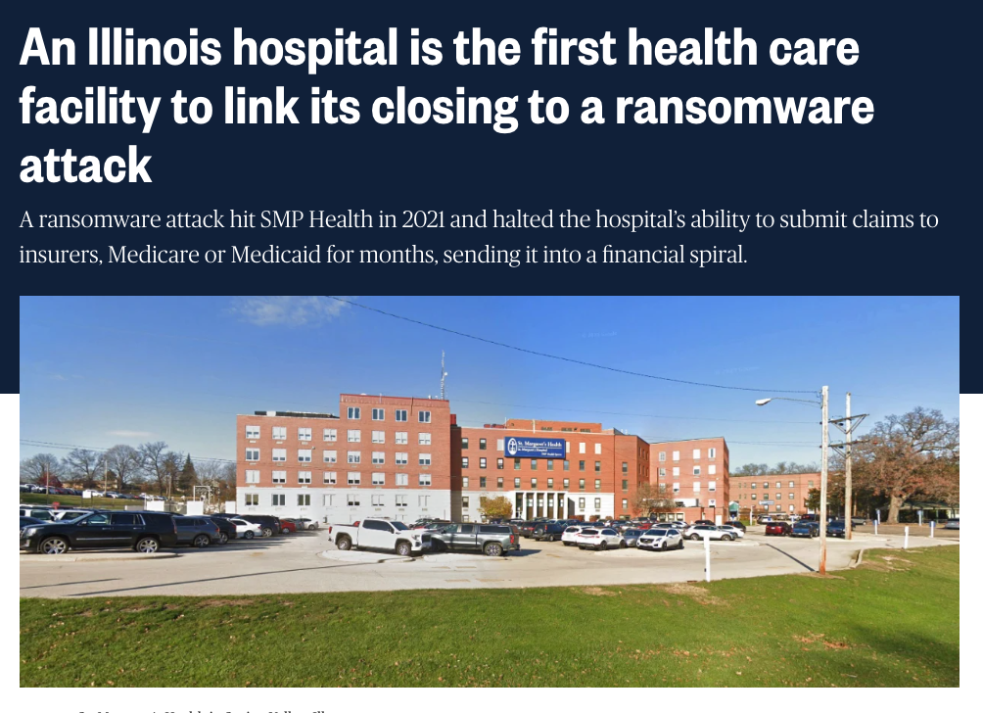

Slide 10
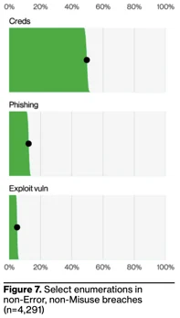
VDBIR: 74% of Data Breaches Involve the “Human Element”

Slide 12
Why do people fall for social engineering attacks?

Slide 13
Lazy Answers

Slide 14
Why Did The Chicken Cross The Road?

Slide 15
Our Own Brains Working Against Us

Slide 16
Which line is longest?

Slide 17
Which line is longest?

Slide 18
Which line is longest?

Slide 22
Perception vs. Reality
The phaonmneal pweor of the hmuan mnid, aoccdrnig to a rscheearch at Cmabrigde Uinervtisy, it deosn't mttaer in waht oredr the ltteers in a wrod are, the olny iprmoatnt tihng is taht the frist and lsat ltteer be in the rghit pclae.
The rset can be a taotl mses and you can sitll raed it wouthit a porbelm.
Tihs is bcuseae the huamn mnid deos not raed ervey lteter by istlef, but the wrod as a wlohe. Amzanig huh?
And I awlyas tghuhot slpeling was ipmorantt!

Slide 23
Perception vs. Reality

Slide 24
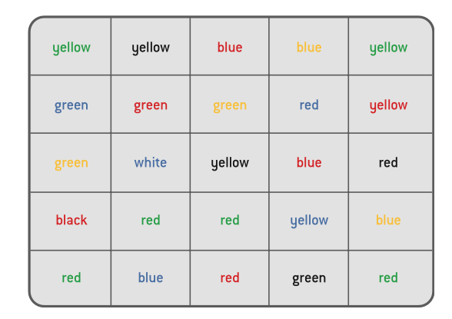

Slide 25
What do employees need to do?

Slide 26
Recognise
Report
&

Slide 28
Use MFA wherever available

Slide 29
More training!

Slide 30
Think like a marketer,
Not like a trainer

Slide 31
Think like a marketer

Slide 32
You can’t effectively train on everything…
If your goal is behavior change,
focus on 2 to 3 behaviors at a time

Slide 33
The art and craft of storytelling

Slide 34
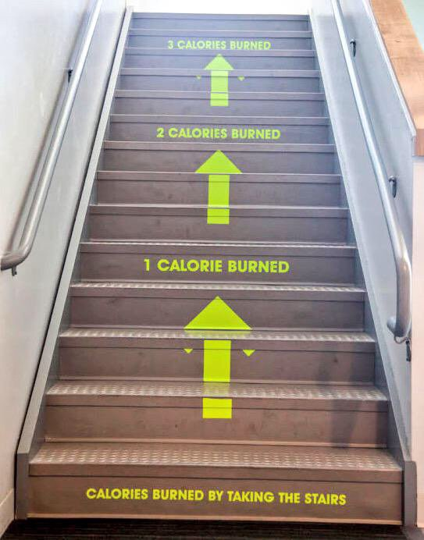
Nudge them in the right direction

Slide 35
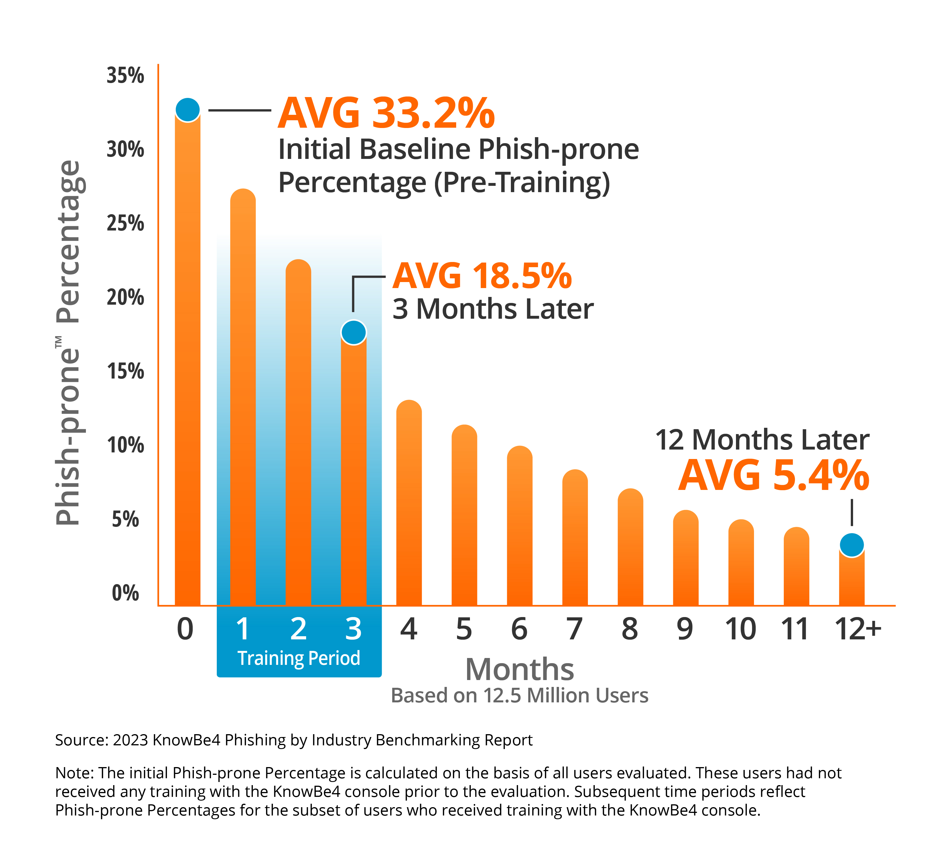
Generating Industry-Leading Results and ROI
Reduced Malware and Ransomware Infections
Reduced Data Loss
Reduced Potential Cyber-theft
Increased User Productivity
Users Have Security Top of Mind
82% Average Improvement
Across all industries and sizes from baseline testing to one year or more of ongoing training and testing

Slide 37
I have a 7-point strategy

Slide 38
Create Champions
Share Stories From the Top
Intensity v Consistency

Slide 39
Thank You
Javvad Malik
Lead Security Awareness Advocate
Email: javvadm@knowbe4.com
Twitter: @J4vv4D
LinkedIn: /in/Javvad

