Slide 1
How to Build Cyber Resilience Against Chronic Threats and Respond to Cyber Breaches?
Laura Cole
Department for Science, Innovation and Technology

Slide 2
National Cyber Strategy 2022

Slide 3
Reduce the burden on everyone
More resilient businesses and organisations
Pillar 2: Building a resilient and prosperous digital UK
More resilient public services
More resilient Critical National Infrastructure

Slide 4
Cyber resilience threats and issues across the UK

Slide 5
How to address these risks?
A whole-of-society approach
Addressing risks at a national scale
Legislative framework for critical services
Support organisations to protect themselves

Slide 6
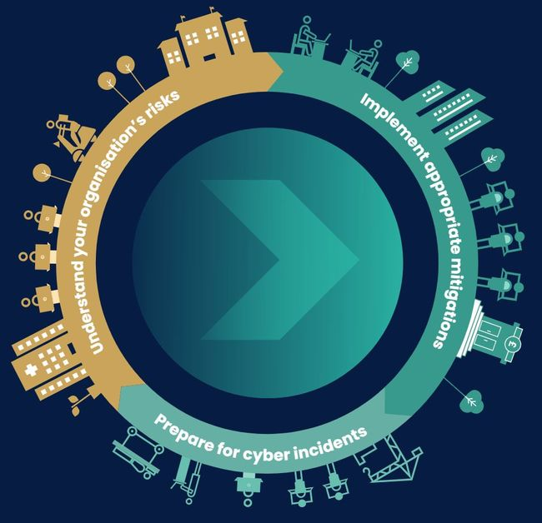
What can you do to protect your organisation?

Slide 7
Top tips
Understand your organisation - what are your critical dependencies?
Cyber security is not just for cyber security teams
Plan how to respond in case things go wrong
If nothing else, implement Cyber Essentials and ask your suppliers to do the same

Slide 8
Any questions?

