Slide 1
CyberCompare
Your partner for purchasing cybersecurity
Build and Implement cybersecurity procurement strategy
November 2023
Notes:
Welcome
Don’t worry – this is not just another powerpoint of doom and gloom
It is also not going to be full of stats about cyber attacks and telling you that what you are doing is wrong.
Instead, I would like this to be an informative session about how to buy cybersecurity and it is completely based on our experience.

Slide 2


Agenda
01
02
Introduction to CyberCompare
Step by step guide to Build and Implement cybersecurity procurement strategy
Notes:
I will introduce CyberCompare
Who we are, what we do, how do we do
And then we will talk about how to have a good procurement strategy for cybersecurity products and services

Slide 3
Our main task: Where should you make your next investment?
Comparisons of security controls: diagnostics, prioritization and security roadmap
Comparisons of solutions, services, vendors, contracts and renewal offers
Notes:
CyberCompare was developed as a result of methodical approach taken to research and find best-fit OT and IT security for a large Bosch OEM site in Germany.
The main aim is to ensure that our customer invests in the most cost-effective way.
And we do this in two ways
First we assessing your current state of security and comparing against similar organisations within your industry vertical
And
Providing in-depth comparison of solutions, services, contracts and renewal offers.

Slide 4








Overview of our 400 most recent projects
Top security categories and industries covered
Public and private sectors covered
Mechanical and Process Engineering
Critical National Infrastructure including Hospitals, Public Transport, Public Services, Airports
Pharmaceutical, Chemical, Oil and Gas
Public Sector (County and District Councils, Educational Institutions)
Automotive and Supplier Industry
Food, Beverage and Consumer Goods
Trade, Distribution and Logistics
Construction and Real Estate
Notes:
We have helped more than 400 organisation – both in private and public sector across variety of cyber security categories
More than 30% are returning customers with more than 2 procurement projects

Slide 5






Bosch CyberCompare is your independent partner for procuring IT, OT and IoT security solutions and products
Proven methodological approach to End-to-end or modular
The result is a decision-ready and transparent overview of offers with a clear recommendation
Extensive offer comparisons
Support in purchase negotiations
Security Risk Assessment & Prioritization
Customised customer target concepts
Top 3
providers
Concept
Tender
Specification
7,000 potential bidders, anonymized tendering
Transparent & independent vendor proposals
Efficient and standardized
Based on well-reviewed templates
Notes:
So how do we do achieve this?
4 step process that can be carried out in a sequence or individually as per client’s need
1. Together we define the concept, carry out a risk assessment, provide recommendation and roadmap for implementation with priorities
2. If you are looking to tender, we can facilitate specification workshop – customised using our proven templates – all geared up for receiving quality response
3. We use this specification, conduct market research, and anonymously approach vendors meeting the requirements for a proposal.
4. Once we receive the proposals, setup meetings with vendors for clarification, carry out extensive comparison by experienced security professionals, and recommend top 3 vendors.
All inputs from the vendors are recorded and included in the report submitted to the company.
Final decision making on who to invite for a sales pitch rests with the customer.

Slide 6

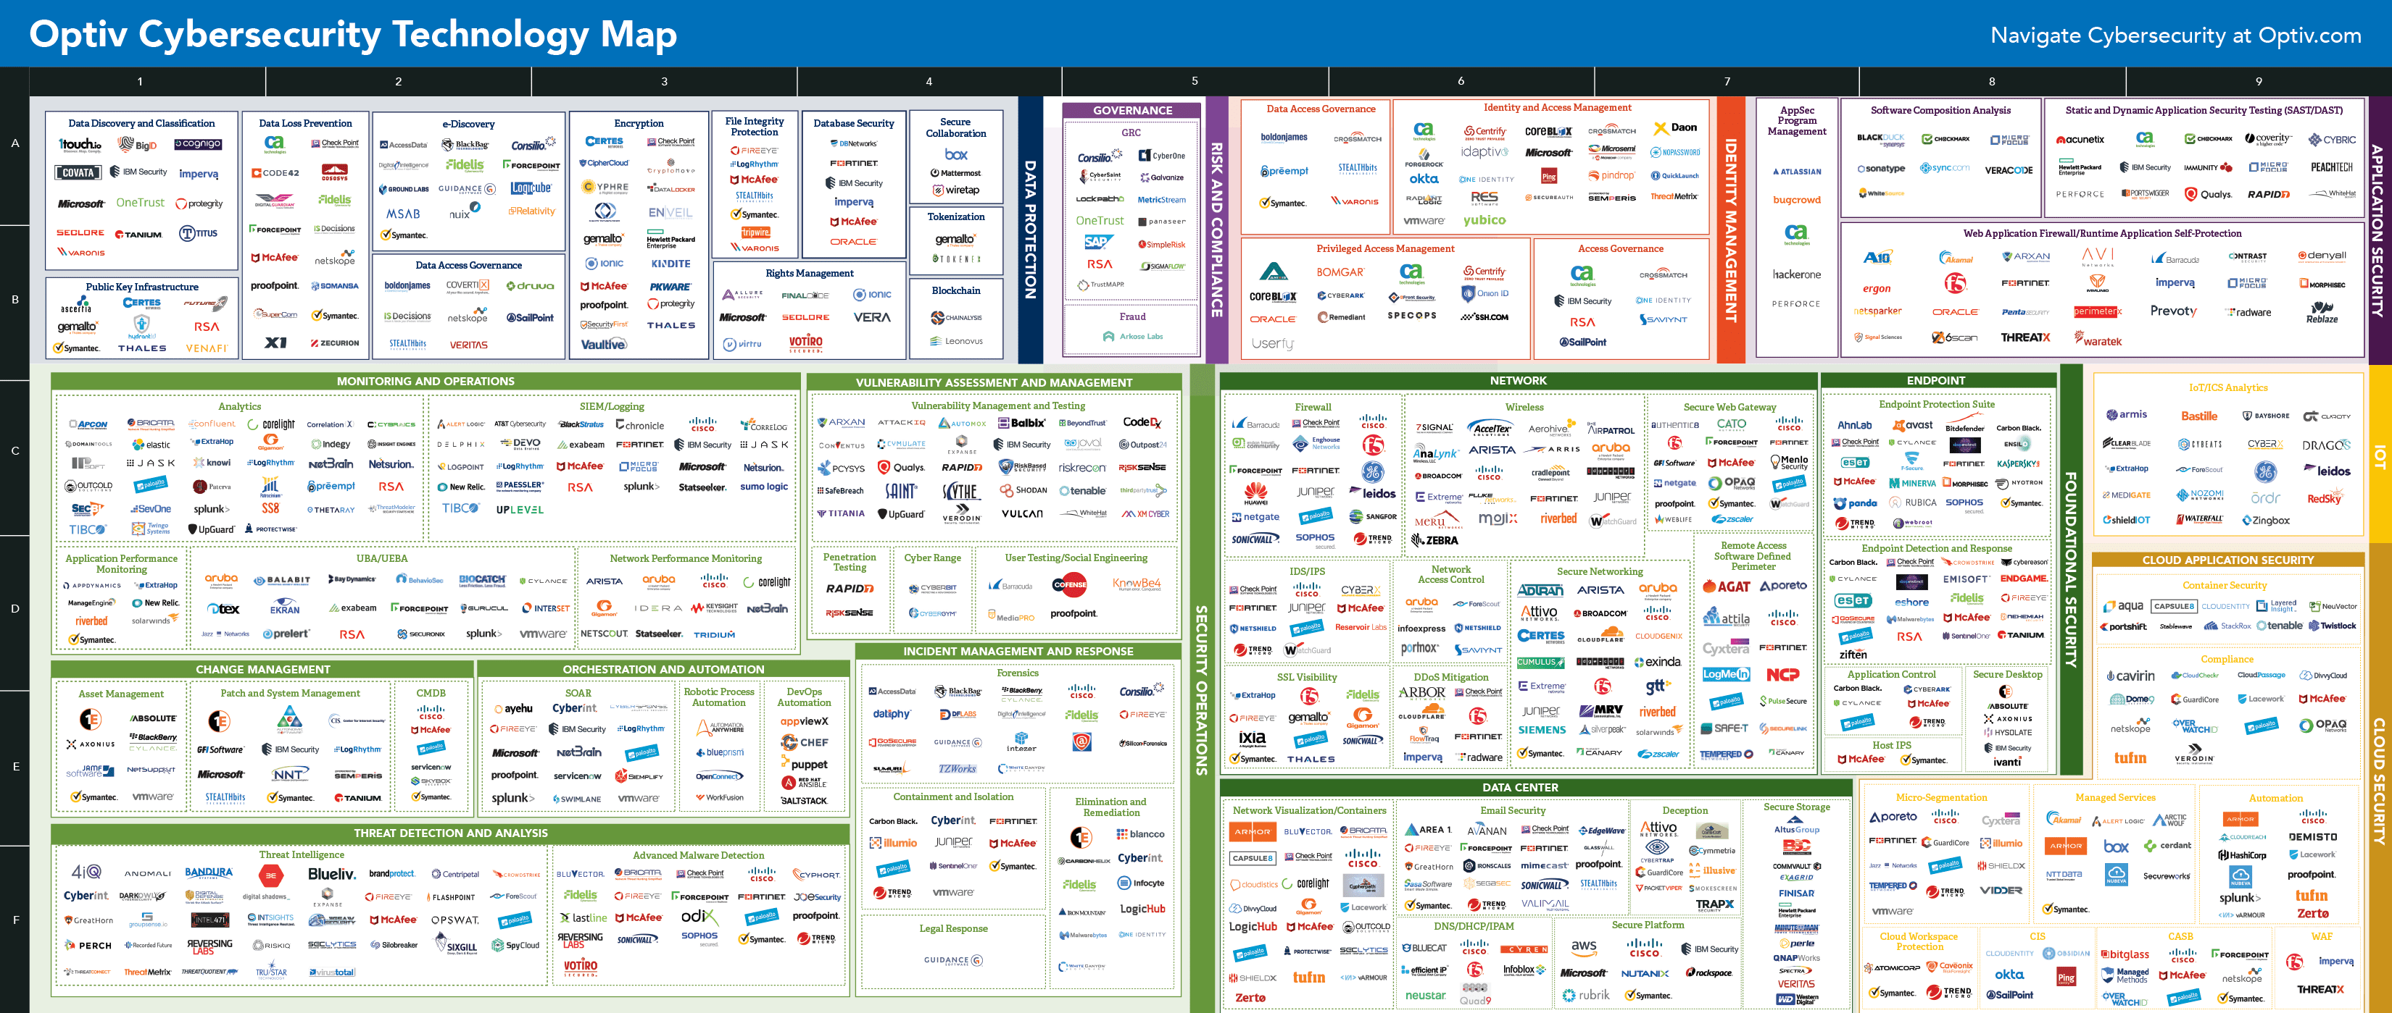



Cybersecurity playing field
The cybersecurity market is highly dynamic
100 billion USD market in US and Europe – 200 billion USD in 6 years
Non-transparent market processes (resellers, partners, system integrators, providers, channels)
Rapid development of existing and new products/services
Notes:
Let‘s pick up the second part of the agenda: How to procure cybersecurity efficiently. As mentioned before, this part is based on our experience of helping over many companies
With each project we continue to learn and make our process more leaner yet comprehensive.
You are aware of the size and complexity of the cybersecurity market that is continuosly evolving – new products, niche categories, acqusitions, reselling channels etc make it complex market to navigate.

Slide 7


Companies are paying for an outdated sales model
Leading vendors spend at least 40% of their revenue on marketing and sales
Main reason: an outdated sales model
Efficiency needs to be increased to make cyber-security more affordable
Notes:
In our experience,
the market has a very outdated sales model that is aimed at protecting unreasonable margins.
It is highly driven through channel sales, utilising framework contract as a shortcut, and ‘foie grasing’ security bundles down the throat of unprepared procurement manager.
We see all leading providers spend 40% (or more) of their revenues for marketing and sales. Real sales +marketing spend even higher (reseller commissions and bonuses partially booked into “cost of goods sold”)
We see this as counterproductive and forcing companies to buy expensive but not fit for purpose solutions and services.

Slide 8

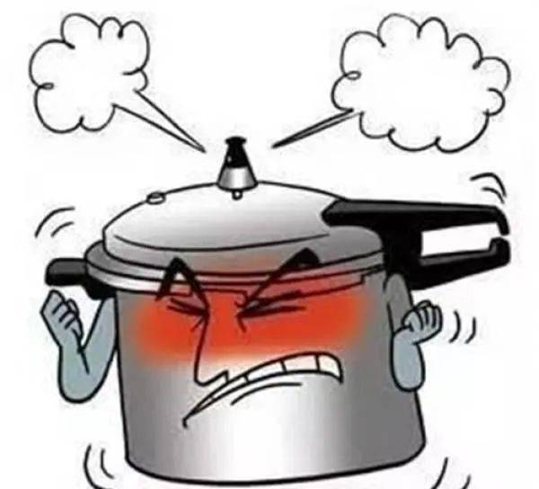
Cybersecurity pressure
Enterprise level
Customer’s viewpoint
Overburdened IT team
CISO in a new role
Talent shortage
Attackers are learning
Supply Chain risk / Insurance
Regulatory requirements
Shareholders / Executive Board
Notes:
Meanwhile within the company, especially within the security team, the pressure to keep the lights on is immense.
Skill shortage, lack of time, constant barrage of attacks that are learning and evolving, risk of exposure from the supply chain etc creates a pressure cooker situation.
In these situation, the security team can use all the help they can get from having the best –fit solutions and services that are easy and quick to implement, integrate and make their life a little easy
So where would you normally look for information about good cybersecurity solutions?
Please dont say ask the CISO?
G-cloud – if cloud based?
Your subscription with Gartner and Forrester?
Ask one of the big 4?
Ask your IT provider?

Slide 9

Where to get information about cybersecurity solutions??
Single/Multiple Selection
Almost 50% of all respondents obtain information about solutions directly from the provider
Independent sources such as brochures / trade magazines are only consulted by <30%
Other sources are negligible in comparison
Bosch – Cybersecurity, Total (N=300), filtered (N=277)
Notes:
Our small research in (DACH and UK) suggested that most went to Googlepedia first and then went direct to the vendors whether it was through website or meeting at an exhibition – who were then directed to the channel partner or resseller.
Is reliance on public tender process the only way to get information about cybersecurity?
In our experience, these methods will only provide you with a very restricted market view leading to inefficient cybersecurity practises.

Slide 10

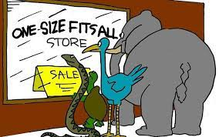
Achieve best possible cost - performance ratio with reduced risk
Approach to create strategy for purchasing cybersecurity
7 Key strategic steps
Prioritization
Description of requirements
Tender interviews / Inquiry with providers
Negotiation
Contract award
Contract management
Notes:
In cybersecurity – “ There is no one size fits all”
You need to create a customised approach for purchasing cybersecurity and broadly it should involve these key strategic steps.
People form procurement will immediately recognise these - so yes these are not new.
Let’s look at each of these steps and remind ourselves on how to make them efficient.

Slide 11

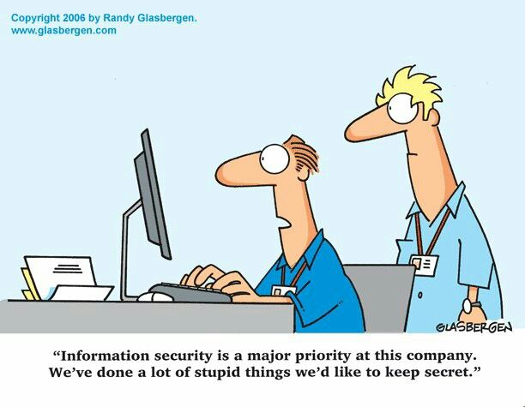
Get it right from the start
Prioritization
Have you considered?
Vendor independent audit
Opportunity cost
In-house vs. outsource
Innovative SME
Best security for your budget
Notes:
Get it right from the start
If you have not done before – I would recommend that you start from the audit – not by your IT service provider or even the security team.
An external unbiased view will provide you with good assessment of your security posture and advice you on the best course to take for next 3-5 years.
Also consider your current capabilities, how would you involve innovation and have a criteria for recognising cost-performance ratio.

Slide 12

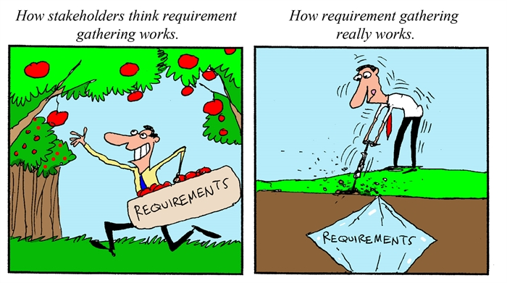
Listing down technical, commercial and regulatory requirements
Description of the requirements
Specifications / Service description
Don’t use “knock-out criteria”
Proof of Concept?
Identify and involve all stakeholders
Define features and options
Implementation cost
Keep it manageable
Notes:
How many times I must have seen a standard specifications on the tender portal and thought “here we go again”.
They are very generic and very often missing detailed information.
If you have done an independent security audit, this step becomes easy.
Identify key stakeholders within your Department related to the security criteria, identify gaps - like skills for implementation, support, training
Learning from your past experience will help
Define these features and service options and focus on your current needs than nice to have trendy features like generative AI.
This will help you create a strong and detailed specification list –
Basis for good response from vendors
Less room for assumptions and leading to a very efficient process
So, now you have a succinct and detailed specification for a successful tender process

Slide 13
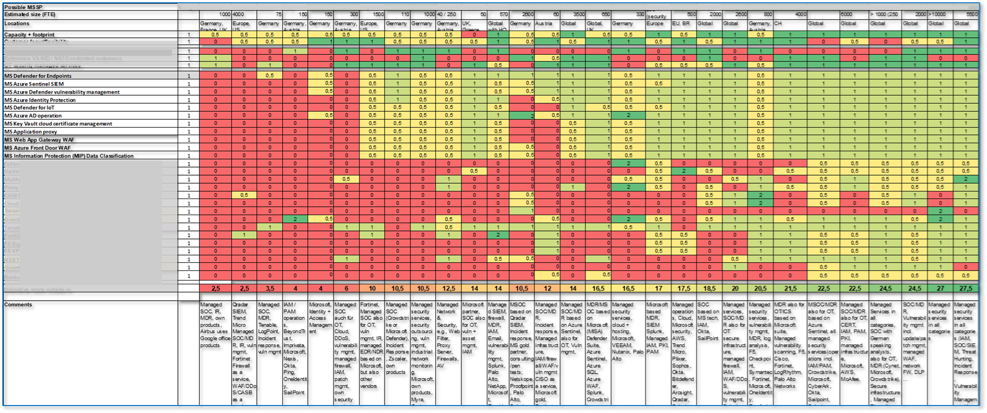
Example heat map for evaluation of 29 MSSPs (outside-in and interview based)
RfP for Managed security services
Notes:
This is the redacted example of heatmap from a tender comparison for MSSP for SOC
In this example, for a district council, there were over 230 criteria identified for comparison.

Slide 14


RFI, RFP, RFQ
Tender interviews and Inquiry with the providers
Things to look out for:
Using same reseller or SI for alternative offers
Who is doing pre-sales presentation?
Separate consulting, implementation and operation
Reselling margins
Value-added service
Notes:
So, you have completed your public tender and started receiving responses and started the process for shortlisting providers for interviews.
So, we have been asked these questions a lot – Is it worth doing RFI before the actual tender?
Absolutely – will help you to validate your specification and project your costs - especially as some solutions and service will easily cost more than 6 figures.
These are the most common things to look out for whether you are whittling down the response through interviews or a tabletop exercise with colleagues.

Slide 15


Assessment and Evaluation
Technical and Commercial Comparison
Things to consider:
Licensing terms as comparison
Proof of concept
A detailed demo presentation discussing a use case
Different charging models
Notes:
You are now ready for comparison on the scoring matrix of some sort against the specification for drawing up a short list.
In order to help comparison look out for these point specifically outside response on features
POC is a tricky one – many providers hate it but we really recommend it considering the amount of investment for some solutions.
Different charging models for some services makes it difficult to compare. In these cases, it is worth consulting specialist in the department to arrive at a benchmark for meaningful comparison.

Slide 16


Maintain a competitive environment
Clarification and Negotiation
Things to look out for:
List prices and “First Offer” used as “smoke and mirrors”
Hidden Fees and Costs
Daily rates
Ask for independent benchmarking
Consider “Equalisation”
Notes:
Now you are in the final stage – maybe inviting the shortlisted 2-3 vendors for negotiation.
It is important to keep a competitive environment and
Clarify … clarify and don’t take anything for granted.
When evaluating response, actively look out for hidden fees – ask lots of questions – especially when you see
extra features added to the specification list
“once coded…”
“customised..”
Equalisation - are any particular rates or costs that seem extremely out of place or unduly high or low?

Slide 17
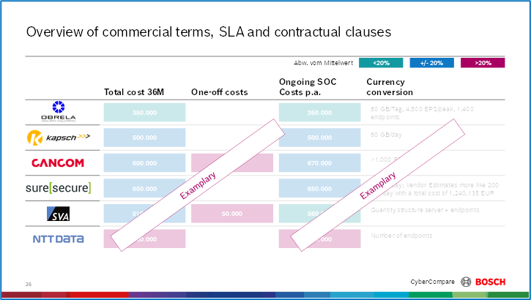
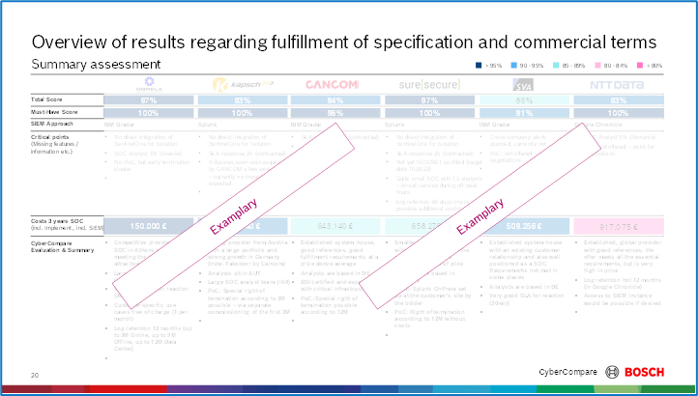
Examples of comparing commercial terms, SLA and contractual clauses
Notes:
If the terms are extensive subcategorise them and compare them separately

Slide 18

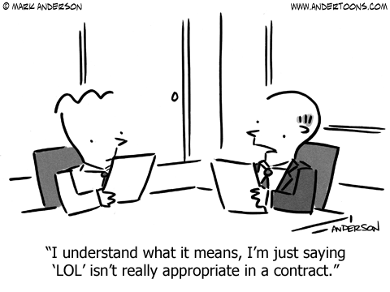
Leading to operational efficiency
Contract award
Things to look out for:
Type of contract
Predictability of cost
Flexibility
Built-in data privacy & security
Basis of building a strong relationship
Notes:
So, you have made your decision and award and drawing up a contract:
Most important part is to built-in data privacy and security and predicting costs

Slide 19


For parties to collaborate and reduce risks
Contract management
Things to look out for:
Tightly control data access
Conduct audits or site visits
Monitor vendor performance
Collaborating on review process
Risk management
Notes:
Most procurement team do contract management very well but some fall apart due to all sorts of reason – mainly lack of knowledgeable staff in cybersecurity
Here are some of the important things to think about
Agree a schedule for audit – site visits should not be just a day out but an opportunity to observe if the vendor themselves follow “practise what you preach”
Monitor performance of the vendor through variety of matrixes and request regular feedback from security professionals
Risk management – security assessment – please don’t send them 800 questions…

Slide 20
Meet us
Stand 25
www.cybercompare.com

