Slide 1
In partnership with ITHQ
Government secure environments: Your people, your transformation, your cyber resilient IT
Cyber Security & Data Protection Summit
15th November 2023

Slide 2



About Us
Introductions

Slide 3


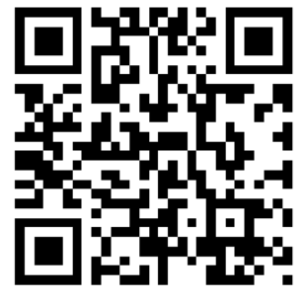
Key considerations on initiating a tech project?

Slide 4
Have you considered Business Change?

Slide 5

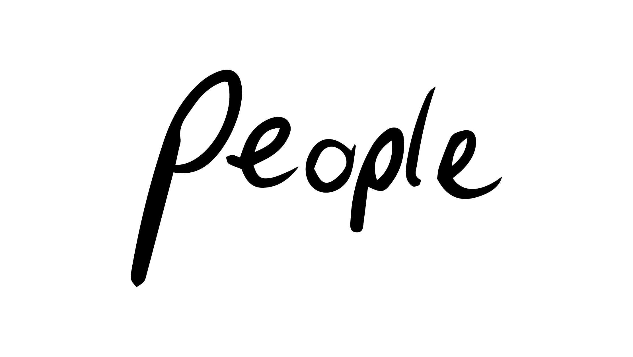
About Us
What is Business Change?

Slide 6
Business Change Management Definition
“…a structured process and set of tools for leading the people side of change to achieve a desired outcome.” (Prosci, 2022)
“…is the management of “side-effects” due to the scope of the programme; and the “preparations” that we must make to turn outputs into outcomes.” (PM Institute, 2011)
“…considers how people can be led through such change…and ensures organisational commitment to change.” (MSP, 2013)
“Business Change Managers are the bridge between the programme and business operations…responsible for the implementation and embedding of new capabilities.” (APMG, 2012)

Slide 7
Why is Business Change important in delivering successful projects?

Slide 8
Outputs + Business Change = Outcomes & Benefits
Outcome
Benefit
Business change
Outcome
Outcome
Benefit
Project output
Corporate objective
Outcome
Benefit
Business change
Outcome
Outcome
Benefit

Slide 9
Outputs + Business Change = Outcomes & Benefits
Better staff retention
Increased productivity
Retrained managers
Delays for applicants reduced
Higher staff morale
Improved continuity
New HR IT
system
Reduced personnel costs
Increased HR
staff efficiency
Fewer HR
staff
New
recruitment process
Applications processed faster
Fewer
vacancies
Lower recruitment
costs
Project output
Business change
Outcome
Outcome
Benefit
Corporate objective

Slide 10
Evidence
“Research shows that ______ of digital transformations fall short of their objectives…Adoption is one key reason!” (Boston Consulting Group, 2020)
five
13%
“Companies that excel at change have _____________ more revenue growth.” (Bain & Co, 2020)
21%
26%
“______ of project outcomes were good or excellent when a change management approach was used vs ______ good or excellent without.” (Prosci, 2022)
39%
59%
“Change resistance is among the ______ most frequently selected challenges in executing digital transformation: ______ of leaders cited implementation of new processes and capabilities as one of their greatest challenges.” (Forrester’s Business and Technology Services Survey, 2022)
70%
73%
88%
“______ of projects met or exceeded their objectives when using excellent change management programs, ______ with good programs, ______ with fair programs and ______ with poor programs.” (Prosci, 2022)
150 % to 300%

Slide 11
Working side by side
Successful Change requires both Technical and People Sides
Design
Develop
Deliver
Technical
“Technical” element executed by project management discipline
SUCCESS!
Reason for Change
Current State
Transition State
Future
State
Engage
Adopt
Use
People
“People” element executed by change management discipline
Prosci, 2022

Slide 12
The 7 Greatest Contributors to Change Success
Active and visible executive sponsorship
Structured change management approach
Dedicated change management resources
Integration and engagement with project management
Employee engagement and participation
Frequent and open communications
Engagement with people managers

Slide 13


Our structured Change Management Approach
1. Understand the change right
We identify the reasons
for the change
2. Define the change right
We understand the
size of the change
3. Design the change right
We design the change &
prepare for the transition
4. Deliver the change right
We bring the change to life
& engage, engage, engage,
5. Embed the change right
We embed the change
& measure the benefits
Key
Lesson Learned & adaptation
Change Diagnostics

Slide 14

Where have we delivered successful Business Change?

Slide 15
Case Study
Policing/National Security
Secure Workplace/Tech/Culture transformation
Three programmes, two of which are within the Government’s Major Projects Portfolio (GMPP)
Multi £m contract to deliver Business Change services since programme inception in 2019 to programme closure in 2025
Multi-agency (12+ organisations)
Benefits include economic, efficiency and effectiveness improvements
c. £1bn over 15 years (HMG and MOPAC)
Three IPA Reviews…Never had a RAG rating of Red
4,500 impacted staff (7,500 if you include the 3,000 that were displaced)
Business Change specialists deployed to support all programme workstreams

Slide 16
So, what are we doing?
Secure Workplace, Tech and Culture change
Led the Business Change strategy
Supported requirements gathering and design
Led stakeholder engagement and communications across all levels, inc. managing Change Agent networks
Undertook business change impact assessments to inform required change interventions
Led business change planning
Undertook readiness assessments
Led business change delivery
Supported all business benefits realisation activity, including identification, measurement and reporting
Managed the transfer of knowledge, including capturing and logging lessons learnt
Upskilled organisation in change management
Supporting the transition to business as usual in readiness for programme closure

Slide 17


Key takeaways

Slide 18
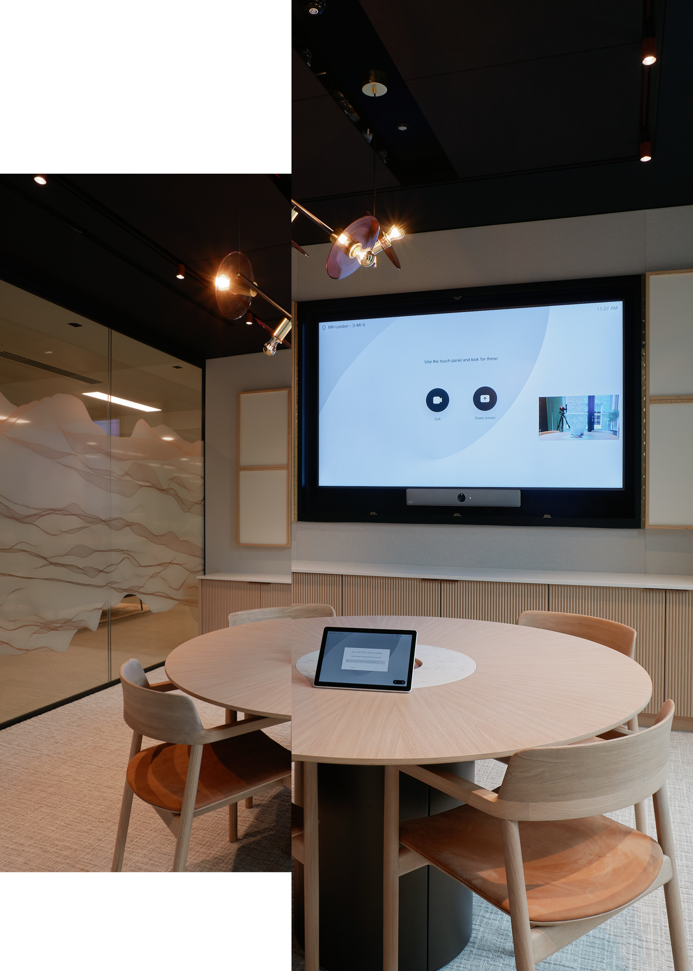
Key takeaways
Don’t assume… Business change interventions are required
Build Business Change services into your project/programme structures from the inception
ITHQ and Change Right have partnered to provide clients with an end-to-end solution to your tech transformation

Slide 19


Q&A

Slide 20

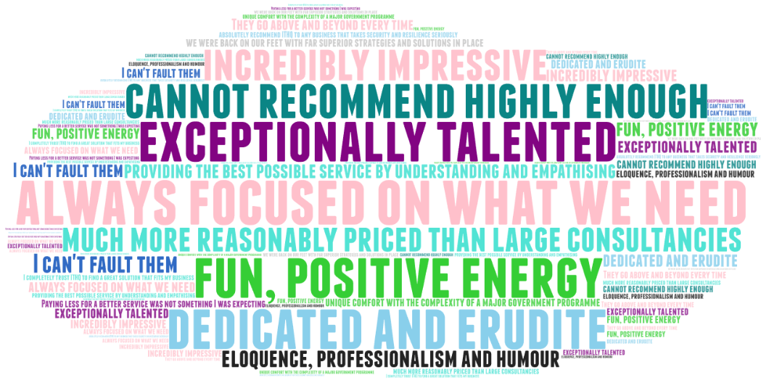


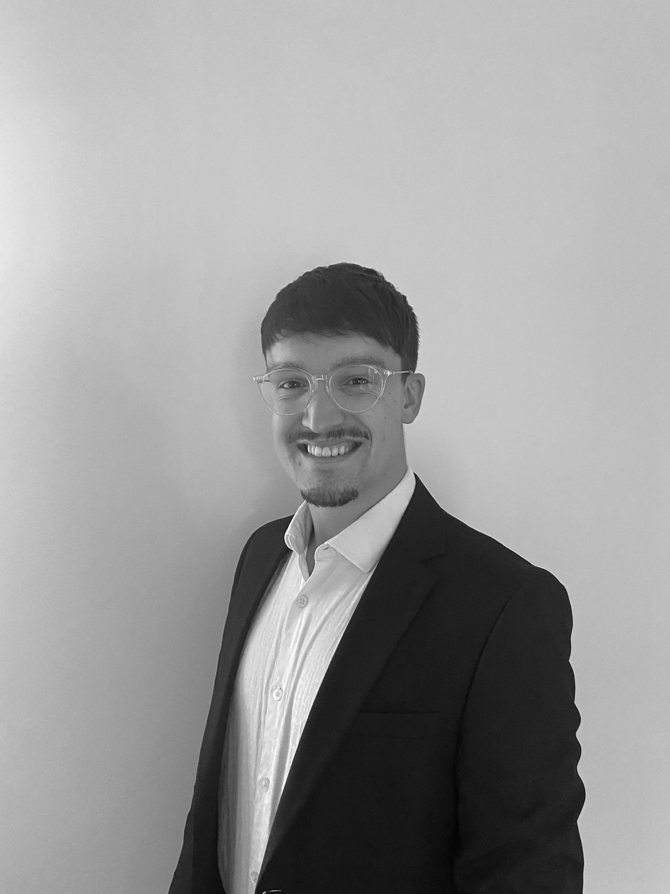
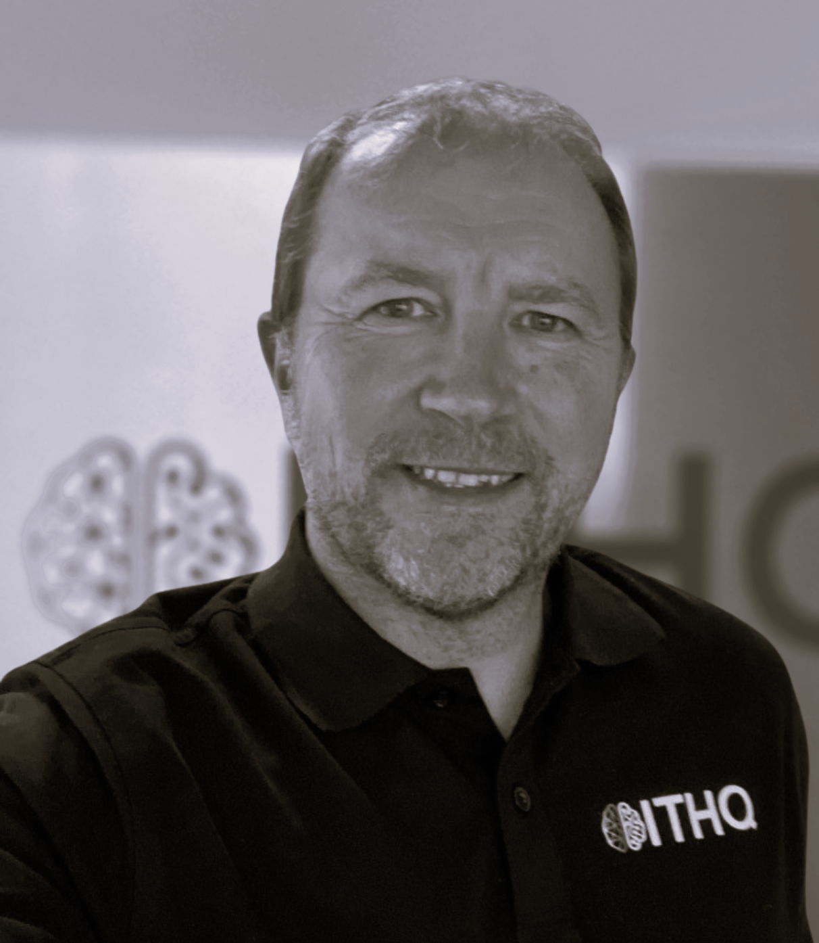

Effective Transformation | Experienced People | Affordable Cost
Contacts
Change Right are a specialist business change organisation within both public and private sectors, holding seven figure contracts with the UK Government, global and household brands. Our business areas include Workplace Transformation, Secure Workplace Change and IT Adoption and Utilisation.
Neil Hanham
Business Development Manager / Client Director
07919 346795
neil@changeright.co.uk
Rachel East
Business Change Lead
07715 748242
rachel@changeright.co.uk
Harry Rawson
Partnerships Manager
07910 453372
harry@changeright.co.uk
ITHQ solves wicked technological problems using strategy, skills and precision-selected solutions. Our clients span public and private sector, and include heavily regulated financial, healthcare, aviation and legal organisations. We are proud of our 100% NPS, with clients reporting our technical excellence, responsiveness and satisfaction guarantee as highlights.
David Thomas
Head of Cyber Resilience
07919 827752
david.thomas@ithq.pro
Sally Nursten
Chief Marketing Officer
07788 451217
sally.nursten@ithq.pro

