Slide 1
BlackBerry Cylance® AI
Paul Fryer
Senior Manager , Sales Engineering UKI&Nordics

Slide 2
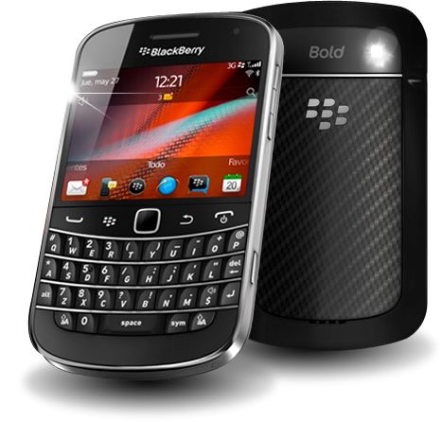
BlackBerry Legacy Along Side The First Wave of Cyber Threats.
Hardware
Operating System
Consumerization of IT “BYO”
BlackBerry Pivots to Software
Apps & Workloads
BlackBerry “Then”
FIRST WAVE
Unorganized analog grade attacks begin to originate early in the millennium and slowly claim victims.
Encrypted Data
BlackBerry Creates and Dominates The Secure Mobility Market
Native end-to-end security of a trusted ecosystem
Network & Comms
1999
2010
2015
User Identity & Behavior
Fleet Management
Notes:
We are proud of our past given how far back it goes. In the early part of the new millennium, an entire population was adapting to a new way of life that incorporated always-on technology and instant information. Blackberry was a huge part of that evolution. This “First Wave” was characterized by standardized technology that was largely corporate issued by IT departments to lower support overhead and streamline security efforts. And BlackBerry was known as a trusted provider of a secure end-to-end ecosystem spanning our devices and all the apps, data, communications and identity management on them.
Cyber threats were increasingly emerging during this wave, but with a typical pattern of “wash, rinse and repeat” of the same attacks variants across a relatively constant and controlled attack surface.
What started off as a slow trickle of threats in 2013 had turned into a waterfall by 2016.

Slide 3
Consumerization of IT Fuels Second Wave of Success For Threat Actors
Hardware
Operating System
BlackBerry acquires
AI emerges as mainstream offensive tool
Apps & Workloads
BlackBerry “Now”
SECOND WAVE
Consumerization of IT drives an increased attack surface at the same time as increased adversary reward.
Encrypted Data
“24 of the top 25 EV makers”
BlackBerry Creates and Dominates The Secure Mobility Market
AI-driven security for heterogenous infrastructure
Network & Comms
1999
2010
2015
2019
User Identity & Behavior
Present
Fleet Management
Notes:
As the handset market exploded with so many new and innovative form factors, we began to see the appetite for our beloved keyboards fall out of favor with the ultimate shift towards the “consumerization of IT” where endusers and organizations adopted a “Bring Your Own” approach. Organizations moved away from a standardized IT model to one based on consumer-driven variety and unlocked a lot of user satisfaction and productivity gains. This along with other shifts towards cloud, SaaS and further mobility also dramatically increased the attackable surface area that adversaries targeted.
It was early in this second wave that BlackBerry pivoted into a software-solution provider and directed its strategy towards addressing a broader set of cybersecurity concerns across a heterogenous set of infrastructure rather than solely on the devices we manufactured. Central to this strategy was our acquisition of Cylance – the cyber industry’s trailblazing AI innovator. Cylance rose to prominence when people realized the Anitvirus market was broken. The idea of updating threat signatures had become outdated and ineffective with the introduction of Wannacry. The number and velocity of threats had grown exponentially after wanncry and it was obvious that Cylance led the industry in time-to-protection and system performance. This is about the time that other cyber vendors moved into a “follow the leader” copy mode and wanted to begin experimenting with AI. (5-7 years after Cylance)
As Blackberry evaluated how the Cylance model could be applied, we found that it could be tasked with powering a broader ecosystem of trust. The amount of time and data that Cylance had been exposed to created a significant gap that no competitor could overcome. BlackBerry made the pivot to securing mobility across a broad set of heterogenous infrastructure.

Slide 4
The Third Wave: AI Becomes An Overpowering Offensive Threat
70% increase in the development of novel malware YTD – BlackBerry Global Threat Report
AI emerges as mainstream offensive tool
THIRD WAVE
Democratized AI leads to mainstream offensive cyber weaponry. Force multiplies the impact of social engineering, phishing and polymorphic payloads.
BlackMamba – chatGPT-powered polymorphic keylogger
ChattyCat – provides POC to build polymorphic including ransomware and infostealers
1999
2010
2015
2019
Present
Notes:
We’re presently in the midst of a new inflection point that will have profound impacts on technology, security and humanity as a whole. The democratization of AI that is easily available to the masses. Applied AI has, until recently, been limited only to those with significant financial and human resources. However with newer, easily utilized models and tooling the barrier to entry has been lowered. And we’re already seeing a 3rd wave where we are already seeing that AI can be used to engineer better and faster phishing and social engineering attacks. Polymorphic malware will be a nightmare with AI velocity that will speed past the eyes of SOC monitoring tools and execute payloads faster and wider before ever being observed. We are exiting the phase of “if you get attacked” and we are entering a phase of “when will the attacking end”.
Malicious use of AI is going to force the need for automation and Predictive AI that can stay ahead of evolving threats.
https://www.csoonline.com/article/575487/chatgpt-creates-mutating-malware-that-evades-detection-by-edr.html

Slide 5
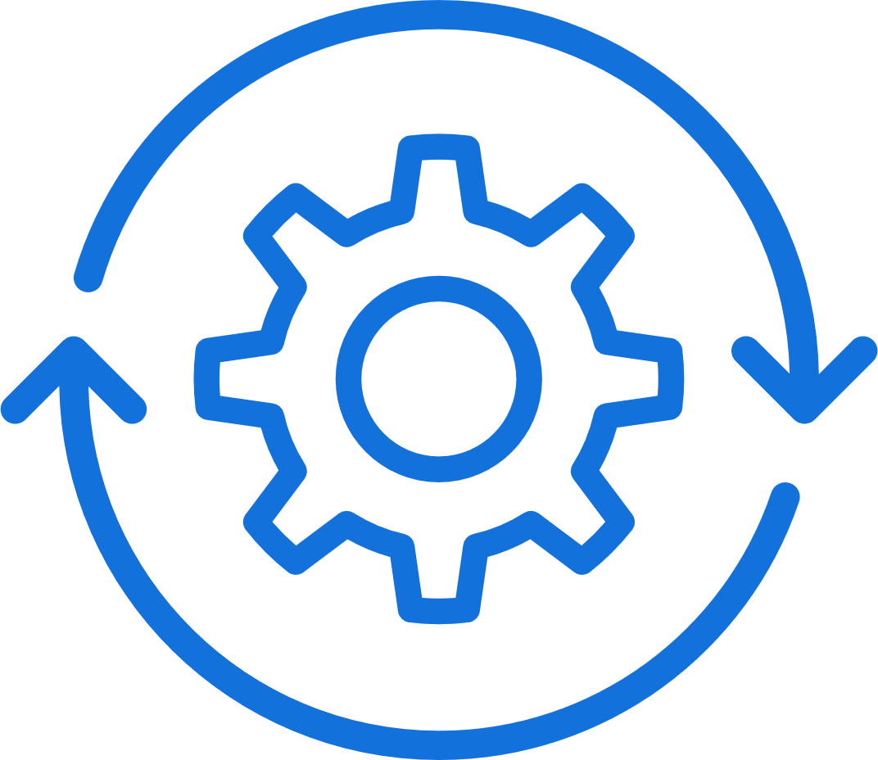
You WILL NOT succeed without AI-driven defense
2 key components are required:
&
Predictive Shielding
Automated Sense-Making
© 2023 BlackBerry. All Rights Reserved.
5
Notes:
We are at an Inflection point. The democratization of AI is driving a new wave of cyber threat at a voracious speed and scale
It is not possible for humans alone to defend against the speed, scale and complexity at which attacks occur. Artificial Intelligence is required to automatically shield against attacks, and also help humans make sense of situations faster.
The velocity and continuous variation of attacks present a mathematic problem that humans alone won’t scale to.

Slide 6
Not all AI is created the same.
Not all AI is Cylance® AI.
© 2023 BlackBerry. All Rights Reserved.
6
Notes:
But not all ML/AI is created the same. And in fact, most models are not mature enough for the challenge. We see this in the outcomes they produce.

Slide 7
The Role of AI in Defensive Cybersecurity
Predictive
Generative
(Machine Learning / Deep Learning)
(Large Language Models like ChatGPT)
Stops attacks automatically.
Doesn’t chat with people.
Chats with people to speed up work.
Doesn’t stop attacks.
Good for automating defense early in killchain
Good for helping make sense of incidents that have already occurred
Prevents zero-day attacks | Stops lateral movement | Organizes alerts
Product assistance | Threat intelligence context | Incident summarization
Notes:
There has been a great deal of media attention paid to artificial intelligence as of late, and for good reason. Clearly, AI will have a tremendous impact on the future. It is especially true in defensive cybersecurity, where AI has already been used for over a decade by Blackberry. In a problem space as broad as cybersecurity, it is important to recognize that different AI models are good at solving different problems. When it comes to threat defense, AI can be divided into two general categories:
Predictive AI models can automatically stop current threats and anticipate zero-day attacks before they happen. Predictive models work early in the killchain (or attack sequence) to make high-confidence decisions around malicious activity and proactively shield organizations from threats. Predictive models don’t converse with people like chatbots.
There are also Generative AI models that interact with people and help them make sense of large amounts of information. The goal of GenAI is to speed up people's understanding of a situation or knowledge base so they can make better informed decisions. GenAI models don’t proactively stop attacks.
Both predictive and GenAI models are powerful and play an important role in cybersecurity. But it has always been our premise that if you don’t have excellence in predictive AI to automatically shield you from as much inbound as possible, you can’t give your practitioners a fighting chance to scale.

Slide 8
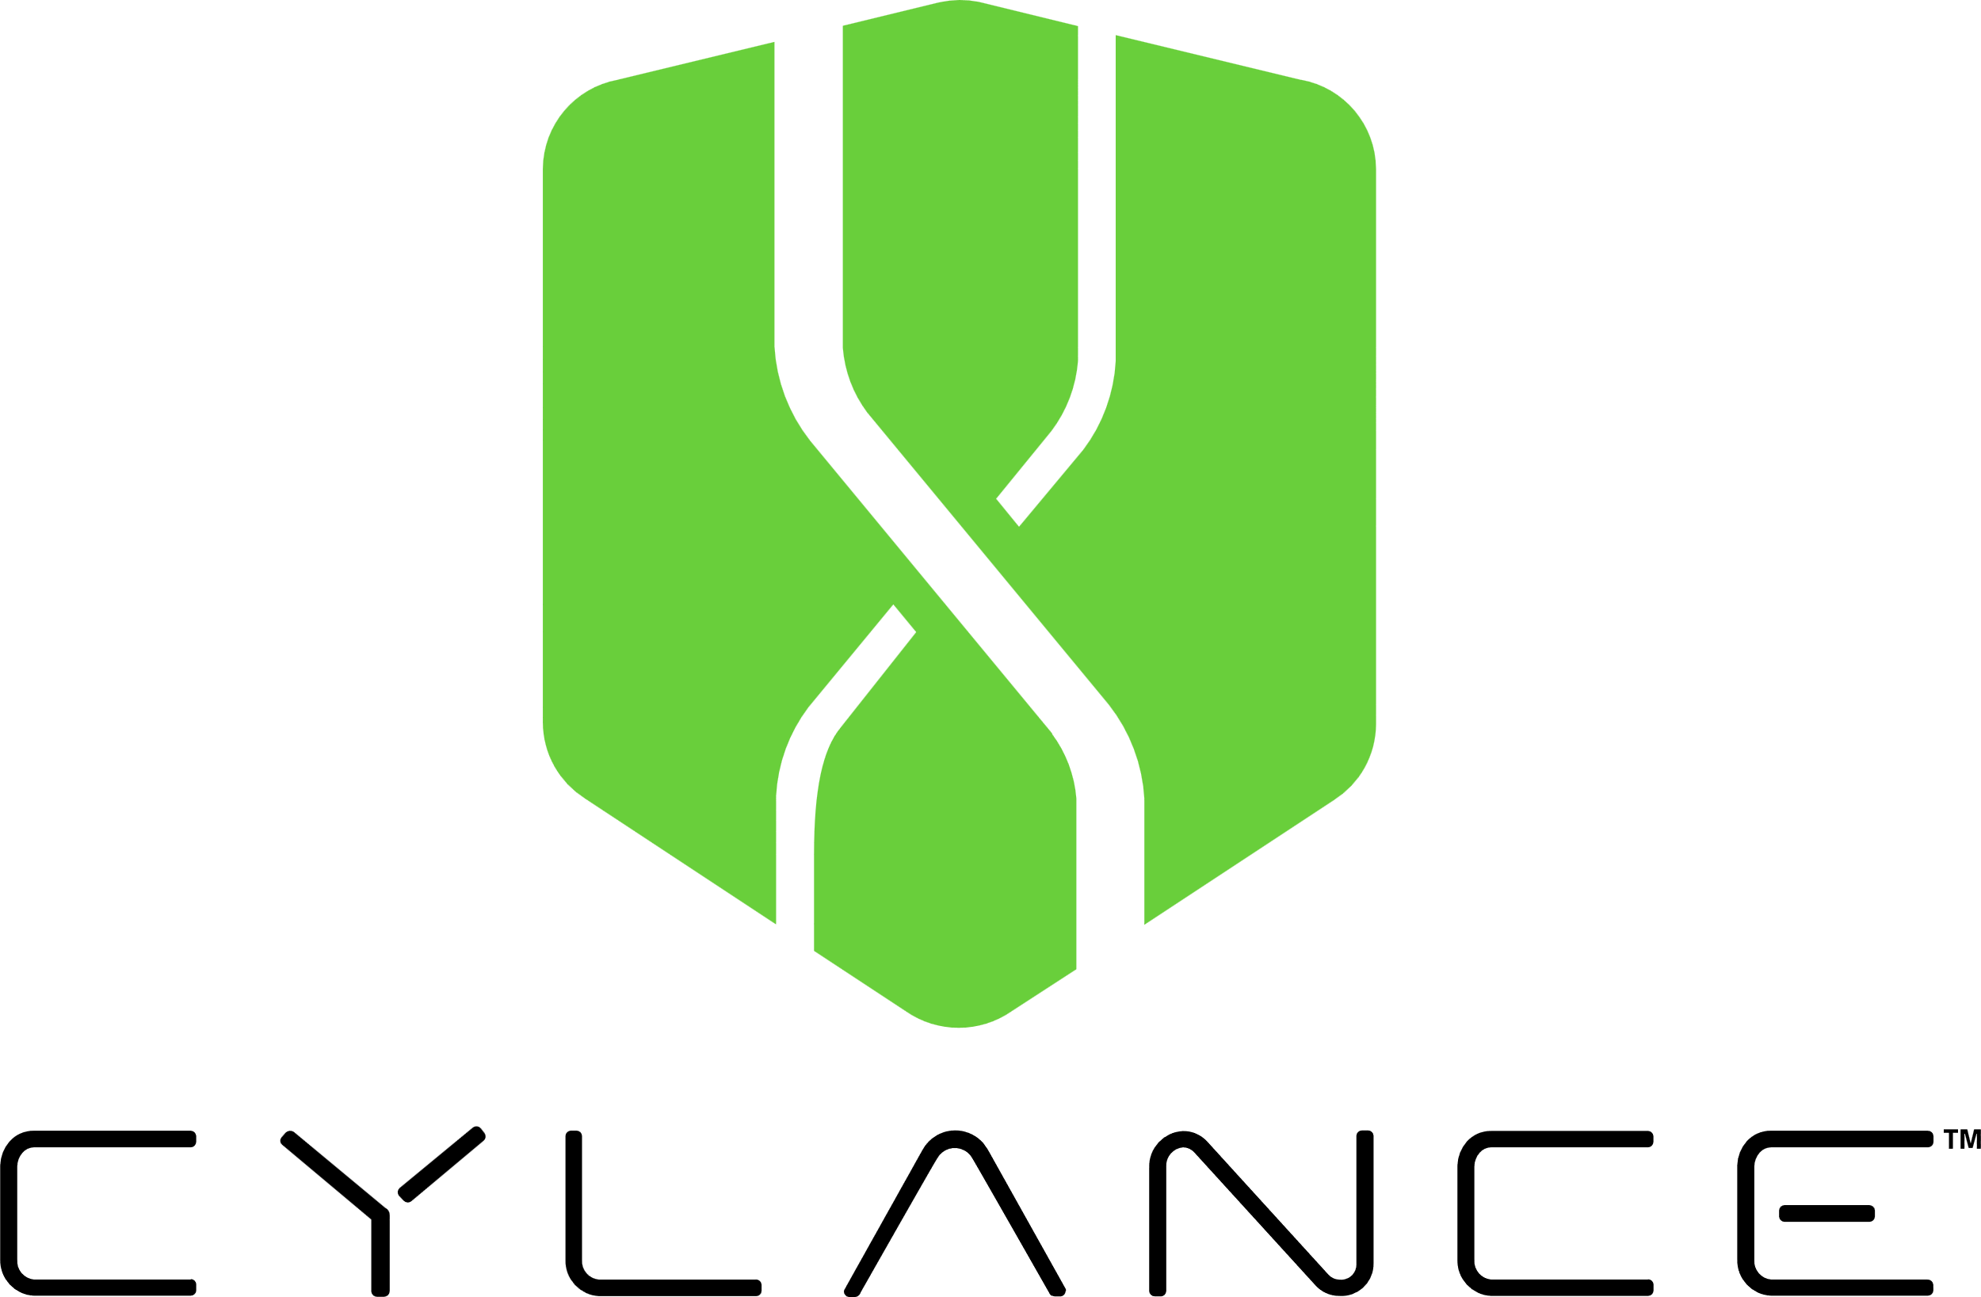
Cylance: Longest running, continuously improving, Predictive AI in market
Aggressive Design Parameters
High efficacy, low noise, & imperceptible overhead
Threat Intelligence Expertise
Global visibility, original insights & analytics
Patented Data Science
The right variation of models, datasets, & attributes
Notes:
For over a decade, Cylance has pioneered AI in cybersecurity and we've developed a well-informed point of view along the way. Despite the abundance of technical jargon and marketing claims in this market, our leadership in the space has taught us what it takes to deliver an AI that can effectively defend your environment, not simply help you recover after a breach occurs.
Predictive AI requires three mastery pillars to succeed:
First, is to set aggressive design parameters from the beginning and only accept AI capable of making high confidence decisions (stopping bad stuff) without hampering productivity with false positives and bogged-down systems. It is essential that these decisions be made lightning fast without affecting system performance - even if there is no internet connection available. Being accurate, fast, and lightweight at the same time is actually quite challenging. This is an area that we have invested heavily in over the past decade. Most vendors cannot deliver all three simultaneously. The result is that one or more of these core performance elements is sacrificed as part of a design tradeoff that permanently cripples the model.
Second, you need to have understand how adversaries work on a global scale. Consuming threat intelligence from others isn't enough. True expertise with original insights that are industry and geo specific are required. The threat landscape is a moving target and continuous real-time visibility is essential to inform and measure an AI defense.
Thirdly, a model's success is not determined by how much data or attributes it has been trained on. In reality, it is about providing the right variation in the training set so the AI does not "overfit" - a condition where it can only stop what it has already seen without the ability to defend against anything new. In order to anticipate future threats – the “predictive” aspect of AI, there is a mastery in what to train on versus a "more is always better".

Slide 9
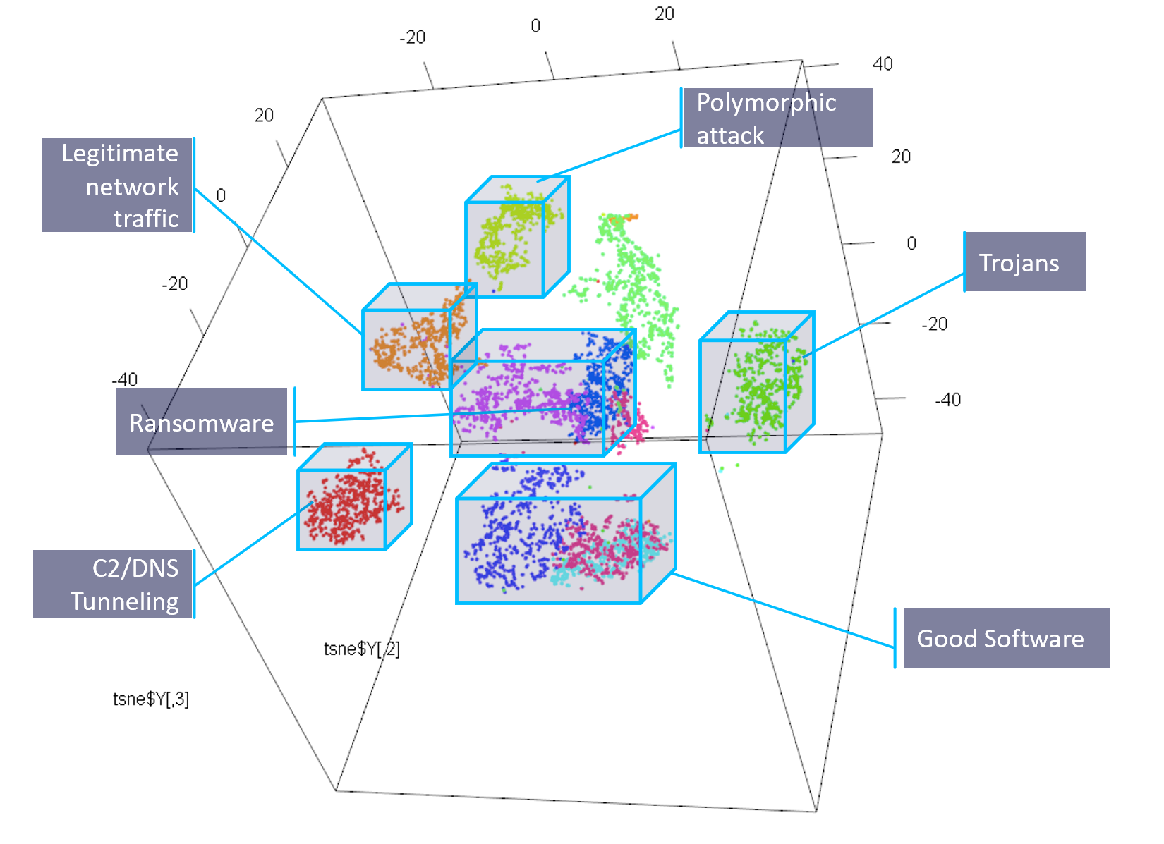
Cylance® AI - Human Intuition at Machine Speed
Conviction at a speed, scale and accuracy beyond human capacity
Entities & Attributes
Train | Cluster | Classify
Automated Use Cases
Static PEs & productivity files
Stop attacks before they execute
Identify and block malicious behavior
Detect lateral movement & C2 beaconing
Enforce authorized access / ZTNA
Organize alerts for situation awareness
Run-time process behavior
User access events
Network packets
Scripts
Notes:
Cylance AI learns from data, akin to human learning from experiences. By presenting the model with numerous instances of diverse cyber attacks, we enable it to discern patterns.
These patterns may encompass traits such as propagation methods, code structures, or targeted systems. Comparable to identifying shared features in different types of fruits, like roundness in apples or color in oranges.
Once the model grasps these patterns, it can anticipate zero-day cyber threats based on the recognized patterns. This process mirrors how one might deduce a novel fruit's identity based on its round and orange appearance.
Regarding "analyzing and clustering features," envision categorizing fruits by attributes like color, shape, and size. Similarly, in machine learning, we categorize and structure the characteristics of various cyber threats to facilitate comprehension and classification.

Slide 10
More Pioneering AI/ML Patents Than Others
Current Published G06N 20/00 Machine Learning Family Patents as defined by Cooperative Patent Classification (CPC) Sept 2023.
57
2
4
11
Bit9 (VMWARE)
Vendor 3
Vendor 4
Cylance
Vendor1
SentinelOne
Vendor 2
DeepInstinct
BitDefender
CrowdStrike
Vendor 5
Notes:
As a pioneer, we have developed more inventive Intellectual Property specific to Machine Learning than many other vendors in market today. This is a key element in what sets us apart in producing highly effective outcomes with low false positives and performance overhead.

Slide 11
Consistently Low False Positives By Design
7-day Total False Positives
7 Day running total 9.18.23
https://www.virustotal.com/gui/stats
2.6
90 day rolling average
Notes:
Speaking of low false positives, you will routinely find us at the bottom Virus Total’s public stats page where vendors 7-day trailing False Positive scores are continuously posted. On the day we pulled this data we had zero, and we regularly don’t even show up in this list when there are no false positive to report over a seven day period. These are the scores after running hundreds of thousands of new attacks per day at our Cylance AI model – at the time. Our 90 day rolling average was just 2.6 out of 13.5 million novel attacks.

Slide 12
AI That Can Anticipate Attacks
Emotet 20 months
Darkside 67 months
Conti 67 months
WannaCry 20 months
DarkSide 62 months
Petya-Like 25 months
LokiLocker 70 months
Yashma Ransom 78 months
Learn the correct diversity of known attack features
To accurately stop threats that have not yet emerged
past
future
minutes
days
months
years
Cylance Temporal Predictive Advantage (TPA)
Notes:
So how do we know if a Predictive AI can actually predict? Is the model learning correctly from what it's already seen to be good at anticipating future attacks?… or stated differently, is it actually self defending?
We assess our AI with a level of internal scrutiny beyond what other vendors doe with a metric we ourselves have developed. We call this metric the temporal predictive advantage or TPA. The way TPA works is simple. Since we cannot fast forward or rewind time, we do the next best thing. Whenever a new zero-day attack emerges, we check whether our older models could have also prevented it. This TPA test confirms that our feature selection and diversity are optimized - not just on the most modern model iterations, but also on a generalized timescale. It’s a litmus for how well we can anticipate new threats.
While many solutions talk about how few hours or days AFTER a new threat it takes them to before they can protect against it, Cylance talks about how many MONTHS or years BEFORE a threat we protect our customers.
A great example is CONTI. Had Colonial actually had Cylance on their endpoints, they would have been protected against it. Not only that, if they had a device that was so out of date that it had not upgraded our agent for over 5 YEARS.. They still would have been protected. (Not that we recommend waiting that long to update your countermeasures!)

Slide 13
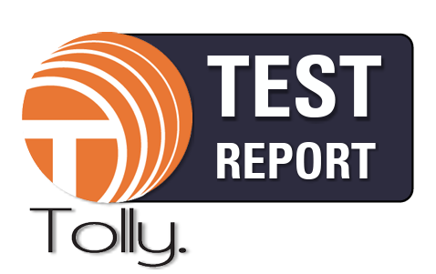
Delivering Outcomes that Matter
Stops More Attacks
18% more than Microsoft
35% more than Trellix
57% more than Sophos
Faster Detection
1.9x faster than Microsoft
13x faster than Trellix
2.5x faster than Sophos
90% Less CPU Utilization than other vendors in the same comparative test
Without Depending on Internet Connection
Vendor 1
Vendor 3
Vendor 2
Vendor 1
Vendor 3
Vendor 2
~5% CPU
~5%
~100%
~100%
~100%
~100%
~100%
~100%
~42 min.
~27
~73
~52
~130
~68
~172
~360
Vendor 1
Vendor 2
Vendor 3
Notes:
Real-world performance is the ultimate test for Predictive AI. How much can it actually stop when faced with new threats, and how does it affect performance?
In order to cut through marketing hype and measure just how effective different predictive AI models are, we commissioned a simple test with Tolly, a leading vendor-neutral product evaluation organization. Tolly tested Cylance with several other leading providers on the same 1000 emerging attack samples for efficacy, speed, and performance impact. The tests included both connected tests, where the product could access cloud-based AI models running on remote compute, as well as disconnected tests, in which the device had to rely on its own AI countermeasures for defense. Every product was configured in accordance with documented best practices, with all optional protections enabled.
The results speak for themselves.
Cylance AI outperformed the competition on every parameter. Stopping more. Doing it faster. And with just a fraction of the overhead required. Cylance stops up to 57% more, 13x faster, and with 90% less CPU load when connected to the internet, and even significantly better when disconnected.
These results are the culmination of our decade-long trail-blazing path of predictive AI mastery.

Slide 14
Cylance® AI: Lighter Weight With Broader Coverage
Cylance efficacy stays constant
Others’ efficacy drops an average of 17% when disconnected
Cylance® AI
Effective for:
Modern AND legacy OSs
Powerful AND depleted resources
Connected AND isolated systems
Resistant to:
Protection disabling payloads
AP Roaming weakness
Network destination denial
~5% CPU
~5%
~100%
~100%
~100%
~100%
~100%
~100%
~42 min.
~27
~73
~52
~130
~68
~172
~360
Vendor 1
Vendor 2
Vendor 3
https://reports.tolly.com/publications/detail/223114
Notes:
There are some important nuances to point out in these results. First, Cylance maintains consistent protection even if the device that it’s defending is disconnected from the internet. That’s important because even connected systems are regularly rebooting and roaming between access points which leave them in a vulnerable state. And there are entire classes of attacks whose aim is to disable endpoint protection by limiting network connections back to vendor cloud resources.
It also means that systems that are intentionally isolated or intermittently connected will not experience materially down-graded protection because they can’t reach out for cloud-delivered help.

Slide 15
Cylance® AI: Lighter Weight With Broader Coverage
Cylance overhead is imperceptible
Others overhead bogs down systems
Cylance® AI
Effective for:
Modern AND legacy OSs
Powerful AND depleted resources
Connected AND isolated systems
Resistant to:
Protection disabling payloads
AP Roaming weakness
Network destination denial
~5% CPU
~5%
~100%
~100%
~100%
~100%
~100%
~100%
~42 min.
~27
~73
~52
~130
~68
~172
~360
Vendor 1
Vendor 2
Vendor 3
Notes:
Cylance is also so incredibly lightweight and effective it can be deployed on nearly any device with imperceptible impact, where other vendors peg the CPU to 100% capacity.
This combination of being edge-deployed AND incredibly lightweight means we can be deployed on virtually any device despite the available system resources or age of operating system.

Slide 16
Unpacking the Whitespace – What Does This Difference Mean?
 More security incidents
 More SOC burden
 More IT burden
 More wasted end-user time
~5% CPU
~5%
~100%
~100%
~100%
~100%
~100%
~100%
~42 min.
~27
~73
~52
~130
~68
~172
~360
Vendor 1
Vendor 2
Vendor 3
 More energy consumption
Notes:
Often the hidden operational implications in the “whitespace” that are most intriguing.
If an organization's AI is less effective, takes longer to make decisions, and consumes more CPU cycles, what does it mean?
Some impacts may immediately come to mind, such as more attacks getting through and end-user satisfaction waiting for sluggish security tools. There is also lost time due to re-imaging of endpoints, as well as increased energy consumption.
Here are a few that are pretty straightforward to model:
Increased security incidents (how many additional attacks will be successful)
Increased SOC investigation burden from payloads that aren’t blocked
Re-imaging burden (how much time do your IT staff and end-users consume trying to get an endpoint back to a healthy state)
Wasted end-user time (how long are your users “stuck in traffic so to speak” – waiting for their security technology to conduct a scan)
Energy consumption (how much more energy will your device fleet consume over time while their CPUs are fully pegged)

Slide 17
More SOC Burden Without Cylance® AI
5K employee org


# Increased Incidents
Alert Investigation
Microsoft Defender | 794 | 397 hrs
Vendor 1
Sophos Intercept X | 2,539 | 1,269 hrs
Vendor 2
Trellix Endpoint Protection | 1,086 | 543 hrs
Vendor 3
28
compromised endpoints/week on average
14
Hours/week investigating endpoint alerts
Notes:
When we look at the cumulative effects over the course of a year for a typical 5K employee organizations we start to see some sizeable (an even shocking) impacts when comparing these key metrics to the Cylance AI performance baseline.
We know from our real-word production telemetry that the typical endpoint is subjected to roughly 1.5 attacks per year, and that users attempt to access a little over 2000 unknown files over the course of one year. When we let the math play out over those conservative datapoints we start to get a sense of exactly how much it matters to have better protection, faster decisions and less CPU impact.
Increased incidents
In fact, when we extrapolate those 1.5 attacks against the efficacy spread in the Tolly results thousands of more attacks will compromise your environment per year. Each one of these could be the next ransomware that grinds business operations to a halt. In some cases, you could experience 7 compromised systems PER DAY more than if you had Cylance in place.
Increased alert investigation
Those same attacks that slipped by from lower automated efficacy could each individually have a devastating impact to business continuity and brand equity, but at a minimum they will also create an operational burden for your analysts as they investigate alerts thrown from other reactive detection tools. On average, analysts spend 24-30 minutes investigating each incident that comes through, according to an Enterprise Management Associates (EMA) study, and that equates to lost capacity chasing down alerts that could have been avoided in the first place.

Slide 18
More IT and End User Lost Time Without Cylance® AI
5K employee org




# Increased Incidents
Alert Investigation
Re-imaging Burden
Time waiting for scans
Microsoft Defender | 794 | 397 hrs | 8,732 hrs | 4,575 hrs
Vendor 1
Sophos Intercept X | 2,539 | 1,269 hrs | 30,471 hrs | 7,495 hrs
Vendor 2
Trellix Endpoint Protection | 1,086 | 543 hrs | 13,039 hrs | 60,785 hrs
Vendor 3
28
compromised endpoints/week on average
14
Hours/week investigating endpoint alerts
14.6
FTE equivalent lost to re-imaging
29
FTE equivalent waiting for file access
Notes:
Re-imaging burden
Forrester estimates that every time an endpoint is compromised and must be re-imaged a cumulative 12 hours of labor time is required (4hrs of IT, and 8 hrs of end-user). This equates to 30k hours of labor time or nearly 15 FTEs worth of time that could be recaptured if Cylance was chosen over Sophos. https://www.blackberry.com/us/en/pdfviewer?file=/content/dam/resources/blackberry-com/resource-library/en/cyber/2022/standard/rp/rp-forrester-total-economic-impact-study-of-cylance-protect.pdf
Time waiting for scans
Every time a user accesses a file, navigates to a network destination or otherwise requires a security countermeasure to make a decision before moving on there is a time tax that is paid. Individually these penalties may not seem like much. A few seconds here, a few seconds there. But again, math can show us the impact over time and at scale. How much time can your end-users be “waiting in traffic” over the course of a year? Turns out if you’re using Trellix instead of Cylance that could equate to 60,000 hours! That’s the labor hours of 29 FTEs that could be recaptured.

Slide 19
More Energy & CO₂ Without Cylance® AI
5K employee org





# Increased Incidents
Alert Investigation
Re-imagining Burden
Time waiting for scans
Energy consumption
CO₂ Equivalent
Microsoft Defender | 794 | 397 hrs | 8,732 hrs | 4,575 hrs | 281 KwH | 24,224 smartphones charged
Vendor 1
Sophos Intercept X | 2,539 | 1,269 hrs | 30,471 hrs | 7,495 hrs | 460 KwH | 365 pounds of coal burned
Vendor 2
Trellix Endpoint Protection | 1,086 | 543 hrs | 13,039 hrs | 60,785 hrs | 3,732 KwH | 4.2 roundtrip flights from London to New York
Vendor 3
28
compromised endpoints/week on average
14
Hours/week investigating endpoint alerts
14.6
FTE equivalent lost to re-imagining
29
FTE equivalent waiting for file access
Notes:
Increased energy consumption
Have you ever noticed your laptop fan kick on and CPU get pegged when a security tool is invoked? That’s what the Tolly experiment observed when competitive products were assessing the sample attacks. While Cylance was quickly making decisions using just 5-6% of CPU load, the rest of the cohort was chugging away at maximum CPU. If we calculate the energy consumption delta between a system at ”short idle” and its maximum wattage rating achieved at 100% CPU utilization – even for a modern energy star certified Lenovo ThinkPad – you will end up consuming hundreds and even thousands of additional Kilowatt Hours per year. If you chose to deploy Trellix over Cylance that difference would be close to 4k KwH. That’s a CO2 (carbon dioxide) equivalent of 2.4 metric tons or over 4 commercial roundtrip flights between London and NewYork.

Slide 20
Pervasive Throughout The Entire Defense Lifecycle
Automatically prevents zero-day
threats before damage can occur
NIST Framework
NIST Framework
Protect
Detect
Identify
recover
respond
Critical for an Effective Cybersecurity Framework
Accelerates investigation & response with coherently organized alert threads
Accurately detects lateral movement to stop adversarial maneuvering
© 2023 BlackBerry. All Rights Reserved.
20
Notes:
Cylance AI is deployed throughout the threat defense lifecycle to provide more automated and up-front shielding against attacks, find hidden lateral movement, and help deliver faster understanding of alerts and events across BlackBerry’s broad cyber platform.
Unlike other platforms that are “back footed” relying primarily on human operator speed to detect and contain breaches and incidents that have already occurred, Cylance delivers a balanced approach that combines automated machine-scale shielding that is demonstrably better than other vendors on the market, as well as the ability to pivot, understand and act from a human operator perspective with ease.

Slide 21
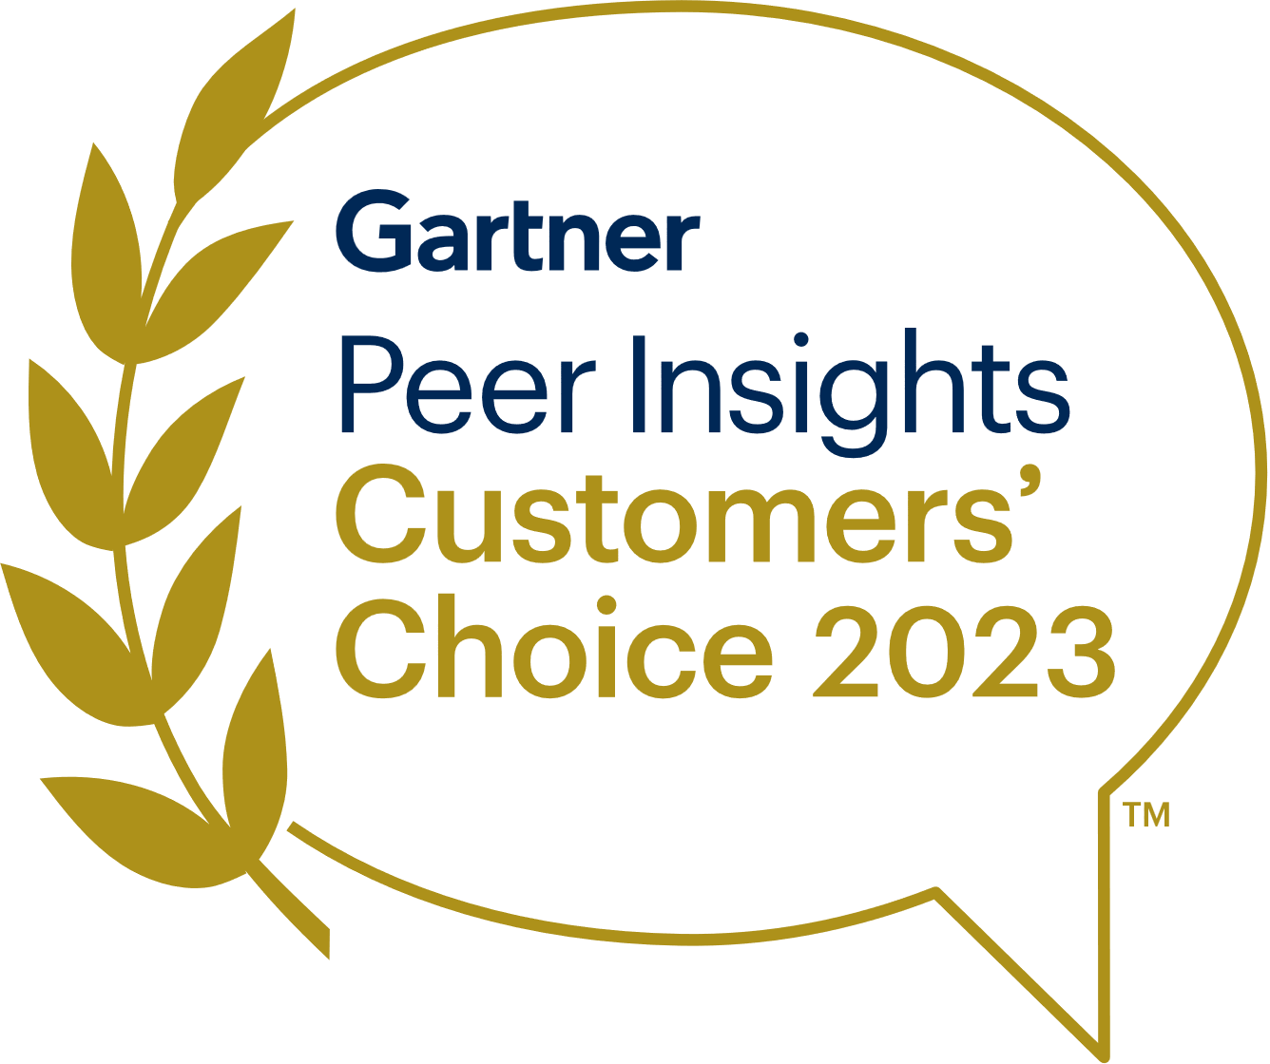
Customer Validated. Proven Outcomes.
“Exceptional cybersecurity solution. BlackBerry Cylance delivered unmatched protection”
Endpoint Protection Platforms
Unified Endpoint Management
“Revolutionary AI cybersecurity. Cylance delivers proactive defense and stellar UX”
“Hands Down One of The Best Tools in Today’s Market”
Excellent Product. Has Helped Us to Eliminate Ransomware
Notes:
Demonstrable outcomes aside, there’s no stronger validation that we could receive in the market than from our current costumers. BlackBerry has been named a 2023 Customers’ Choice for Endpoint Protection Platforms by Gartner Peer Insights and we are incredibly proud of this distinction as it is based on the direct feedback from our customers who use our product every day.
In addition to achieving the overall Customers’ Choice distinction, we were also named the same for the large and mid-market enterprise segments, across every region in the world – making us one of just three vendors to check all of these boxes. And don’t forget, we are also the ONLY vendor to hold a Customers’ Choice designation for both Endpoint Protection Platforms and UEM.
https://www.gartner.com/doc/reprints?id=1-2F184UTC&ct=230918&st=sb
https://www.blackberry.com/us/en/company/newsroom/press-releases/2023/gartner-peer-insights-names-blackberry-a-2023-customers-choice-for-endpoint-protection-platformsmers-choice-for-uem

Slide 22
Our Customers and Partners
Notes:
With over 12,000 customers including 9 of the 10 Global Banks, all of the G7 governments and 9 of the 10 top automobile manufacturers we are extremely proud to be the trusted vendor of choice for so many organizations. While we don’t name the majority of our customers publicly, we’d be happy to put you in contact with peer organizations under NDA.
https://www.blackberry.com/us/en/success-stories

Slide 23
How Can We Help You?
Malware
Prevention
SBOM Integrity
Cyber Readiness
Critical Comms
Managed SOC
Data Protection
Zero Trust Network Access
Secure Mobility
© 2023 BlackBerry. All Rights Reserved.
23
Notes:
We’re here to provide better security outcomes, not complicated technology or marketing hype. We understand the challenges of managing operational risk with limited resources, especially when traditional solutions require excessive effort from your team.
With an extensive set of AI-driven platform capabilities, we help many organizations such as yourself meet their mission securely and efficiently.
We’d love to hear about the challenges at the top of your list and explore how we can partner together.

