Slide 1
Proactive Cyber Resilience: Threats & Mitigations
Intelligence Driven and Response Ready
October 2023

Slide 2
About Me
John Higginson
Consulting Director – Unit 42
I’ve spent the last 8 years working for a number of consulting companies, specialising in Incident Preparedness.
Prior to this I spent almost 17 years in the British Army and gained a broad experience in IT and IT security working in range of roles.
My current role at Palo Alto Networks allows me to take a threat-led approach to consultancy.
I work with security teams and business leaders to help them understand the cyber threats they face, assess their preparedness in order to highlight any risks they are holding to allow these to be managed appropriately, so that the organisation can respond efficiently and effectively, minimising the impact on the business.

Slide 3
Topics for Discussion
Introduction to Cyber Threats
The Motivation Behind Cyber Threats
Case Studies
Protecting Yourself from Cyber Threats
How your organisation can become more Cyber Resilient
Q&A

Slide 4
Introduction to Cyber Threats

Slide 5
Types of Threat Actor
Script Kiddies
New to hacking
Little knowledge or skills to perform hacks
Use tools and scripts developed by more experienced hackers
Hacktivists
Break into systems out of protest
Use their skills to promote a political or social agenda
Targets are usually government agencies or big corporations
Cyber Criminals
Use their knowledge and skills for financial gain or malicious reasons
Their activities can cause major damage
Usually involved with stealing personal and financial information
State- Sponsored
Recruited by governments to gain access to secret information of other governments and companies

Slide 6
Unit 42 IR Report: Incident Types
BEC and Ransomware make up 70% of the cases handled by Unit 42 teams
Notes:
Stats
------
Cases: 280+ ransomware cases, and we’ve witnessed victims across 100+ Countries.
2,679 victims - Our threat researchers monitor the dark web for new victims and, and in 2022, 2,679 victims was identified.
Information for about seven new victims posted to dark web leak sites—averaging out to about one new extortion target every four hours.
However, this is only the victims who refused to pay, so the numbers are likely higher.
Number of victims 4% higher than 18 months ago
Groups: 55 ransomware groups observed, with new groups being identified constantly.
LockBit, BlackCat (AlphV), Conti, BlackBasta, CL0P, others
Others will spin up as old ones are closed down.
Data theft: 70% data loss in late 2022, compared with mid 2021 where we saw only 40% of data theft.
Data Theft is the most common multi-extortion tactic used by ransomware groups.
The six ‘myths’ which the NCSC and the ICO have identified as commonly held by organisations that have fallen victim to cyber incidents are:
If I cover up the attack, everything will be ok
Reporting to the authorities makes it more likely your incident will go public (NCSC will not report publicly or tell regulator)
Paying a ransom makes the incident go away
I’ve got good offline backups, I won’t need to pay a ransom
If there is no evidence of data theft, you don’t need to report to the ICO (if systems accessed, assume they have been breached)
You’ll only get a fine if your data is leaked
Second highest incident type investigated by Unit 42 - 34% of incidents
7-48 day typical dwell time before BEC compromise is detected and contained
38 day median dwell time
$286,000 is the average amount of successful wire fraud
The U.S. Federal Bureau of Investigation calls BEC the “$43 billion scam,” referring to statistics for incidents reported to the Internet Crime Complaint Center from 2016-2021.
Initial Access for BEC:
Brute-force attacks against email platforms (no MFA enabled)
Social engineering tactics to trick victims into providing credentials

Slide 7
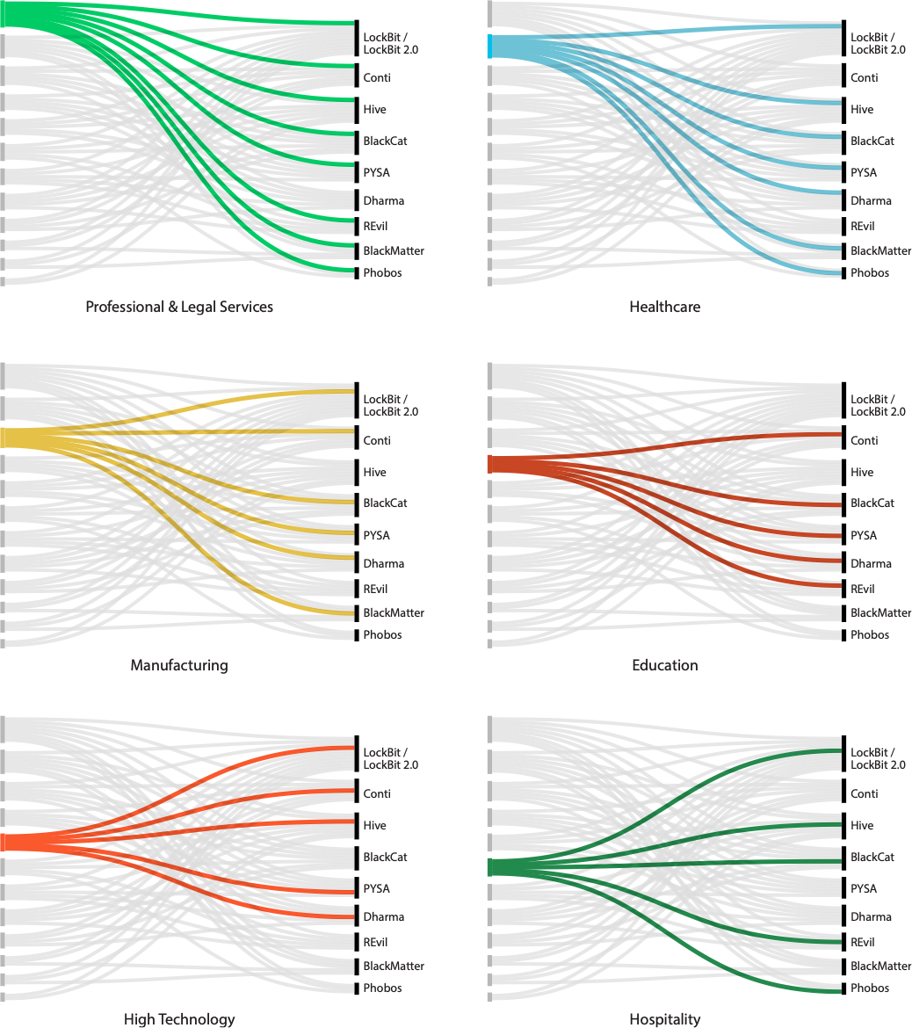
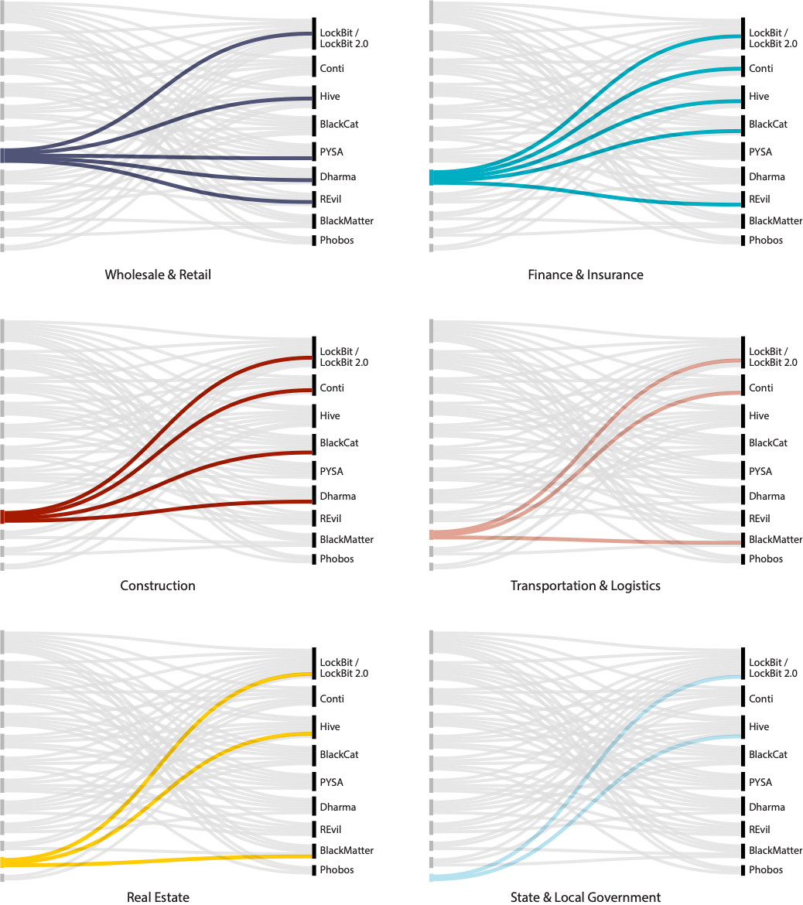
Industries vs. Ransomware Groups
Industries Affected by Ransomware vs. Ransomware Groups
Different ransomware operators target different industries
Some industries (i.e. Prof. & Legal Services, Healthcare, & Manufacturing) are targeted by nearly all groups

Slide 8
Unit 42 IR Report: Attack Vectors
Attackers are looking for an easy way in.
3 attack vectors represent 77% of the suspected initial access vectors for incidents
Notes:
Attackers are looking for an easy way into organizations, leveraging techniques that require little effort or complexity.
The top three access vectors for threat actors were phishing, exploitation of known software vulnerabilities and brute-force credential attacks—focused primarily on remote desktop protocol (RDP).
These three attack vectors totaled over 77% of the suspected root causes for intrusions.

Slide 9
The Use of Extortion Is Shifting…
and actors are eliminating potential inefficiencies
Encryption
Data Theft
Denial of Service
Harassment
Translation: Ukrainian! All your personal data has been uploaded to general network. All data on the computer is destroyed it is impossible to restore them. All information about you became public, be afraid and expect the worst. This is for your past, present and future. For Volyn, for the OUN UPA, for Galicia, for Polissya and for historical lands.
Notes:
WHY BACKUPS AREN’T ENOUGH
Extortion techniques are now more effective
Threat actors can coerce victims to pay even if they’ve already backed up and protected their data.
Attackers threaten to disclose sensitive data
The threat to expose sensitive data is a coercion technique used by attackers. Backups cannot prevent the damages of leaked data such as reputational degradation and potential regulatory fines and sanctions.
Backups create a false sense of confidence
There have been incidents in which organizations decided not to pay ransom because they had strong backups. In response, threat actors launch intense harassment campaigns whose damages end up costing more than the ransom demand.
Quadrouple extortion – Encryption , Data Theft, DDoS, Harassment
Double extortion: Data theft whereby data is posted for sale to third parties, or publicly on dark web leak sites.
Highly effective
Extortion, after all, does not require the scrambling of files, and some malware authors have recently been rediscovering this fact
Around 10% of IR matters do not involve encryption, and instead rely on data theft.
Information of value/regulatory control is typically targeted - PII, sensitive, commercial/IP and controlled data. Attackers know that this information must be legally protected, and is regulated (extra pressure).
Backups are no longer enough - it can’t protect against reputational damage, loss of trust/confidence and potential fines from regulators
Create a false sense of security - groups will follow up with harassment campaigns.
Unit 42 expects this upward trend of double extortion to continue.
Triple extortion: DDoS - Unit 42 has rarely observed threat actors leverage DoS as an extortion tactic—we see this in less than 2% of ransomware negotiation matters. However, it does happen on occasion.
Can be used to get their attention.
But less effective than data theft and harassment.
Quadruple extortion: Harassment –
Ransomware threat actor groups will target specific individuals in the organization, often in the executive team, with threats and unwanted communications (voicemails, direct emails).
Potentially business partners, media. We’ve observed cases of family members or relatives being mentioned by attackers.
Threats to contact business partners, the media
leaking identities on social media/leak site.
Leveraged by threat actors as an extortion tactic grew from an average of <1% (mid-2021) of Unit 42’s monthly ransomware cases to a monthly average of approximately 20% towards the end of 2022, so particularly striking.
While the available data and case information reflect an upward trend, the information available is limited and contains significant outliers. As such, while we believe this extortion tactic will continue to be used by threat actors, it is difficult to predict how frequently it will occur in the future. Unit 42 will be closely monitoring this trend.
Applies pressure on an organisation to take notice and/or engage.

Slide 10
The Motivation Behind Cyber Threats

Slide 11
What do the Threat Actors Want?
While the majority of threat actor groups are after payment and will do almost anything to get it, some groups will leverage threats as distractions for high-value information.
Distraction
In some cases, threat actors in APT groups use ransomware as a distraction from a larger and more impactful compromise.
Money
The number one goal for many criminal threat actors is getting paid. They are also interested in multiplying their payday and pursue information that could be valuable to third parties.
Intellectual Property
Ransomware has been used as a way of disguising intellectual property theft or cyber espionage.

Slide 12
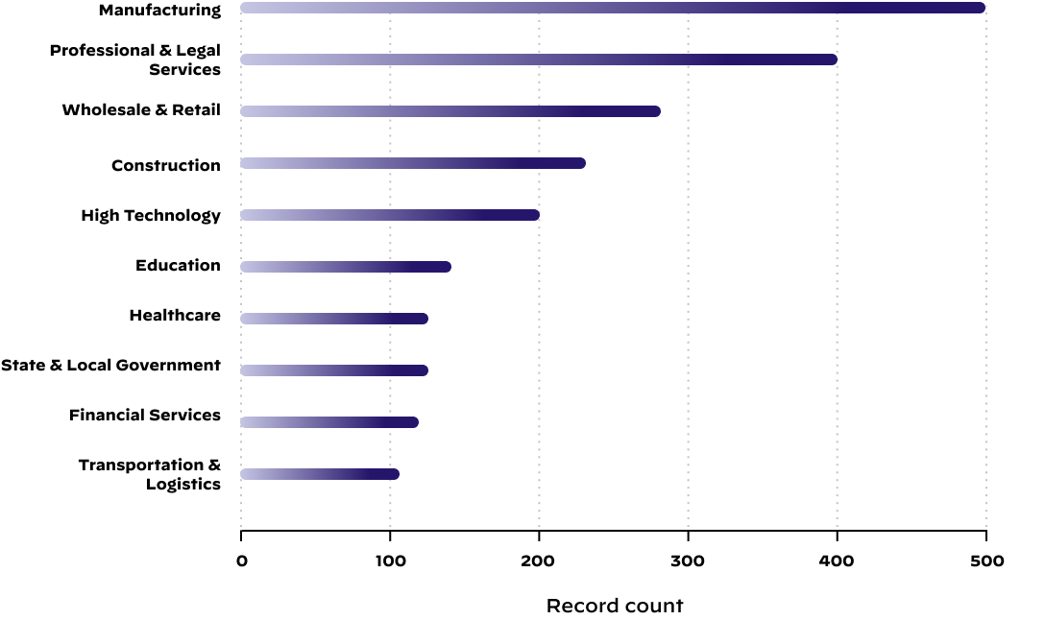
Unit 42 Ransomware Report: Industries most heavily impacted by extortion
Attackers are targeting all industries
Top industries impacted by extortion attacks were:
Manufacturing
Professional & Legal Services
Wholesale & Retail

Slide 13
Case Studies

Slide 14
Brute Ratel C4 Ransomware Case Study: Phishing Access Vector
BRC4
Recon
x4
Gootloader Installed
BRC4 Installed as Windows Service
Phishing Email Attachment
Ransomware
$
Demand
Exfil
Translation: Ukrainian! All your personal data has been uploaded to general network. All data on the computer is destroyed it is impossible to restore them. All information about you became public, be afraid and expect the worst. This is for your past, present and future. For Volyn, for the OUN UPA, for Galicia, for Polissya and for historical lands.
Notes:
Case in point,U42 called to help large org w/ ransomware attack .
started with a phishing email, one of top initial access vectors for all incidents.
contained a zip file, installed a malware downloader called Gootloader.
Gootloader first-stage downloader- malware was used to install a reverse shell gave TA persistent access to an endpoint.
Using that access, TA pivoted to install BRC4 on 4 servers - installed as a Windows service to avoid detection.
Using BRc4 on servers, TA able to internal reconnaissance & access sensitive files.
exfiltrated hundreds of gigs to be used as double-extortion
Post data exfil, TA deployed ransomware & made a multi-million dollar ransom demand.
As shown even rware groups are leveraging the same tools being used by nation-states.
actors borrow tools & techniques to carry out attacks, even when their motivations & goals different.
TRANSITION:TA’s, all about improving success rate. they learn from each other, constantly innovate & pivot tactics to improve efficiency & effectiveness.

Slide 15
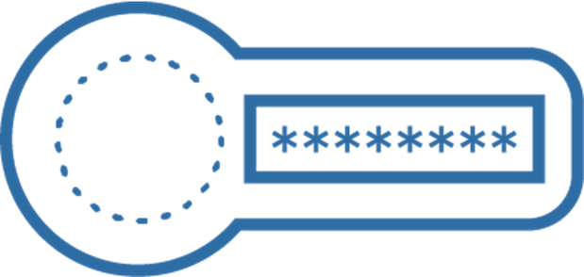
Business Email Compromise Case Study
How a $20 investment and 7 days of work can earn you $1.2m!
Threat Actor accesses and reads email
Copies of previous invoices manipulated
Fake Invoices & CFO approval sent to Wire Transfer Dept.
Two Wire Transfers Sent to International Bank
$1.2M!
Approve?
Yup!
$20
Accountant receives ‘Late Invoice’ Phishing Email - provides O365 credentials
Threat Actor registers domain similar to org
Fake CFO email created using registered domain
7 DAYS!
Notes:
Headline: How a $20 investment and 7 days of work can earn you $1.2m!
As part of a monthly audit, org found two wire transfers missing tax documentation.
When they asked accountant about it, he denied processing the transactions.
Org had a wire transfer approval process:
1) Accountant creates invoice
2) Sends invoice to CFO for review
3) CFO replies with an approval/denial via email
4) Invoices + approval sent to Wire Transfer dept for processing
All of that happened, so concerned email accounts were compromised; we were called in to investigate.
Forensic investigation findings:
Accountant received an invoice from someone claiming to have a late invoice requiring payment; requested that accountant login to download a ‘secure receipt’
Accountant provided O365 credentials; threat actor was logging into email within minutes
Over several days, TA read emails and figured out internal wire transfer approval process
For less than $20, registered a domain VERY similar to the organizations
Used fake domain to create a fake CFO account
Downloaded copies of previous invoices from accountant email; uploaded to PDF editing website to manipulate banking details, amounts, etc.
Sent manipulated invoices to fake CFO account requesting ‘approval for wire transfer’
Replied from fake CFO account with an approval
Fake invoices + fake CFO approval sent to Wire Transfer department for processing
Wire 2x transfer dept processes wire transfers to international bank totalling $1.2m
A month had passed, so funds had already been transferred out of bank.

Slide 16
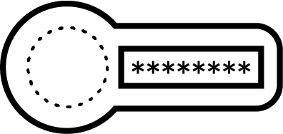
MFA-Bypass Use Case: MFA Fatigue/Bombing Attacks
$1M!
MFA Approved
1. Attacker compromises user’s email creds and logs in numerous times.
3. Attacker gained access to email system and subsequently processed a $1M fraudulent wire transfer.
MFA
2. User is flooded with numerous MFA authentication requests - many are denied until ultimately one is approved.
X
X
X
X
X
MFA-Fatigue Attack
Notes:
We saw a BEC attack earlier this year where the attacker managed to compromise the email credential of one enterprise user, but their email was protected by MFA. The threat actor just spammed them over and over again with MFA prompt, until the user clicked that button on their phone or their watch. Sometimes even best security practices like MFA can be circumvented by resourceful threat actors in the most basic ways, like spamming a user until it clicks yes out of fatigue and frustration just to make that prompt go away.

Slide 17
Protecting Yourself from Cyber Threats

Slide 18
Questions to ask yourself today…
How safe and secure is my online behaviour in the office and at home?
What personal information do I share online?
How strong is my password (really)?
Do I think before I click?
Do I consider all MFA requests and what might have triggered them?
Do I know where to report my security concerns?

Slide 19
How your organisation can become more Cyber Resilient

Slide 20
Path to greater Resilience
Know you threats
What threat actors are targeting the Public Sector?
Assess your network security
Conduct routine testing
Plan for the worst
Ensure your plans are up to date
Exercise them
Notes:
Threats - do you know what threat actors are targeting your sector? How do your controls map against their TTPs? Rather than trying to stop everything, a more informed approach is likely to be more cost efficient and far more effective
Network - when was the last time that you had a penetration test or ideally a red team conducted?
Plan - if you havent got a plan, then you cant expect your team to respond efficiently and effectively!
A well structured plan is key to a coherent response - without it you can expect chaos
“You dont want to learn to dance on the day of the dance!”
Avoid commodity TTXs they offer very limited value - rather do a truly bespoke exercise that is tailored to your infrastructure and controls, ideally it looks at your current BC and DR solutions as well as the business impacts resulting from a serious incident - this will then highlight gaps specific to your organisation and allow you to make informed investment decisions on how to manage those gaps or any risks appropriately. In particular, this usually showcases to the Exec the disconnect between BC/DR plans and the business needs, and as a result the unknown risks they are holding
I have run bespoke exercises of this nature to a range of organisations and across all sectors - my biggest takeaways are:
BC/DR plans are rarely if ever updated in line with Cyber scenarios
RPOs and RTOs in BC plans are totally unaligned with the business need
Businesses dont realise the risks they are holding
They havent thought about what their priority services or functions are and how to recover them rapidly
Little consideration to how and what might be involved if there was a need to roll back data and how to get back to a known good state
No thought to how to prioritise back log of work/activities

Slide 21
Q&A

Slide 22
Thank You

