Slide 1
Fact or fiction? Mistake or malice? Navigating insider risk
Alistair Mills
Director Security Engineering, at Proofpoint

Slide 2
What is Insider Risk?

Slide 3
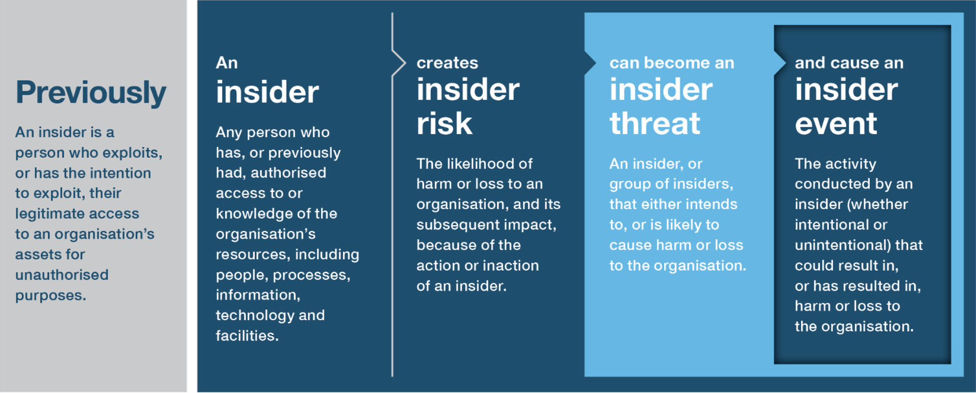
Source: NPSA Insider Risk Definitions

Slide 4
“If you have people, you have insider risk”
- NPSA

Slide 5
Why is insider threat a problem?
Notes:
What is the challenge or problem we are trying to solve?
And then naturally what can we do about it? Should we do something about it?

Slide 6
Constant change
Gig Economy
Supply Chains
Cloud
Communication
Remote Work
6
Notes:
We’ve seen a big focus on this topic of Insider Threats. What’s changed that has put such a spotlight on an organizations insiders.
Last 10yrs work changed – place you go to something you do. This accelerated massively over the last 3yrs
If we take a broader view:
Data and business now has wide range of contributers – traditional empliyees, temps, contractors, 3rd partys in supply chains or customers. All of whom need acces to critical data and applications.
This is all while organisations have struggled with visibility and control.
These organizations and groups are collaborating across common applications and data infrastructure, with organizations struggling with visibiluty
Users are connected to, and data resides in, just about every Cloud service – from file sharing and SaaS applications to communications and social media
The use of chat, email and text are all now common within organizations and have changed the nature of how the security perimeter must be formed.
The attack surface and just exploded. It is incredibly hard for organizations to secure their environment in this reality.

Slide 7
Employees take data when they leave…
…and are top of mind for CISOs
Insider threats are costly and time consuming
of users changed jobs in the past two years
82%
of all insider threats are malicious
26%
25%
of CISOs agree that employees leaving their organization played a role in a data loss event
average annual cost of a malicious insider
£3.3M
of those who left a job took the data with them
44%
85
average number of days to contain an insider
Source:
2023 Proofpoint State of the Phish Report
2023 Proofpoint Voice of the CISO Report
2022 Cost of Insiders Threat Report

Slide 8
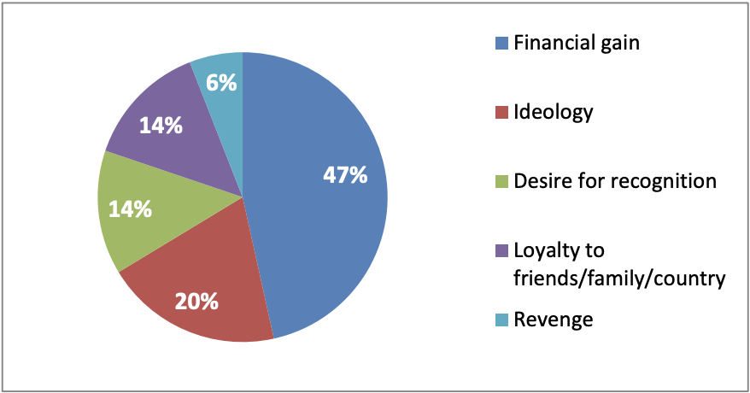
Source: CPNI INSIDER DATA COLLECTION STUDY

Slide 9
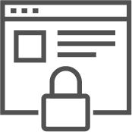
Not fully addressed by traditional security approaches.
DLP
UEBA
PAM
EDR
Complex and easy to bypass
Prone to alert fatigue
Limited to IT and privileged users
Focused on external threats
9
Notes:
Brandon: Rob, with all of the technology available, why are we still hearing about this problem? I would think it would be solved by now.
Rob to walk through the slide
Brandon: Rob, can you share some real world examples of insider threat incidents?

Slide 10
How can we mitigate Insider Risk?
Notes:
What is the challenge or problem we are trying to solve?
And then naturally what can we do about it? Should we do something about it?

Slide 11
Insider Threat Management does Security Monitoring; it is NOT a Surveillance Tool
Security Monitoring
Surveillance Tools
Monitors activity of riskiest users
Protects organizations from financial & brand damage
Built with privacy by design
Manages data on ‘need to know’ basis
Provide a holistic picture of a specific person
Monitors behavior, identity & other people-centric activities
Tools used to monitor employee productivity

Slide 12
What Is Needed In the New World to Understand People
The New Information Protection World
The Old Information Protection World
Is there sensitive or regulated data?
BEHAVIOR
CONTENT
Is there unusual user activity, intent, and access context?
Is there linkage to compromised accounts, phished users, malware, OAuth abuse?
THREAT

Slide 13
Risky users should be monitored with ITM
EXAMPLES
Every Day vs. Risky Users
High Risk Employees
HR watch list, very attacked people, new hires
Departing Employees
terminations/layoffs, resignations, notice, performance plans
Privileged Access
IT admins, financial admins, customer support, call centers
Non-Employee Users
contractors, service providers, supply chain partners
Risky users typically constitute about ~10% of the user population

Slide 14
Understanding Data Loss Incidents
Access
Manipulation
Exfiltration
Copy to personal cloud storage
Share with personal / burner account
Sync/copy cloud file stores
Change file name
Encrypt file
Email to personal / burner account
Copy from cloud to unmanaged device
Search/copy from file shares
Export data from web interfaces
Change file extension
Add to archive or compress file
Copy to USB / external hard drive / AirDrop
Print
Copy structured data from thick client apps
Create multi-part archive
Notes:
As it turns out, data loss, even though it's a problem we've struggled with since the inception of this industry, actually gets really straightforward once you start looking at it. And at Proofpoint we have the advantage of looking at this across thousands and thousands of organizations. And you don't actually have to have an insanely complicated classification scheme to understand most data loss. In fact, sometimes you don't even have to do classification at all. What you really have to understand is how data is accessed, how data is manipulated and how data is exfiltrated.
And there's only 4 ways that data gets accessed. People look at it in cloud file shares on OneDrive. They look at it in traditional file shares if you still have those. They take data out of applications that have web interfaces like salesforce or GitHub, or they copy structured data from thick client apps. Source Code is, of course, a way to do that. Maybe they're exporting a CAD drawing, something along the lines of creating a file. Now that access is not that difficult to understand across cloud, and of course, across endpoints. The next segment was basically how that data is then manipulated by end users, and they don't have that many choices there, honestly. Even somebody trying to disguise the data that they're stealing doesn't have a million choices. They really have 5. And this turns out to be a really strong signal in understanding data loss. How often do you change the name of files, except to add, maybe “Final” at the end of the PowerPoint. Hopefully. You're using OneDrive and you don't have to do that anymore. How often do you change a file extension on any file on your machine? It breaks the file. There's no point in doing that on a regular basis unless you're trying to hide what you're doing. Do you encrypt files as part of non-standard business workflows. People usually don't do that. Do you create multi-part archives to move multi-gigabyte files around. You probably don't do that unless you're a data extortion actor. So, understanding these signals, independent of all of the classification things that we've historically had to do, for DLP is an incredibly effective way to identify when things are actually going wrong, regardless of whether or not you've classified that data or you've classified that user as ultimately risky.
And once the data has been accessed, and it's been manipulated, of course it has to leave before it actually causes risk. And those patterns have also largely standardized, personal cloud storage and burner accounts still rain supreme. And you know, even data thieves these days have a little bit more respect for the environment, or maybe they don't want to pay for Toner, because printing is a lot less common than it used to be as data exfiltration. But those are not a million different things that you have to understand in order to stop, and really, 95% is conservative here, you could really get North of 99% of all data loss incidents, if you simply understand these basic things.

Slide 15
Meet Evan… She Plans to Leave the Company
Has access to company intellectual property files
Working remotely from home
Going to a competitor
Feels entitled to the intellectual property she creates
Content & Context signals and alerts security team; triggers investigation and step-up monitoring
Evan has access to research data in cloud storage and decides to steal files
Installs personal Google Drive on work laptop
Security team has forensics to create legal case
While working from home, downloads files to work laptop
Copies all work files to personal Google Drive
Evan returns fake dummy laptop to evade investigation

Slide 16
Meet Warner… He Is Not Careful with Company Data
Part of R&D team
Has access to company intellectual property files
Works with 3rd parties
Working remotely from home
Attempts to upload files to 3rd party website
Uninstalls corporate software to improve performance
Security team investigates, determines he is careless; enrolls him in Security Awareness Training
Copies sensitive files to USB ahead of business trip
Data download blocked due to sensitive content and user posture
Out-of-policy activity; generates alert and changes monitoring policy to risky user
Risky behavior increases user risk posture; generates alert

Slide 17
People-centric
insider threat management
Identify
User Risk
Prevent Security Breaches
Accelerate Incident Response
Quickly identify risky user activity and data movement
Protect proprietary, sensitive, and regulated information from unauthorized or risky exfiltration
Leverage context to understand the who, what, when, why of alerts
17

Slide 18
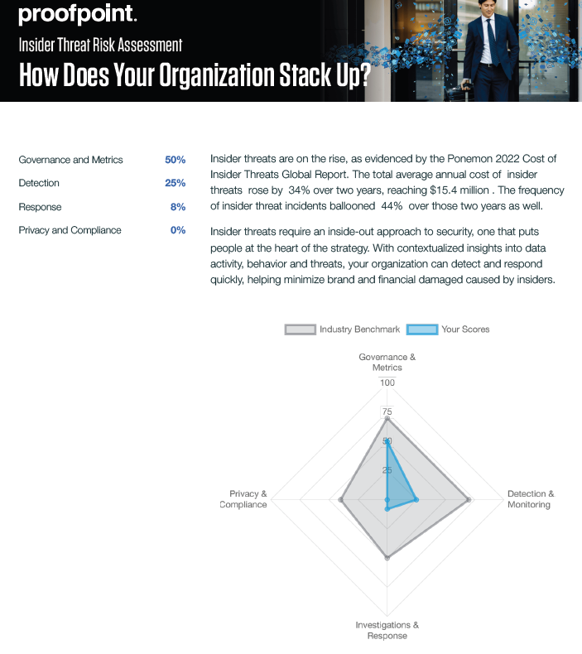
Want to know more?
https://www.proofpoint.com/au/resources/webinars/webinar-series-insider-threat-awareness-month-mitigate-risk-insider-threats
https://www.proofpoint.com/us/learn-more/insider-threat-risk-assessment

