Slide 1
"In the shadows: Protecting your data, and mitigating the rise of double extortion"
Mark Grant - Specialist Sales EMEA: Cloud Data
Adam Jacobs - DSPM Product Specialist EMEA

Slide 2
Rubrik is widely recognized as the leading innovator
2020-2023
4 of 5 Insurance Companies
3 of 4 Telecom Companies
3 of 5 Specialty Retailers
2 of 4 Defense Firms
5000+ customers
2500 joint customers
2019, 2020, 2022
7 years running
Notes:
OU - Thank you for the partnership large wins over the past 5+ years including 3 of the top 4 F500? Telecom Companies
$1.7M in DR ACR YTD
Open pipeline in 7% of your OU accounts
Today really want to expand our reach with a keen focus on law firms and disruptions (add in Mike’s segment)
What do we do
We secure customer’s data from ransomware so they can recover from their backup without having to pay the ransom
We drive ACR from the simplest path of adopting cloud through backup and archival data to overcoming cloud security concerns with how we protect their data at every stage of their cloud adoption (insert Mike’s pillars of adoption message here - check with Luke on naming)
We do this quite well having driven 100PBs of data to Azure across over 2.5K joint customers together.
What type of data,
Data that is very costly to keep on prem, back-up & archival data, NAS data, as well as data already in the Microsoft cloud, backing up cloud native and M365 to Azure
Here comes our second act
Our strategic partnership has been solidified with a long-term commitment to serve customers. In August of last year Microsoft become an investor in Rubrik the result of which has delivered 2 new PRACR SaaS offerings to jointly offer Zero Trust Foundations to our customers in M365 data protection & recovery and (find a better statement here) and an air gapped or worm lock copy of their data in Rubrik’s Azure Cloud Vault
integrated Cloud & Security solutions for Enterprise Customers on their journey of Digital Transformation
Every Rubrik solution can be sold via the MP

Slide 3
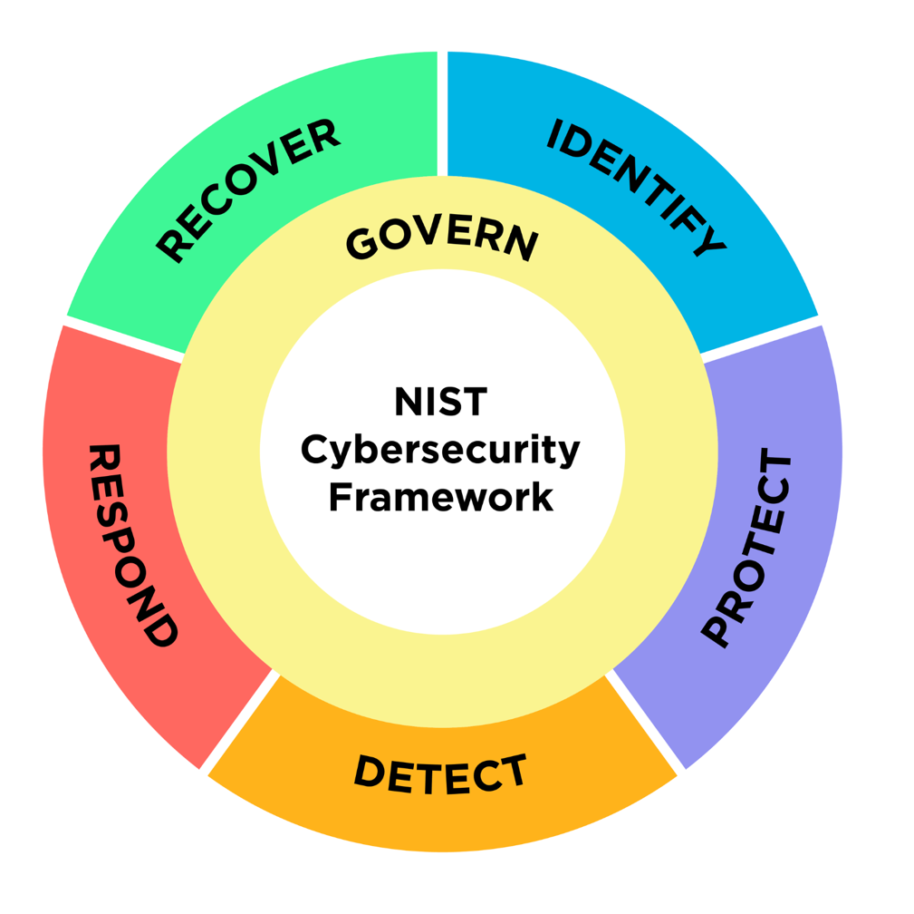
The first complete Data Security Platform
1. Identify
Continuously and autonomously discover, classify, and contextualize all known and shadow data.
4. Respond
Quickly assess the blast radius and compromised data. Investigate and remove access if needed.
2. Protect
Minimize, segment, encrypt, anonymize, mask, and ensure least privilege access to sensitive data.
5. Recover
Deliver data availability that withstands adverse conditions.
6. Govern
Label data, assign ownership and control the residency.
3. Detect
Continuously monitor sensitive data access to warning of emerging threats.

Slide 4
Cyber Recovery + Cyber Posture = Complete Cyber Resilience
Notes:
The problem is not “How do you secure your data?”
The problem is “What happens when they get in?”
Then the answer is “I’m not worried because my data is secure"
The sense of urgency is the same as for Rubrik: how do you recover from a cyberattack?

Slide 5
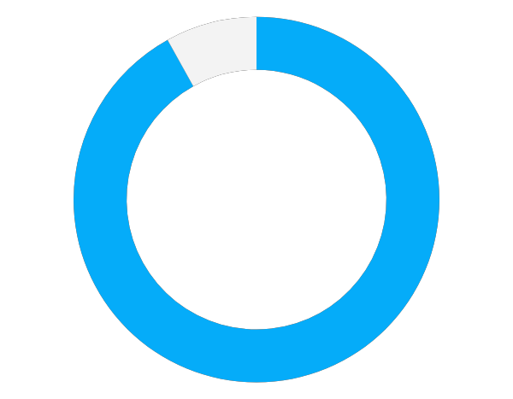
Hackers aren’t breaking in.
They’re logging in.
9% Exploits and others
91%
of initial cloud intrusion vectors were user driven.
Mandiant Threats to Cloud Environments, Q2 2023
Rubrik, Inc. @ 2023. Confidential - All rights reserved
Notes:
"hackers are not breaking in, they are logging in." This reality stems from the proliferation of sophisticated phishing techniques and the widespread compromise of credentials. Attackers exploit human vulnerabilities through deceptive emails and fraudulent websites, seamlessly infiltrating systems. This accentuates the paramount importance of maintaining meticulous control and visibility over sensitive data, especially in cloud environments. Without a robust system to monitor and authenticate user access, organisations face heightened risks of unauthorized entry. Thus, investing in advanced security measures to fortify data control and visibility in the cloud is imperative in safeguarding against these increasingly prevalent threats.

Slide 6
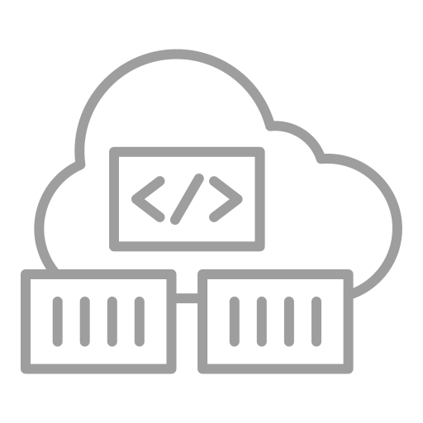
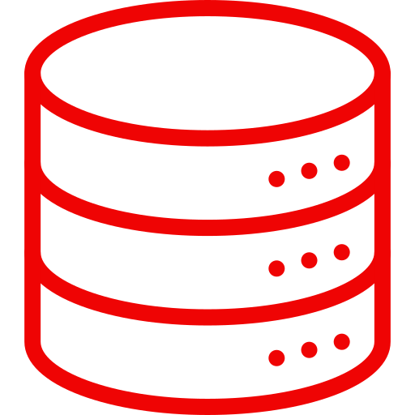
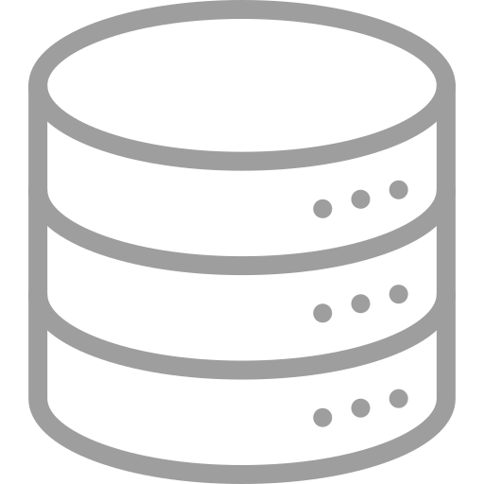
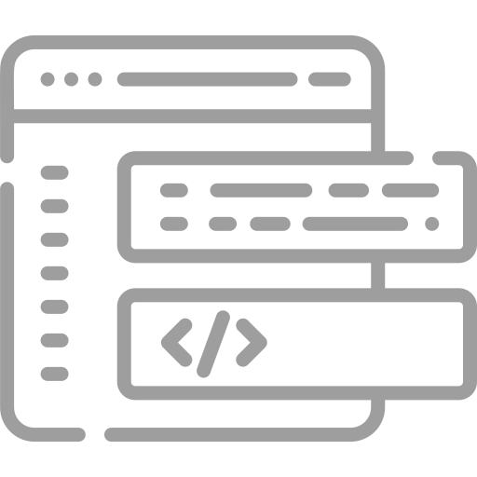
Not designed for Cyber Resilience
Is there an unpatched vulnerability or misconfig?
Anomaly on my server or container?
Is the network access authorized?
Servers
Servers
Containers
APIs
Compromised Identity
Data
Users
Data
Code Repos
IaC

Slide 7
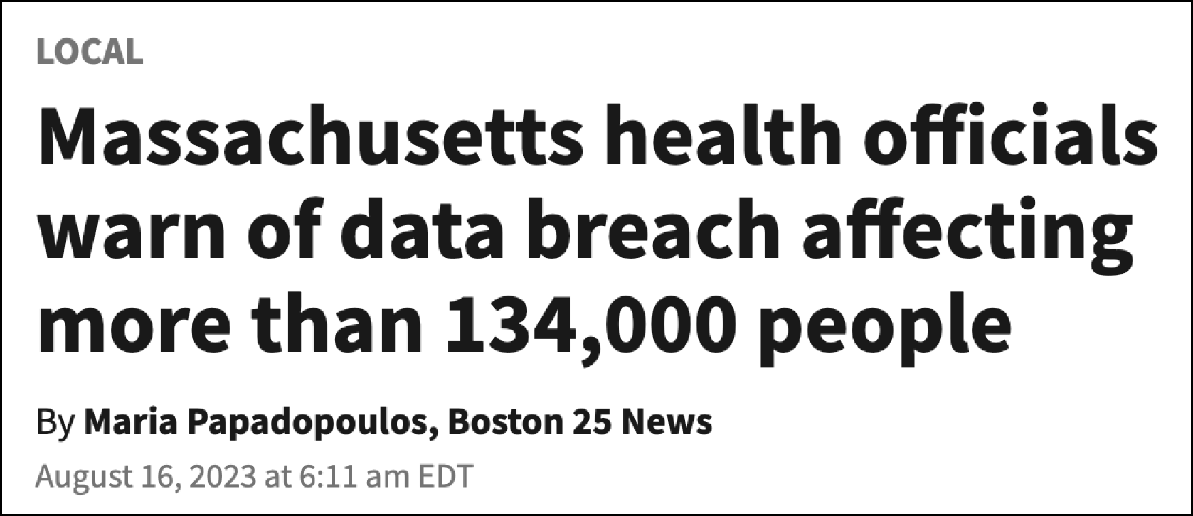
Traditional security is thwarted
Data encrypted or destroyed
Data stolen

Slide 8
Why Are Organizations Stuck Paying Ransoms?
Ransomware locks down data
Option 2: Attempt to recover
Engage IT Ops
Engage SecOps
Option 1: Pay ransom
Is My Data Recoverable?
Has Sensitive Data Been Compromised?
Can We Prevent Reinfection?
What’s the Scope of the Attack?
Can We Recover Quickly?
PAY RANSOM / HOPE FOR BUSINESS RECOVERY
‹#›
Notes:
Ransomware attacks are shining a spotlight on why it’s so important to integrate data security into your data management platform and IT operations
Here is what our customers are experiencing today:
Attackers are penetrating perimeter defenses and locking down data
Organizations have two fundamental options:
Option 1: Pay the Ransom. Even if ransomware demands are met, however, there is no guarantee that the attacker will provide a decryption key that will unlock encrypted data within an acceptable timeframe
Option 2: Attempt to recover
First, IT and Security teams turn to their backup data. If the data is compromised by ransomware, the organization may have to pay the ransom.
Even if they have access to backup data, can they find data anomalies to assess what applications are impacted? Can they find the last known clean copy of data from which to recover the application? If they fail on both fronts, they may have to pay the ransom.
Lastly, they need to recover critical applications in a timely manner to protect the business. If they can’t get back online quickly they may have to meet ransom demands.

Slide 9
You encrypted my data. And you want me to pay to get it decrypted?
Nope. Recovering with Rubrik

Slide 10
I stole it too. There is employee data in there and it’s about to be uploaded to the dark web.
time to pay up.
120%
growth in double extortion ransomware that involved both the encryption of production data as well as exfiltration
Source: Zscaler ThreatLabz 2022 Ransomware Report
Notes:
Source: Zscaler ThreatLabz 2022 Ransomware ReportSource: Zscaler ThreatLabz 2022 Ransomware Report

Slide 11
The Rise of Double Extortion
Data Destruction
Cyber Recovery
Breach
Data Exfiltration
Cyber Posture
There is no recovery from Data exfiltration!
In 2021 40% of Ransomware attacks involved data theft, in 2022 that was 70%
In 2023 the average cost of a data breach rose to USD $4.45 million
Of all record types, customer and employee personal identifiable information (PII) was the costliest to have compromised.
Notes:
Police northern ireland

Slide 12
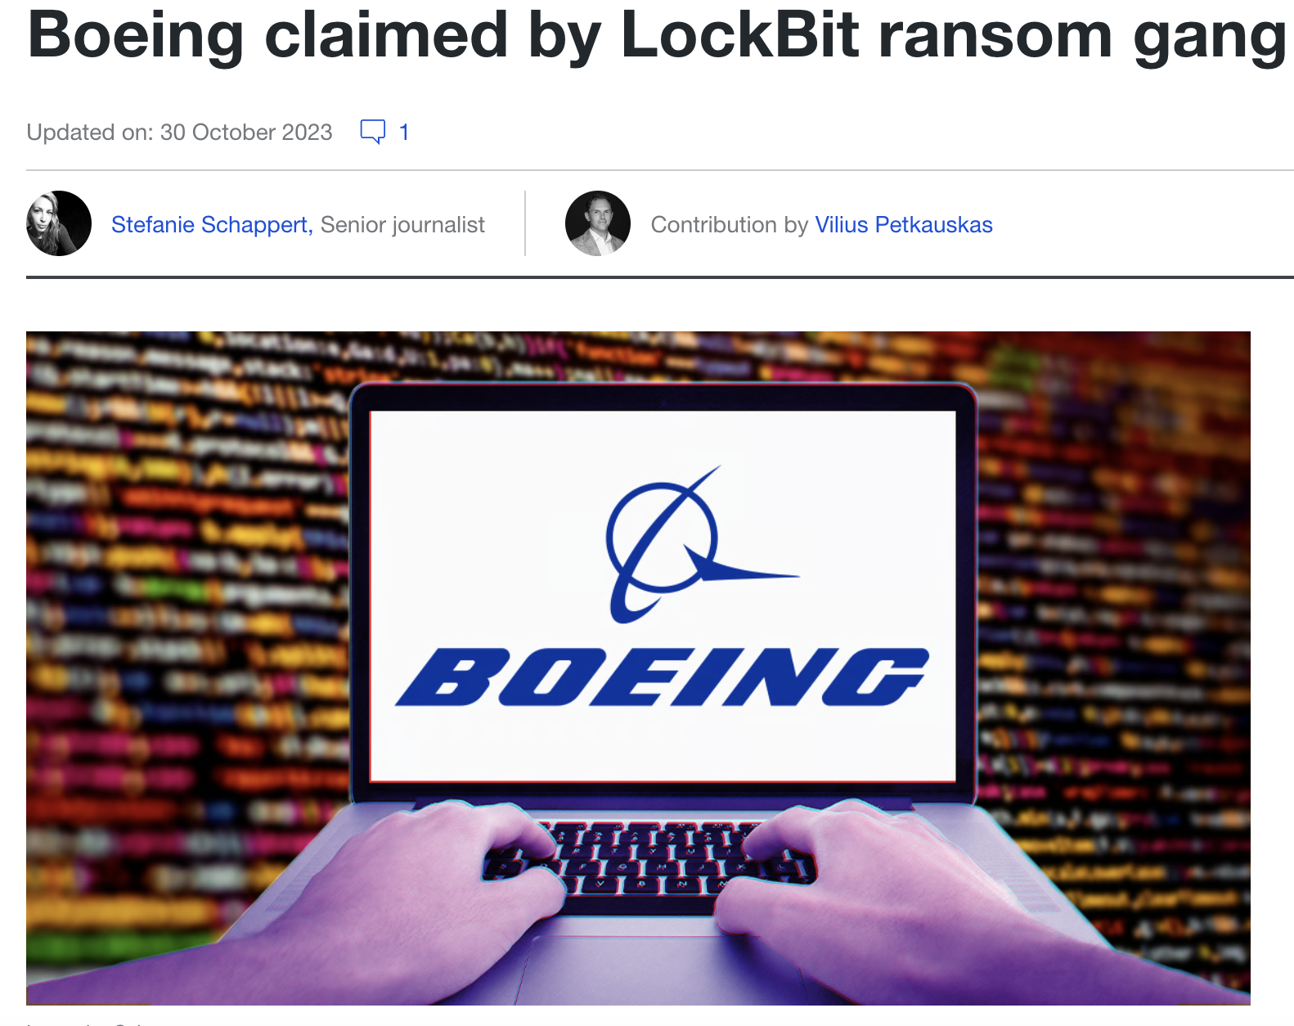
Recent Example
"LockBit says it has a tremendous amount of sensitive data that will be published if the company does not contact the group by a November 2nd deadline”

Slide 14
Why is Cloud data so hard to secure?
#ShadowData
Rapid Growth: Cloud data can scale rapidly, making it challenging to manage and control
Multifaceted Ecosystem: Cloud environments involve a multitude of services, each with its own configurations and settings.
Vendor-Specific Security Tools: Different security tools and features potentially leading to gaps in security coverage.
Lack of Visibility: Limited visibility into data flows and access patterns.
Compliance Variability:Navigating diverse regulatory requirements across different geographical regions.
Governance Gaps: Establishing and enforcing consistent data governance policies.
Identity and Access Management (IAM): Who can access and how is it used?
Notes:
over the last few years the journey into the cloud has been accelerated and currently a quarter of companies host over 40% of their data on public clouds. This trend is poised to surge in the coming years, signifying a monumental shift. Consequently, sensitive data, the bedrock of our operations, is now dispersed across various public cloud infrastructures. This is expected to increase to 58% of organizations within 24 months. This inherently means that sensitive data is also now distributed across multiple public clouds. for one in six more than 40% of their organization’s corporate data that resides on public cloud services today is sensitive. This is expected to almost triple to 45% of organizations within 24 months.82 percent of breaches involve data stored there. Cloud adoption continues to increase, and copies of data are often shared between clouds without oversight by IT or security, resulting in the growth of shadow data, which is untracked.
The Vast Majority of Data Storehouses Contain Sensitive Data and Are Important to the Business, 86% have sensitive data stored in a data lake, data warehouse, or data lakehouse. (Snowflake) These platforms serve as the pivotal hubs of contemporary data management. With multi-cloud strategies now being the norm, more than three-quarters currently store sensitive data in more than one IaaS/PaaS platform. With each platform having its own native policies and controls, ensuring complete security of all cloud-resident sensitive data can be challenging. The publicity of ransomware and other cybersecurity attacks has raised the awareness of data security as a critical component of an organisation’s overall cybersecurity strategy. Not surprisingly, they are earmarking their
cybersecurity budgets to include data security. Specifically, 87% of organisations expect to increase their spending on data security technologies and services over the next 12-24 months, with more than one-third classifying these increases
as substantial.

Slide 15
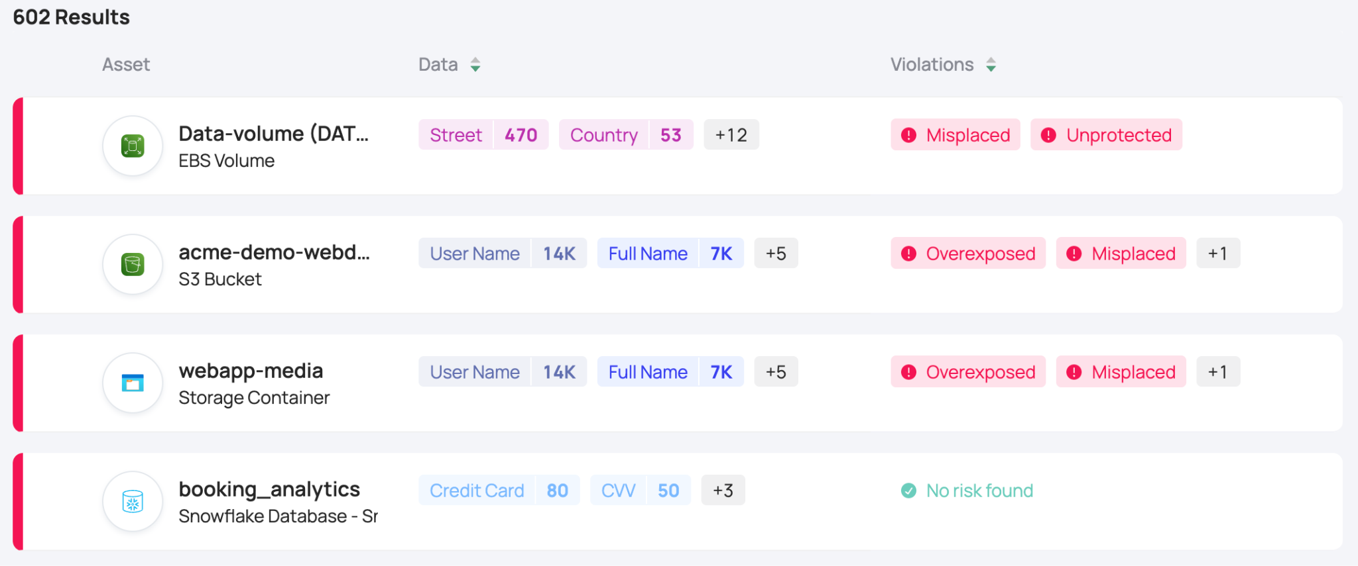
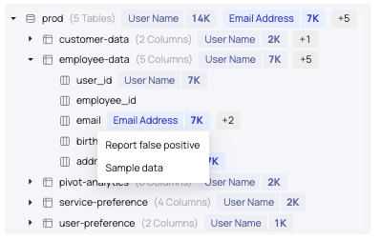
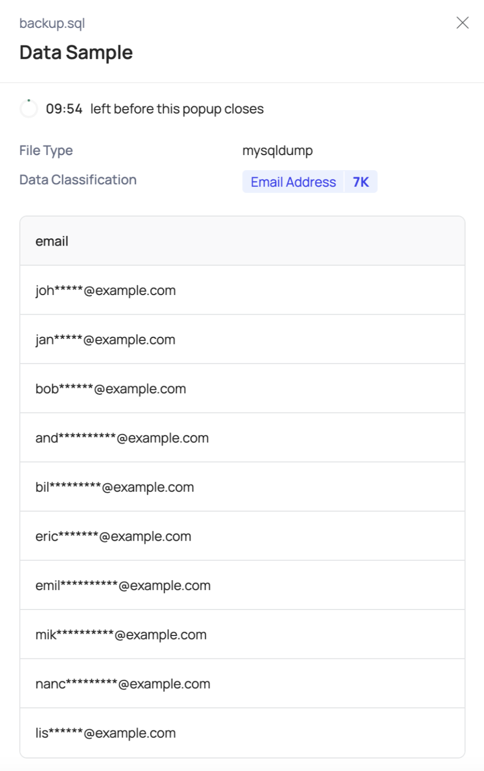
Data discovery & classification
Sensitive Data Exposure & Context
The foundation for data security
What data you actually have (i.e., type of file and contents)
The context around your data (i.e., residency, owner, and usage)
The data’s sensitivity level. This is determined by looking at the information gathered in the first two bullets, in conjunction with its location, to understand if sensitive data is being safeguarded with the appropriate controls.

Slide 16
Minimising data breaches
1. Data Hygiene - Remove unnecessary data
2. Data Access Governance (DAG) - Least privilege identities
3. Data Security Posture Management (DSPM)
4. Anomaly Detection & Response (DDR)
Notes:
Delete data you don’t need, redundant data, not accessed or modfifed data, flat file dumps, shadow copies, unmanaged backups
Implement least privildege principle or data access governance
Manage posture
Detect activity as its happening and shut it down.

Slide 17
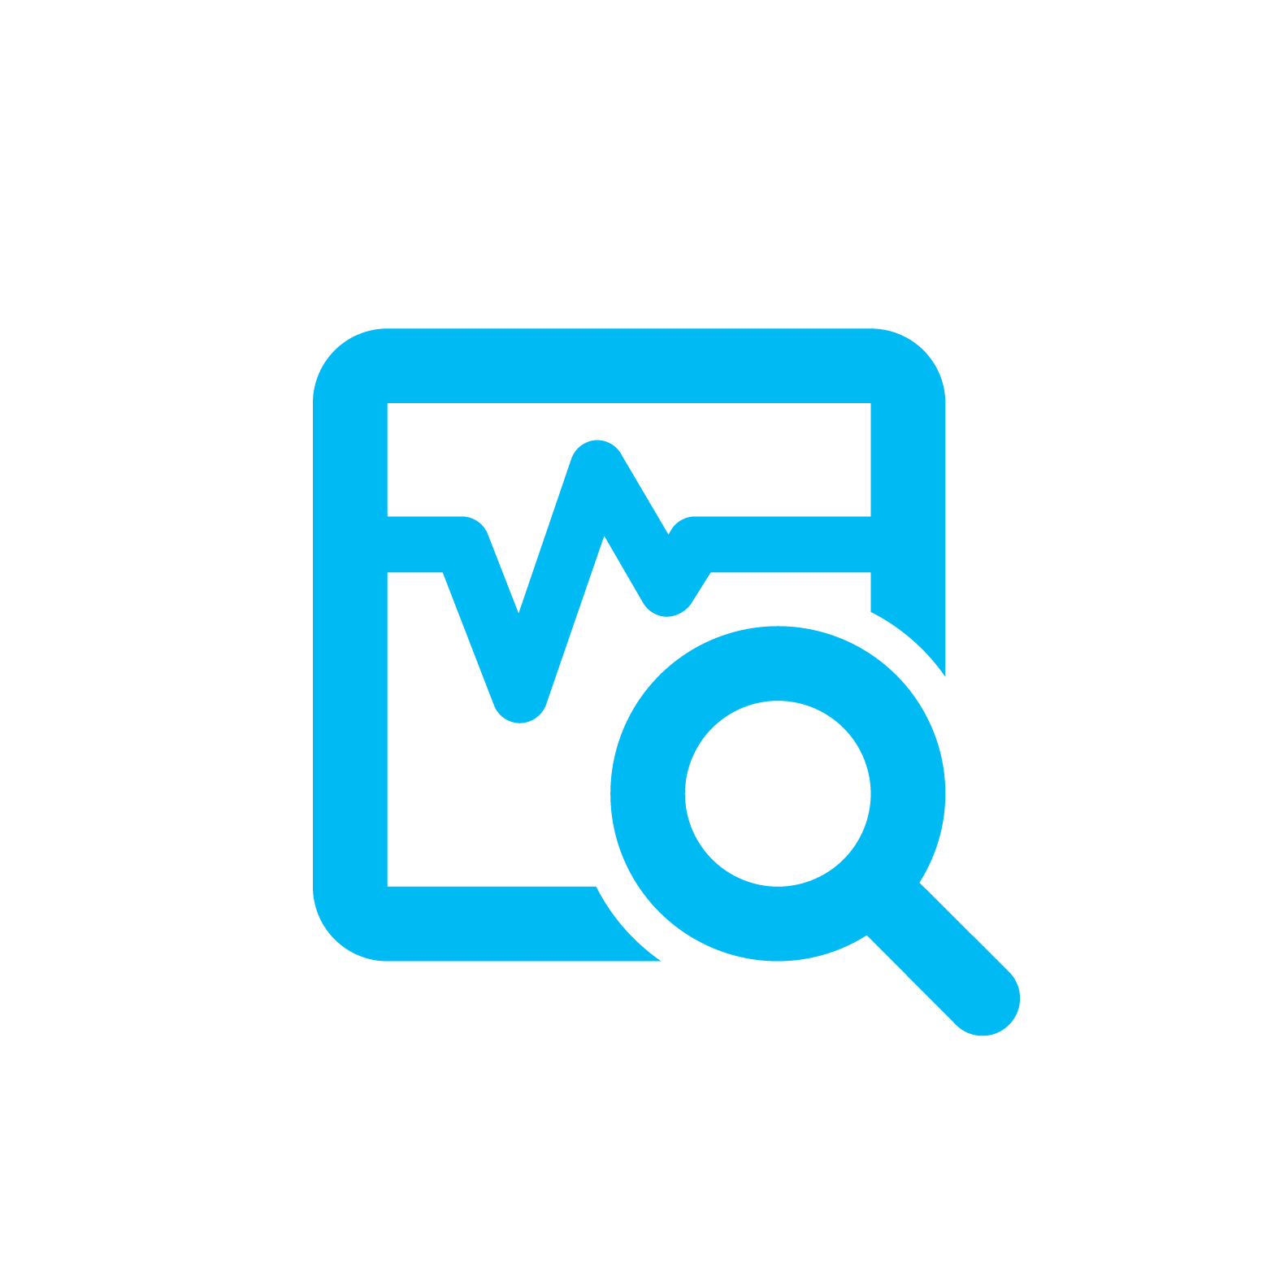
Rubrik Security Cloud + DSPM
Data Resilience
Data Observability
Data Remediation
Data Protection
Data Threat Analytics
Data Security Posture
Cyber Recovery
Zero Trust Design
Continuously Evaluated Security Policies
Data Access Policies
(Who can access?)
Data Activity
(Who is accessing and how?)
Data Security Posture
(How is the data protected?)
Sensitive Data Discovery, Classification & Contextualization
Autonomous Asset Discovery
Cloud
SaaS
Data Center
Cloud
SaaS
Data Center

Slide 18
One page summary
The Customer was looking to increase their cyber and data security capabilities and posture. Part of the program was testing the Laminar product to increase visibility and security of the Cloud/SAAS based data.
During the Proof of Value period we discovered multiple points that proves the validity of this program as we discovered anomalies and unexpected personal and sensitive data. We are also able to see many Terabytes of data being consumed in the cloud that was not serving a business purpose which will result in savings in cloud spendings.
The test data and scope for this Proof of value project was a small but realistic dataset of the entire organisation. In a full production environment we would expect to see dozens more results of similar importance.
Some key data security and efficiency outcomes from this project are:
4 Million unmasked instances of Customer PII in a Snowflake database
18 assets containing misplaced Personal and Financial data in the Azure environment
Over 10 TB in 49 copies of a previously discontinued database within AWS
GDPR data found that was stored in the United States
All these findings were immediately actioned

Slide 19
Thank you
Notes:
The problem is not “How do you secure your data?”
The problem is “What happens when they get in?”
Then the answer is “I’m not worried because my data is secure"
The sense of urgency is the same as for Rubrik: how do you recover from a cyberattack?

