Slide 1
In the moment nudges – What? How? Applying nudge theory to awareness
Tim Ward // CEO & Co-founder ThinkCyber tim@thinkcyber.co.uk
Delivering secure behaviour change
Notes:
Thanks of that kind introduction John.
So yes, I’m going to

Slide 2
What is nudge theory?
Thaler and Sunstein “Nudge”
Soft, paternalistic nudges
'Forcing' methods drastic, direct, and require conscious determined effort (by the person/people being 'changed’).
Nudge methods are easier for people to imagine doing, and less threatening and disruptive to actually do.
Choice architecture: shaping the environment to steer these decisions
“Limited rationality”
Significance of context
Cognitive biases come to play
Can start by incorporating into what you are already doing
Notes:
Thaler Sunstein – though much work builds on Tversky and Kahnemans work
Essentially helping people make decisions that are in their own best interest.
Enforced change vs nudge
Instruct to tidy room - Play a tidy up game
Signs say no littering - Improve availability or visibility of bins
Counting calories – smaller plate
Weekly budget – use a basket not trolley
Join a gym – use the stairs
Really important aspect of this is that decisions are being made anyway and the environment will influence them what ever we do

Slide 3
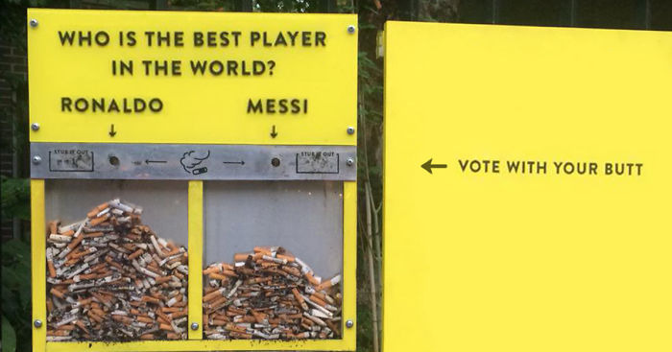
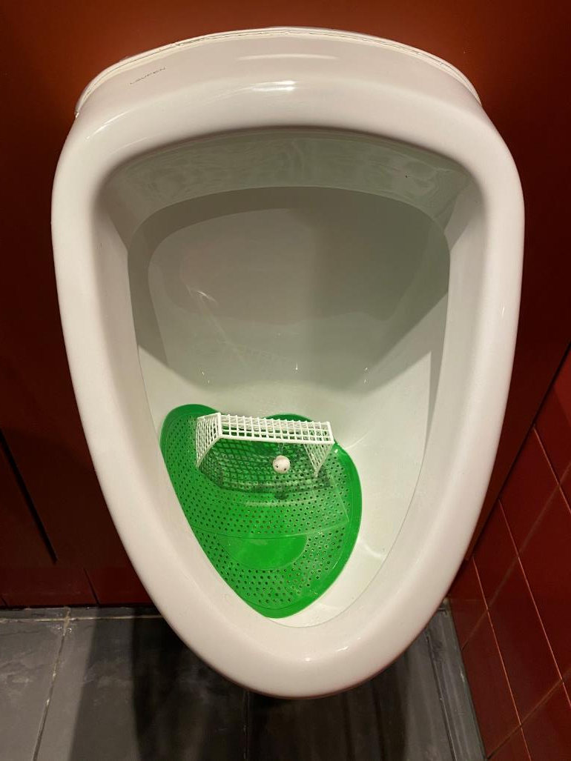
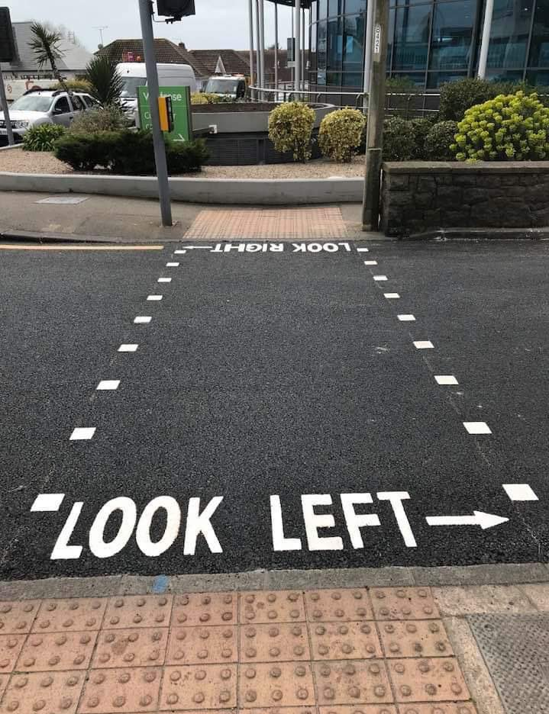
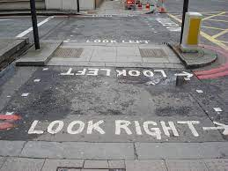
Examples
Super market
School canteen
Saving
Hand washing NHS & abattoir!
Notes:
Supermarket – apples or sweets on the top shelf?
School canteen
Attractiveness Vegetables labelled with creative names Convenience Fresh fruits, located near the box, at eye level Normativity Question from the employee: "Would you like to try ... How about a vegetable?"

Slide 4
What about sludge?
Unhelpful nudges – deliberate or accidental?
Password advice that is too complex
Darkpatterns.org
Unsubscribing
Cancelling subscriptions
Phishing lures use dark nudge patterns

Slide 5
What makes a good nudge? MINDSPACE
Messenger | We are heavily influenced by who communicates information
Incentives | Our responses to incentives are shaped by predictable mental shortcuts such as strongly avoiding losses
Norms | We are strongly influenced by what others do
Defaults | We “go with the flow” of pre-set options
Salience | Our attention is drawn to what is novel and seems relevant to us
Priming | Our acts are often influenced by subconscious cues
Affect | Our emotional associations can powerfully shape our actions - take care over fear without agency
Commitments | We seek to be consistent with our public promises and reciprocate acts
Ego | We act in ways that make us feel better about ourselves

Slide 6
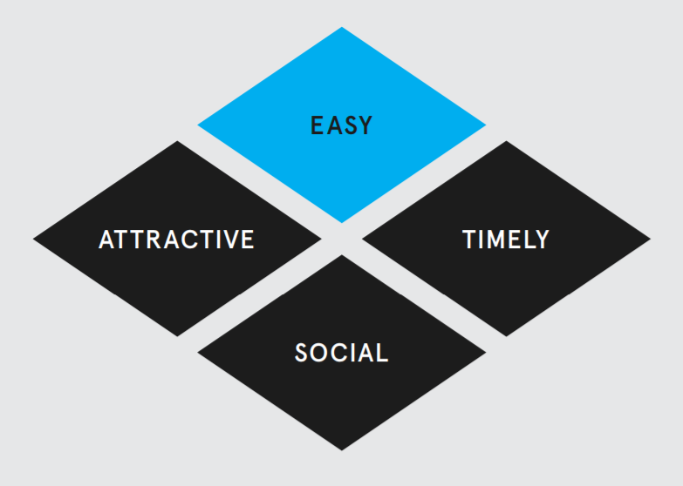
What makes a good nudge? EAST
The four components of an effective nudge…
Easy
Attractive
Social
Timely
EAST® image used with permission ©Behavioural Insights Ltd. Not to be reproduced, copied, distributed or published without the permission of Behavioural Insights Ltd.
Notes:
More common senseical

Slide 7
Applying nudge theory – part 1
You are communicating anyway…. Refine it
MINDSPACE
Other cognitive biases – availability, loss aversion, reciprocity, social norms
Tesco delivery saver 10.2% uplift (See “Ripple” Groom and Vellacott)
Framed as a loss: Don't miss out on unlimited FREE deliveries
Friendly delivery driver image – “hot state” of receiving groceries
Smiling face – mimicry/positivity
Looking towards …
“Delivery saver customers save on average £76.44” [authority]
Notes:
Anchoring – rely on first piece of information given
Availability – perceive risk based on experience – so examples and stories about attacks can be effective

Slide 8
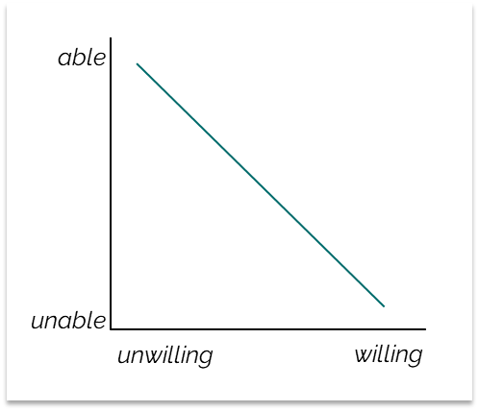
BJ Fogg Behaviour Model
The three factors for ANY behaviour to happen…
Motivation
Ability
Prompt
Order matters
Don’t start with motivation, start with a prompt
See BJ Fogg - https://www.tinyhabits.com/
https://www.behaviormodel.org/
Notes:
Timeliness / Salience
Actually prompt / more physically “nudge”
Context prompts and Action prompts

Slide 9
Applying nudge theory – part 2
Key behaviours to avoid phishing:
Think before you click
Report suspicious emails
How to change end-user behaviour to think before clicking links and report suspicious emails?
Notes:
Key to preventing phishing is both a healthy scepticism and users pausing to think before acting on an email.
One of the best behaviours to encourage in users, that supports thinking before they click, is to report suspicious emails.
However most IT/Security teams don’t have time to respond and without a reward for good behaviour users stop reporting

Slide 10
Example: safe email use
PROMPT
(Prompt the change)
Timeliness is key
Deliver the prompt when in email
A clearly visible reporting button can be a good prompt
“You’re in email, remember phishing”
“Is this link safe?”
ABILITY
(Make it easy)
Easy to remember
Don’t over-complicate
Reinforce need to be cautious with email
Easy to act
Simple message: “if it doesn’t feel right, then report it”
Reporting button
MOTIVATION
(Make people want to)
Threat appraisal
How many phishing emails received?
Distribute real examples
Social proof
How many reports have been made? (“Your colleagues are reporting…”)
Notes:
Ready.
Again, timeliness is key.
In email
A phishing button is quite a good prompt.
The prompt is along the lines of “you’re in email. Remember that some of those emails could be dodgy.”
Easy.
Key thing is not to over-complicate.
Can be tempting to try to make everybody an expert in spotting phishing.
But better to focus more on the fact that you can’t trust all emails.
And provide a simple action to perform if you have any doubts - report
Willing.
Drive threat appraisal.
Make people aware of how many received. Make the threat real.
Maybe distribute actual examples. Amazing how many security awareness courses are based on showing people cartoon drawings of emails. Find a way to show them the real thing.
Social proof. How many reports are received. And stopped by your team (can play to reciprocity cognitive bias)

Slide 11
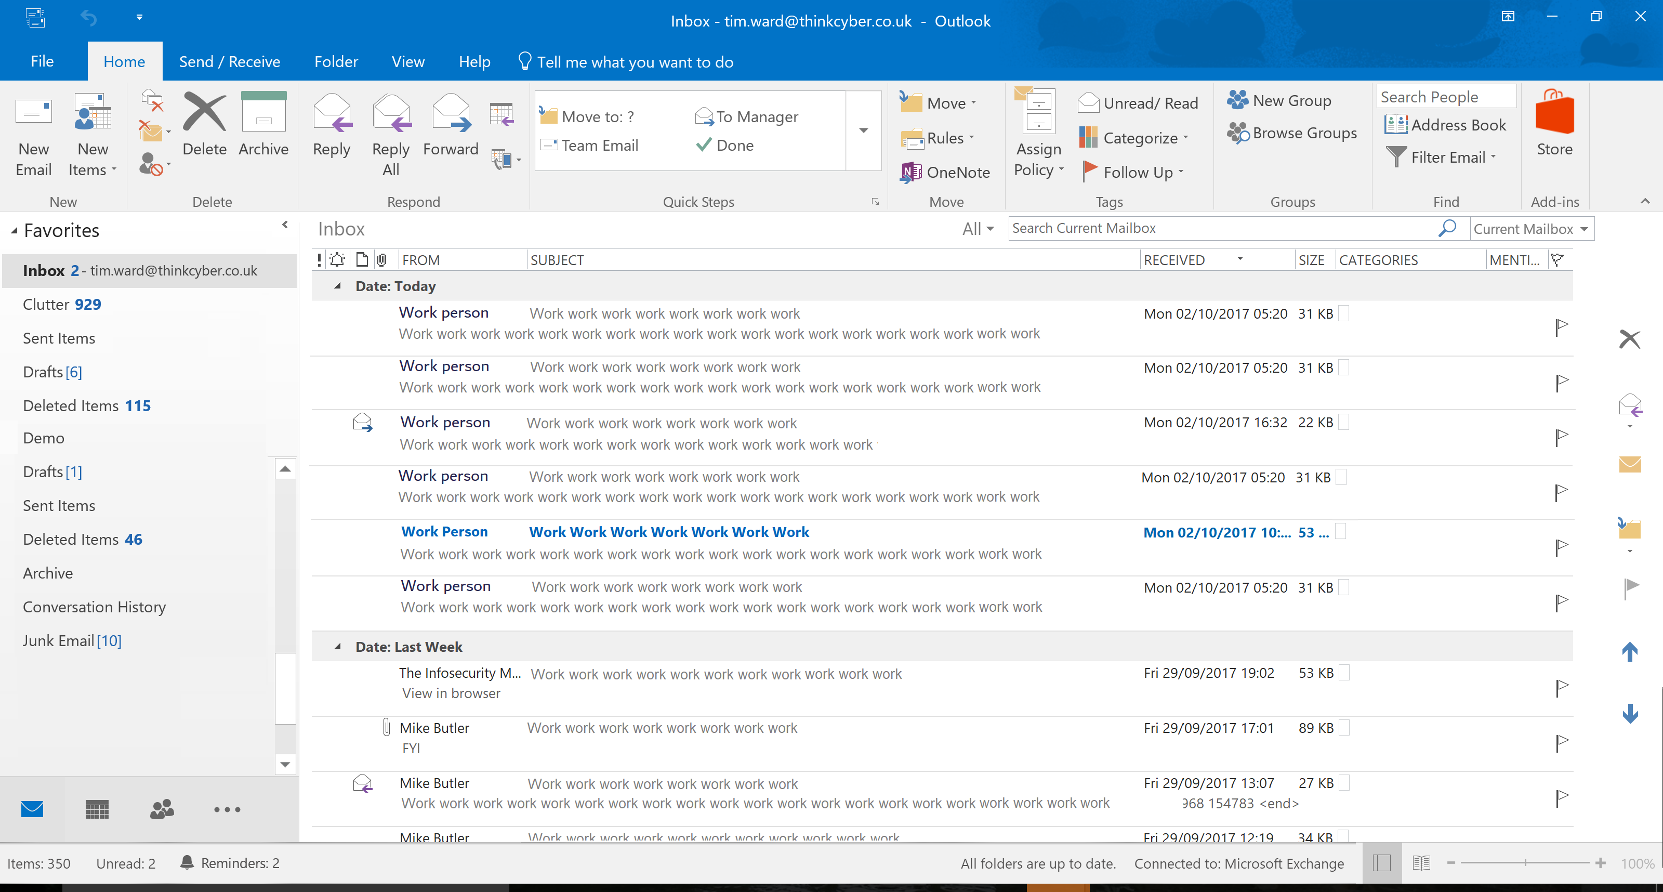
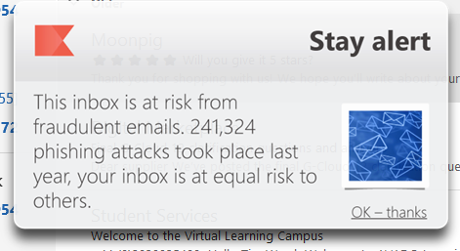
Delivered in context
Reminder when interact with email
PROMOTES DESIRED BEHAVIOUR
Reminds people of the threat
Timely, salient, priming
Threat/coping, authority, anti-optimism bias
Measurable impact in research project with Cardiff University
Notes:
Timely reminder
Easy to digest – 30 seconds
Easy action – report it
Motivation – social proof
Timelines / salience
Measure
Have seen click rates half after only 3 months

Slide 12
Engagement
How to increase both engagement and retention, to measure and adapt?

Slide 13
Engagement
PROMPT
(Prompt the change)
Timeliness is key
Drip feed
Ongoing
Topical
Annual awareness training is a poor prompt
ABILITY
(Make it easy)
Easy to access
Content delivered to the user
Quick and easy to digest
User choice
Easy to do
Actionable advice
MOTIVATION
(Make people want to)
Threat appraisal
Personal context
Real examples
“Fear of loss”
“Positive frame”
Exploit curiosity
Engaging content/
Stories & narrative
Biases & learning science techniques
Notes:
Loss more significant to a gain – loss aversion to avoid an action
Positive frame when want to do an action
Express the risk in negative terms, but present your solution using positive framing.
https://www.neurosciencemarketing.com/blog/articles/positive-framing.htm

Slide 14
Behavioural science and our own research tells us how to address this, by targeting the “The sweet spot”
Context
eLearning
Videos
Post-incident Phishing-sims
Too Soon
Too Late
Trigger
Action
Punishment with training
Hard to contextualise
Forgotten Out of context
Infrequent
Prime before the behaviour
Intervene just-in-time
Notes:
Why does this smatter
Awareness practitioners can justify their roles!
They can measure what they do is working
They can target behaviours
A quick goggle will tell you everyone is talking about behaviours…. But NONE of them can measure and intervene before they happen!

Slide 15
Behaviour change campaigns
One behaviour (or group of related behaviours) at a time
2-3 months to see impact
Coherent and consistent content
Subtle and relatively infrequent
Mix things up to avoid habituation

Slide 16
Example campaign: Check the sender
For example a "Check the sender" campaign might work as follows:
Week 1+2: Tracker
Train and baseline
Week 3+4: Tracker + security story.
Introduces phishing threat and importance of checking the sender before clicking a link
Track link clicked from new sender events
Week 5+6: Tracker + reminder no.1 + nudge.
Reminder reinforces concept
Real-time nudge when hover link in email from new sender
Track link clicked from new sender events
Week 7+8: Tracker + reminder no.2 + nudge.
As above

Slide 17
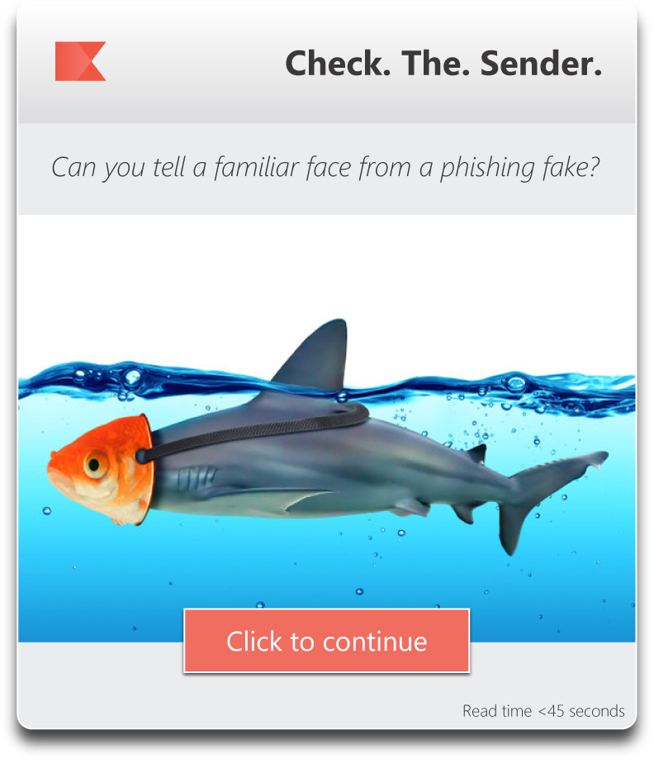
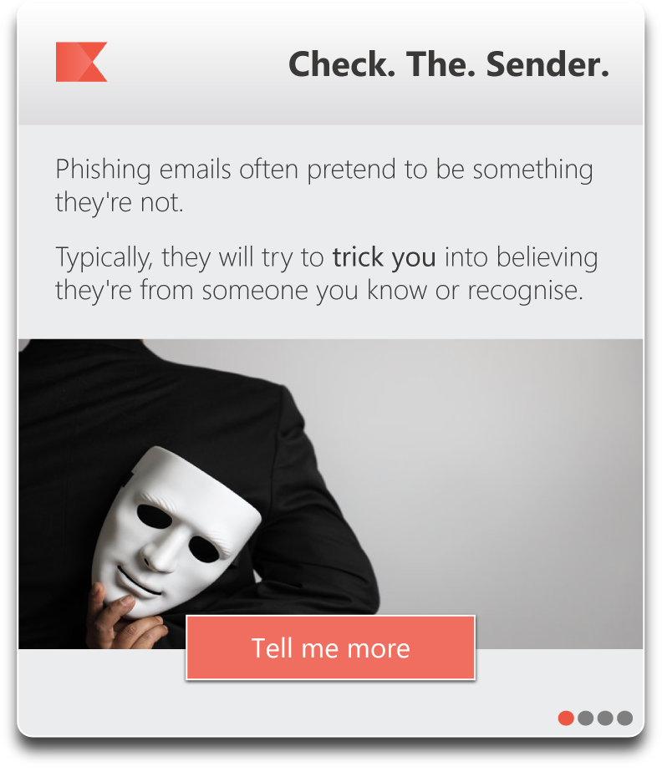
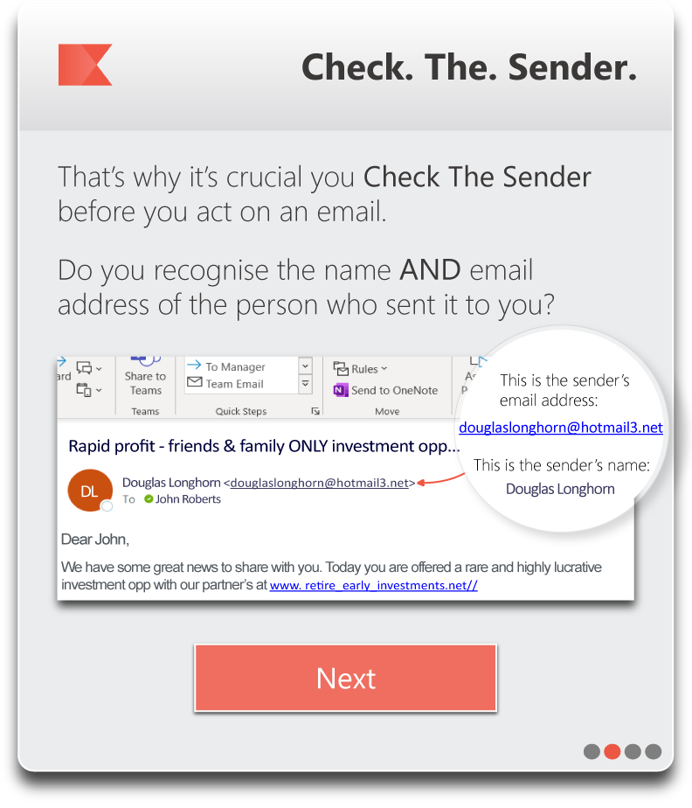
FOCUS ON KEY LEARNING POINTS
Provide actionable security advice, with click-through for more information
DESKTOP ‘OVERLAY’ FORMAT
Low friction but conspicuous.
Engaging paged content including Q&A
ENGAGEMENT TRACKING
Measurement of dwell time and click-through statistics
Ease, timeliness, salience, availability
Notes:
Organisational context gone – automated posters
80-90% engagement

Slide 18
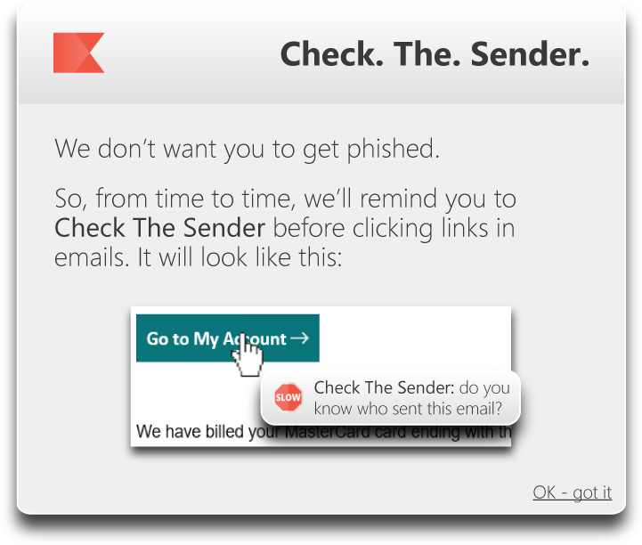
Delivered in context
Reminder when interact with email
PROMOTES DESIRED BEHAVIOUR
Reminds people of the threat
Offers a simple coping strategy
Timely, salient, priming
Notes:
Organisational context gone – automated posters
80-90% engagement

Slide 19
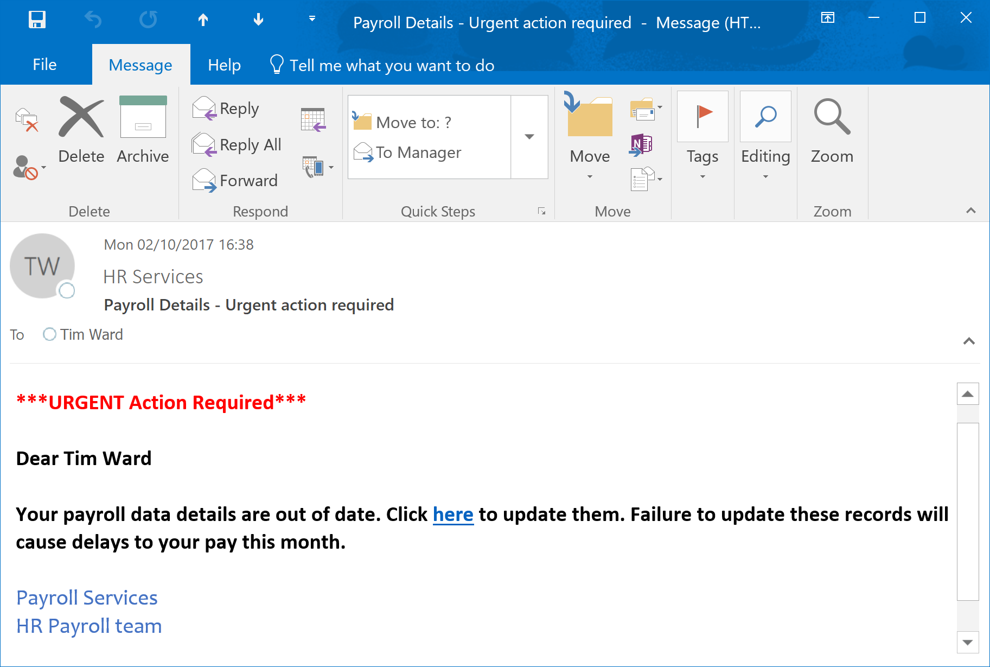
Delivered in context
Nudge the user when they encounter a link in an email from an external sender
PROMOTES DESIRED BEHAVIOUR
Move from System 1 (automatic) to System 2 (deliberate) thinking
ENGAGEMENT TRACKING
Measurement of nudge statistics to track trends
Link hovered vs link clicked
***URGENT Action Required***
Dear Tim Ward
Your Payroll data details are out of date. Click here to update them. Failure to update these records will cause delays to your pay this month
Payroll Services
HR Payroll Team
Notes:
Timely reminder
Coping or facilitator nudge

Slide 20
Measurable impact

Slide 21
Real-time awareness
Right content, right time, right way
Notes:
Take nudge to logical conclusion

Slide 22
A tap on the shoulder: What do we mean by “real-time” security awareness?
Supporting people "in the moment" as close to the point of risk as possible, and proactively steering them to a secure behaviour.
NOT finding new mediums to nag people via:
e.g., Email, Teams, WhatsApp, Slack or SMS, unless it's timely and relevant to what they are doing.
NOT responding to events in the SIEM to trigger awareness after the fact:
It's too late, the event has happened
People find it hard to contextualise any training
Risks "punishing people with training" just like phishing simulations have been doing for years.
Why does this matter?
Choice between supporting people, guiding, steering and reducing risk….
Or continuing to nag and beat them up when they get something wrong.

Slide 23
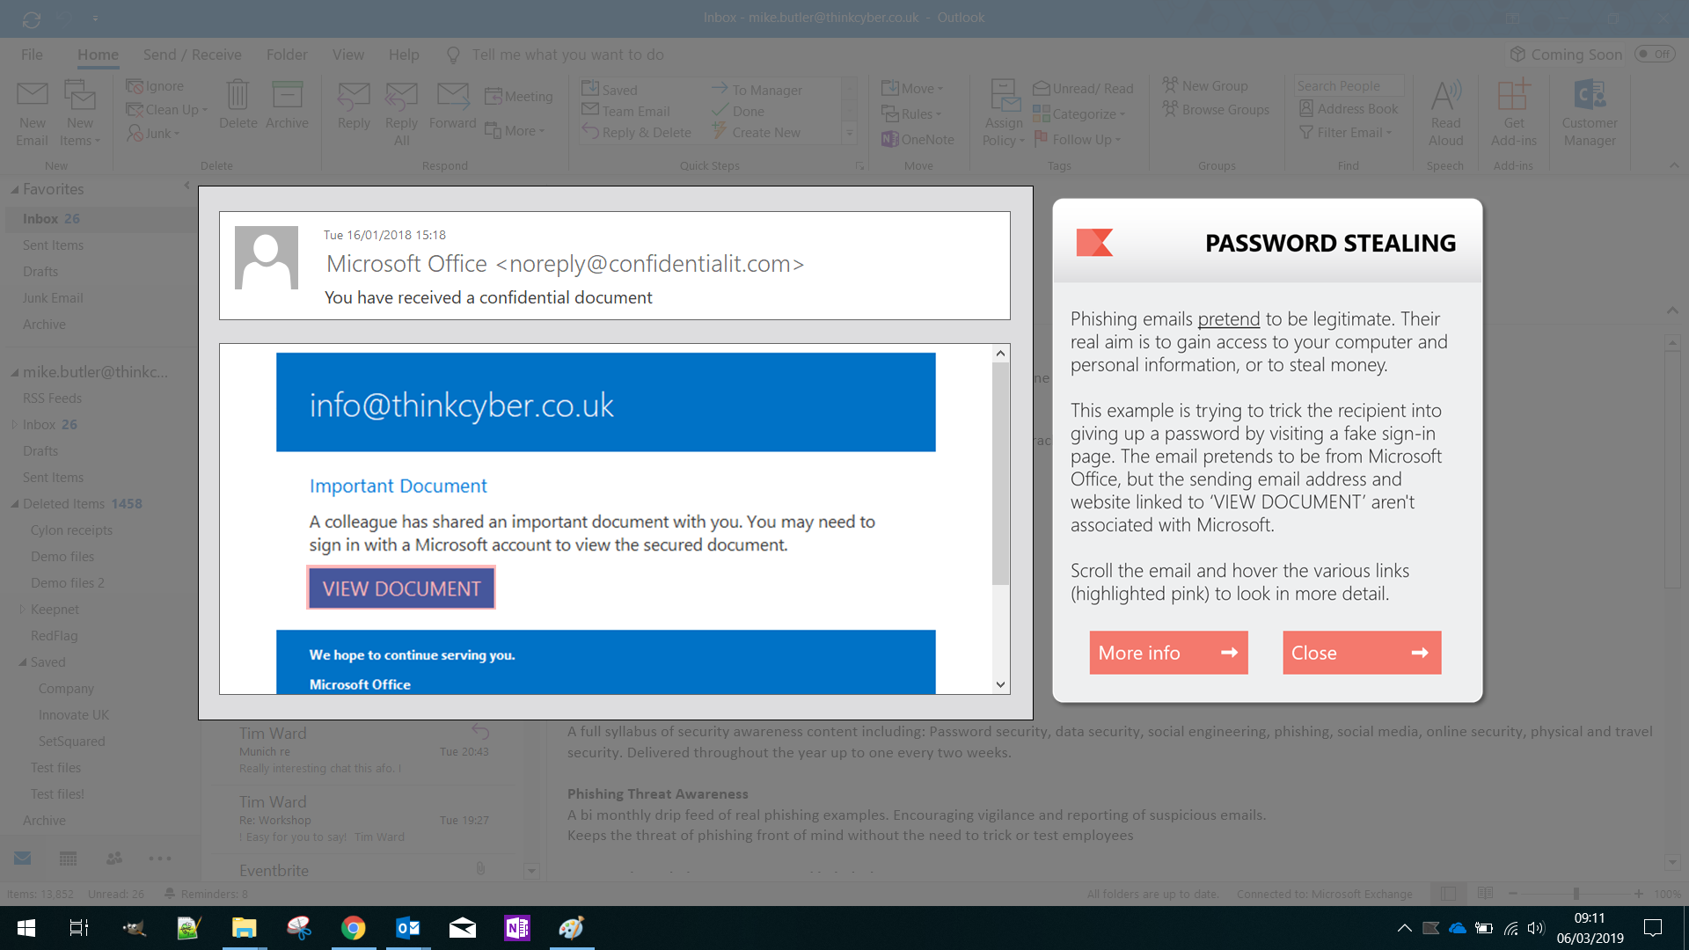
Delivered in context
Low friction ‘nudges’ periodically delivered when in an email application. People choose when to engage
Ongoing threat awareness
Real examples of phishing emails with annotations noting what to look out for
PROMOTES DESIRED BEHAVIOUR
Reminds people to report suspicious emails, and closes reporting feedback loop
ENGAGEMENT TRACKING
Measurement of dwell time statistics for monthly/quarterly risk measures
Social proof, reciprocity, timely, salient, priming
Notes:
Timely reminder
Easy to digest – 30 seconds
Easy action – report it
Motivation – social proof
Timelines / salience
Measure
Have seen click rates half after only 3 months

Slide 24
Delivered in context
Visual reporting nudge
Changing image/text to avoid habituation
PROMOTES DESIRED BEHAVIOUR
Easy and actionable reporting
Notes:
Timely reminder
Easy to digest – 30 seconds
Easy action – report it
Motivation – social proof
Measure
Have seen click rates half after only 3 months

Slide 25
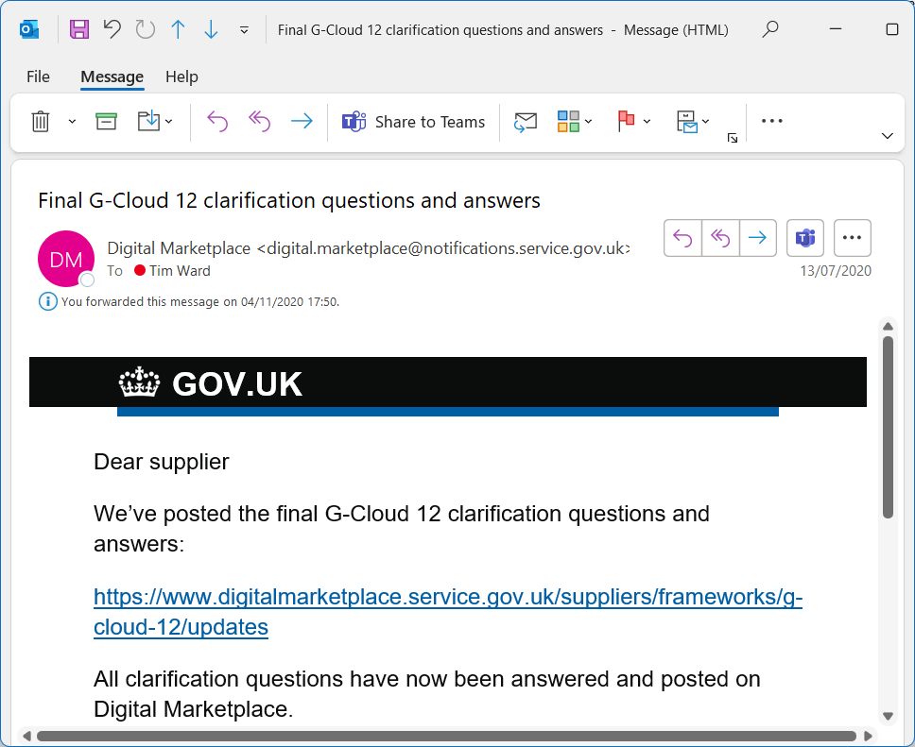
Delivered in context
Nudge the user when they enter credentials AFTER clicking
PROMOTES DESIRED BEHAVIOUR
Move from System 1 (automatic) to System 2 (deliberate) thinking
ENGAGEMENT TRACKING
Measurement of nudge statistics to track trends
Timely, relevant
tim.ward@acme.com
∗∗∗∗∗∗

Slide 26
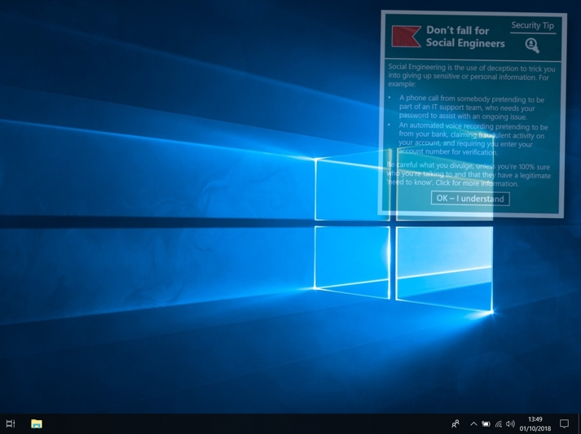
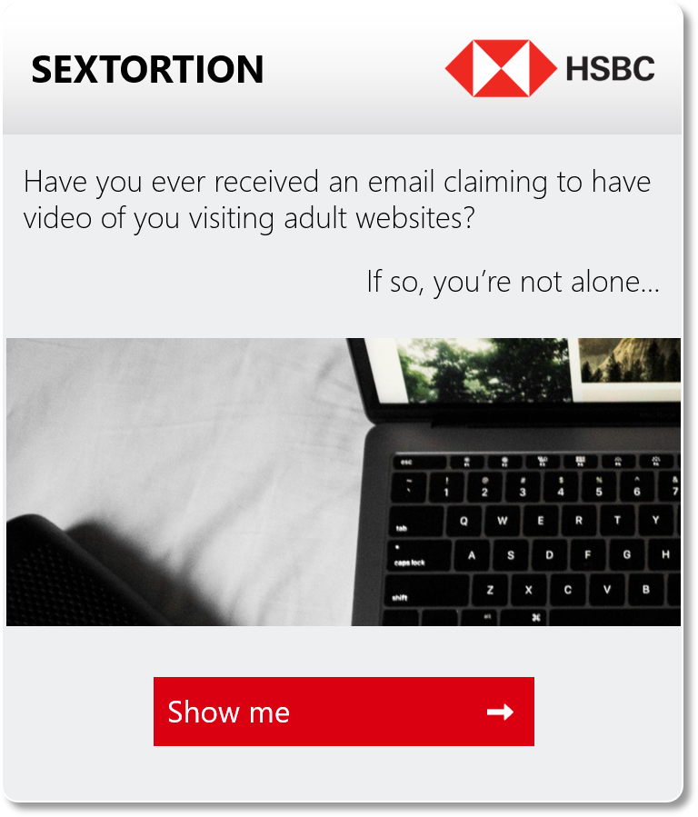
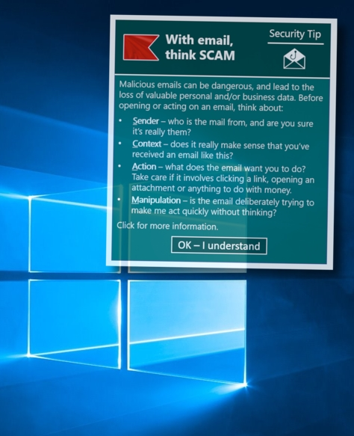
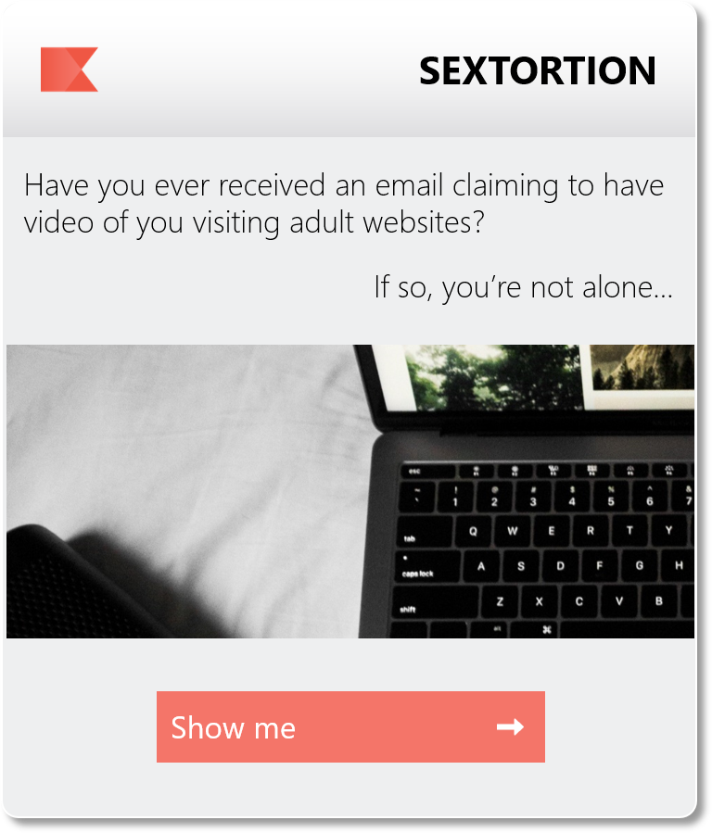
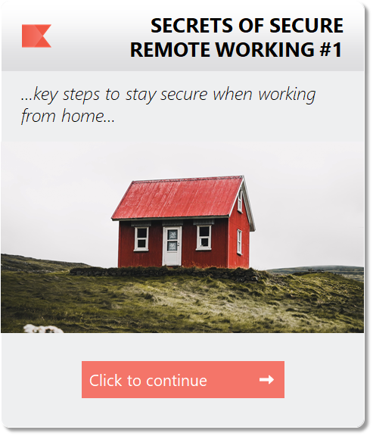
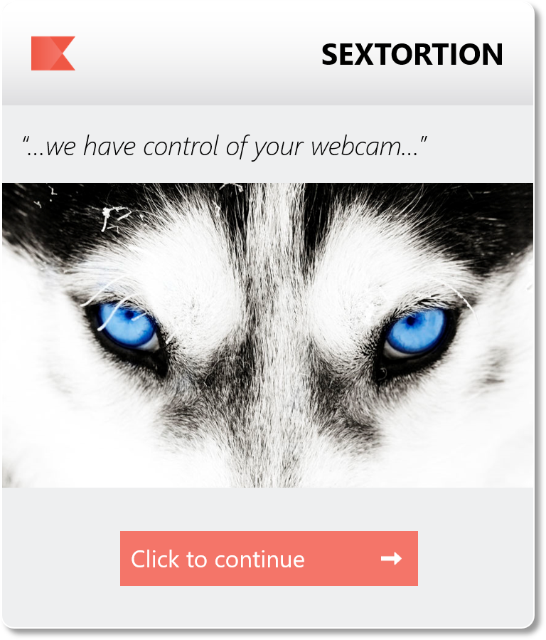
FOCUS ON KEY LEARNING POINTS
Provide actionable security advice, with click-through for more information
DESKTOP ‘OVERLAY’ FORMAT
Low friction but conspicuous.
Engaging paged content including Q&A
PRACTICAL/RELEVANT CONTENT
Monthly tips delivered from curated and continuously updated syllabus
ENGAGEMENT TRACKING
Measurement of dwell time and click-through statistics
Ease, timely, topical, salience
Notes:
Organisational context gone – automated posters
80-90% engagement

Slide 27
DELIVERED AT POINT OF RISK
Behavioural prompts delivered at the right time to be effective
MULTIPLE USE CASES
Phishing: link click, inbound attachments, username into browser
Data loss: web uploads / copy, outbound attachments, removable media
Safe browsing: web downloads, social media, insecure wireless
Policy: admin account use, screen locking, printing

Slide 29
tim.ward@thinkcyber.co.uk

Slide 31
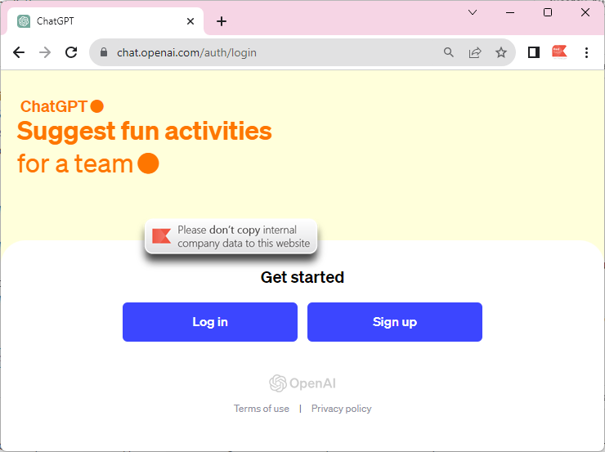
31

Slide 32
Final observations
People don’t (always) make rational decisions!
Nudging is about “choice architecture”
EAST / MINDSPACE / BJ Fogg offer simple frameworks
Timeliness and context are fundamental
Real-time interventions should be about supporting, not nagging!
Make it measurable
Taking “nudge” to its logical conclusion… Real-time nudges allow you to offer a tap on the shoulder And measurably drive behaviour change

Slide 33
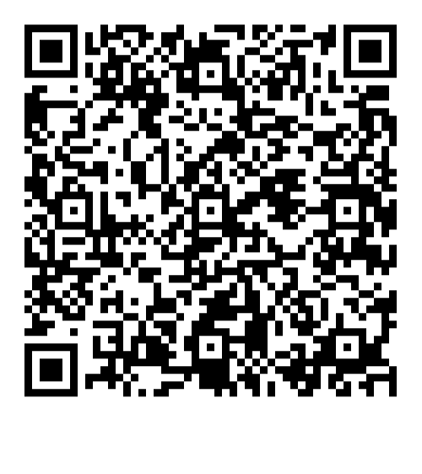
Don’t miss your chance to ask a question!
Delivering secure behaviour change

