Slide 1
Microsoft Security: A Case for Rationalisation
Kamal Gayashan & Matthew Bond

Slide 2
Trustmarque at a glance
Headquartered in the historic city of York with offices in London and Hamilton, Glasgow, our heritage, reputation and unrivalled experience, stands us apart from our competitors.
1987
Formed in York
200+
Technology partners
500+
Accredited Living Wage Employer
Vendor accreditations
36+
Years of experience across NHS, public and private sectors
600+
Global partnerships with powerhouses (Microsoft, Cisco and Dell Technologies)
Employees across the world
5000+
Customers since the beginning
Driving social value through community skills and development
24/7
Security and network operations centre support

Slide 3
Our Practices
Cyber security
Software
Managed services
Hardware
Professional services
Identifying unique challenges and exposure to threats and implementing the right security solutions to protect customers and their users.
Professional and
managed services
Digital workplace
and automation
Our specialist teams can provide a range of value-added services throughout your entire IT lifecycle.
Embrace remote and hybrid working with digital workspace solutions powered by Microsoft 365.
Software services
Hybrid cloud and datacentre
We deliver the best advice on software licensing arrangements to help you reduce costs and improve performance.
Working with the world’s top cloud providers to help customers leverage the best of public, private and hybrid cloud.
Testing and assurance
by Acutest
Data and analytics
Our testing unit, Acutest, keeps critical customer projects in check and is a leading testing and quality assurance provider.
Providing modern Business Intelligence (BI) and data analytics tools to the NHS across finance, clinical, operations and planning.
Enterprise
connectivity
Securely connecting people, data and devices to digitally enable better outcomes, including through consultancy services and 24/7 support.

Slide 4
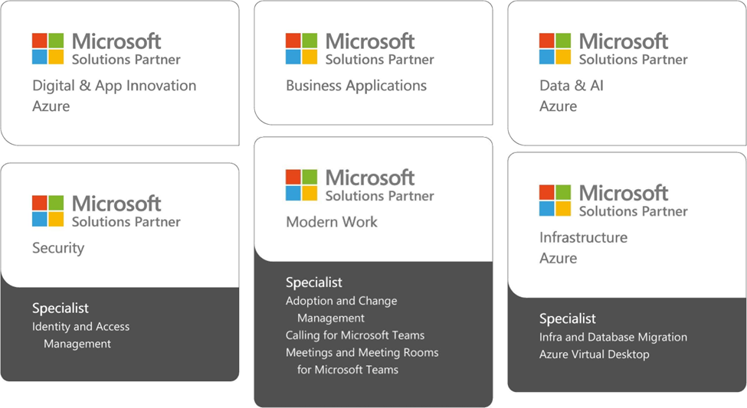
Microsoft
Windows. Microsoft 365. Azure. Power Platform. Microsoft licencing. We are fluent in all things Microsoft. That’s why we are one of the UK’s most accredited Microsoft partners with all six cloud designations:
Digital and App Innovation (Azure)
Security
Data and AI (Azure)
Infrastructure (Azure)
Modern Work
Business Applications
As a strategic partner to Microsoft, we support their commitment to empowerment of every person and every organisation to achieve more.

Slide 5
Challenges with complex security
Increased Complexity
Integration Issues
Management and Monitoring
Performance Overhead
False Positives/Negatives
Scalability
Vendor Lock-in
Regulatory and Compliance Issues
Evolution of Threat Landscape
Costs
Notes:
More components mean more potential failure points / Difficult to configure and maintain
Combining multiple security solutions can lead to compatibility and interoperability issues.
Requires skilled personnel with specialized training / Increases overhead due to the need for continuous oversight
Can slow down system performance / lead to reduced efficiency and productivity
Different sensitivities between systems can trigger false alarms, requiring resources to address / miss actual threats
This can be challenging with complex security setups
Some organisations might find it difficult to switch or integrate with other products
Difficult to demonstrate compliance with various regulatory standards
Security threats are constantly evolving - Complex systems need to be adaptable and agile to address new types of threats.
Often more expensive to implement and maintain / cost of ongoing training and updates can be high

Slide 6
Microsoft Security Solutions
SIEM/SOAR
Microsoft Sentinel
Microsoft 365 Defender
Endpoints
Collaboration
Apps
Identities
Defender for Endpoint
Defender for Office 365
Defender for Cloud Apps
Defender for Identity
Cloud
Defender for Cloud

Slide 7
Steps to rationalisation
Assessment & Inventory
Identify overlap & redundancies
Gap analysis
Prioritize tools
Plan migration & transition
Feedback loop

Slide 8
Benefits to rationalisation
Cost reduction
Streamlined operations
Lower risk
Improved visibility
More secure

Slide 9
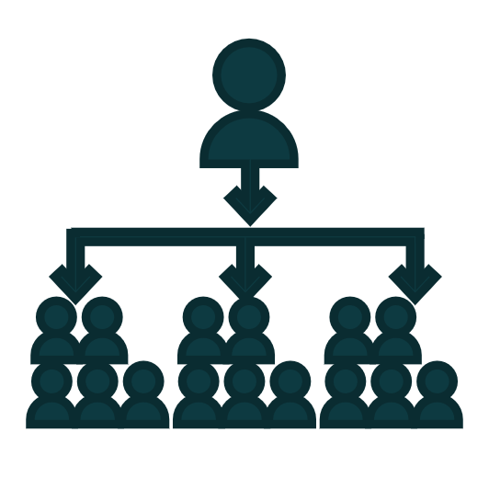
Holistic approach
Sentinel SIEM + SOAR
Public cloud
Third-party vendors
Threat-intelligence
Firewalls
Other services
Cloud resources
Microsoft Sentinel
Microsoft Sentinel
Microsoft Sentinel
Microsoft Sentinel
Microsoft Sentinel
Defender for Cloud
Defender 365 XDR
Phishing emails
Malicious link or file
Malware installation
Compromised identity
Access cloud apps
Data exfiltration
Defender for Office 365
Defender for Office 365
Defender for Endpoint
Defender for Identity
Defender for Cloud Apps
Defender for Cloud Apps
Identity Protection
Purview Data Loss Prevention
Lateral movement
Active Directory attacks
Defender for Identity
Defender for Identity

