Slide 1
Generative AI Security
Preventing Microsoft Copilot Exposure
August 2023
Notes:
Today’s topic is on Generative AI security and today we are going to deep dive into Microsoft co-pilot for M365 and how it relates to data security, exposure and exfiltration. There are lots of variants of co-pilot, such as Copilot for Power BI, Co-pilot for Github but we are going to focus on M365 copilot. I’m Richard Lander Stow, a Public Sector Sales Engineer here at Varonis. I’m a chartered IT professional and have been working for Varonis for the last 2 years. Prior to that I have spent the last 20 or so years of my career working in the UK public sector predominantly in Cyber Security. This has been, with both civilian departments and military organisations. I also work alongside local government, healthcare agencies and the larger educational establishments.

Slide 2
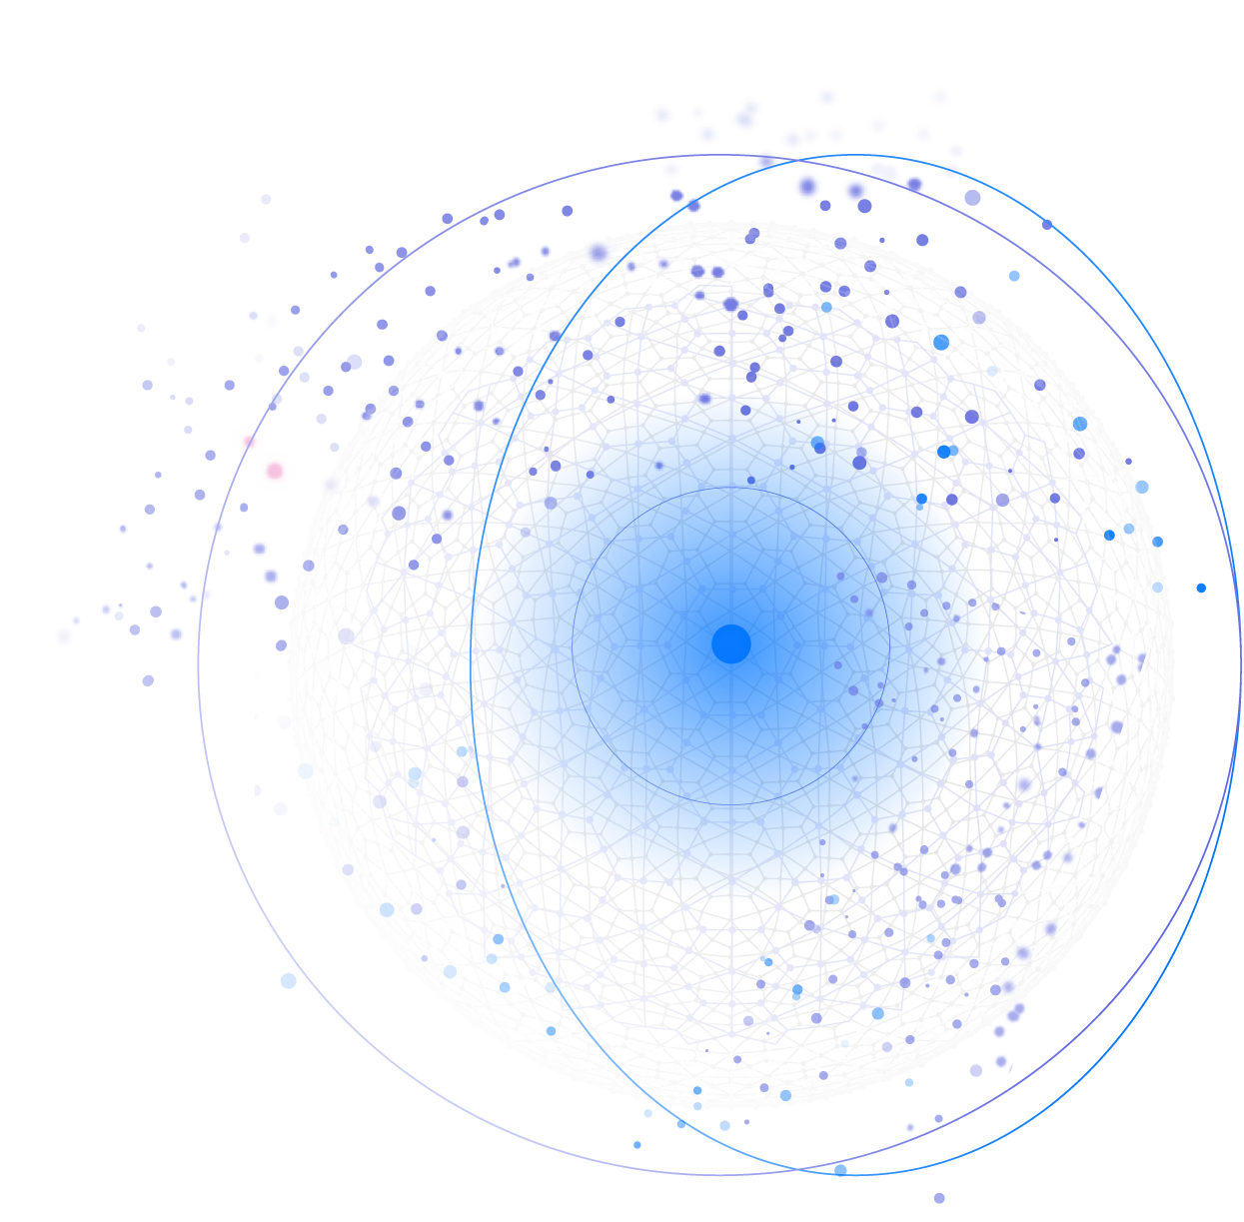
Agenda
The promise and risk of generative AI
How Copilot works
Microsoft’s security model
How to prepare for a safe rollout
Notes:
A quick look at the agenda. How do we want to handle questions etc?
I’ll start with an intro to co-pilot, then describe how Microsoft protect co-pilot. It’s in early access and I think now if using GPT4 for those that are familiar with Chat GPT and the various iterations of GPT.

Slide 3
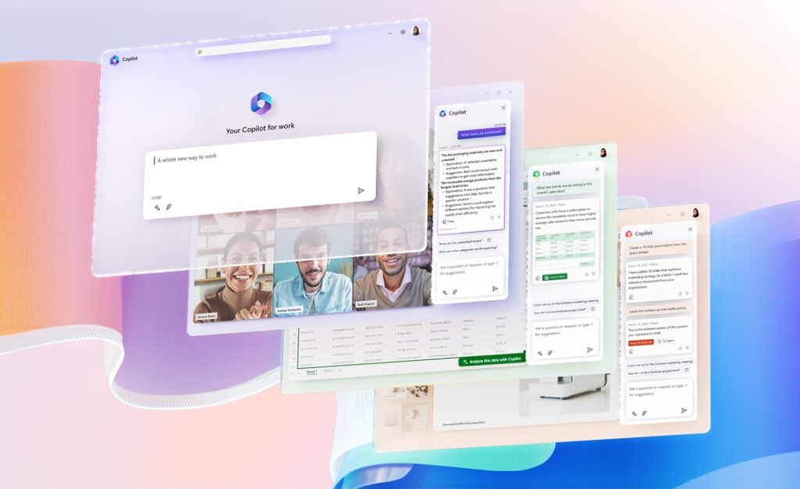
“The most powerful productivity tool on the planet.”
Notes:
https://www.youtube.com/watch?v=KtsVRCsdvoU
Microsoft co-pilot is being described as the most powerful productivity tool on the planet. If you’ve ever used gen-ai tools such as chat GPT, Bard and others you can probably see why it’s being called that. Imagine having Chat GPT built into all of your office apps like work and powerpoint, excel and teams. It doesn’t only have the benefit of open AI and the large language models they are developing but it’s also grounded in your business context. It has the benefit of learning you org as well. Think about the use cases that this unlocks.
Next slide

Slide 4









Use cases:
Copilot can join your Teams meetings and summarize the discussion in real time and capture action items
Copilot in Outlook can help you triage your inbox, prioritize emails, summarize threads, and generate replies for you
Copilot in Excel can analyze raw data and give you insights, trends, and suggestions
Microsoft 365 Copilot
Notes:
Here are a few more examples Microsoft gave during their launch event:
Copilot can join your Teams meetings, take notes and summarize in real time what's being discussed, capture action items, and tell you which questions were unresolved in the meeting. Not only does it transcribe the call, which is something a lot of other apps can do, but it will summarise it, create action items, create a new file based on that discussion
Copilot in Outlook can help you triage your inbox, prioritize emails, summarize threads, and generate replies for you.
Copilot in Excel can analyze raw data and give you insights, trends, and suggestions.
A big pain point now is having a lot of raw data in Excel that we are struggling to create pivot tables. You can ask co-pilot “what does this data mean?” “what are the trends?” What should I care about, what should I be thinking about.

Slide 5
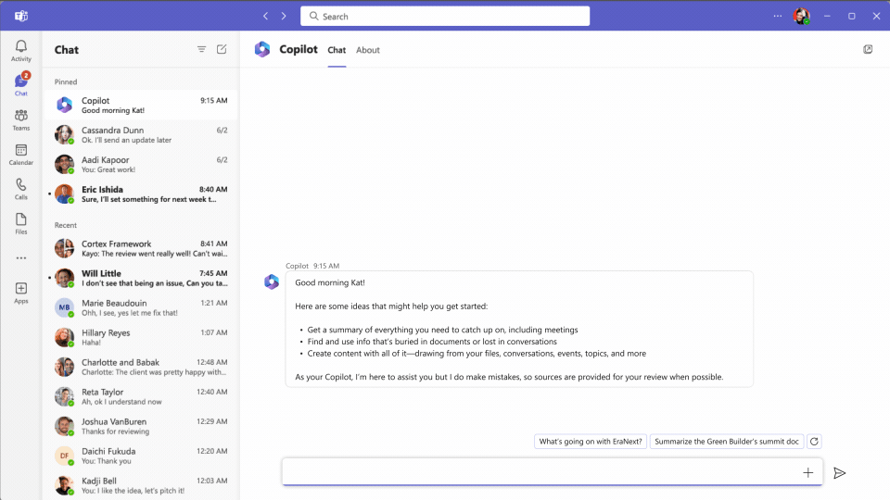
Notes:
All right, I took a couple animated gifts out of their launch event. Here's a situation where it's living in teams. And I can ask a simple question like Hey, what happened with the FABRIKAN account yesterday?
And it's gonna go through my emails, go through my calendar, go through my OneNote anything I have access to as a user, and try to give me a plain English answer to what happened with that account. Yesterday.

Slide 6
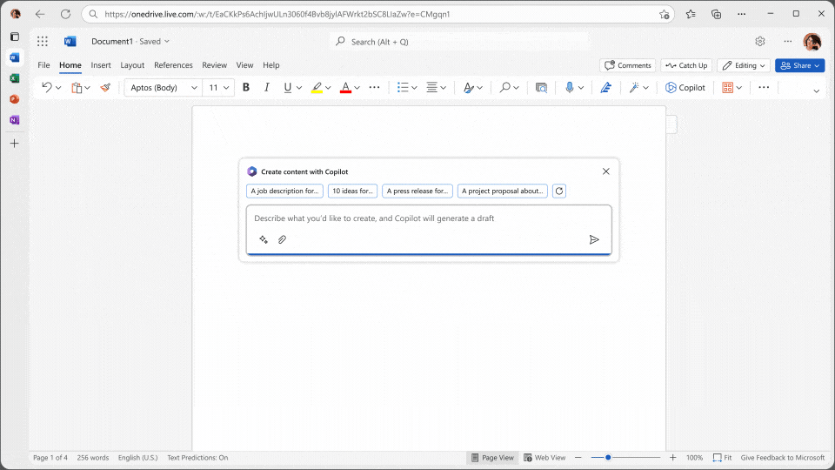
Notes:
Right. Another example, within Word, I want to create a proposal for this client based on the notes that I have. So I'm feeding co pilot. Some of the files I have access to my one note, a Word doc and it's going through it's creating a 25 page, net new Word document. And it's in the format that I want its proposal. So its ability to create net new data, I think is awesome. You know, might take me a week to do this now now copilots 35 seconds. But it's also a little bit scary. Right, Mike from a data security and data lifecycle management perspective, just how fast we can create new data.
We're taking things that usually would, you know, think about manual effort hours and hours of time, and condensing that in such a short period. So obviously, there's great productivity benefits, but I think when we get into some of the security things and you know, automating enumeration and discovery and potential data exfiltration we're also making it easier for nefarious purposes.
Just have a think. Is your company already allowing people to use generative AI tools? Not specifically co-pilot, are employees allowed to use Chat GPT, Google Bard, Dhalli? Just because it's so new, and I think companies haven't fully wrap their hands around. What it means. And so you know, a user opening up a browser and typing in you know, bard.google.com I don't think a lot of companies are blocking it.

Slide 7
How Copilot works
Notes:
Now let's get into the technical inner workings of how Microsoft's AI works.

Slide 8
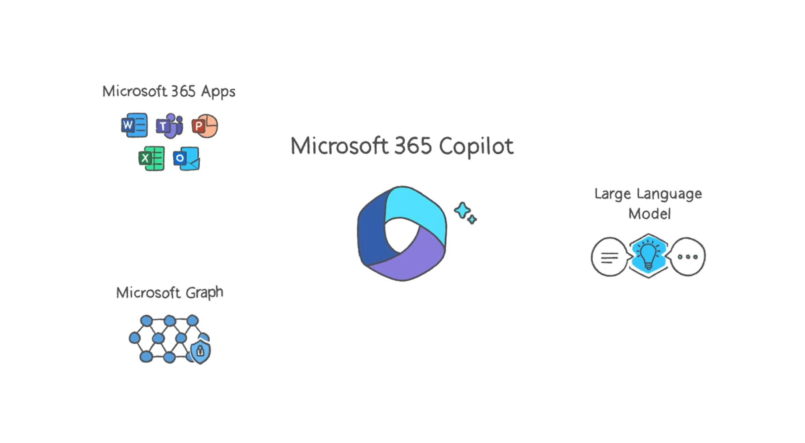
Notes:
Copilot works using 3 key components:
Your Microsoft Office Apps,
The Microsoft Graph, which is all your content and context from emails, files, chats and more.
And a Large Language Model capable of parsing and producing human readable text.
This is how co pilot works. So we have this nice diagram and walk you through it. So as you just saw from an end user perspective, co pilots got to live with inside live inside these M 365 apps. It'll be like if you remember Clippy in the old days sitting there right in the app itself.

Slide 9
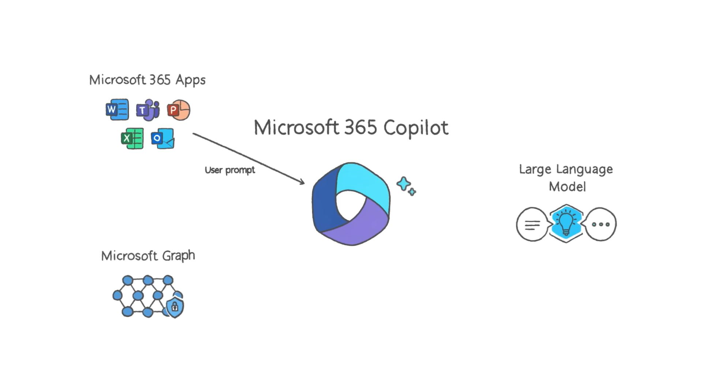
Notes:
It starts with a user making a prompt via an Office App
And you can type to it just like you would chat GBT. It's a prompt based AI, at least for now. There will be some image based AI later. But you asked a question in natural language in plain English, say, you know, hey, co pilot. How many constituents do we have? Right?

Slide 10
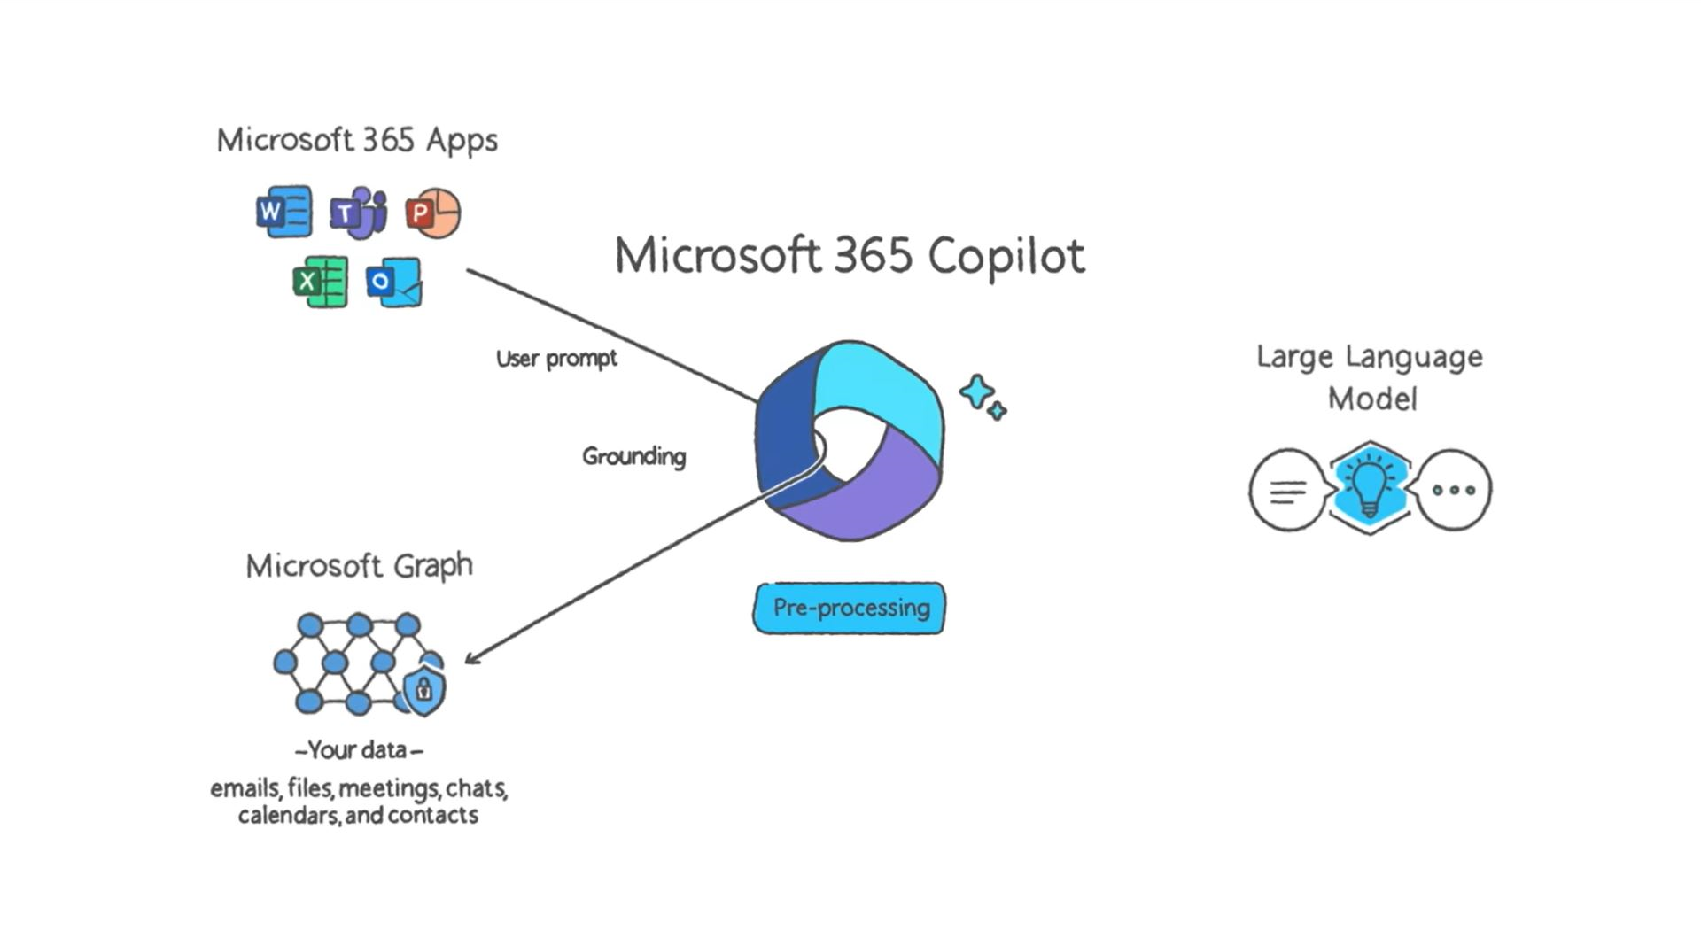
Notes:
Copilot pre-processes the prompt in a process they call Grounding, which basically searches all of your content and context in the Graph to enhance and improve the quality of the prompt to help deliver answers that are relevant and actionable.
Whatever the question might be. It's going to pass that prompt to the Microsoft Graph and do something called a grounding call, essentially a pre processing grounding call. And think about grounding as grounding your query and your business context.
If I ask a general AI, if I go to Chat GPT and say, What's new in London, then is going to tell me a general answer about what's going on with London based on public information it can read. But if I say what's going on with London, here in my Borough’s Co-Pilot, that answer is going to be grounded in all the information that is relevant to my Borough and based on my borough’s relationship with London. So think about grounding as grounding it in your business context.
This is powered by Microsoft Graph, which is the same thing that powers things like Delve and empowers so many other apps within the Microsoft 365 ecosystem. One thing I want to mention here is that Co-Pilot for M365 uses the user's permissions, so if I'm making the query, when it crawls the graph to gather data, gather email files, meetings and chats. It's using my personal permissions.
It’s going to take into account everything that I have access to in microsoft 365. And that’s a double edged sword. There's a boundary there in the sense that I'm not going to be able to query things that I shouldn't have access to and are outside of my purview. In my role. The other side of that being, most users are going to have access to data that they don't need and maybe are completely unaware that they have access to. We've seen this to an extent with for example, delve in the past people have often been found poking around Delve and seeing what type of content they have access to across their organisation. But this is even a more advanced version of that same concept and more data is going to be exposed as a result.

Slide 11
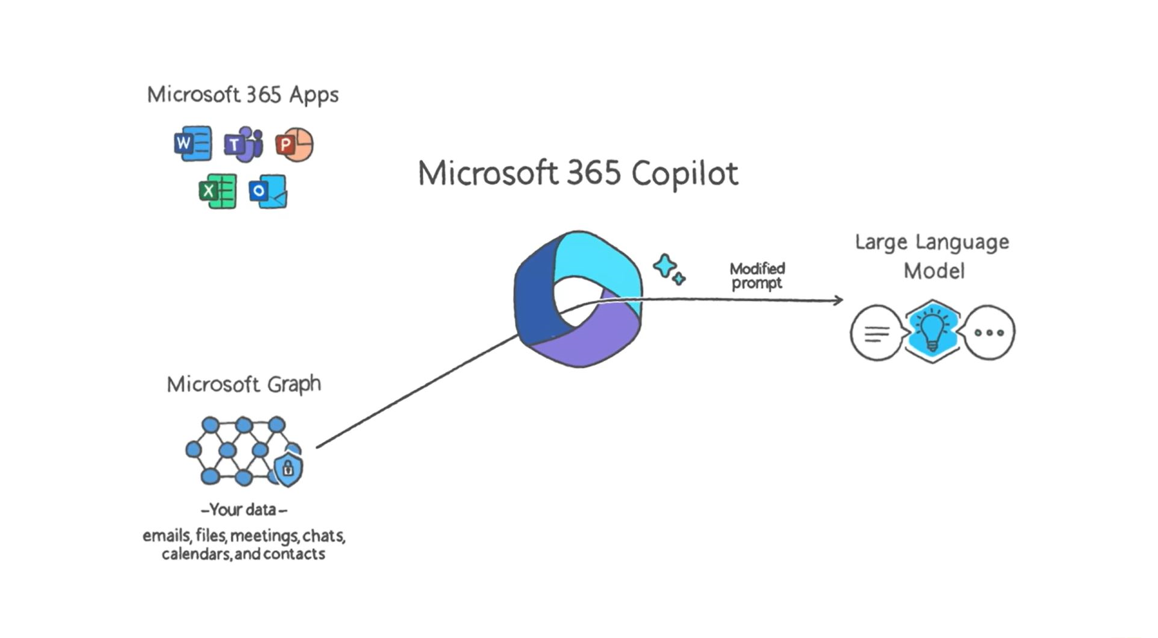
Notes:
Copilot then sends the modified prompt to the LLM, much like you would put a question or task to Chat GPT.
So after it does that pre processing grounding call to gather this context from the data you can access? It's going to augment that prompt where enrich that prompt and that's when it's going to send that modified prompt to the LLM. And the LLM that it uses is something called Azure open AI. And I'll talk a minute about how Azure open AI is different than open AI, the company and the model that you know like the creators of GQ. GPT, three GPT, four and all these other models.

Slide 12
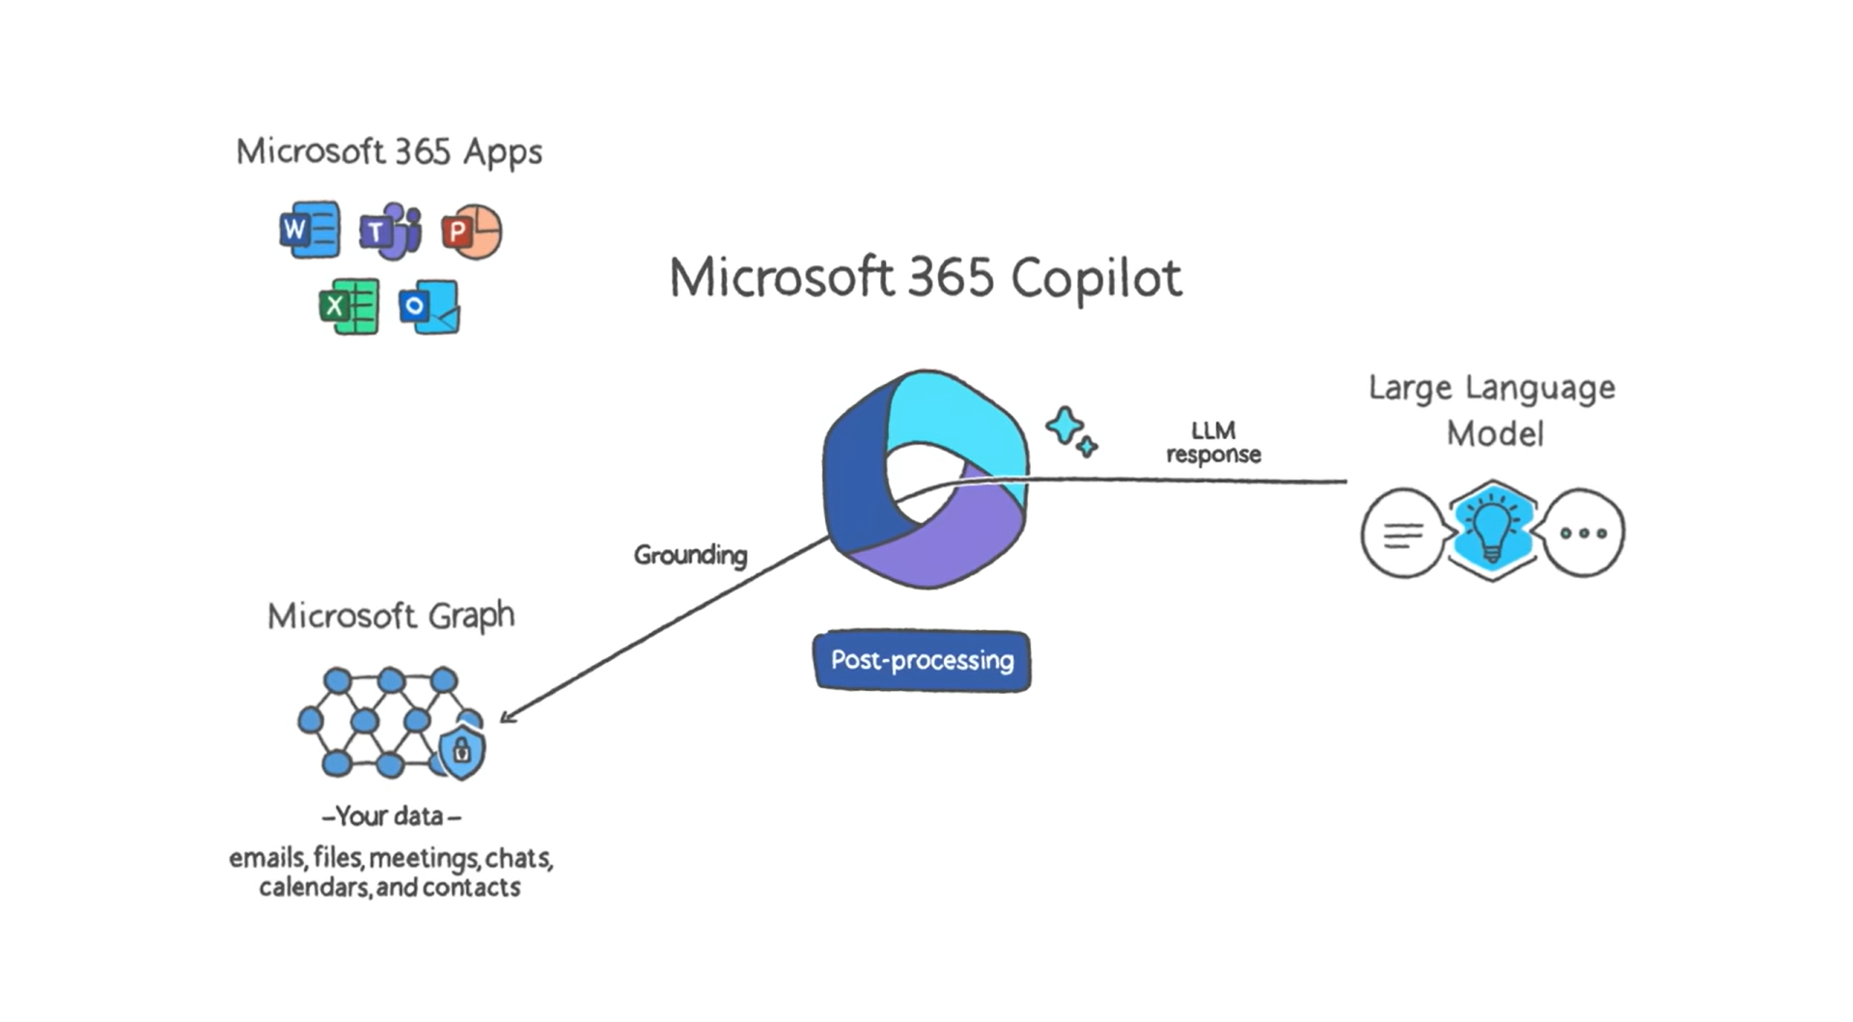
Notes:
Copilot then takes the response output from the LLM (similar to a GPT response) and does post-processing, which involves another round of grounding in the MS Graph for your content and context and some responsible AI checks as well as command generation (e.g. create a draft summary).

Slide 13
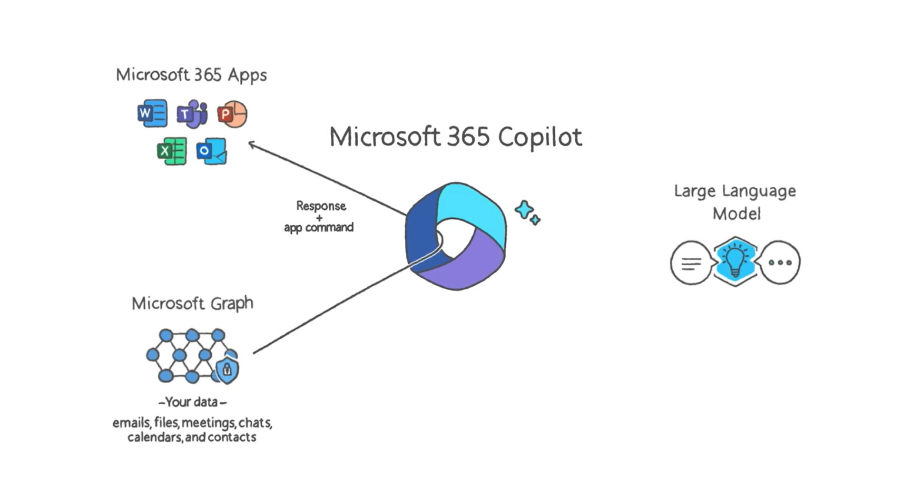
Notes:
Finally, Copilot sents a response back to the user, and commands back to the Office Apps.
It's going to generate a response the LLM is it's going to it's going to generate a response and send it back to the user in form of maybe a textual response but it can also execute commands right and can also create pivot tables you can create net new files you can do a bunch of automation. So that's something to consider as well.

Slide 14
Some quick AI concepts
Grounding call – giving the LLM use-case specific information not related to its training
Semantic index – a map of data and relationships that glue related concepts together
RAI – responsible AI
Model poisoning – intentionally manipulating training data to compromise a model’s accuracy, performance, or security
Hallucination – when an LLM confidently presents a response the seems reasonable but is not accurate based on the context
Notes:
So I mentioned what the grounding call is. There's another term called semantic index. And that's basically a map of the relationships between the users and the data and the concepts within your company that Microsoft has built and stores within the Microsoft Graph.
Model poisoning in particular kind of really piques my interest from a security perspective. If we have a malicious insider, or could be an external attacker, and, there's all sorts of threat actor groups that aren't always after ransomware. Sometimes they're just trying to do damage to an organisation. And this is a new avenue where I might be able to be generating content for the sole purpose of throwing off what our general AI is doing internally. So when other other members of my organisation are trying to do stuff in good faith. I've really sabotaged their efforts there by putting bad data into the system.
You kind of think about it as like intentionally brainwashing, the the LLM because, again, it's going to learn based on training data provided and if users are intentionally feeding it, false information to get it to do something incorrect. That is certainly a threat vector that we have to be careful about
Hallucination is you know, similar concept in the sense that we're getting bad results, and the response seems reasonable. But it's kind of misinterpreted, right? At the end of the day, this is a machine not a human making these decisions that are generating this AI content. So we can end up with responses that on first glance seem legitimate but under deeper scrutiny or inaccurate things are misinterpreted. The wrong context is applied. And we wind up with a response that really does not meet our goals of having an accurate response to our prompt.
. And then we'll talk more about the human factor and then need to be not get lazy with just assuming that the content generated by your GPT or co pilot specifically is going to be good enough to like press send on before you've reviewed it yourself for accuracy or safety and security.

Slide 15

Microsoft’s relationship with Open AI
Invested $10B+ in OpenAI
Azure OpenAI, which powers Copilot, is a private instance that OpenAI cannot access
Azure OpenAI wraps models such as GPT-4 and DALL-E with a security promise from Microsoft
Notes:
So the AI, the large language model, that compiler uses is called Azure Open AI.
Microsoft's relation ship to open AI the company, Sam Altman's Endeavour is a little bit fuzzy, they've invested $10 million plus in open AI they own I believe 49% So they don't have a controlling stake but they are certainly influential.
Think of Azure AI as a wrapper around the models that the open AI team developed such as GPT 4 and DALL-E with, as Microsoft says, the promise of Microsoft security built in.
So whereas the general open AI that you can use, you know and pay for doesn't have these added protections,
Microsoft is adding sort of the safety layers like responsible AI checks, and obviously, it's able to give you the rounding benefits. And I think it's important to know that your data, which we'll go over in a second does not train people when AI does not have access to your data, if you're using copilot and here's some of the models that open AI or Azure open AI rather has access to today, DALL-E which is you may or may not know the DALL-E model is the one that can be used to generate images from natural language. You could say a create me an image of a dog surfing or something like that and it'll go and just generate you like five different images.
Just speaking for myself, I'm excited about the promise. I think a big thing for me is that ability to join like a team chat you know a lot of my time is spent in meetings with our clients and I try my best to take notes but I'm also doing my own talking and things so having that summary of meetings with our clients so I can make sure we have appropriate action items.
Anything that can help me focus and respond to emails, or analyse data focused risk information to help my customers will certainly help, particularly if it can help me report on that too based on previous presentations and reports that I personally have created.

Slide 16
What’s Microsoft’s security plan?
Notes:
so let's talk about Microsoft security plan. So. So Microsoft does this big launch event. They go through all these cool use cases, from an end user perspective. They get business users super excited that their life is gonna get much easier. They don't have to do any of these mundane tasks like data crunching and compiling data and building proposals. They're stoked, they're like, when can we get it? And the security teams, you know, folks like you, Mike are like, wait a minute, I need to understand how this works. What is Microsoft's plan to make sure that if I allow this, then I'm not going to get breached. I'm not going to introduce new threat vectors. And so let's go through what Microsoft's plan is.

Slide 17
The good news
Tenant isolation
Training boundaries
Responsibility checks
Microsoft 365 Copilot
Notes:
I separated this into the good news and the bad news. We did a lot of research into what Microsoft’s plan is. So couple of great things tenant isolation. Talk about that in a second. Training boundaries and responsibility checks. So this is the good news. Let's do that first.
So lets start with tenant isolation.

Slide 18
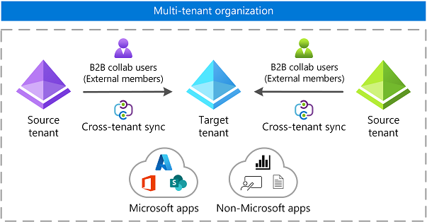
Tenant isolation
Copilot only uses data from the current user's M365 tenant.
The AI tool will not surface data from other tenants that the user may be a guest, in nor any tenants that might be set up with cross-tenant sync.
Notes:
SO, you can only access data from your parent tenant, which I think is really, really important. Because this is the first question that came to my mind when I started learning about their security model. As they are rolling out to big organisations I seem to have, that have a big collaboration presence, they have a lot of guests users that they invited the organisation that for all intensive purposes, with the way in 365 functions, they're part of that environment right there. By being a guest user they have essentially have an account in Azure Active Directory. They can be members of teams groups. But Microsoft through co pilot has prevented those types of users from accessing data and the environment that they're a guest in. This is a good thing for security. I'm glad they made this decision. It's not an easy decision to make the same multi tenant organisations are not going to be able to cross collaborate could be a limiting factor for some large multi tenant organisations, but I think it's important that they drew this line in the sand to say, hey, we're going to keep you within your tenant, even if you have this b2b relationship. And it doesn't matter…. you can only query the data that you are a member of directly.
Unknown 16:59
I’m not sure if this impacts the folk here but this does give significant challenges in a merges and acquisition situation.
Yeah, but the biggest frightening thing I think they've mitigated which is guest users having access to co-pilot. and previously they'd have to really be sophisticated to go and find information to steal. But with co-pilot if they could just ask a question, and syntax and you know, they don't need to know PowerShell scripting. They don't have to be developers, engineers. They don't need hacking tools to go out and discover information. They could just say, hey, find me all of the bonus information for Varoniss employees, right? Like, it just removes a hurdle of technical sophistication to do damage. And if you've got guests having access to this, it would be a little bit of a third party risk issue.

Slide 19
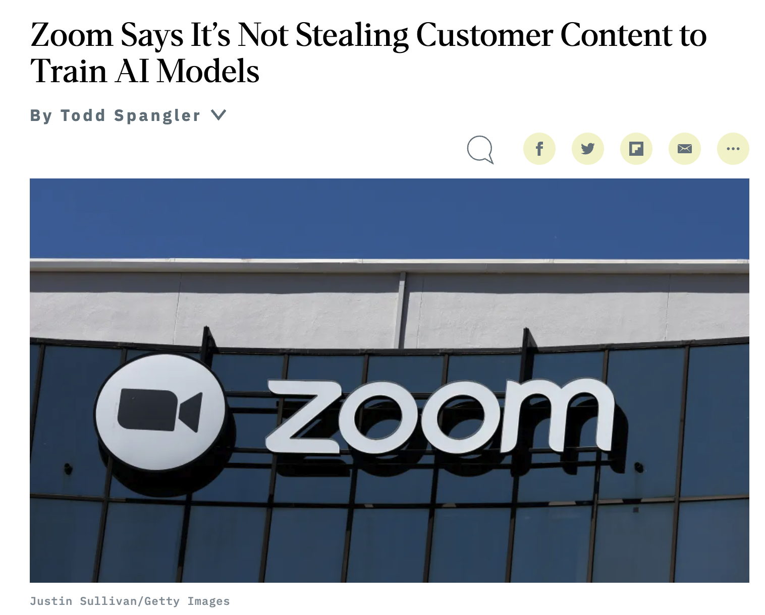
Training boundaries
Copilot does not use any of your business data to train the foundational LLMs that Copilot uses for all tenants.
You shouldn't have to worry about your proprietary data showing up in responses to other users in other tenants.
Notes:
Another good thing this is a great thing. I know zoom has been picked on about this, but training boundaries. So copilot does not use any of your business data to train its LLM. So those enriched prompts that contain your business context, your emails, your chats. Your contacts. I mean it's going to the Azure open AI service to generate you a response. It is not training that LLM or the LLM is not benefiting and it cannot use that information to go and inform and improve responses for other tenants. So it's within your tenant boundary.
It’s doing the kind of that processing locally, so to speak. I know it's not really locally but locally within your tenants, at least as far as the you know, the data that is being queried so that's not getting fed back up and there's not going to learn and know more about your corporate finances, for example, to share with everyone and 365 customer who's trying to leverage so if I go say, Tell me everything you know about Varonis, you know, they're not going to get our data. There's no way you know about for us.
Yeah, so the benefit of that training on the Varonis business is that it stays within theVaronis walls. Unlike with Zoom, if you're not familiar with this story, the Zoom got called out for saying that it has the right to use all of its customers data to train its LLM. And you know, that scared a lot of people out because there's some sensitive conversations that happen within zooms right so to know that that data is crossing a boundary and that they can benefit from it just because you know you sign an agreement they become their customer could be could be super concerning. I think they rolled that decision back but I haven't been following the story of that closely, but it is something to be aware of when we're doing business with with with organisations that have AI based tools.

Slide 20
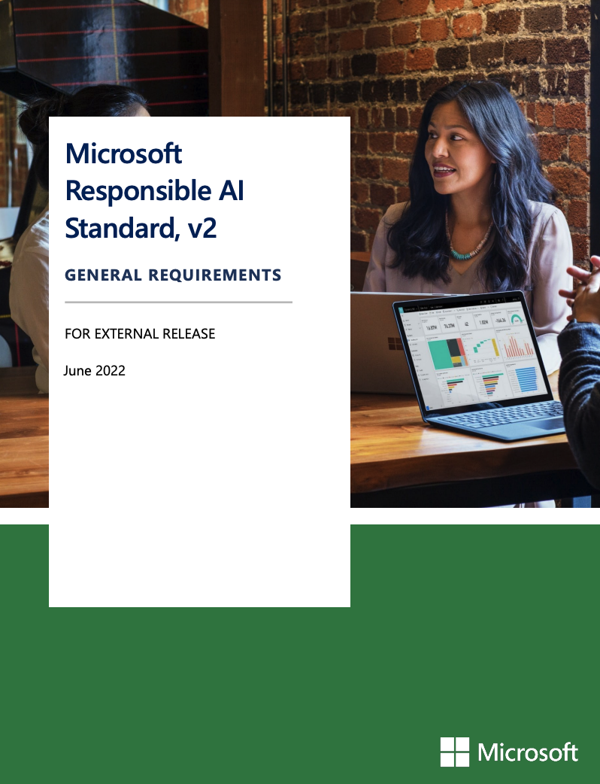
Responsible AI checks
Microsoft outlines six key principles for responsible AI:
  Accountability
  Inclusiveness
  Reliability and safety
  Fairness
  Transparency
  Privacy and security
Notes:
The third thing, the third Good thing I thought was that it's performing these responsibility checks there's a whole white paper that they wrote on what they consider to be responsible AI.
There's a lot of concerns about, you know, letting this genie out of the bottle and what AI can do. And so Microsoft has the six key principles. They say that they're going to try to make sure that they responsibly develop, not go too fast. They're gonna make sure that their AI is fair, transparent. Obviously privacy and security is top of mind, but I really like this, but it seems a little fluffy to me. I'm not sure exactly what Microsoft is doing behind the scenes. Is it going to suppress information in a response because it doesn't think it's fair? Possibly, but it'll be hard to tell until it is being used more widely.
Transparency is great for example, but it stops somewhere, right? They know, they’re never going to let us see inside the black box to understand how this all works, transparency only goes so far.
You can even have an LLM writing and creating new LLM. So how do you how do you ask an LLM to be transparent about the LLM that are created becomes this big Russian doll like nesting situation.
In other Ais you have things like Einstein, an expensive component of Salesforce, which you have to opt-out of.

Slide 21
The bad news
Permissions
Labels
Humans
Microsoft 365 Copilot
Notes:
Let’s go through the bad.
We work alongside M365 every day. Varonis for M365 Is a product line and we do a lot of permissions analyss

Slide 22
Typical M365 Exposure Levels: Unsafe for Copilot
Notes:
This is data from an anonomised tenant.
People have access to too much information.
Since co-pilot has access to user permissions it will also have access to too much data.
A big part of my job is doing these risk assessments with a large variety of organisaions.
One thing every org has in common is the huge spike in org-wide access.
A lot of people focus on anyone, external and guest. We regularly find public teams sites, public sharing created before it was locked down, or an area that was missed e..g OD. There are dynamic access groups that don’t require approval.
Microsoft really put the responsibility onto you to make sure you are in control of your permissions and that you are enforcing a least privilege model internally.
This is a day 1 risk, the moment you turn it on it is going to be using the graph and will see everything you have access to. Whereas model poisoning takes time to build out

Slide 23
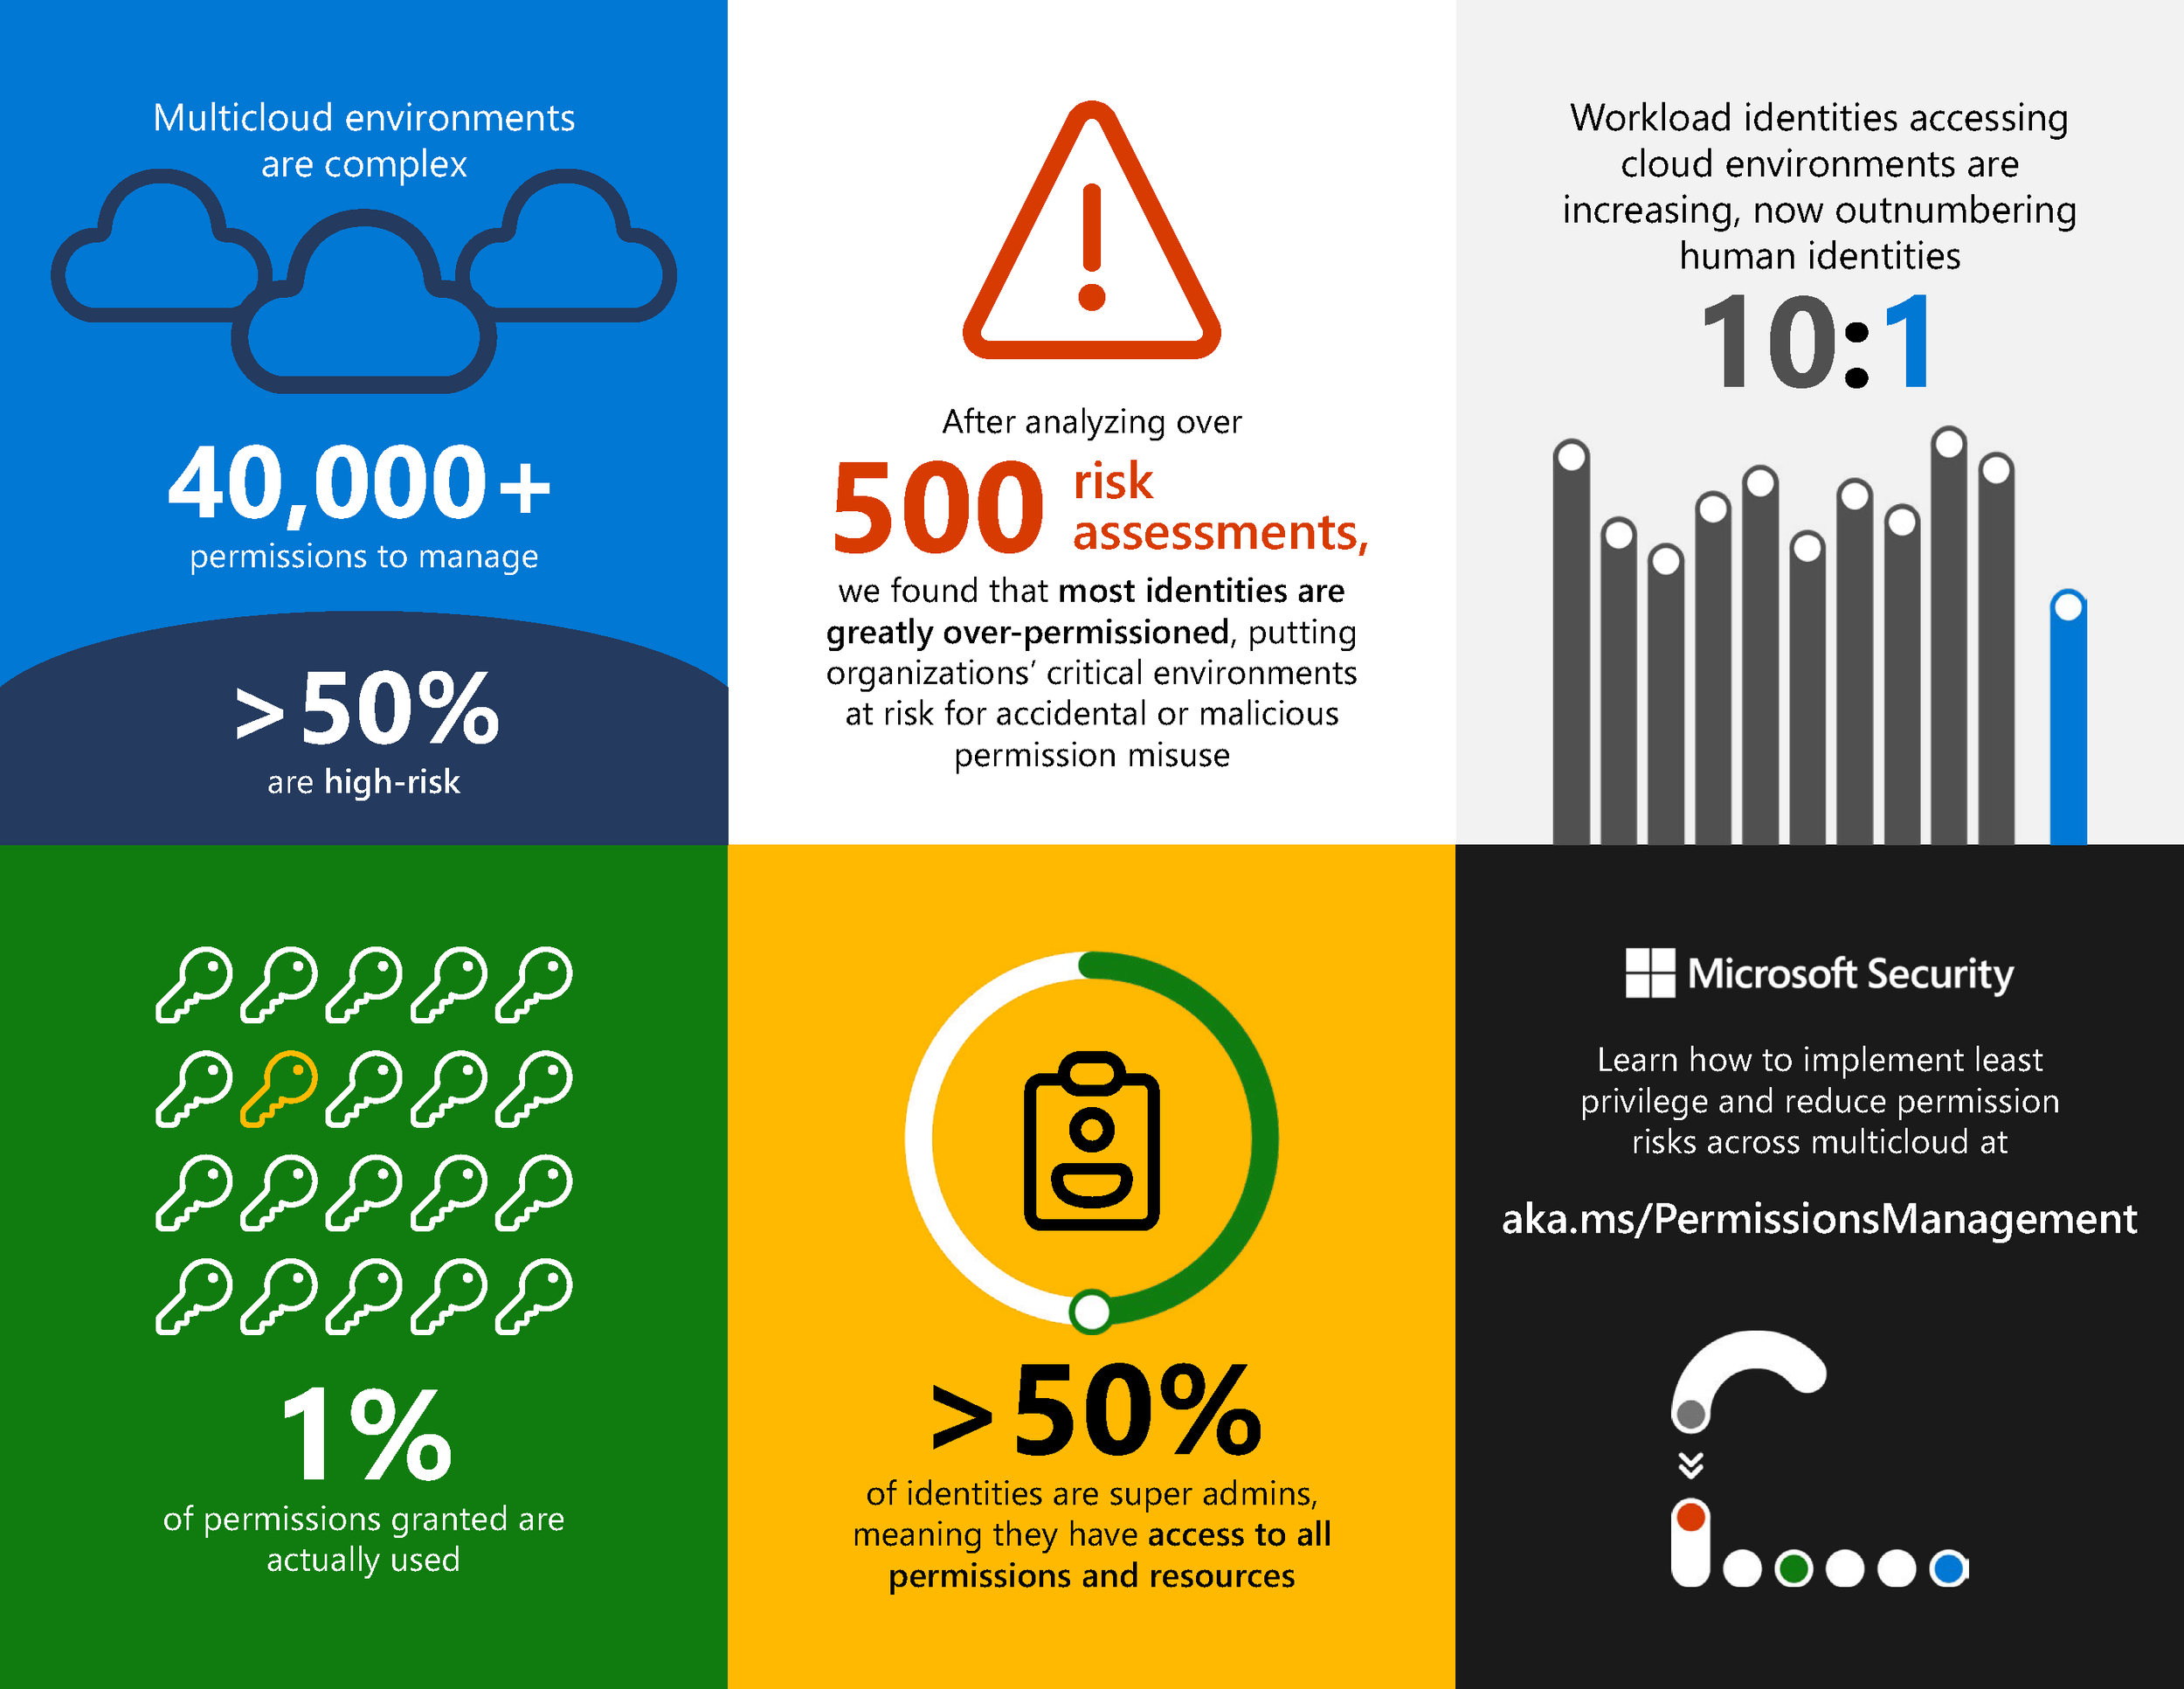
Microsoft’s Cloud Permissions Report
Most identities are greatly over permissioned
More than half of permissions are high risk
99% of user permissions are unused
Notes:
And even Microsoft, who say one hand they recommend Copilot needs good access controls to ensure security and privacy of the data that’s used to generate net new content.
On the other hand they’re also saying that their assessment of M365 tenants shows the exact same problem we’ve been highlighting and talking about for years.
Only 1% of permissions granted are actually used.
Think about the ephemeral nature of link sharing.
Permissions creep is something we report on and manage every day.
Don’t worry you have control over what Co-Pilot can access…..we have ACLs but we gave the keys over to the users. It’s not like the old days when I’m managing an AD group. Microsoft is giving us the permissions management tool, but the users can create these links.

Slide 24
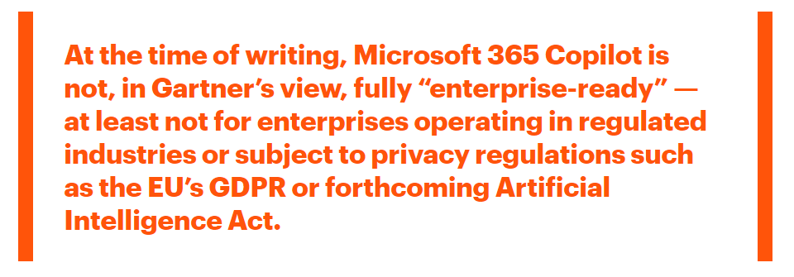
What does Gartner think?
Gartner Blog – 31 May 2023
Source: https://blogs.gartner.com/avivah-litan/2023/05/31/how-to-make-microsoft-365-copilot-enterprise-ready-from-a-security-and-risk-perspective/
Notes:
Gartner as well as Forrester have raised concerns about the readiness of Copilot for business in the typical state that they run with more permissions and data than they really need access to.
This is a snippet from Gartner, and Forrester are also doing some really cool research on it.
Known repositories of data.
Prompt engineering problems. Re-wording your prompt to work around AI limitations.

Slide 25
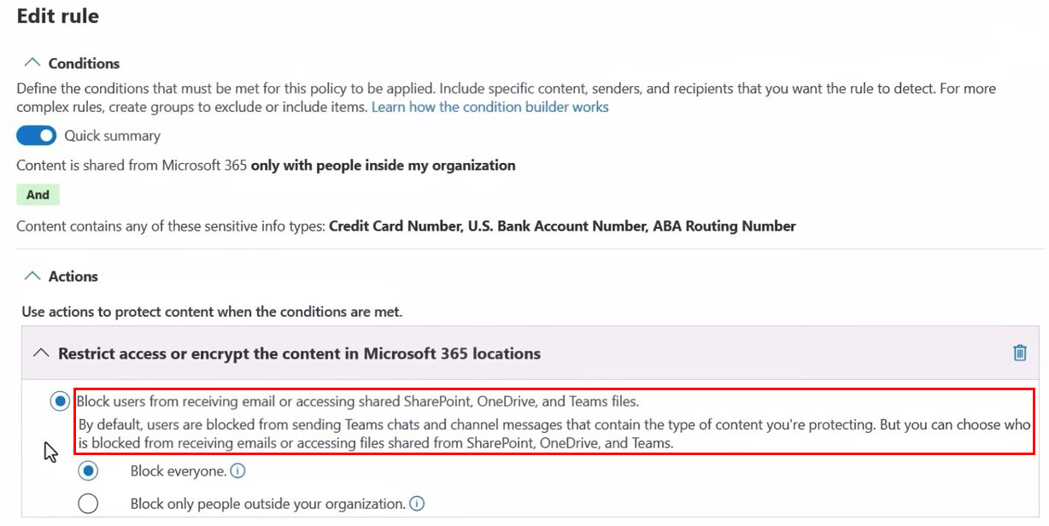
Labels
New content generated from labelled content does not have a label applied to it.
Microsoft’s answer?
Set a block or encrypt policy on any labelled content you don’t want Copilot to see.
Notes:
Labels save the day!! Think about Official Sensitive. Labels become very heavy handed.
When we know thousands of files are being generated each week, it makes me wonder just how practical and scalable that sort of recommendation is.
Without the block policy applied to a label, then any labelled files a user has access to will be used by copilot to generate content.
More, content generated from labelled files will not have any labels applied to it, which introduces more risk to the business and breaks the classification policy of an organisation.
How do you block certain information from getting to co-pilot?
DLP often configured in audit mode.

Slide 26
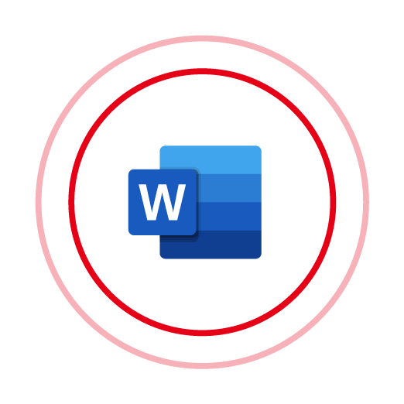
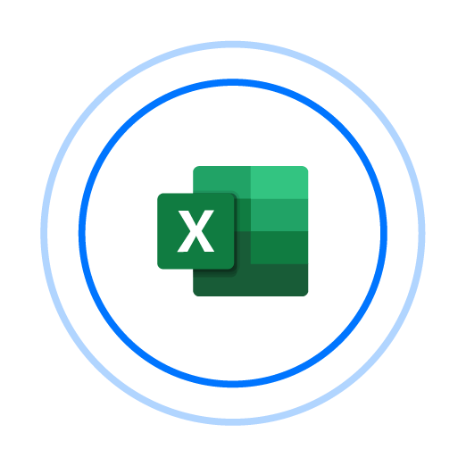
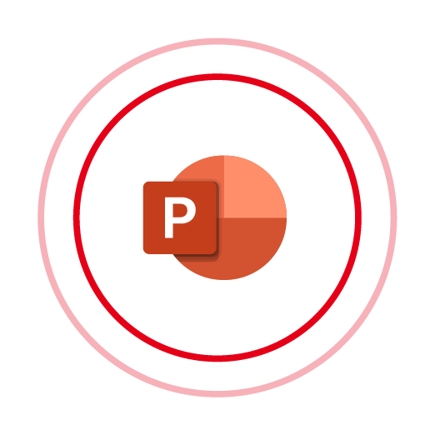
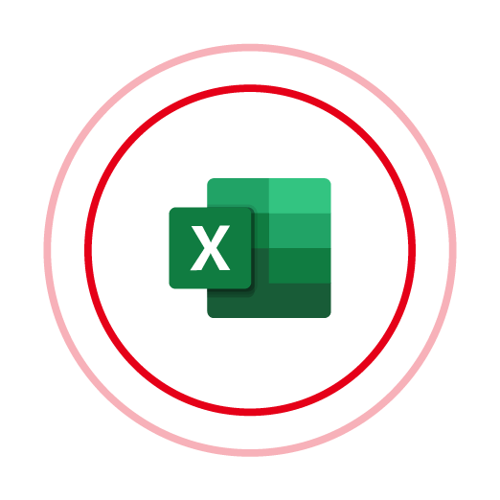



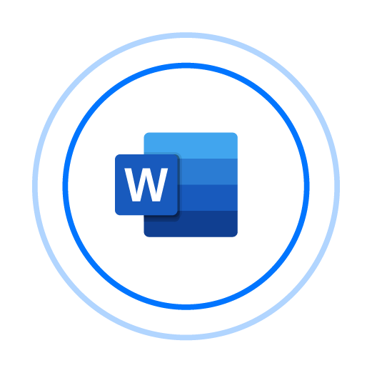
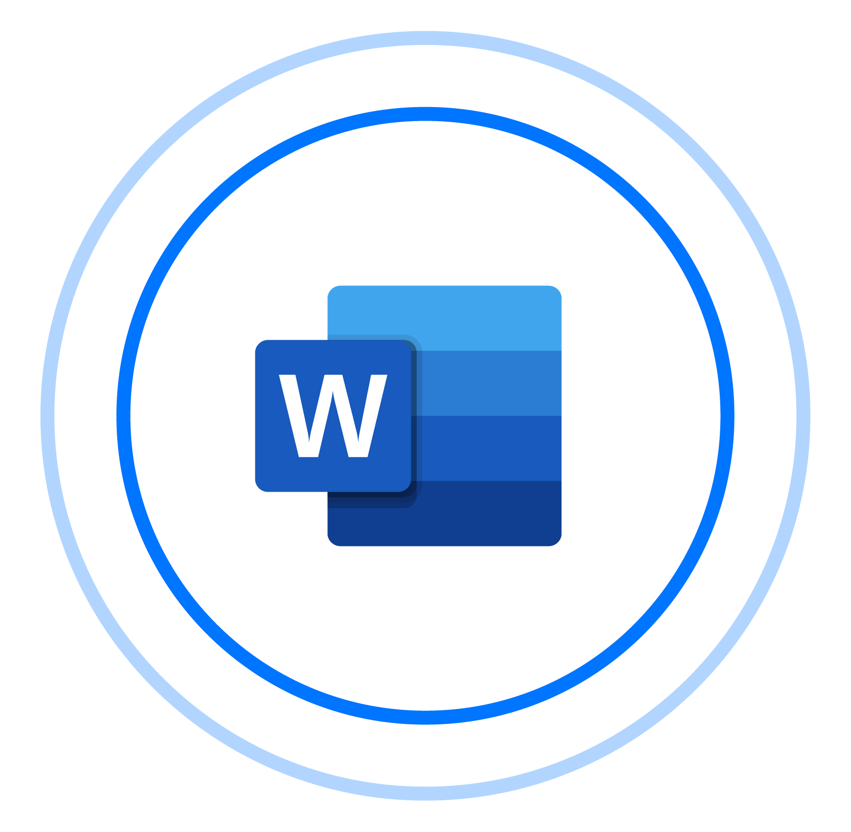

DLP works like magic? ✨
DLP

Slide 27




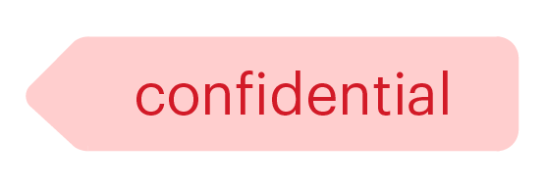

I wouldn’t bet my business on it.
Files are frequently labeled incorrectly or not at all
Without accurate labels, there are no controls
Even if it was perfect, DLP can’t be the only preventive control
Notes:
Varonis makes DLP work
We can identify files with missing or incorrect labels
With DCL we can add or fix a label
DCL will be available in SaaS in H2

Slide 28
A copilot for insider threats?
Notes:
We’ve all seen how Copilot can efficiently generate us new content, so let’s consider this scenario.
A Malicious insider (or a hacker who’s compromised targeted account), uses Copilot to collate, sort and itemize all the sensitive, financial and personal data my account has access to and generate it into a new word document with appropriate sections...
Even if those source files are labelled confidential and would be blocked by the DLP, this new document that Copilot has helpfully and efficiently built for the attacker will not be labelled and can now easily be taken out of the business and breached.

Slide 29
Preparing for a safe Copilot rollout

Slide 30
Varonis sets you up for Copilot success
Automatically enforces least privilege by removing excessive permissions and sharing links
Automatically fix incorrect or missing labels – on data generated by humans or AI
Ensures downstream controls like encryption and DLP work
Monitor data and alert on abnormal behavior

Slide 31






Varonis automates data security outcomes
Sensitivity
Real-time visibility of AI-generated data
Permissions
Reduce AI’s blast radius
Alert on suspicious behavior
Activity
Enable downstream DLP

Slide 32
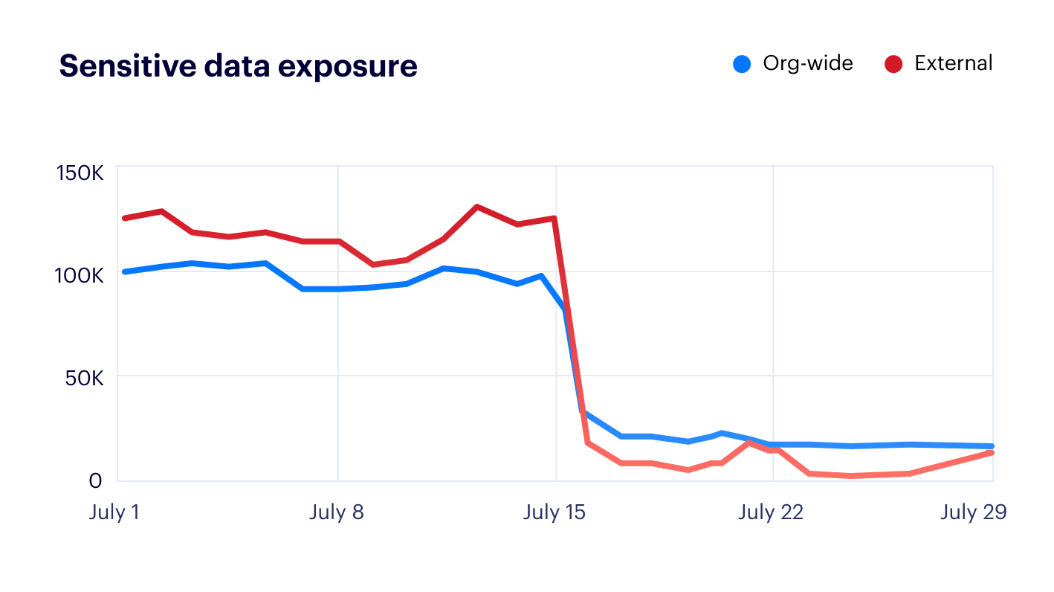



Results from a recent Varonis customer
Automatically eliminated nearly 100% of external and org-wide data exposure in their first 90 days.
CONTINUOUS DATA MONITORING
2 insider threats stopped
RESOURCES CLASSIFIED
0
2.2M
MISCONFIGURATIONS FIXED
34
0

Slide 33
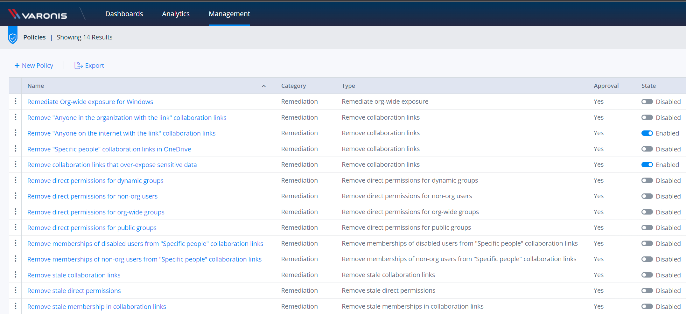
Policy-Based Automation Delivers Copilot Readiness
Notes:
It takes a robot to challenge a robot… automating the self-healing of your M365 exposure from day-to-day activities allows your business to not just be ready for Copilot but sustain safe Copilot use as higher volumes of are net-new data are generated and shared daily.
Our activity, permission and content-sensitivity analytics makes this a seamless process of cleaning out the stale and over-permissive access without impacting the business.

Slide 34
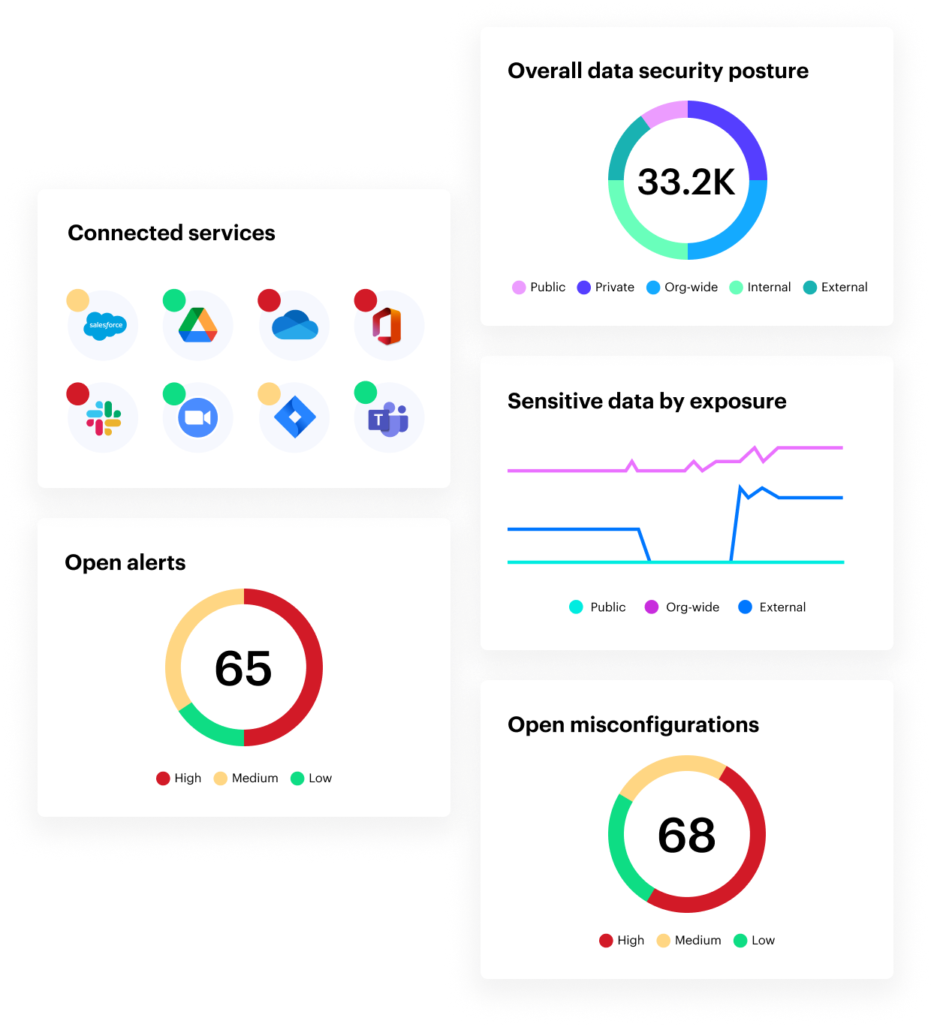
How we start:
Free risk assessment
Map key data stores
Prioritize risks
Enable full platform access
Analyze permissions, identities, configurations
Discover & classify data
  Exposed sensitive data, shared links, rogue admins
  Active Directory & SaaS configuration risks
  Compliance gaps
Monitor data usage
Assign IR team
  Enable activity
  Enable meaningful, high-fidelity alerts
  Accelerate Investigations
  Introduce dedicated IR analyst
  Optimize alerts as-needed
  Notify you of any suspicious activity

