Slide 1
Secure Everything You Build and Run in the Cloud

Slide 2
Common challenges securing cloud
Visibility
Multi-cloud
Noise
Prioritisation
Automating compliance
Shifting left so security isn’t the blocker for cloud innovation
Consolidation through a single pane of glass

Slide 3
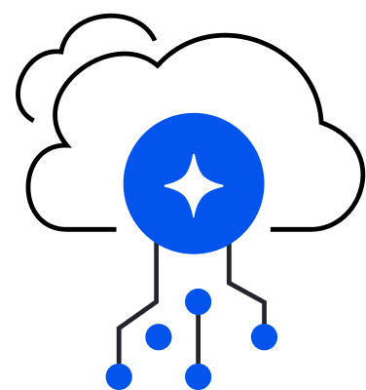
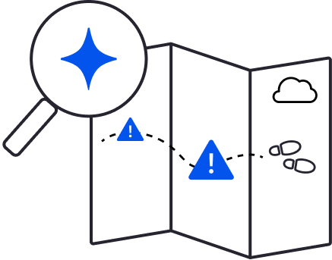
Cloud changes everything
New environment
New risks
New ownership model
How do I get visibility into my environment?
How do I prioritize the real risks and eliminate the noise?
How do I ingrain security into our teams?
Notes:
First of all, it changes everything about the environment you are protecting. - Starting from the environment ownership which is now decentralized. This is really at the core of the challenge. With cloud, each developer makes their own choices. If AWS just added a cool new managed DB service, sure – I’ll try that. - Rapid innovation - the speed cloud enables for building services is insane. Because you can use so many things, because I don’t need to build my own services and software gets shipped faster that ever before. So you end up with an environment that is: multi-cloud, Multi-architecture with many abstraction layers and services. IaaS, PaaS, containerized applications, serverless applications, and Hundreds or thousands of technologies
As a security team, it makes it really hard to even get visibility into that ever changing environment and nothing showed that better than Log4Shell where teams scrambled to even identify it across their environment.
Second it changes the risks:
Exposure is really simple –In cloud, everything is born with a public IP – it’s in the cloud! Exposure is a click of a button away. - Risk is complex – At the same time, finding exploitable attack vectors is really difficult because attack paths now exist that are combinations of risks like misconfigurations and excessive permissions that enablement lateral movement to a crown jewel. - Unprecedented velocity and scale of attacks - Exposure to breach in hours – Wiz research has shown that PII in a public bucket can go from exposed to a breach in under 8 hours.
Take for example, the fact that we hear weekly about a customer database being exposed. That really underscores how hard it is to find those risks before the attackers do. As security teams, it also means it’s harder than ever before to prioritize the real risks and eliminate the noise of alerts that don’t matter.
Finally, it changes the process and ownership: - Devs owns their own infrastructure and each team chooses and deploys its own tech - A centralized architecture choice from the security team quickly becomes obsolete if you don’t have the buy in of your cloud teams.
This makes it difficult for security teams to ingrain a culture or knowledge of security into these decentralized teams.
Pause

Slide 4
Why is it so hard to find critical risks in the cloud?
Complex environment
Complex risk
Complex to operationalize
Multiple clouds
AWS, Azure, Google, OCI, Kubernetes
Effective internet exposure
What is effectively exposed to the internet?
Lack of visibility
No complete picture of the cloud environment
Multiple architectures
VMs, containers, serverless, PaaS
Vulnerabilities & misconfigurations
What risks make resources vulnerable?
Complex suite of tools
Fragmented across 5+ tools, agents & sidecars
Thousands of technologies
Growing # of services, applications, libraries
Lateral movement
What is the effective internal access?
Lengthy time to resolve
Development, DevOps, business units

Slide 5
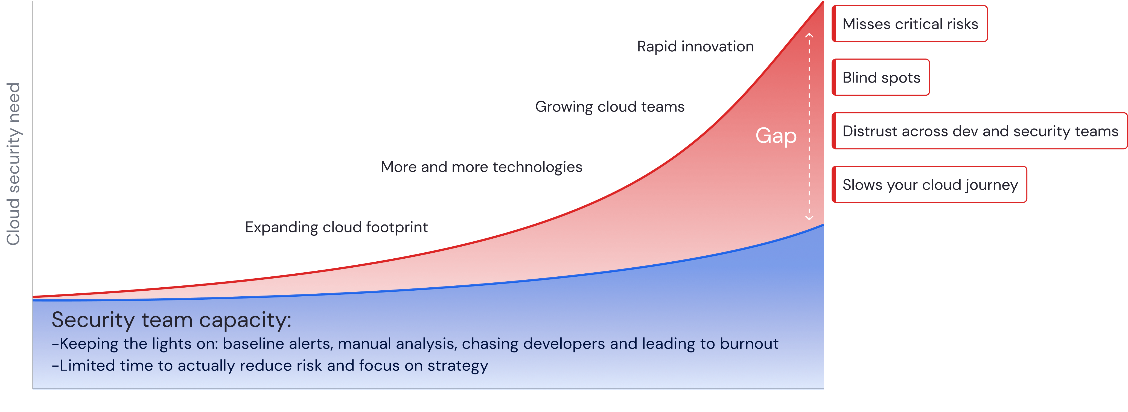
The time to scale your cloud security model is now
We can’t keep doing the same thing.
Notes:
The demands for security in our organizations to support all theses changes in the cloud is growing at an exponential rate.
At the same time, the capacity of our security teams is usually growing at a slower rate and unfortunately most of that capacity is typically sucked up with keeping the lights on activities – triaging baseline alerts, manual detective work, and chasing development teams.
This leaves limited time to do the work security teams actually want to do – reducing risk and focusing on more strategic efforts. It’s no wonder that burnout is so prevalent in our industry.
This all results in an increasing gap where blind spots can exist, critical risks are missed, seeds of distrust exist across your teams, which all lead to your cloud journey not moving at your desired pace. This isn’t a gap that we can just hire our way out of, so we really need a new approach.
Segment notes:
For mid-market, lean into practitioners that wear many security hats and that traditional approaches require adopting a lot of siloed technologies
For enterprise and majors, lean into the need for tool consolidation

Slide 6
Cloud security needs a new operating model
Notes:
We need a new operating model for how cloud security works that rethinks our approach of how cloud and security teams work together and the processes that facilitate it

Slide 7
Built for the cloud: agility and self-service
Cloud security is a team sport
Security team: central visibility and control ​
Self-service
Dev team a
Dev team b
Dev team c
Notes:
So if it’s not just security teams, what’s the path forward? We believe cloud security needs a playbook that treats security as a team sport, empowering security, development, and operations teams to work together and control risks across the pipeline.
Security teams need:
100% seamless visibility into the entire environment without bothering devs​ for any cloud, any architecture​.
Unified policy framework and enforcement across the full environment
On the other hand, dev teams don’t want to see everything. They want
Ownership and visibility into the parts of the infrastructure that they are directly responsible for securing.
And it has to be super simple for them to use. Devs aren’t going to live in a security tool all day so they need a self-service way that they can get clear priority, context, and evidence for efficient remediation of risks when they need it.

Slide 8
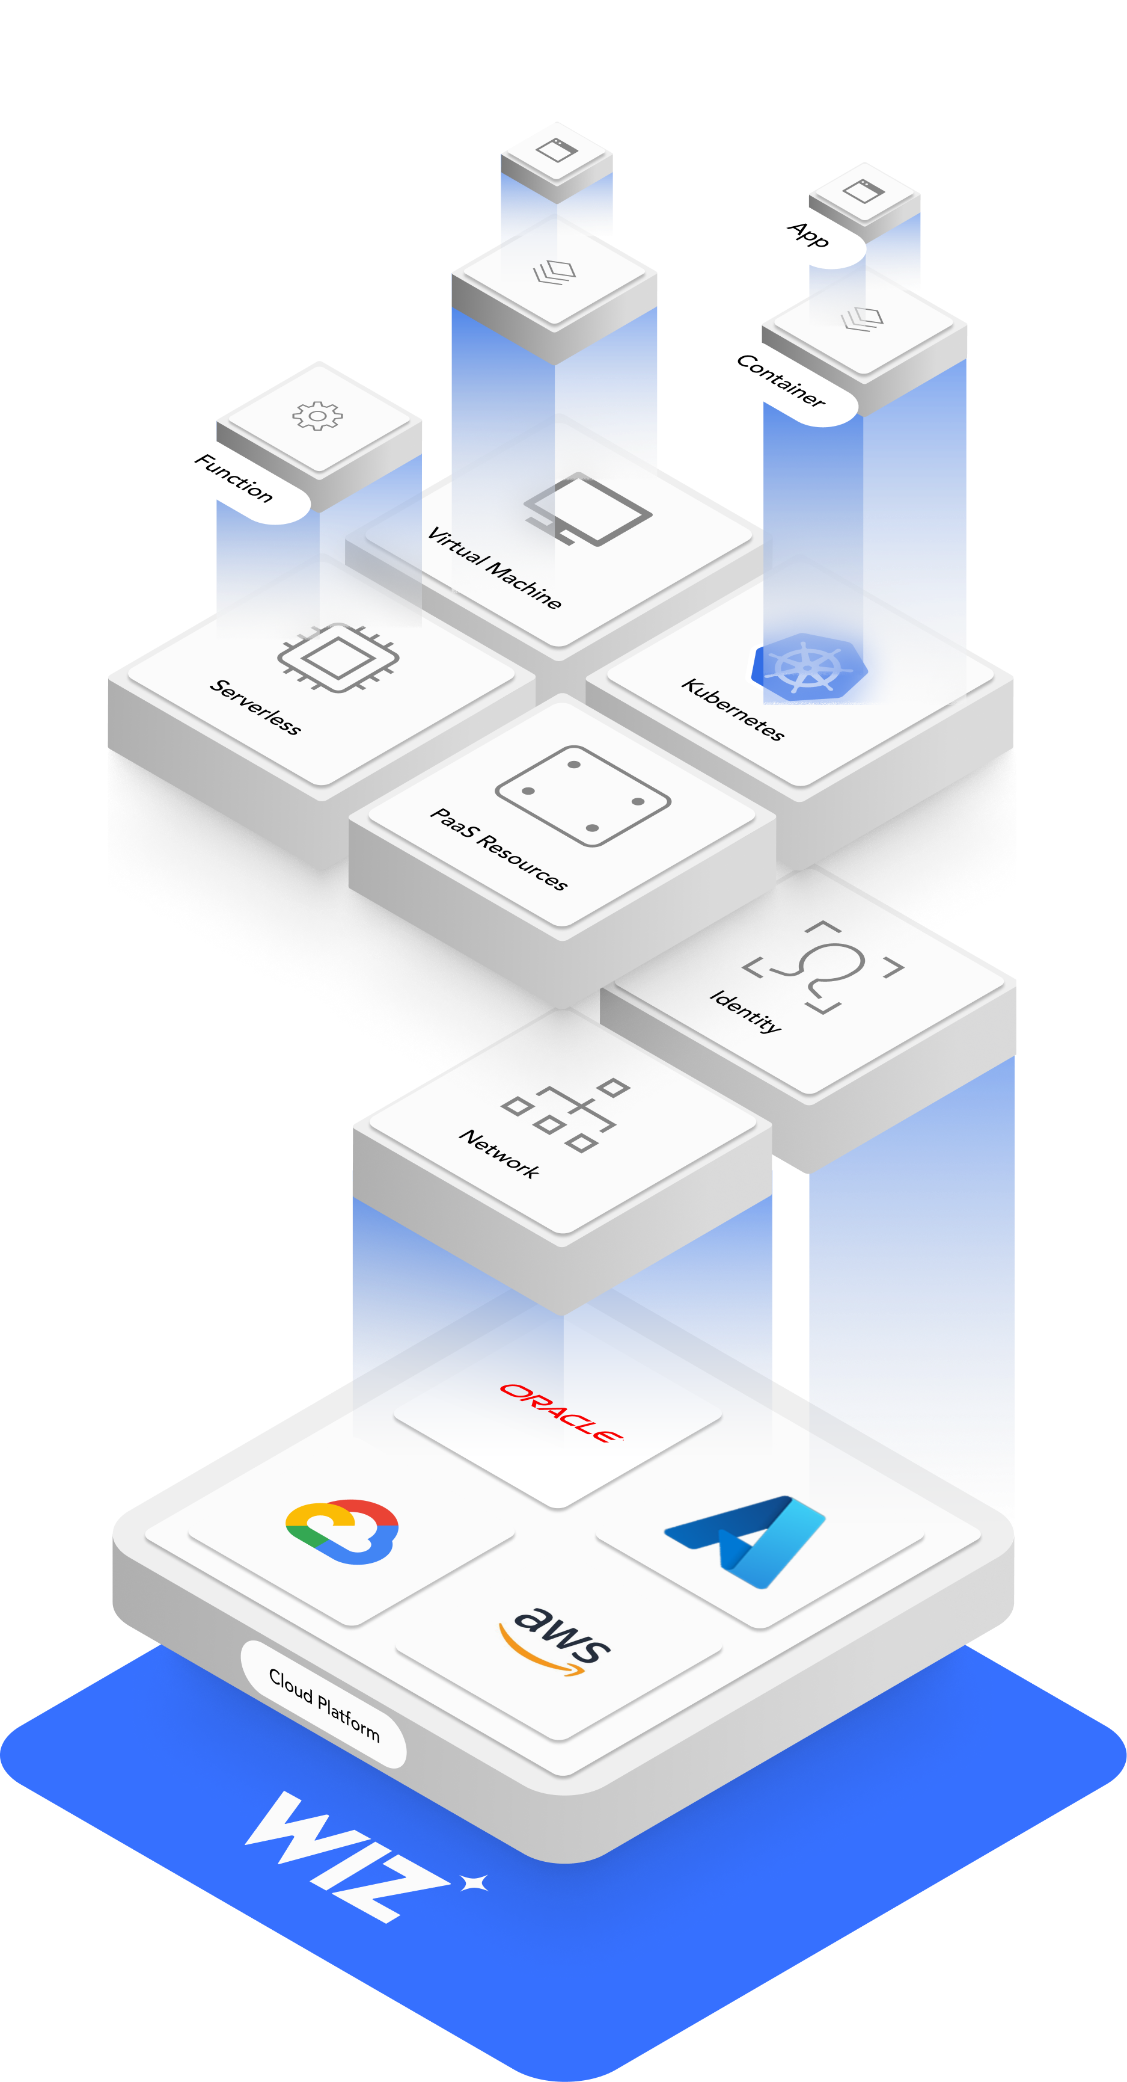
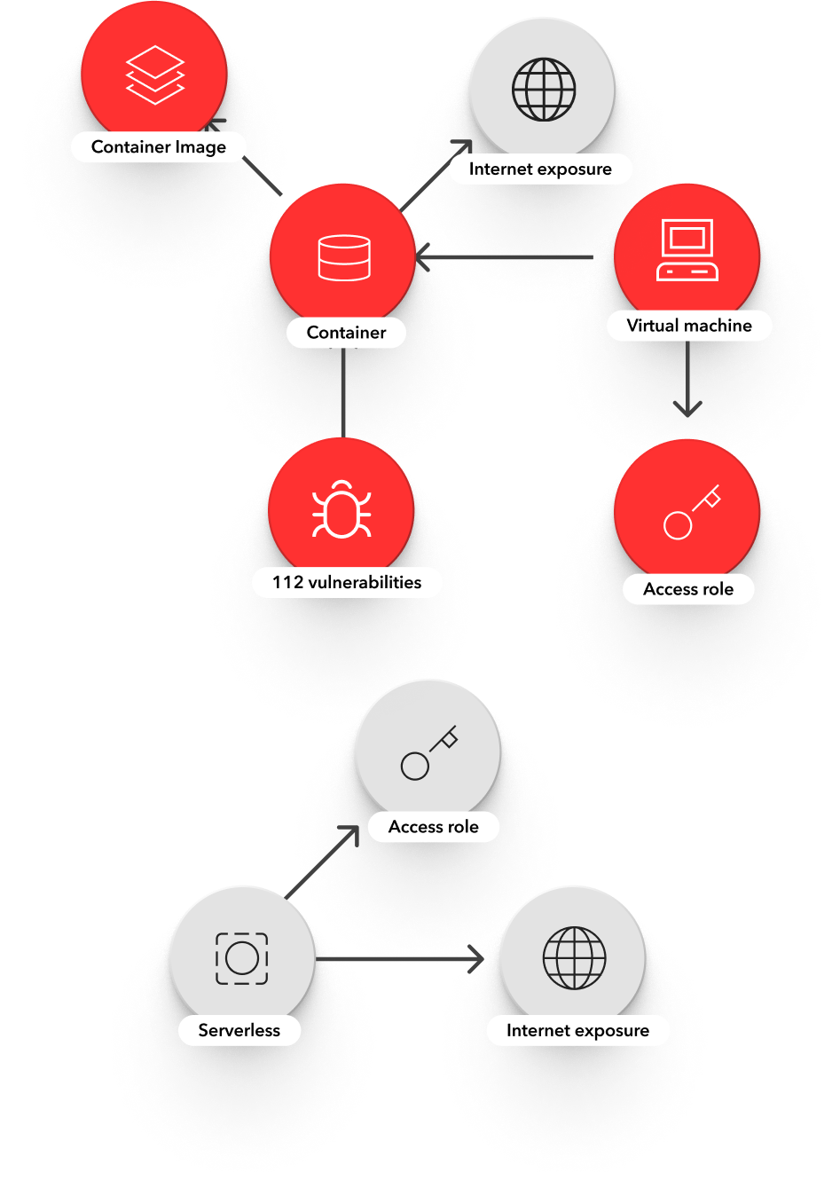
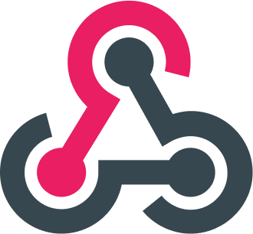
A new approach to cloud security
1
Agentless scan of cloud metadata and workloads
2
Perform a deep cloud assessment
3
Identify the most critical risks
4
Proactively harden your cloud
Traditional scanning
Vulnerabilities and missing patches
Misconfigurations
Malware
Partner integrations
20+ integrations
Cloud risk engine
External exposure
Excessive permissions
Exposed secrets
Lateral movement paths
Cloud remediation
Serverless
Containers
VMs
PaaS
One-click remediation
Automated security response
Remediation guidance
Wiz threat research
Novel cloud vulnerabilities and attacks
CI/CD Guardrails
One policy across the stack
Container and VM image scanning
IaC template scanning

Slide 9
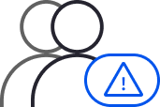
One unified platform for your cloud security journey
Dev
DevOps/IT
GRC
Vulnerability
Management
Cloud Security
SOC
Cloud Native Application Protection Platform
CSPM (Configurations)
Vulnerability Management
Container & Kubernetes Security
CIEM (Entitlements)
CWPP (Workloads and Hosts)
Cloud Detection & Response
DSPM (Sensitive Data)
IaC Scanning & CI/CD Integration
Compliance Reporting
Inventory / CMDB
Secrets & Malware Scanning
M&A Integration
PaaS
Containers
VMs
Serverless
Notes:
Discovery questions:
Where are you on your cloud journey? (eg: get off on-prem/migration, trying to be compliant, etc), Tell me about your cloud environment (multi-cloud, single cloud, containerized, etc)? What do you use it for? What do you use each cloud for? [Listen for cloud maturity, environment size, and business impact]
How do you get visibility into your environment? [Listen for challenges]
How do you secure it? [Listen for challenges]
What tools do you have in place? [Listen for competition/incumbents]
[Click]
What teams are responsible for your cloud security program? How do they work together? [Listen for who your champion/stakeholders are, are teams siloed or collaborative?]
Help me understand how you triage alerts and prioritize as a group? How do you combat alert fatigue and false positives? [Listen for challenges]
How do your teams manage different tools / your security program? [Listen for challenges]
What cloud security projects or use cases are you working on right now? [Listen for active projects/evaluations and where they just decided on a project]
[Click]
What if I told you that you could have a unified approach to cloud security that covers all of your use cases today and in the future? A platform that provides you comprehensive visibility and risk assessment that eliminates alert fatigue and manual effort across teams?

Slide 10
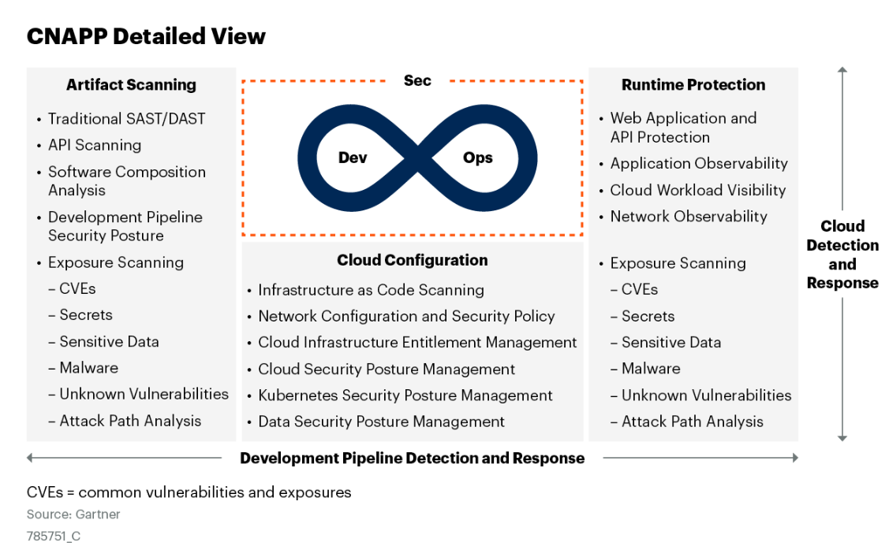
Gartner validates our approach
CNAPP offering should have certain key characteristics:
All services should be fully integrated, not loosely coupled independent modules (typically resulting from a vendor’s internal silos, poorly integrated OEM components or those added from an acquisition). Integration should include the front-end console, unified policy across multiple points of inspection and a unified back-end data model.
Single security policy for risk assessment across all artifacts — containers, VMs, serverless functions and data storage.
Deep understanding of relationships between the elements of an application (VMs, containers, service functions and storage), security posture, permissions and connectivity, typically enabled by underlying graph database technology.
Notes:
And in the past few years, Kubernetes has become the mainstream way for running containers. In fact, according to a Cloud Native (Computing) Foundation (CNCF) annual survey, 96% of organizations are either using or evaluating Kubernetes (compared to last year)
And 90% of Kubernetes users leverage the cloud-managed Kubernetes services by the cloud providers, meaning – they mostly run in the cloud
There are 5.6 million developers using Kubernetes today (~30% of all BE engineers), a 67% increase from a year ago. Just to get a sense of the growing popularity of this technology.
This of course means that the container and K8s security market is growing really fast. The size of the container and Kubernetes security market is currently evaluated at USD 1.3B. And it’s expected to grow at an annual rate of 22%.
This is a HUGE market and GREAT opportunity for Wiz

Slide 11
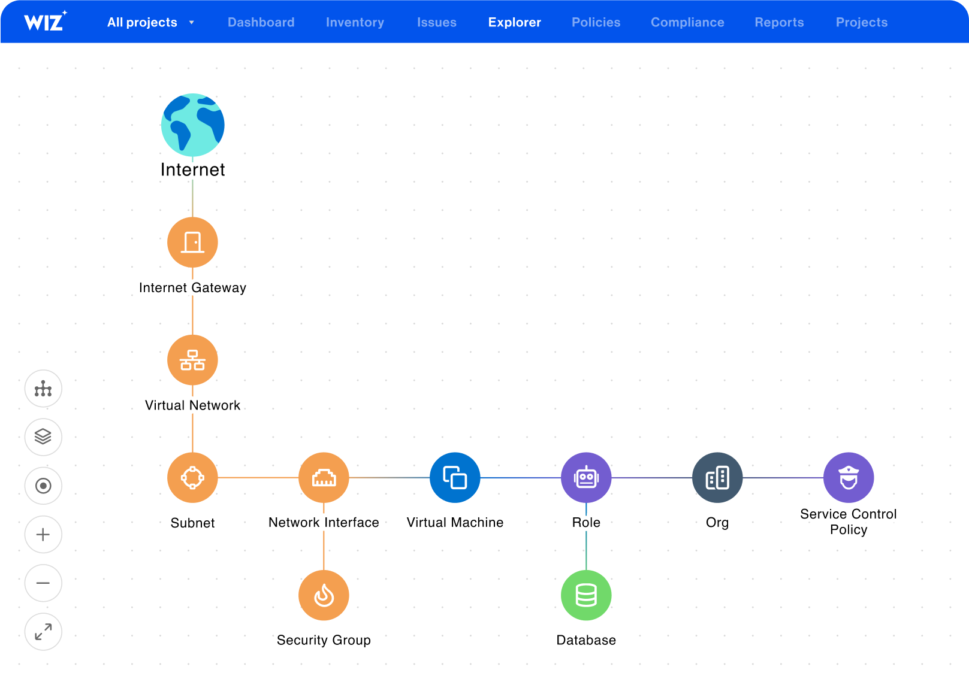
The cloud security operating platform
Identify all risks, AND show their context and correlation
Notes:
Wiz was built to be the platform for a new cloud security operating model.
First, we provide seamless visibility into your environment using an API-based deployment model that models your cloud security architecture on our graph. We show you a full inventory of all of your resources, whether VMs, containers, or serverless, and we show a full network topology that shows how they are routed to the internet. We also model your identities and entitlements on the graph and show you what additional resources or services can be accessed

Slide 12
The cloud security operating platform
Prioritize attack paths to focus on the highest impact risks
Notes:
We map out and prioritize attack paths to your crown jewels so you can understand the likely intrusion points that will have the largest impact if exploited.
In this example, Wiz is highlighting a publicly exposed VM with a critical network vulnerability with a known exploit and data access to sensitive PII. All of this context allows your teams to proactively find the largest risks in your environment

Slide 13
The cloud operating model enable:
Success criteria of the cloud operating model
I know my environment
I can respond fast and fix critical risks
My dev teams know their cloud environment and its risks
My SOC team knows the risk of a cloud resource without calling the dev team
I can drive broad cloud initiatives
Automated cloud security compliance reporting to demonstrate I’m managing risk in cloud and drive improved compliance
Notes:
The outcome of the modern cloud security program is:
Security gets fully visibility and they can automatically manage their cloud asset inventory without excel spreadsheets
Security feels confidence in their ability to respond fast and fix critical security issues like the next Log4shell
We extend security to other teams including devs who self-service understand their cloud environment and its risks, this is our “Go-Green”
SOC teams know the risk of a resource without needing to call the dev team
Security can focus on continuous improvement by driving best practices through broad initiatives, e.g. next month I’m going to undertake a project to enforce least privilege in my AWS environment or we’ll remove exposed secrets the following month
This enables organizations to have a plan and model for managing risk in the cloud which enables them to build in the cloud more quickly and securely

Slide 14
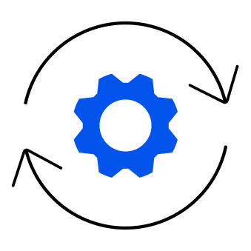
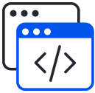
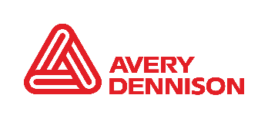
Improve the business value of your cloud security program
Rapidly Improve your security posture
The cloud went from being our least understood to our most understood space, and that was entirely due to Wiz.
Greg Poniatowski Head of Threat Management
5x better
Improved visibility and coverage
Unprecedented time to value
The Wiz platform is the consolidation of tools across all
the security domains we’ve identified as must-do to protect our cloud workloads.
Adam Fletcher CSO
10x Lower
Within hours, we had the full power of Wiz. Nothing has ever matched that in terms of quick, painless deployment and no-maintenance after the fact. From the point of engagement to the point of ROI, it was easy to choose Wiz. We hadn’t even paid and already got results. Nowhere else was this process so fast.
Increase operational efficiency
Effort to find and remediate issues
Transform your cloud operating model
Our DevOps teams log in directly to Wiz to identify and remediate issues, thereby scaling the Infosec team’s reach and velocity.
Melody Hildebrandt
CISO
Dev&Sec
>55% of Wiz users are developers
Igor Tsyganskiy President and CTO
Our cloud journey is revolutionizing the company, so it is critical we can secure it. Security cannot be a blocker.
Jeremy Smith
VP InfoSec Officer
6 Months
Faster
Accelerate your Business
Accelerate timelines of business goals
Deploy in minutes, leverage
actionable insights in days

