Slide 1
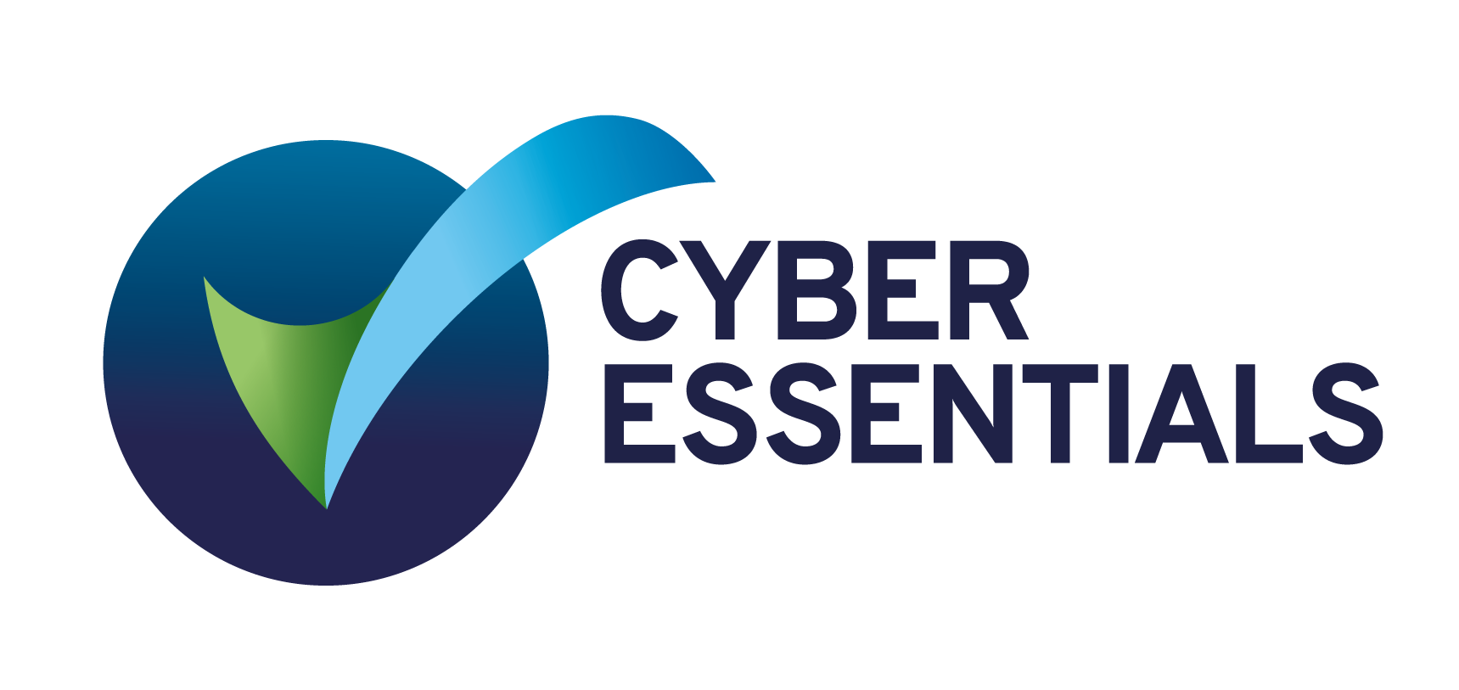
Cyber Essentials
Practical guidance on achieving certification
Marc Davis
Zscaler Solutions Consulting, UK&I
November 2023

Slide 2
Introducing Zscaler

Slide 3
Over 500,000 users
in UK Gov & Public Sector

Slide 4
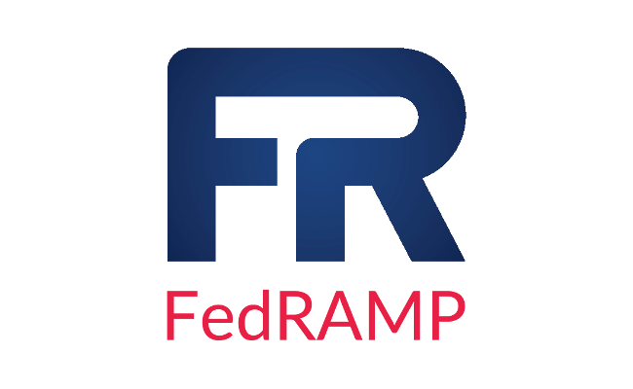
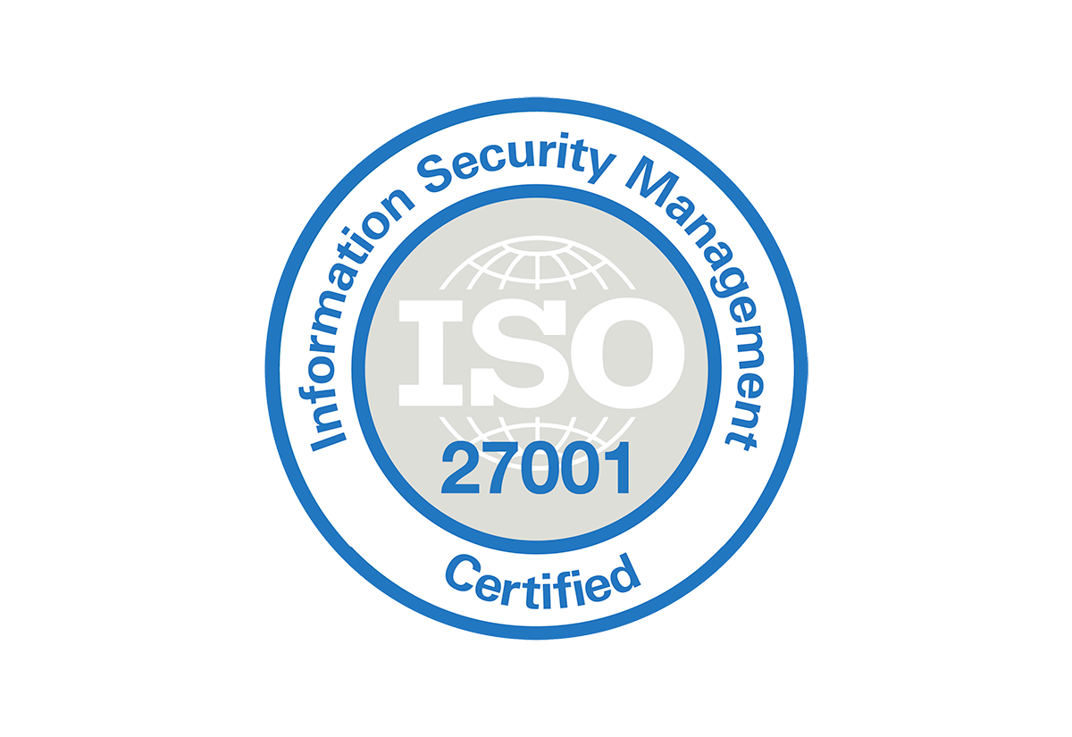
Zscaler Evolution
Proven history of rapid innovations & growth
CSPM CIEM
Zero Trust Workload
UCaaS App Monitoring
INDUSTRY’S 1ST
Multi-Tenant Cloud
Security Platform
Zscaler Internet Access
Deception Integration
Web App Protection
Private app Browser Isolation
Zscaler Private Access
Zscaler Digital Experience
Disaster Recovery Zero Trust SD-WAN
AI/ML
Partner APIs
Internet Browser Isolation
Inline
DLP
SSO Integration
Mobile
Security
Inline CASB
Cloud
Sandbox
DNS
Security
Cloud
Firewall
Office365
Integration
IPO
NASDAQ-100 Index
FOUNDED
2007
2008
2009
2010
2011
2012
2013
2014
2015
2016
2017
2018
2019
2020
2021
2022
2023
1B
Transactions Per Day
10B
50B
200B
300B
100th Patent Filed
200th Patent Filed
300th Patent Filed
Founder
Visionary
SWG MQ
100% Renewable Energy
LEADER
SWG MQ
LEADER
SSE MQ
11th Year as Leader
Notes:
Founded 2007
Launched ZIA 2008
Evolved and grew
Gartner leader from 2011
Launched ZPA 2016
Public 2018
Launched ZDX 2020
Still Gartner leader - moving into SSE to reflect the scope of the platform
Continue to innovate with DR and ZT SD-WAN
Customers were bold back in 2008, but demand has snowballed, now passing 300B TPD

Slide 5
Solutions Across Four Key Areas
Business Analytics
Knowledge from trillions of daily telemetry signals
Cyber Threat Protection
Prevent compromise and lateral movement
Data Protection
Prevent data loss, inline and API
Zero Trust Connectivity
Users, Branches, Factories, Public Clouds, Data Centers
Globally Distributed Cloud: 150+ Data Centers, China Connectivity, Peering, BCP/DR
Zscaler for Users
0"
Zscaler for Workloads
Zscaler for B2B
Zscaler for IoT / OT

Slide 6
Tailwinds powering the adoption of Zscaler
Internet / SaaS Office 365
Secure & fast access
Direct-to-Cloud Network Transformation
Secures local breakouts that SD-WAN provides
Work from Anywhere
Fast and secure access to applications
IaaS/ Public Cloud (Azure / AWS)
Secure cloud workloads, app-to-app communication
IoT/OT
Bring zero-trust to IoT/OT
5G
Enabling safe edge computing

Slide 7
What is Cyber Essentials?

Slide 8
Introduction to Cyber Essentials
What is it?
Why is it important?
What about ‘Plus’?
Notes:
What is Cyber Essentials?
A UK Government backed scheme, run by the NCSC, that helps to protect organisations of all sizes against the most common (80%) cyber attacks
Why Cyber Essentials?
Organisations can reassure customers they are working to secure their IT against cyber attacks
Attract new business with the promise cyber security measures are in place
Build a clear picture of an organisation's cyber security level
Some Government contracts require Cyber Essentials certification
What about Cyber Essentials Plus?
Cyber Essentials Plus encompasses the same protections as Cyber Essentials
However, an additional hands-on technical verification is carried out to ensure the protections have been applied to the required standard
This document is therefore applicable in helping Zscaler prospects and customers work towards both Cyber Essentials and Cyber Essentials Plus Certifications

Slide 9
Cyber Essentials ‘Technical Controls’
Firewalls
Secure Configuration
Secure Update Management
User Access Control
Malware Protection

Slide 10
Introducing our special guest…

Slide 11
Roy Holder – Senior Infrastructure Engineer
DWP - Specialist Devices Team
Zscaler services deployed 6 years ago initially for Managed MacBook Service SaaS platform (750+ devices)
Currently managing 3000 developer users on the Engineering platform.
New MacBook solution on the Production platform.
Consuming ZIA and ZPA service to access both OPH and SaaS services

Slide 12
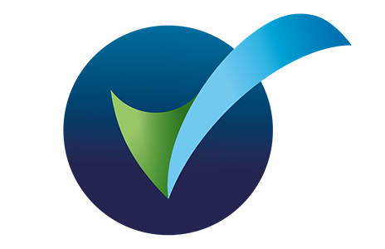
Technical Controls - A closer look…
Firewalls
Secure Configuration
Secure Update Management
User Access Control
Malware Protection

Slide 13
Technical Control Checklist
Firewalls
Aim
Change default passwords or disable remote admin access
“To make sure that only secure and necessary network services can be accessed from the internet”
Prevent access to the admin interface from the internet
Block unauthenticated inbound connections by default
Ensure inbound firewall rules are approved and documented
Remove or disable unnecessary firewall rules
Use a software firewall on devices connected to untrusted networks
Notes:
“You must protect every device in scope with a correctly configured firewall (or network device with firewall functionality).”
There is a lot of low hanging fruit here, which should be taken care of as best practice - Passwords, excessive configs, housekeeping etc..
There is a theme around removing all internet facing devices, which has become one of the most exploited attack vectors - particularly with exposed ADC’s and VPN endpoints
MFA alone is not enough for these devices
Leverage firewalling on all devices that are traffic originating

Slide 14
How Zscaler can help
Firewalls
Turn apps dark
Secure Traffic Flows
Eliminate internet facing exposure of all private apps and assets.
Secure all internet bound traffic from users, IoT and OT.
Enhance security by implementing least privileged access principles
Reduce exposure by shrinking external and internal attack surface
Reduce operational overhead by simplifying technical controls and policies
Notes:
Z can help achieve compliance in this area in a number of ways. I’d like to call 2 our specifically….
Using ZPA to turn apps dark - The principle here is that no private resources need to have a public attack surface.
Traditional VPNs that offer a way in continue to be the bane of many organisations lives.
There is rarely a week that passes without one of the household name remote access providers publicising some kind of vulnerability that provides attackers with a back door
Keeping devices patched and up-to-date is one thing, and that is tracked under a separate control.
However the bottleneck around this can be removed by implementing a solution like ZPA that adheres to ZTNA principles…
No inbound attack surface / listener
Authenticate users before access
Only connect users/devices to the apps they are authorised to access, to eliminate lateral movement
@Roy?

Slide 15
DWP Q & A
Firewalls
Q - How are DWP leveraging Zscaler to reduce their internet attack surface?
The Engineering platform has only SaaS services so we were keen to ensure that users could access resources safely from any location. With policy based control DWP can securely allow access to external or internal resources whilst reducing the attack surface. ZPA ensures users only have access to allowed applications which are not publicly visible.
Q - How are DWP securing their user to internet flows with Zscaler?
Engineering users are all Road Warriors and utilize Client Connector app as part of the core MacBook build. External routing is done via ZIA and internal routing via ZPA.

Slide 16
Technical Controls - A closer look…
Firewalls
Secure Configuration
Secure Update Management
User Access Control
Malware Protection

Slide 17
Technical Control Checklist
Secure Configuration
Aim
Remove and disable unnecessary user accounts
“Ensure that computers and network devices are properly configured to reduce vulnerabilities and provide only the services required to fulfil their role”
Change any default or guessable account passwords
Remove or disable unnecessary software
Disable any auto-run feature which allows file execution
Ensure users are authenticated before allowing access
Ensure appropriate device locking controls
Notes:
“...by applying some simple technical controls when installing computers and network devices, you can minimise vulnerabilities and protect against common types of attack.”
This control is all about ensuring your devices are configured as lean as possible, so they can only fulfill the tasks they need to, and no more.
Again, lots of non technical common sense best practices at play here such as, user account management, password management, device locking controls.
However, there are some interesting areas around user authentication and software execution where Zscaler can add some value.

Slide 18
How Zscaler can help
Secure Configuration
Refine JML Processes
Zero Day Protection
Leverage SAML and SCIM for effective Joiner, Mover, Leaver access controls.
Leverage inline security controls such as Cloud Sandboxing to stop users from downloading known malicious and ‘zero day’ payloads.
Reduce the operational complexity of managing the user account lifecycle
Reduce risk of endpoint infection and ‘patient zero’
Streamline Incident Response processes to reduce the blast radius of a breach
Notes:
Customers talks to us a lot about how we can help with the so-called JML process - Joiner, Mover, Leaver
This is something that, if not handled effectively, can expose you significantly from a data loss and possible breach
It's the classic scenario where somebody leaves the org, but their accounts do not get removed. This can open a significant attack vector, depending on the systems and users level of access.
COLONIAL PIPELINE
Probably the best recent example of this is the Colonial Pipeline breach, by Darkside, in 2021.
Access was gained through a VPN using an orphaned account.
The ultimate cost - $4.4m in ransom payments
https://www.frontierzero.io/blog/orphaned-accounts-security
Due to the fact Zscaler sits inline in terms of accessing both internet based and internal providence resources, we are very well placed to enforce the JML policies - i.e. as soon as a user leaves, or a third party completes their job, access will be removed
Or if a user hands in their notice, they can be auto transitioned into a holding group which limits their ability to exfiltrate data
Zscaler cannot do this alone, but relies on integration with your IDP - Azure AD, Ping Fed, OneLogin etc.
Leveraging SAML and SCIM protocols, we can ensure that users access is onboarded and removed in real-time, as needed.
Access policies can then be built against the attributes we leverage from the IDP
@Roy?

Slide 19
DWP Q & A
Secure Configuration
Q - How do DWP ensure users only have the permissions they need to fulfill their job roles? How does Zscaler help with this?
DWP use RBAC to define project roles and apply permissions in our IDP. Zscaler allows us to integrate using SAML and SCIM which allows automated workflows to be pushed from the IDP. The integration helps with the JML process also.
Q - What controls do DWP have in place to mitigate against Zero Day threats?
DWP leverage our security product vendors including Zscaler Threat Labs website and subscription alerts plus we have a dedicated team (CRC) that get alerts online (CVE, RSS feeds). Cloud sandbox service allows suspicious files to be integrated before being made available to users.

Slide 20
Technical Controls - A closer look…
Firewalls
Secure Configuration
Secure Update Management
User Access Control
Malware Protection

Slide 21
Technical Control Checklist
Secure Update Management
Aim
Keep software up to date
“Ensure that devices and software are not vulnerable to known security issues for which fixes are available”
Software must be licensed and supported
Removed from devices when it becomes unsupported
Apply critical or high-risk updates within 14 days
Address vulnerabilities with a CVSS v3 score of 7 or above
Address fixes for undefined vulnerabilities provided by vendors
Notes:
“Vulnerabilities are regularly discovered in all sorts of software. Once discovered, malicious individuals or groups move quickly to misuse (or ‘exploit’) vulnerabilities to attack computers and networks.”
There is a bit of overlap here from the firewall control, but i think we are all agreed that software (endpoint or network device) needs to be kept up to date
NCSC do provide some specific guidelines within CE around ensuring critical or high risk updates are installed within 14 days of release - particularly if the vulnerabilities patched exceen a CVSS score of 7.
Broadly speaking, Zscaler can help meet this control in a number of ways…

Slide 22
How Zscaler can help
Secure Update Management
Browser Isolation
ZTNA
Visibility
Provide an air-gap between end device and content, to mitigate against threat transfer and company confidential data loss.
Protect internal systems.
Build an inventory of endpoint software across the user estate, to gain granular insights into installed software and running processes.
Gain deep visibility into endpoint software inventory for accurate auditing
Turn internal services dark, hiding potentially vulnerable attack vectors
Maintain excellent user experience without the risk of infection and data loss
Notes:
Zscaler can help here in a number of ways.
Firstly, protecting your inra from known vulnerabilities - We have already spoken about ZTNA principles, and these also apply here.
Secondly,protecting your users and euc from vulnerabilities
A lot of organisations we are speaking to are taking the cyber security mindset of ‘Assume Breach’ which essentially means they are resigned to the fact they are going to get hacked, so its all about then limiting the blast radius. I.e. if an endpoint of a high profile user were to be compromised, it's all about restricting what can be controlled
One way of doing this is to use Browser Isolation
This essentially works by rendering web content in the zscaler cloud, and then only streaming the pixels down to the device for user consumption.
The benefits of this are the fact the user can still access and interact with the web content, but they remain air gapped.
This means controls can be put in place to thwart the spread of malicious payloads and also limit possible data loss which is often the net result of a breach.
This protects the end device, but also can stop problematic interactions between compromised devices and your internal or external applications
Finally, visibility is absolutely key to understand your inventory of devices and your potential exposure
@roy?

Slide 23
DWP Q & A
Secure Update Management
Q - How do DWP keep on top of their assets and software inventory today?
We use SIEM platforms to gather and collate data from services like the Zscaler platform plus we have additional local agents that collect device/software inventory.
Q - What challenges do you face keeping software and firmware up-to-date?
Main challenge is the time needed to package specific versions of software so we look to evergreen packages if possible. Firmware and macOS updates are now automated in release cycles plus we leverage conditional access.
Q - How has Zscaler helped you in this area?
(e.g. ZPA / Browser Isolation)
Zscaler has features like risky users policies that allow non-compliant devices to require remediation before being allowed access to resources. We also use ZPA device posture to ensure devices are managed correctly plus CBI for unclassified or unapproved websites.

Slide 24
Technical Controls - A closer look…
Firewalls
Secure Configuration
Secure Update Management
User Access Control
Malware Protection

Slide 25
Technical Control Checklist
User Access Control
Aim
Have in place a process to create and approve user accounts
“Ensure that user accounts are assigned to authorised individuals only and provide access to only those applications, computers and networks the user needs to carry out their role”
Authenticate users before granting access to application
Remove or disable user accounts when no longer required
Implement MFA where available
Use separate accounts to perform administrative activities only
Third Party accounts are also in scope for this Technical Control
Notes:
“..accounts with special access privileges have enhanced access to devices, applications and information. If these accounts are compromised, an attacker could take advantage of their greater accesses to corrupt information on a large scale, disrupt business processes or gain unauthorised access to other devices in the organisation.”
The user is commonly regarded as the weakest link in terms of cyber security, so its important user access control is managed carefully.
Non technical best practices should be a matter of course for all organisations in 2023 - approval processes for account creation, account deletion, limited account scope etc.

Slide 26
How Zscaler can help
User Access Control
Segmentation
Third Party Access
Protect business critical ‘Crown Jewel’ apps and data.
Enable granular Just-In-Time 3rd Party access to company resources, governed by a centralised policy with full logging and auditing.
Reduce the operational complexity of managing the user account lifecycle
Enhance security around Crown Jewel apps
Build a flexible architecture to securely onboard and manage 3rd Parties
Notes:
From a Zscaler point of view, it's almost a bit of rinse and repeat from a controls perspective here.
Authentication before access - tick
User to app segmentation via ZPA to avoid lateral movement - tick
However,one thing we have touch on much yet is 3rd party access.
How many of your grant access to some resources to individuals outside of your org?
How do you manage this today?
Where Zscaler can help is having the ability to provide what we call ‘privileged remote access’ to 3p’s, with the following benefits:
No client or vpn to deploy or manage
JIT provisioning with automation for policy adding/removal - driven by your IDP (great examples with AAD)
Access to not only web, but ssh, rdp and vnc which cover a lot of the most common use cases we are hearing from our customers
Advanced functionality such as session recording and payload scanning via our sandbox
Fully logged and audited for compliance
This is resonating extremely well for us, and is a uige area of growth seeing as errant 3p access has been a big vector for attackers in some of the highest profile breaches in the last 10 years - the most infamous perhaps being the breach of US retailer Target in 2013.

Slide 27
DWP Q & A
User Access Control
Q - What is DWP’s position on Zero Trust / Least Privileged Access? To what extent do you feel this is being delivered via Zscaler?
The Engineering platform has been built with Zero Trust as the template of the solution and this approach is being widely adopted as the approach to building/delivering new services. Zscaler has allowed DWP to continue the journey with the ability to have posture checking for both the user and device. ZPA allows policy access to certain applications.
Q - How do you manage 3rd party access into your environment today?
DWP can utilize ZPA connectors that are hosted by 3rd parties which they manage, but we are able to apply time-bound restriction policies to applications. We are also looking into the possibility of using CBI for certain user cases.

Slide 28
Technical Controls - A closer look…
Firewalls
Secure Configuration
Secure Update Management
User Access Control
Malware Protection

Slide 29
Technical Control Checklist
Malware Protection
Aim
Use Anti-malware software to protect devices
“To restrict execution of known malware and untrusted software, from causing damage or accessing data”
Update Malware protection in line with vendor recommendations
Prevent the execution of Malware and malicious code
Prevent connections to malicious websites over the internet
Actively approve apps before deploying them to devices
Maintain a current list of approved apps
Notes:
“If a system is infected, your organisation is likely to suffer from problems like malfunctioning systems, data loss, or onward infection that goes unseen until it causes harm elsewhere.”
From a controls perspective, this feels like the big one. The one that will make the most headlines
And the hardest one to control - this is all common sense, but easier said than done in terms of control
Particularly when users are at the centre of IT, and they are always the weakest link

Slide 30
How Zscaler can help
Malware Protection
Cloud Effect
Cyber Threat Protection
Access Control
Zscaler partners with over 40 security providers, leveraging threat intelligence which contributes to over 200k daily updates to our cloud.
Full inline security stack, underpinned by SSL inspection at scale, and AI/ML to deliver actionable security outcomes.
Control access to Sanctioned and Unsanctioned apps with inline CASB policies and Tenant Restrictions.
Fully managed ecosystem of Tier 1 security partners, delivered as-a-service
Practical implementation of AI and ML to achieve tangible security outcomes
Fine grained control of app consumption, reducing risk whilst driving productivity
Notes:
The bottom line is, you need to have anti-malware measures in place, and this is very much Zscaler’s bread and butter
To give yourselves the best chance of staying clean, you don't want to be chasing your tail running updates and ensuring you have the latest set of protections in place
Consuming security as a service is a must, and zscaler do this with what we call the cloud effect
Over 200k security updates per day, from over 40 threat partners - including msft whom we partner with in a number of areas - MAPP validate
Also, all customers benefit from malicious activity identified in out cloud - the cloud effect
But what does our stack cover?
Everything from av, malware, advanced threats including c&c, zero days, IPS - as well as heuristic based controls trained on the vast data sets captured from our > 300b transactions per day.
This, coupled with our extensive access control portfolio which includes inline and out of band (API) CASB, as well as url filtering and integrated browser isolation, we have a number of options to cover all the main bases when it comes to risk reduction.
This is what we have been recognised for as an industry leader since 2010!
@roy?

Slide 31
DWP
Malware Protection
Q - What have been the key operational improvements you have noticed since deploying Zscaler?
DLP and CASB functions that are available plus Data Discovery Report. The SaaS Security Report dashboard allows visibility of applications that can be easily classified.
The platform was able to survive the extra demand to resources during the Covid period.
The BAU support team have been able to benefit from the seamless integration into Zscaler that allows support tickets to be resolved quicker due to ease of use.
Q - What is DWP’s biggest concern in the current cyber landscape?
The introduction of AI and automated threat actors plus staying secure whilst allowing productivity from hybrid working.

Slide 32
Technical Controls / Zscaler Capabilities Mapping
Firewalls
Secure Configuration
Secure Update Management
User Access Control
Malware Protection
Full inline SSL/TLS inspection for all traffic, at scale
Unified Client Connector Endpoint Agent - Tamper Resistant and Secure
Internet Access (ZIA)
Cloud Firewall
File Type Control
Cloud Firewall
Adv Threat Protection
Cloud Sandbox
Browser Control
Cloud Sandbox
Browser Isolation
Private Access (ZPA)
Cloud App Control
Priv. Remote Access
App Protection
Tenant Restrictions
Digital Experience (ZDX)
Deception
URL Filtering
Notes:
BUILD SLIDE
So in summary, I hope I have demonstrated that Zscaler has a vast range of capabilities that can help cover the main bases in terms of Cyber Essentials bets practice
Truthfully, I have not really covered the half of it when it comes to our full range of capabilities, but I only had 45 mins!
We’d be delighted to talk you through some of our innovations such as Business Insights and Risk 360 tools, as well as our direction in terms of 5G and edge computing

Slide 33
Summary & Call to Action

Slide 34
Final thoughts…
Defence In Depth
Cyber Essentials Certification is not the destination
Come and speak to us on the stand!
Notes:
Final thought from DWP - @Roy - Anything you would like to say to close?
Quick summary of features that we are looking at internally like Risk 360 and Zscaler Cloud Connector.
Re-emphasis that CE requires a defence in depth approach
CE is not the destination - Introduce the CAF as a more comprehensive set of controls - next level - How it compares to industry standards such as NIST & CISA
If you think we can help, please come and speak to us on the stand to arrange a meeting or Reach out to us via email

Slide 35
Thank You!

