Slide 1
The Evolution of Zero Trust, and why we need Negative Trust
Tony Fergusson, CISO EMEA, Zscaler

Slide 2
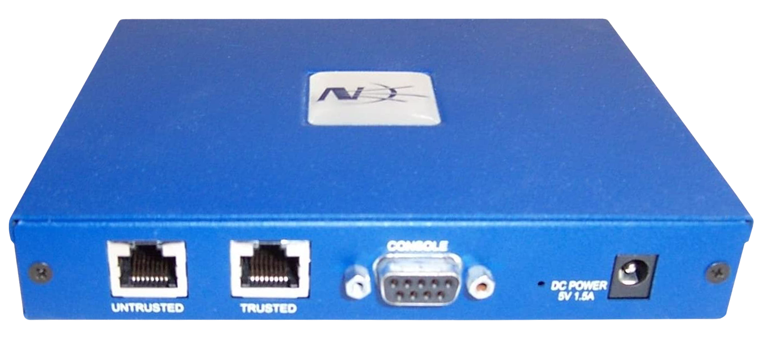
Un-Trusted Zone
Trusted Zone

Slide 3
Trust used to be simple
Internet
Un-Trusted Zone
Trusted Zone
DATA
USER
HQ

Slide 4
Then we tried to extend Trust
Internet
Un-Trusted Zone
Trusted Zone
REMOTE
OFFICE
VPN
WAN
DATA
MOBILE USER
BRANCH OFFICE
USER
HQ

Slide 5
This resulted in Positive Trust
Express Route
SDWAN
REMOTE
OFFICE
VPN
WAN
DATA
MOBILE USER
BRANCH OFFICE
USER
HQ

Slide 6
So we created Zero Trust
REMOTE
OFFICE
MOBILE USER
BRANCH OFFICE
USER

Slide 7
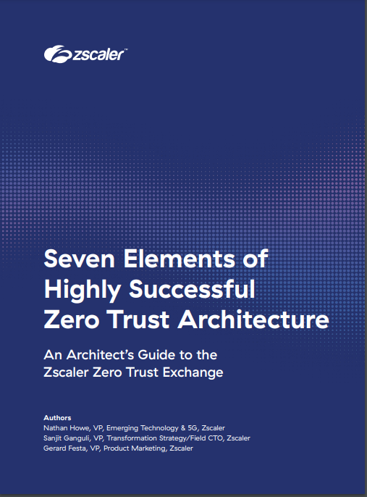
Zero Trust
Managed by others
Managed by you
SaaS
Internet
Data Center
Factory
IaaS/PaaS
App Connectors
Inside-out Connections
Enforce
Policy, Per Session Decision and Enforcement
Connection initiated to an app, not a network
7) Enforce Policy
6) Prevent Data Loss
Control
Content and Access Risk
5) Prevent Compromise
4) Assess Dynamic Risk
Verify
Identity and Context
3) Where is the connection going
2) What is the access context
1) Who is connecting
Connection Terminated to the Zero Trust Exchange
Access over any network
User + Device | Thing | Workload

Slide 8
Adversary and Response Trends
Sophisticated
attackers are stealthy
Advanced attacks are human-operated
Security analysts chase ghosts and burn out
91% of attacks don’t even generate a security alert.
71% of attacks are not malware-based.
32% of typical workday wasted on investigating/validating incidents that are not
a real threat.
SOURCE: MANDIANT
SOURCE: CROWDSTRIKE
SOURCE: IBM

Slide 9
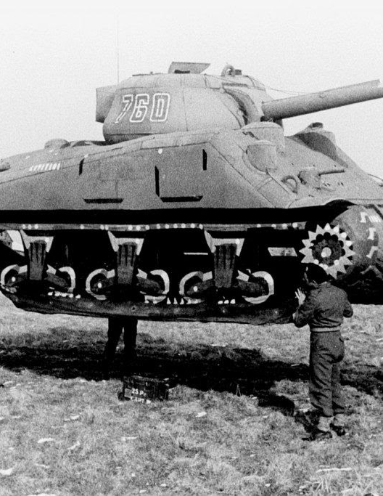
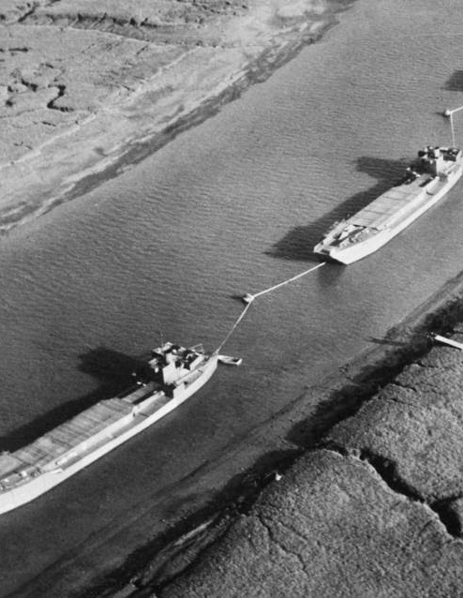
What’s going on in these pictures?

Slide 10
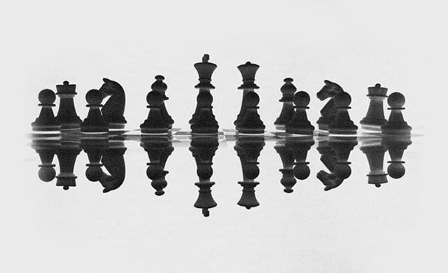
Mirror Chess
Predictability in any conflict with an intelligent opponent isn’t a good strategy.

Slide 11
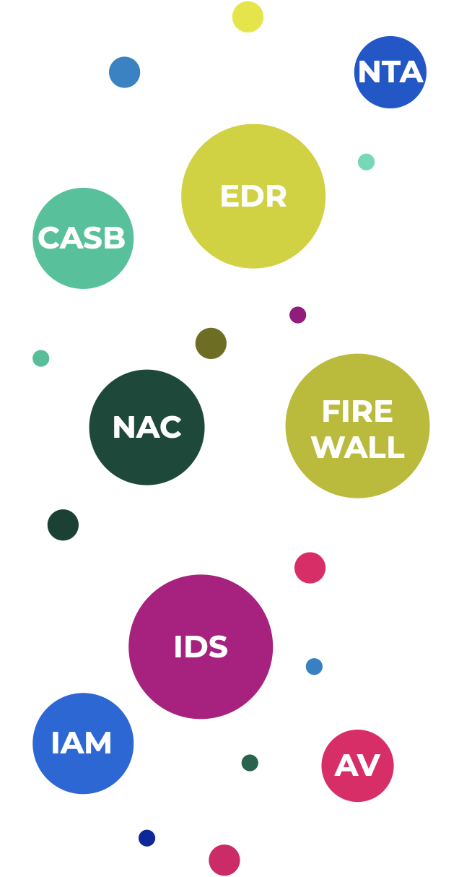
The Data Tsunami
100s of alerts to triage
Analysts are paralyzed
1s of incidents to remediate
Containment takes weeks
10s of leads to investigate
Inadequate root-cause analysis
1,000,000s of events collected
Big data, not good data.
Huge effort to collect and tune

Slide 12
Negative Trust
Decoy Users
Decoy Apps
Users
Apps
Privilege Escalation
Lateral Movement

Slide 13
How and why attackers succeed
Runs AD recon
Uses ‘live of the land’ techniques to remain undetected
3
2
Exploits perimeter infra
Compromises an exposed perimeter application
Distributes ransomware
Uses infrastructure to push ransomware org-wide
Steals credentials
Disable endpoint protection to access legitimate user creds
6
4
Runs recon
Scopes environment to find
vulnerable applications
1
5
Moves laterally
Mimic user behaviour and uses legit credentials to evade SIEM analytics and network monitoring

Slide 14
Disrupting advanced attacks with Negative Trust
Ransomware execution
Endpoint decoys detect ransomware execution
AD Reconnaissance
Active Directory decoys detect exploitation of AD resources
Exploitation
Perimeter decoys detect exposed application compromise
Ransomware distribution
Network decoys detect attempts to distribute ransomware
Credential Theft
Endpoint decoys detect use of stolen credentials
Lateral Movement
Network decoys detect lateral movement

Slide 15
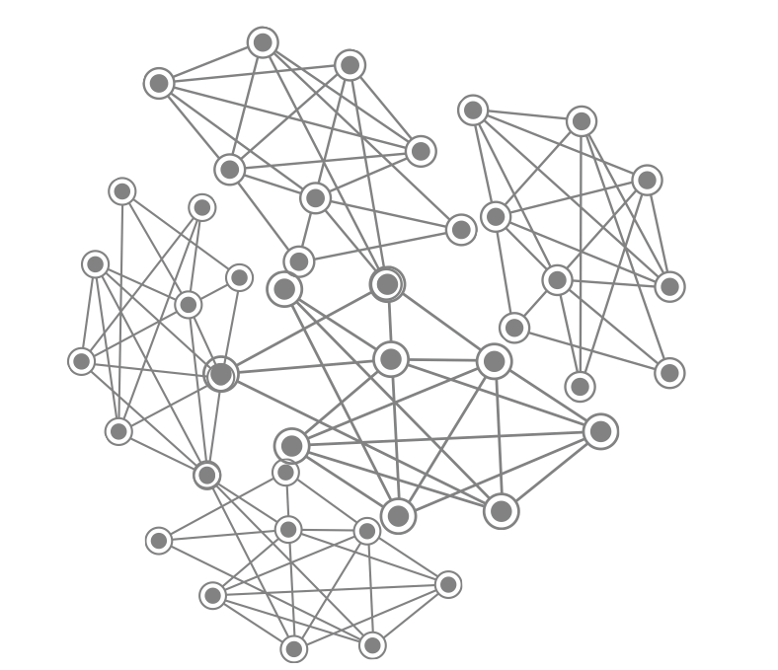
The Path Towards Negative Trust
Positive Trust State
Zero Trust State
Negative Trust State
Limited visibility. Multiple attack paths.
Several opportunities for lateral movement.
Connect users directly to apps and services. Minimize attack paths.
Create false attack paths. Detect lateral movement. Derail attacks.

Slide 16
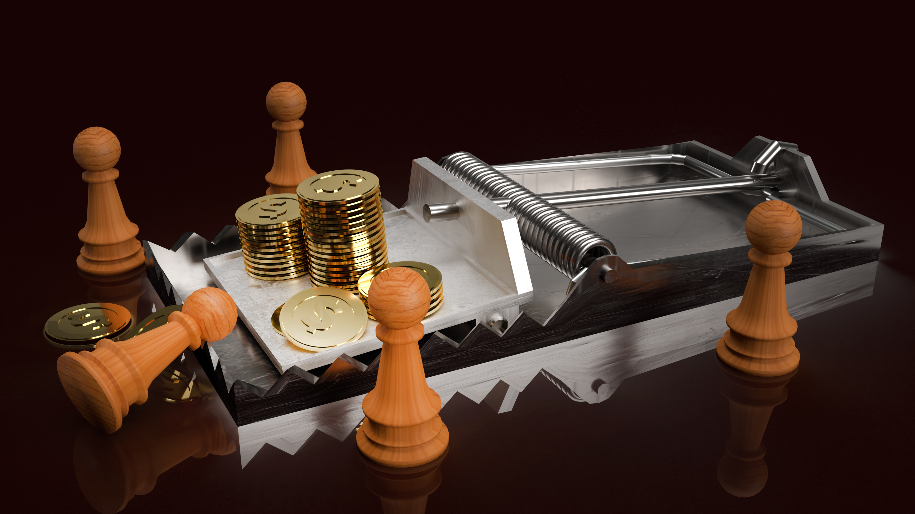

Slide 17
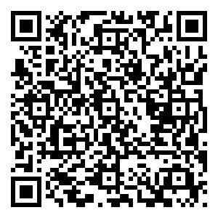
Zero Trust Learning Resources
Tony Fergusson
CISO EMEA
Seven Elements of Highly Successful Zero Trust Architecture
7 Questions Every CXO Must Ask about Zero Trust

