Slide 1
Transforming for a Digital Future: Setting out the roadmap for data and ethics
Sue Bateman, Chief Data Officer
18 October 2023

Slide 2
Two questions
1 | Where are we now?
2 | What’s next?

Slide 3
The public sector data landscape is changing
Huge increase in the volume of data
Shift in understanding and awareness of the importance of data
Major investment in data strategy, skills, and infrastructure

Slide 4
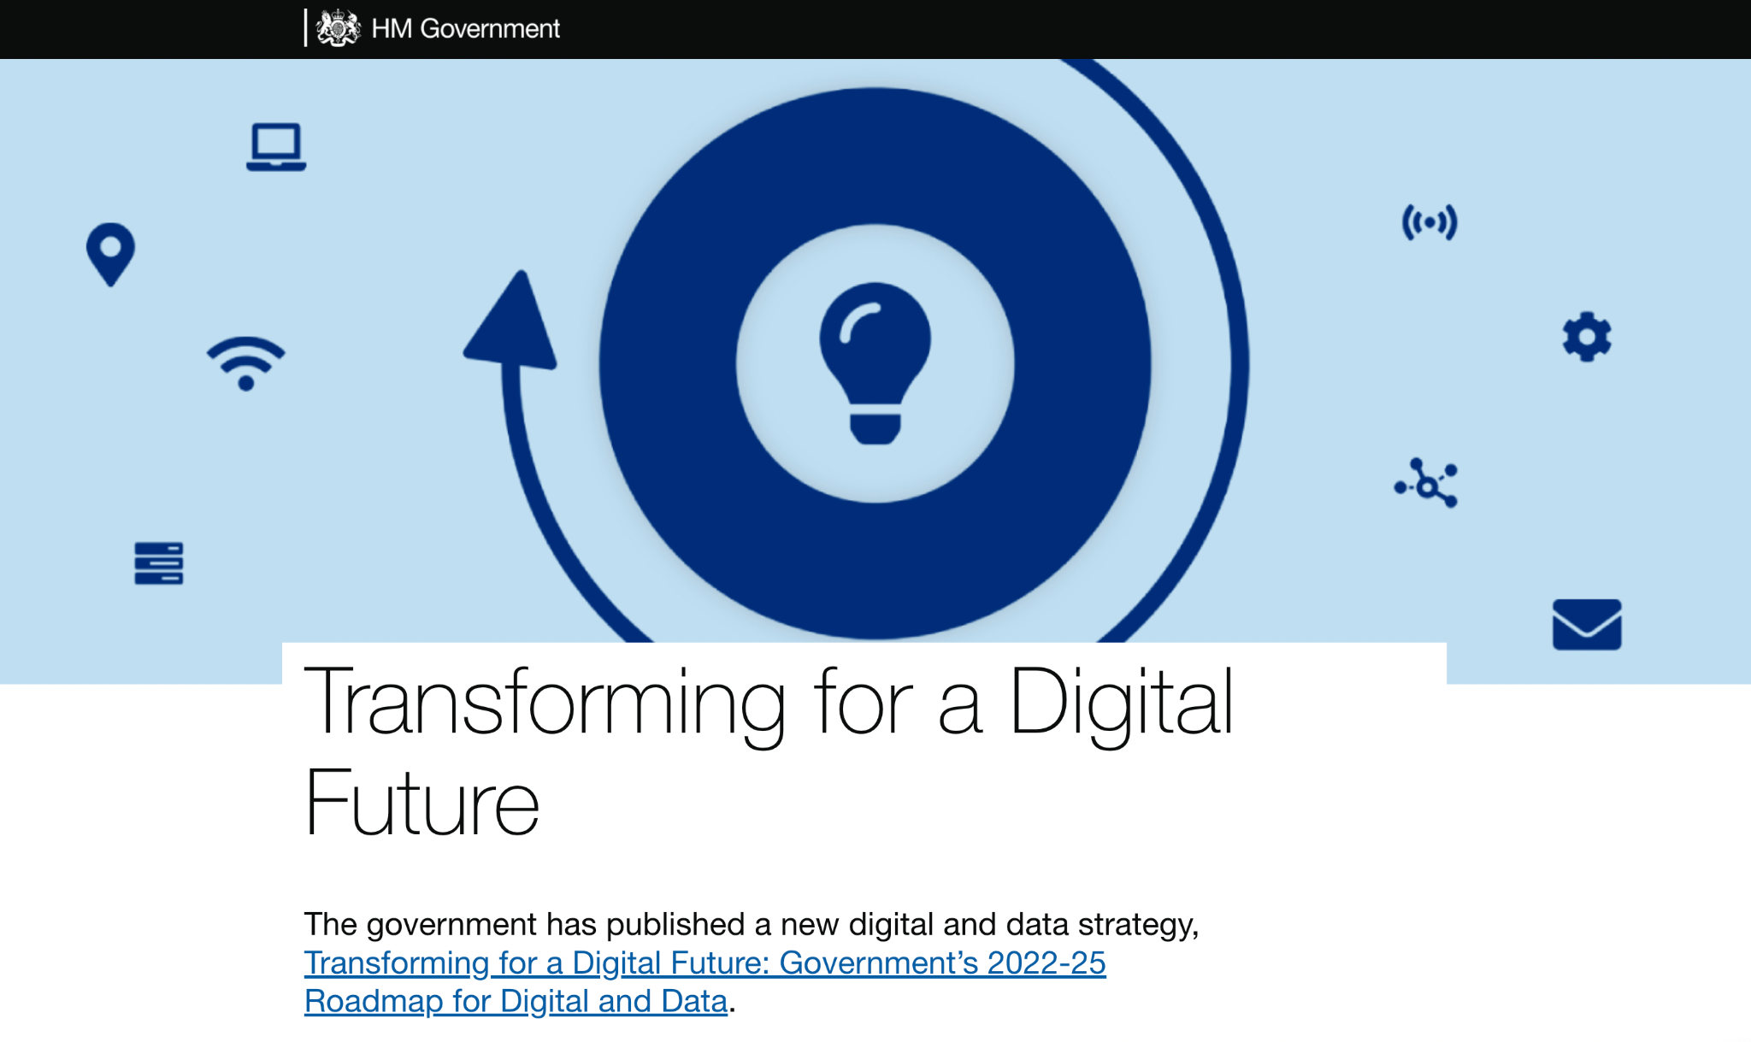

Slide 5
Bringing the community together
Data Connect
Our Data Communities
Putting in place governance - and driving collective action
Data and Technology Architecture Design Authority
CDO Council
Recognising the importance of data management
The Data Maturity Assessment
Removing legal barriers
Digital Economy Act 2017
Data Sharing Network of Experts
Putting ethics and transparency at the heart of what we do
Algorithmic Transparency Recording Standard
Some of our successes so far

Slide 6
Two questions
1 | Where are we now?
2 | What’s next?
Notes:
Which brings me to what’s next?

Slide 7
The bedrock for responsible adoption of new tech
Cross-government data standards
The right frameworks for responsible adoption

Slide 8
The Government Data Marketplace
Essential Shared Data Assets
Metadata specification
Data
Standards

Slide 9
Emerging technologies such as GenAI
Landscape Review of existing guidance on responsible use of data and AI
Framework
for responsible adoption

