Slide 1
The Public Sector Tech Marketplace: What's the picture in 2023?
Gus Tugendhat, Founder
18th October 2023

Slide 2
Trusted by buyers, suppliers and the media
Sample Customers and Media Partners
Public Sector
Suppliers
Media
260+
Press citations in 2022
“Serious-minded business data provider Tussell”
Matthew Vincent

Slide 3
Transforming open data into actionable data
Open Data
Third-Party Data
Data Processing
Contract Data
Companies House
Suppliers
Win government contracts
TED (EU) / FTS
Aggregate
Contracts Finder (UK), Sell2Wales, PCS
Digital Marketplace
Match
Public Sector
Get better value from suppliers
Circa 70 local portals
Normalise
Spend Data
Cleanse
916 public bodies
Machine learn
Contact Data
Details of 80,000 Key Decision-makers
Moody’s Analytics
Press
Scrutinise public spending
We use a combination of machine & human data validation to maintain best-in-class data quality and accuracy

Slide 4
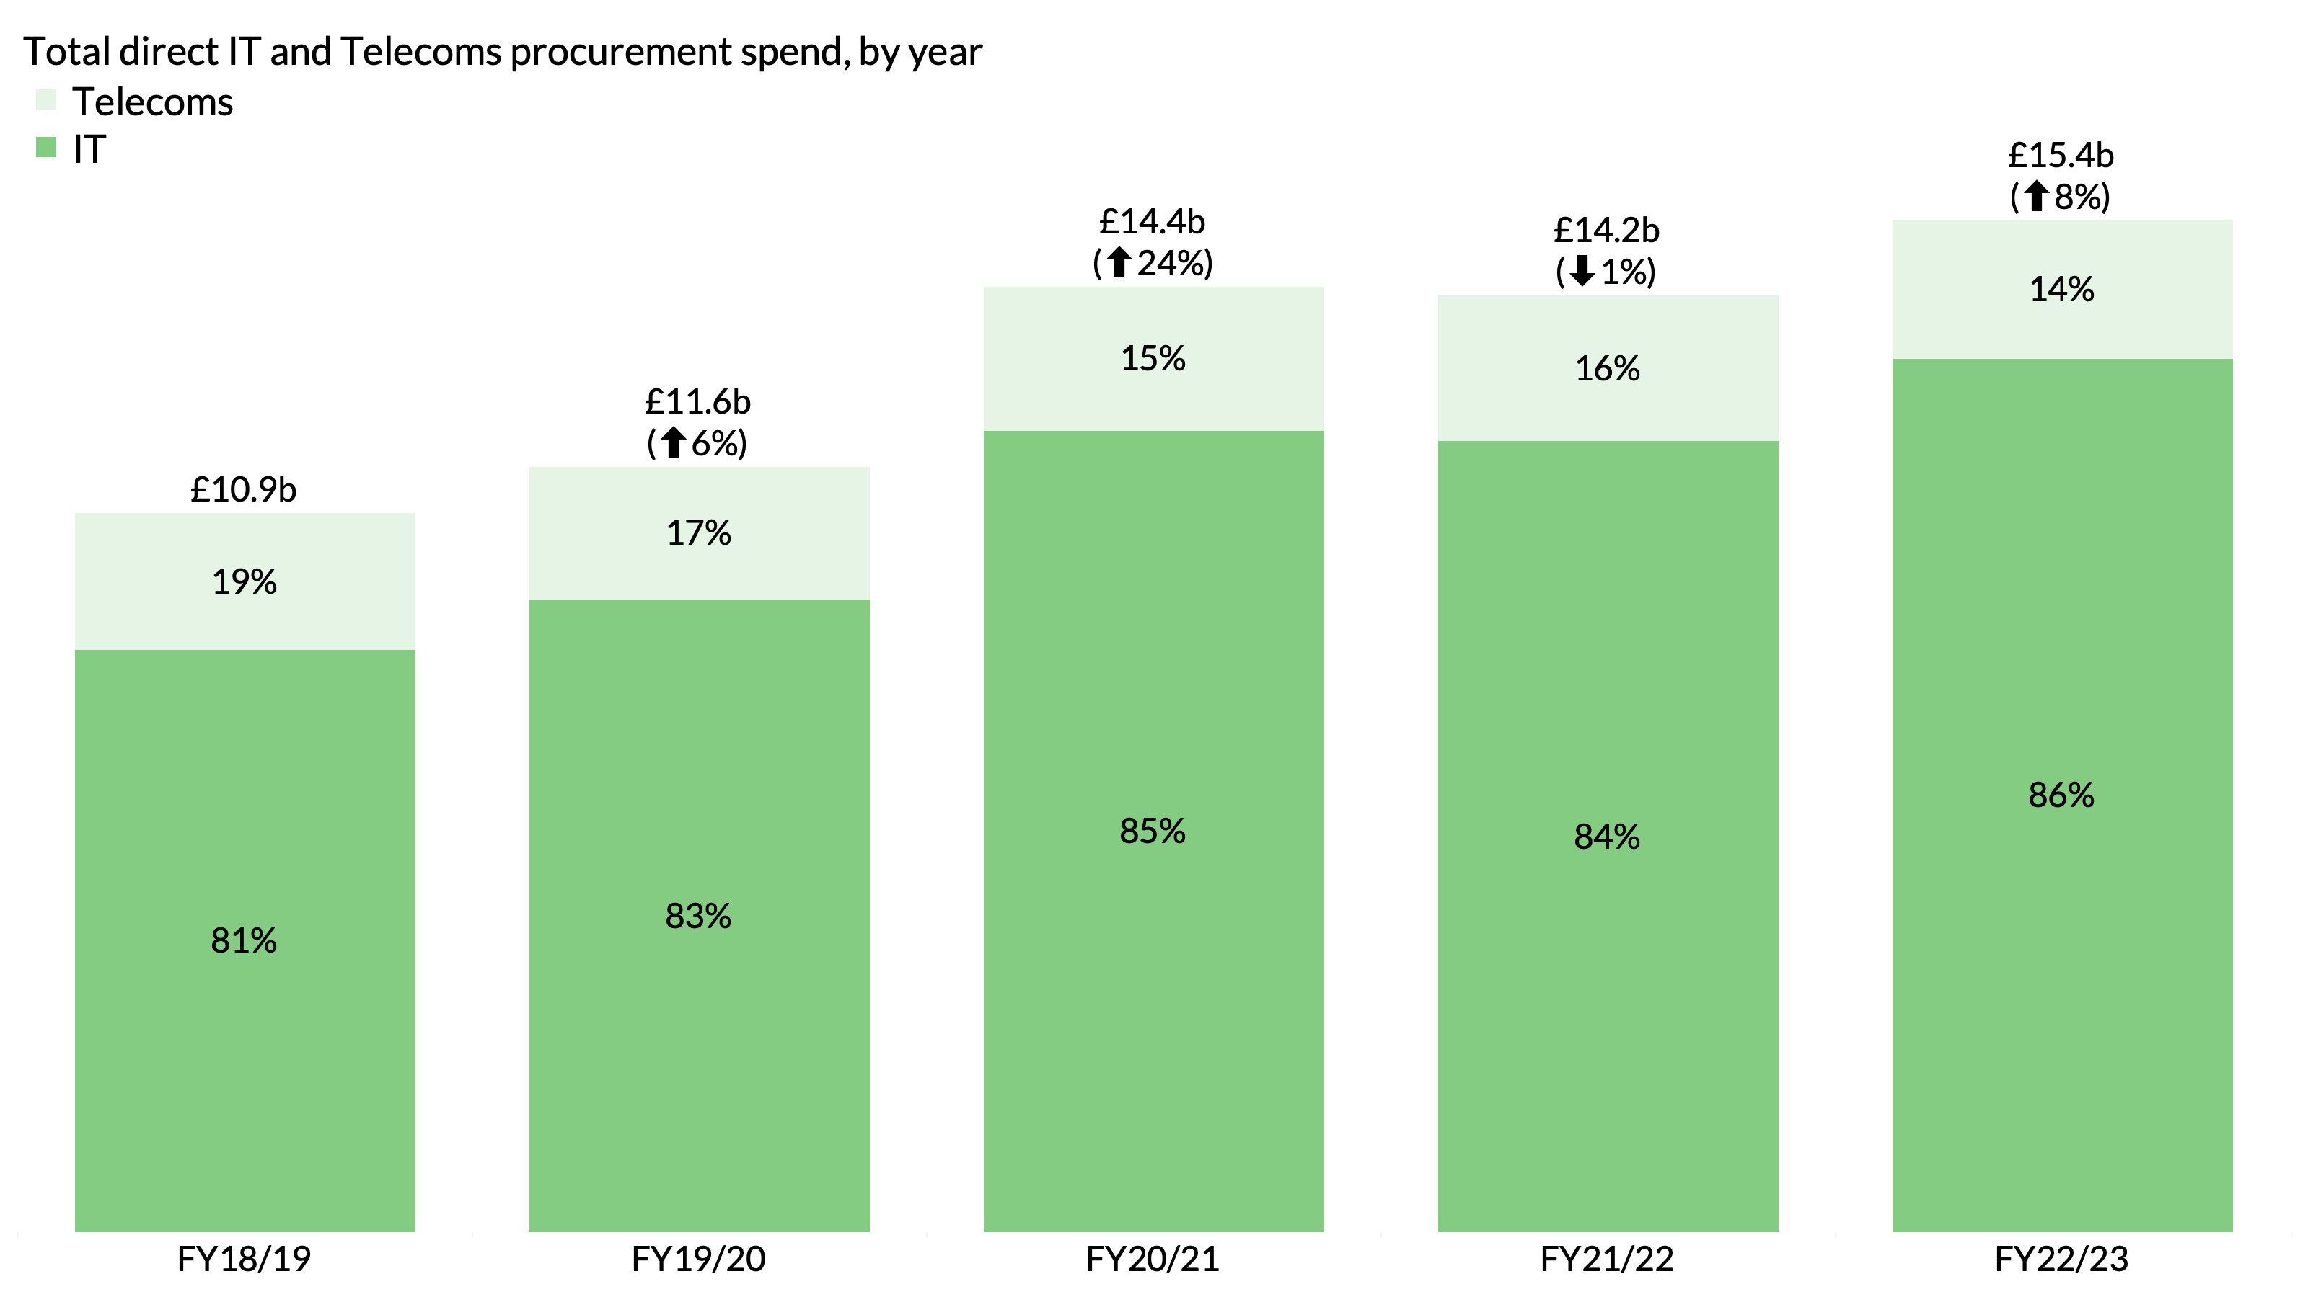
Wider public sector procurement spend on ICT grew sharply during the pandemic and has carried on growing from that baseline – the new normal
*This analysis excludes buyers who are yet to publish full invoices for FY22/23 incl. MOJ, HMPPS, Met Police
Notes:
Total: £52.3bn

Slide 5
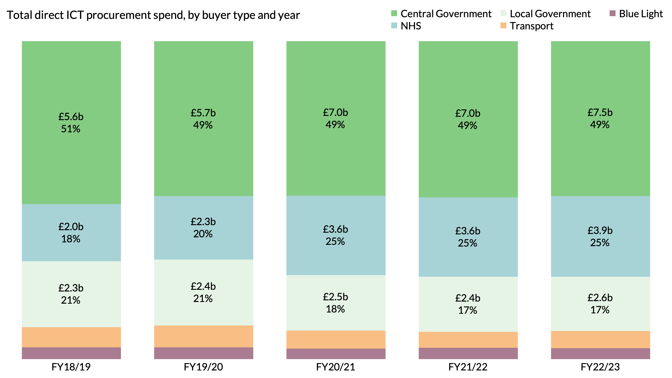
Half of the addressable market for ICT procurement is in Central Gov’t, while the NHS has overtaken Local Govt and now accounts for one quarter of the total
Notes:
Total: £52.3bn

Slide 6
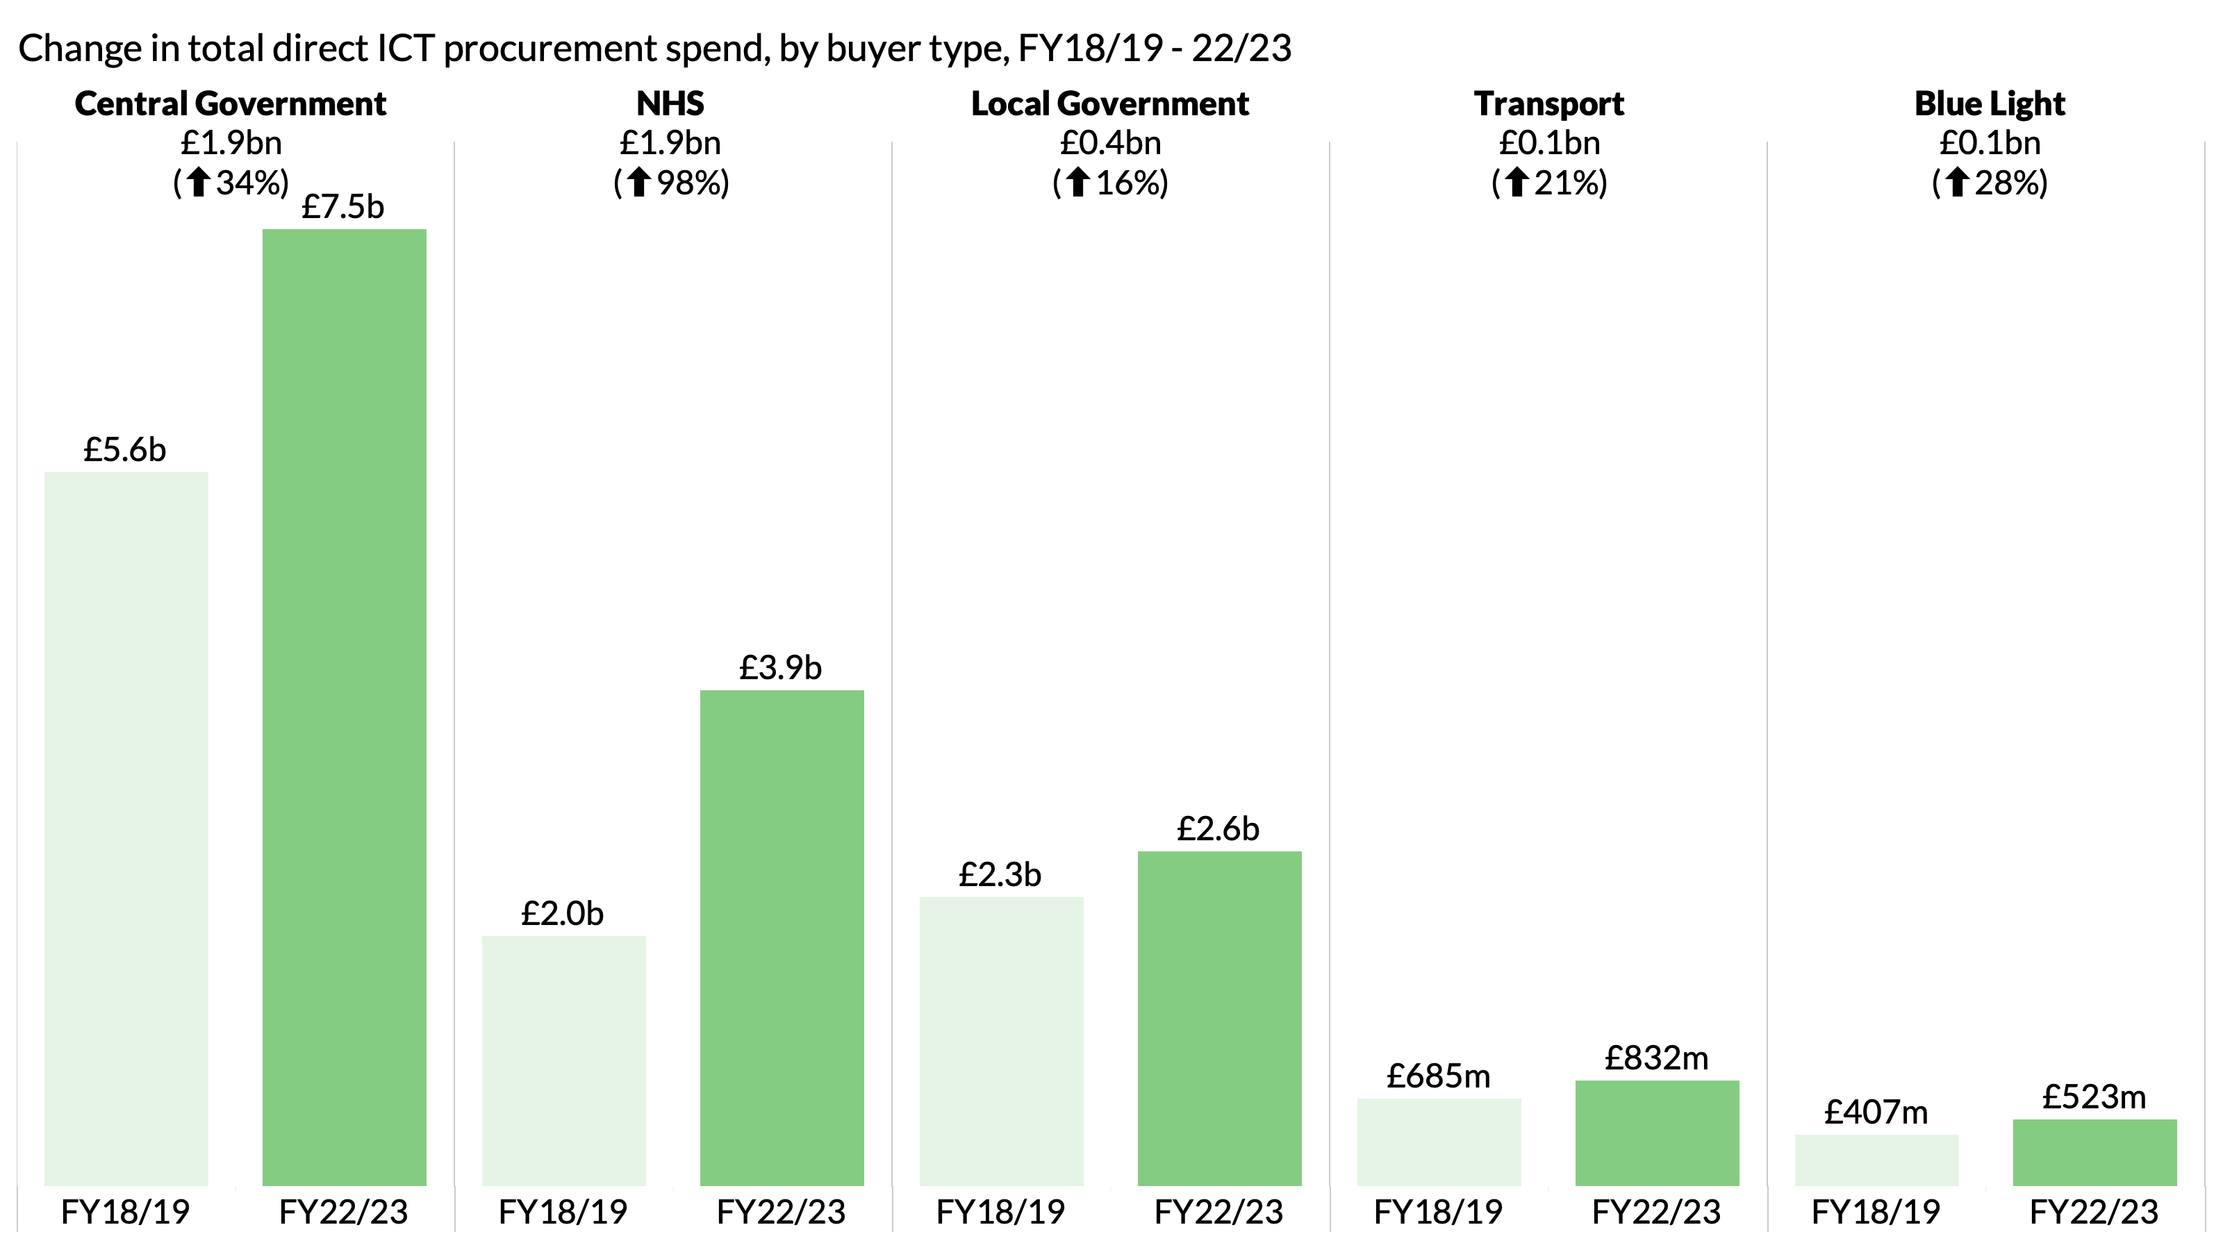
The NHS now accounts for the second largest pool of ICT procurement spend, nearly doubling in size over four years
Notes:
Total: £52.3bn

Slide 7
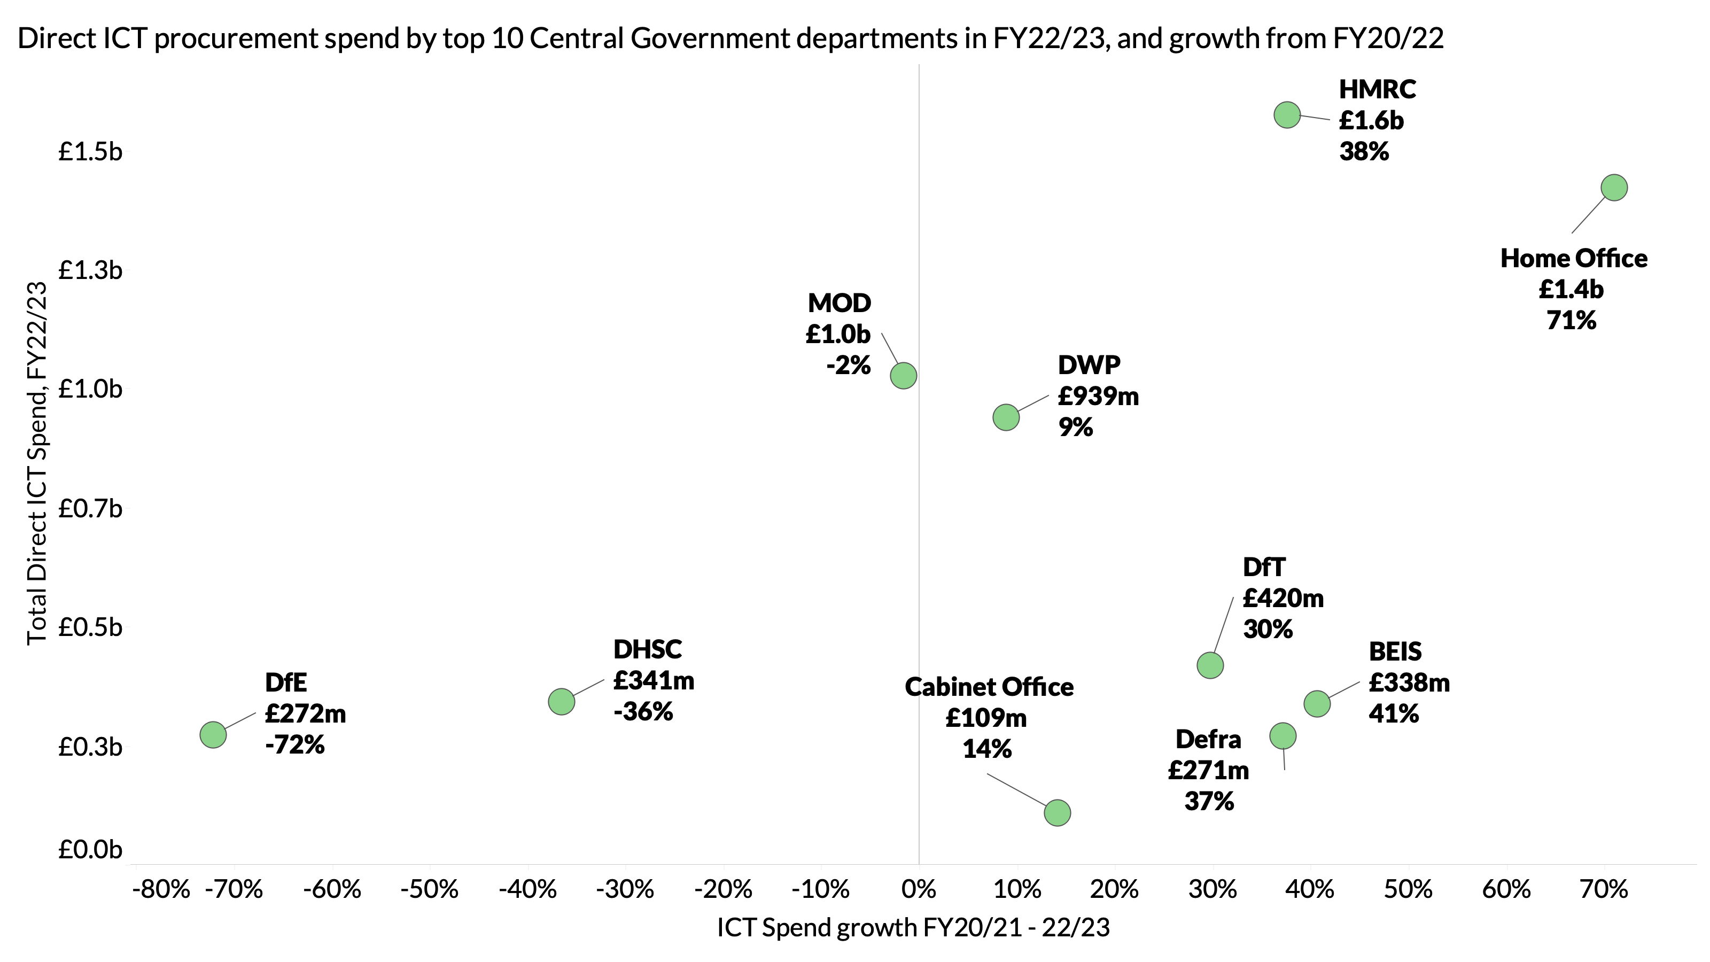
The top 10 Central Govt departments have very different profiles of ICT procurement spend
*BEIS was split into 3 separate departments in 2023
Notes:
Total: £52.3bn

Slide 8
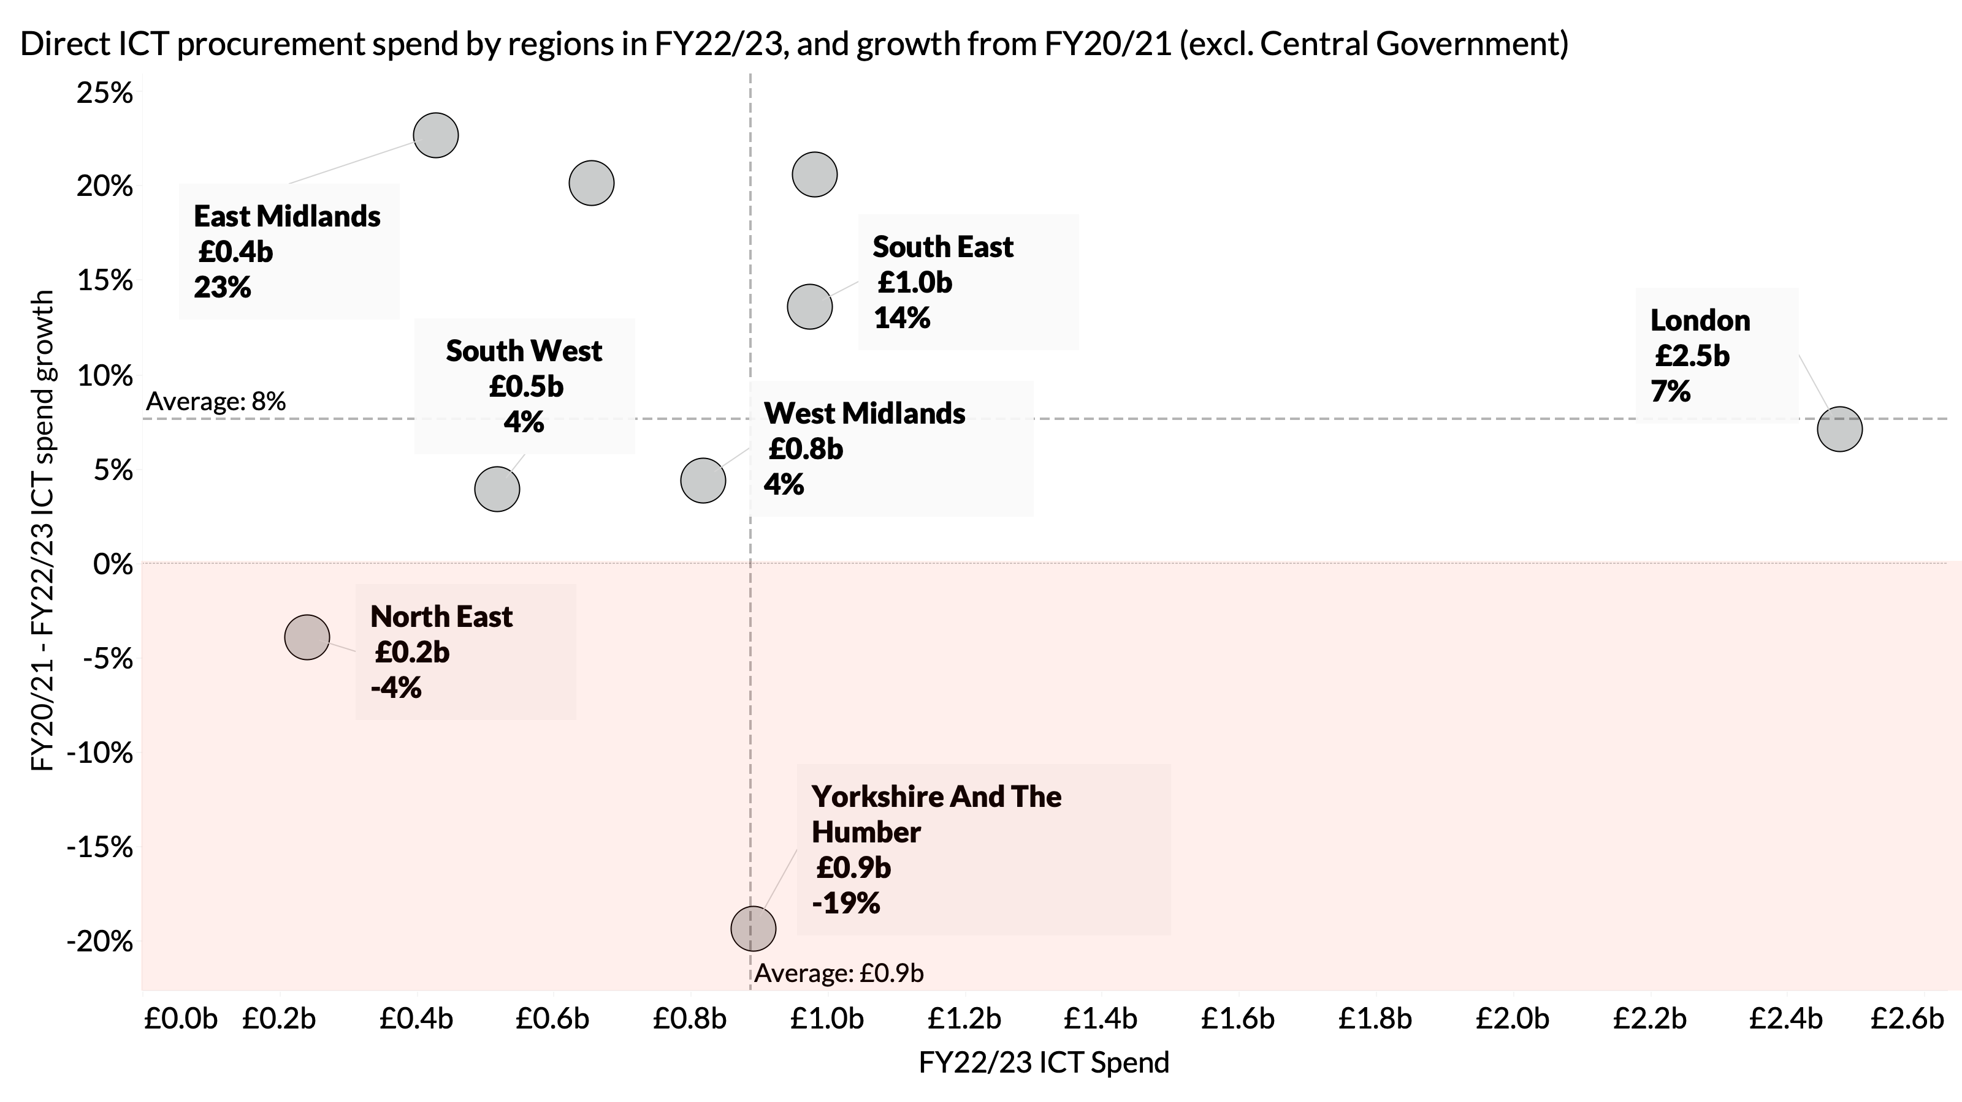
Trends in ICT procurement spend show regional disparities as well (excludes Central Govt)
East of England
North West
Notes:
Yorkshire has shrunk because NHS England (who is headquartered there) has shrunk by 38% - mostly due to a drop off in spend going to Capita
the South West, as well as the North East and Yorkshire – is that they are spending considerably less than other regions with IT reseller, the Access Group

Slide 9
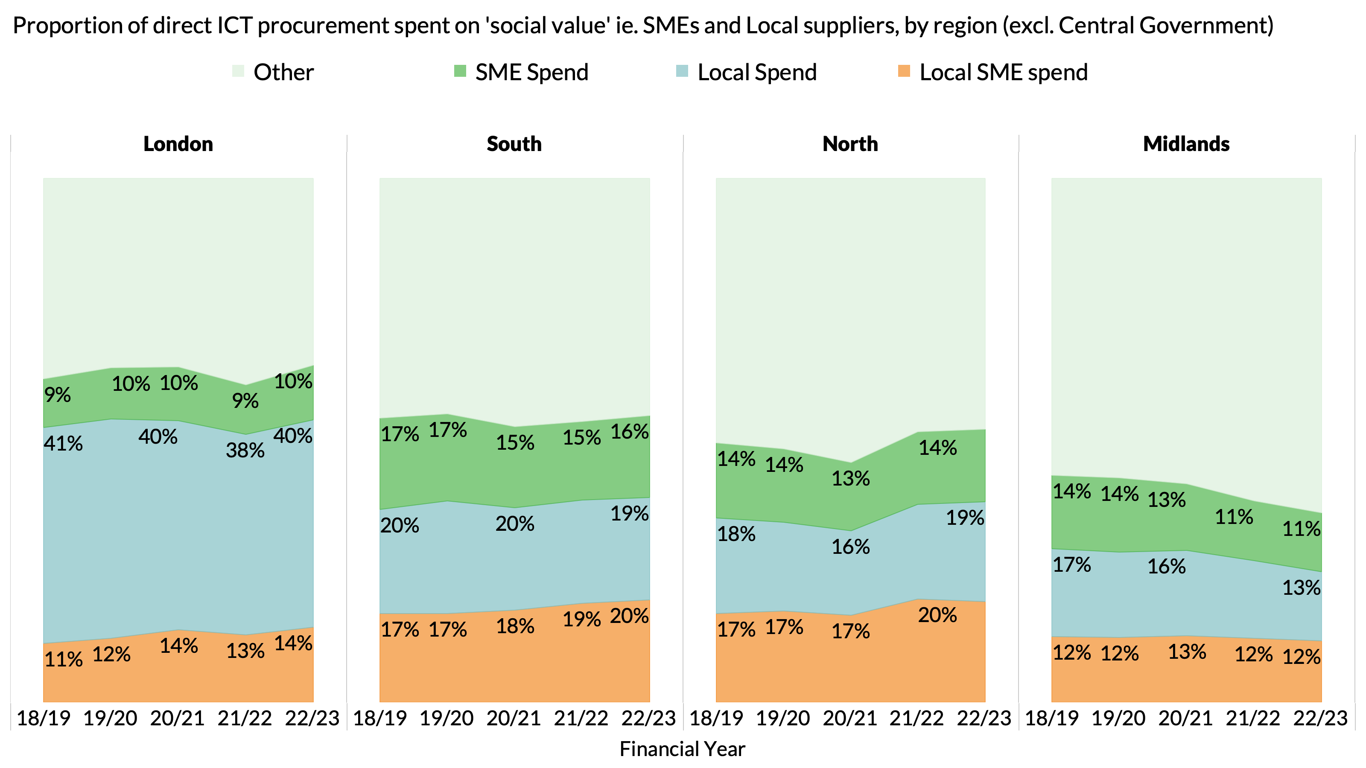
Excluding Central Govt, roughly 50% of ICT procurement spend is with SMEs and/or local firms
Notes:
Total: £52.3bn

Slide 10
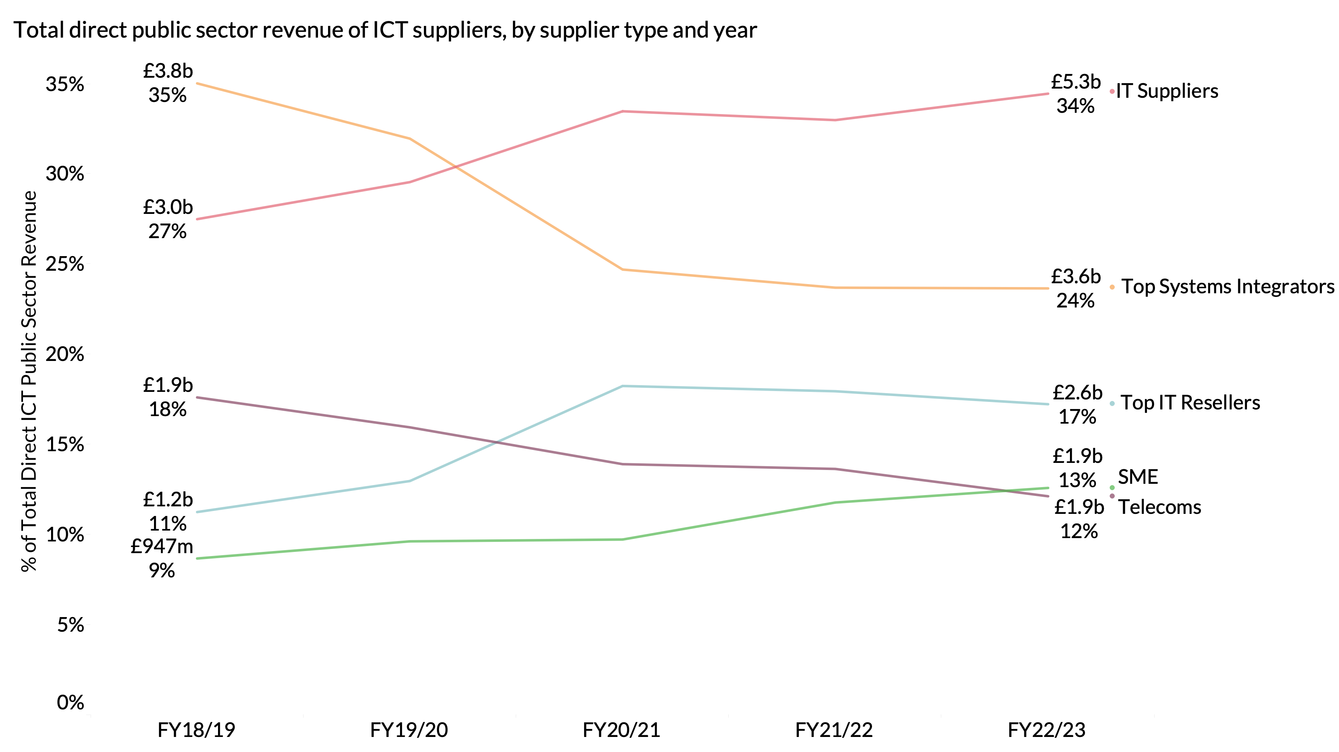
The market landscape has evolved significantly, with a marked increase in purchasing from the IT vendors and resellers
Notes:
Total: £52.3bn

Slide 11
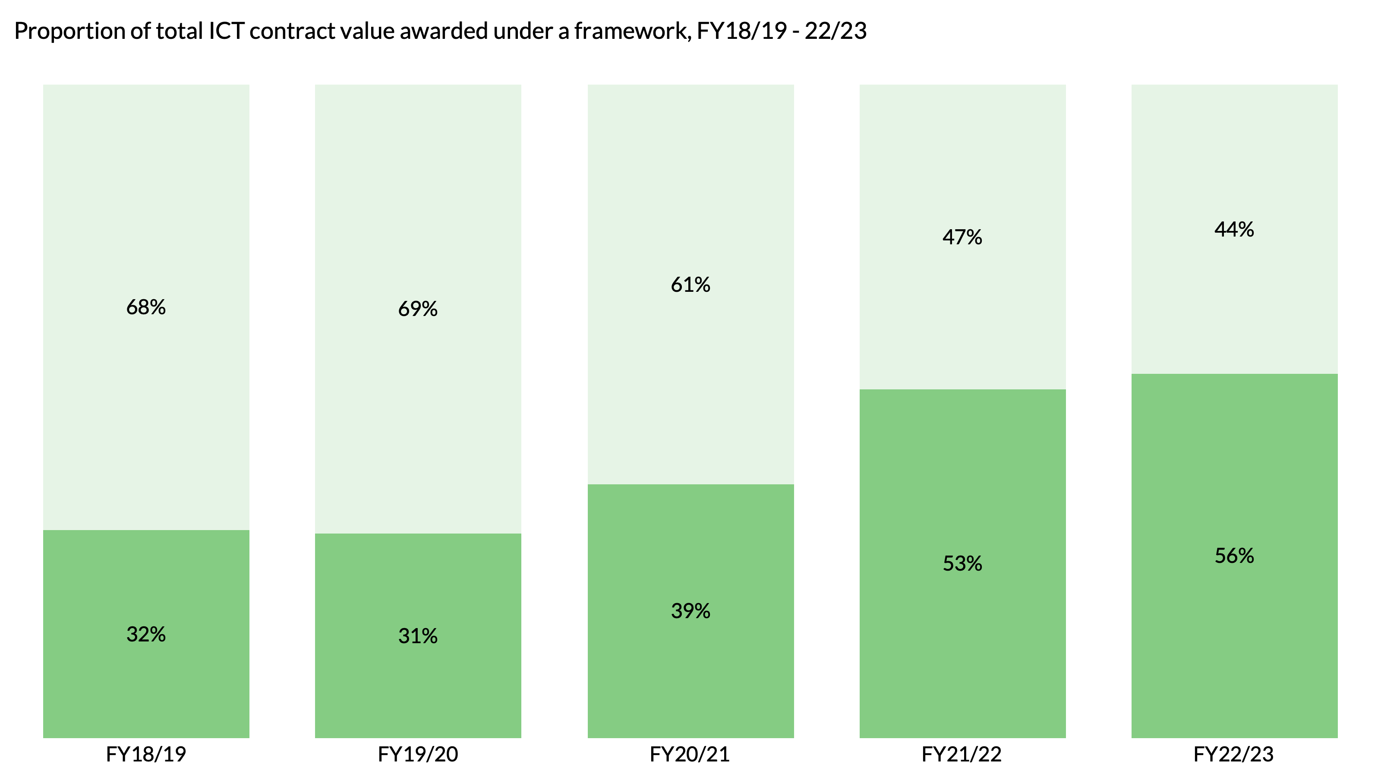
Frameworks have become the dominant route to market within the ICT space
Notes:
Total: £52.3bn

Slide 12
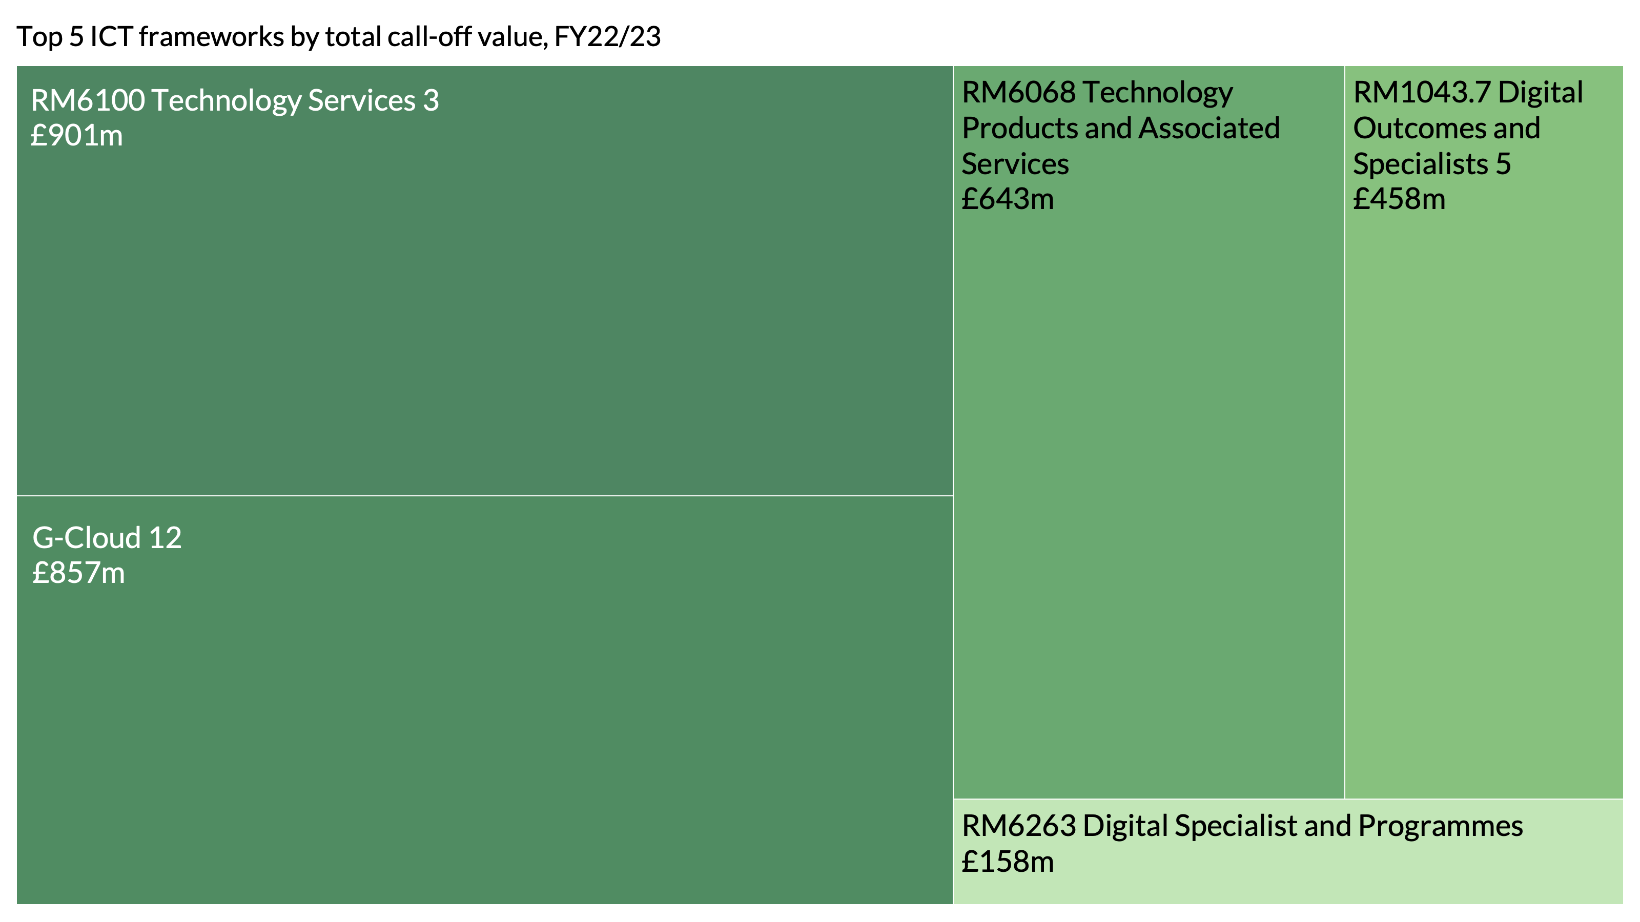
It is vital for buyers and suppliers alike to utilise the right framework
Notes:
Total: £52.3bn

Slide 13
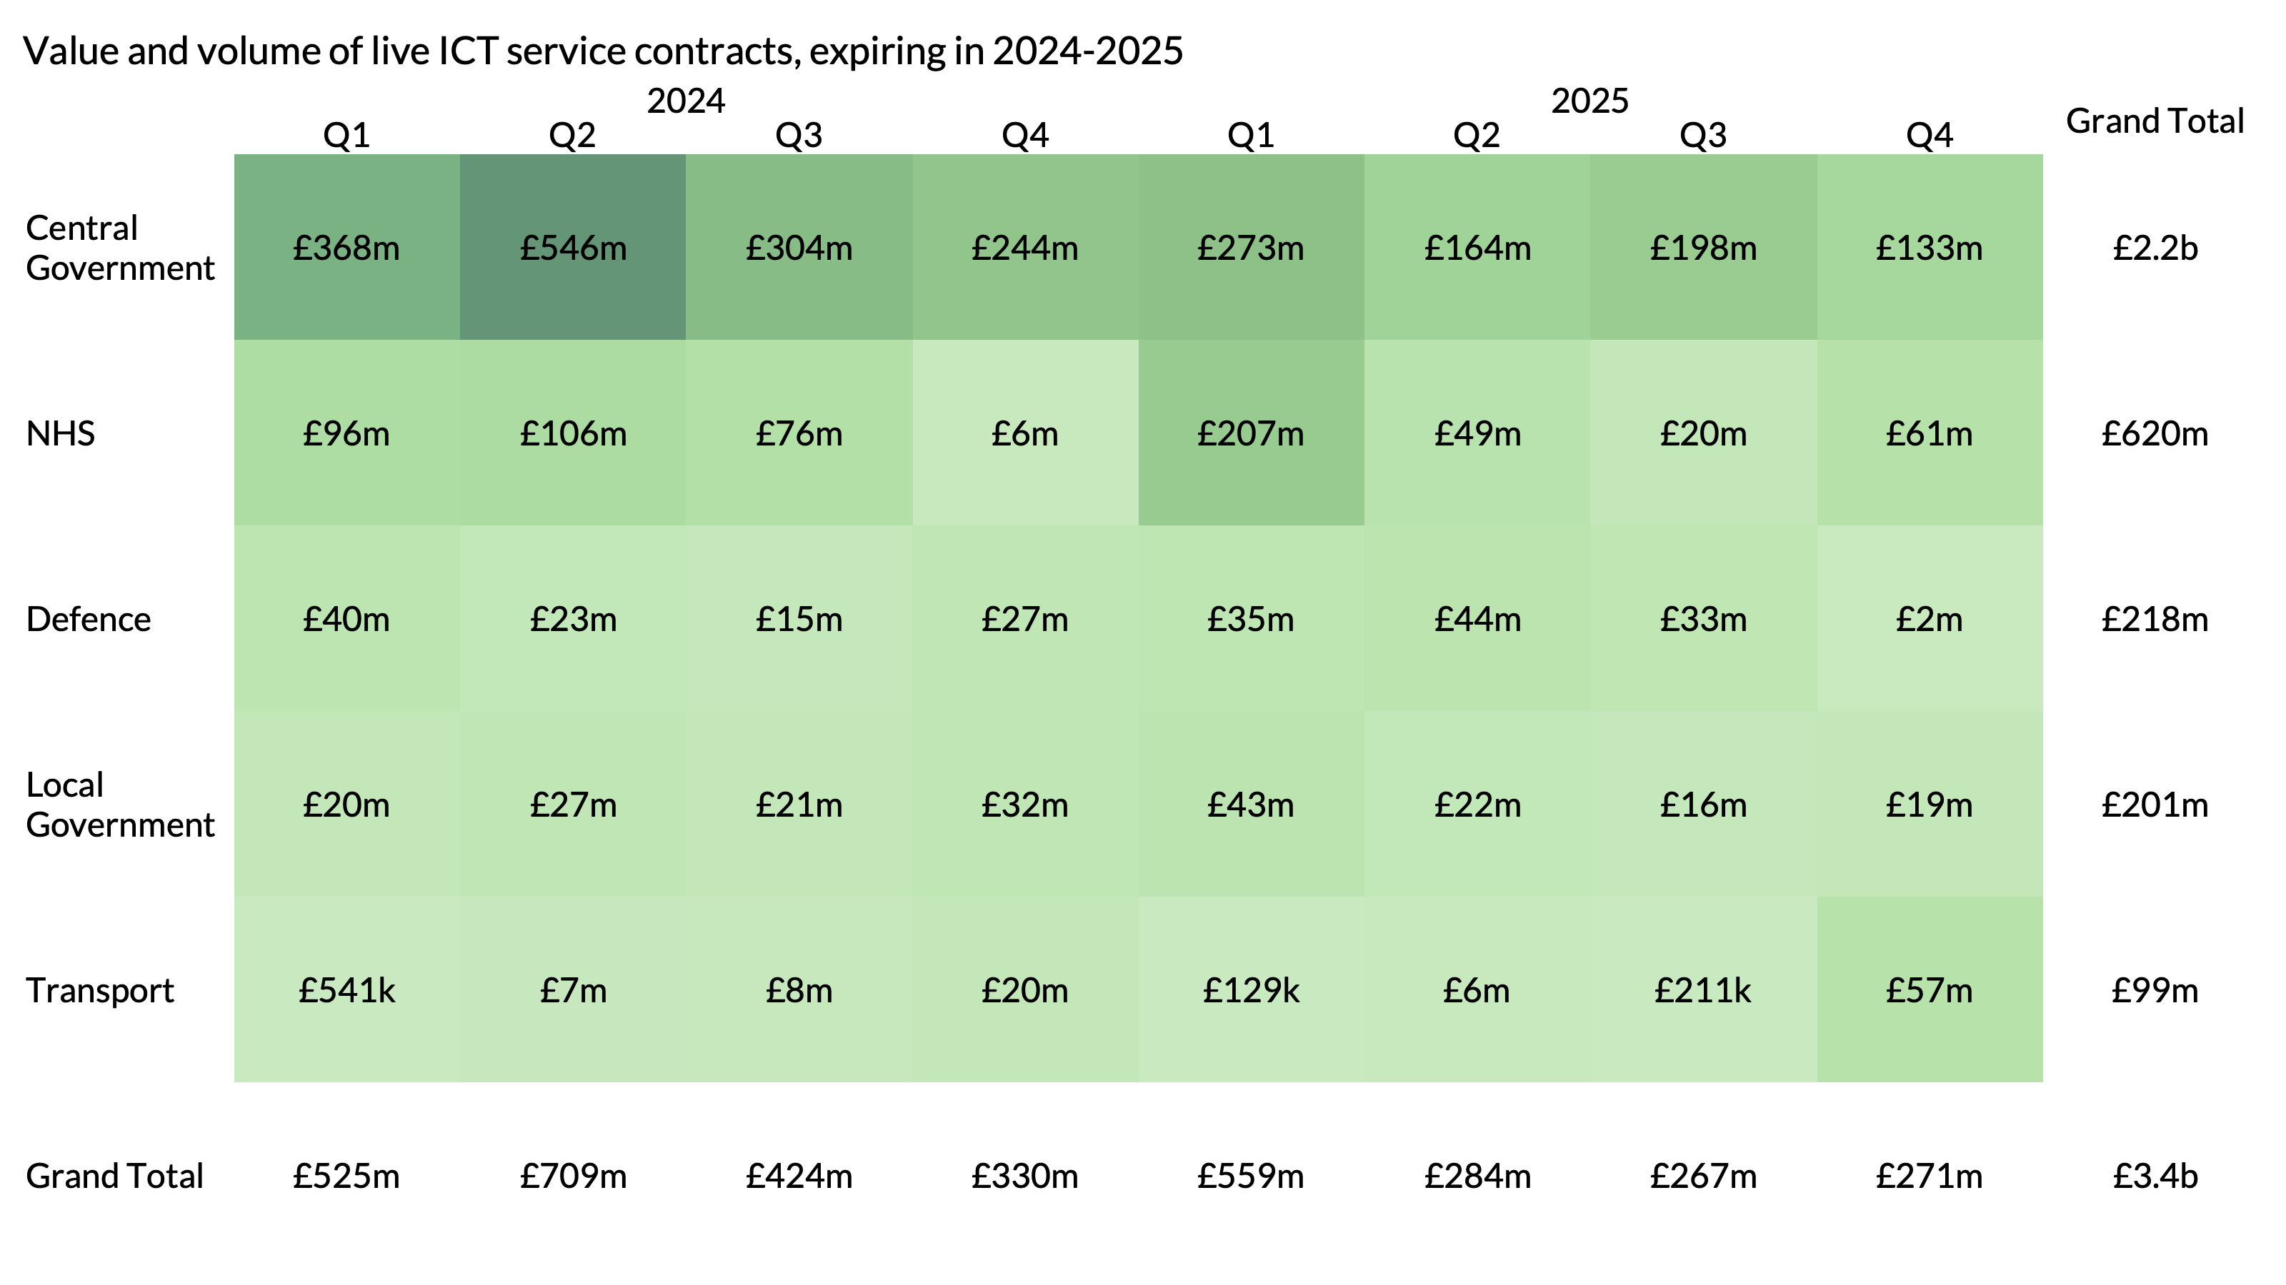
There are £3.4b worth of ICT services contracts expiring in the next 2 years – are you ready to capitalise on the upcoming opportunity?
Notes:
Total: £52.3bn

Slide 14
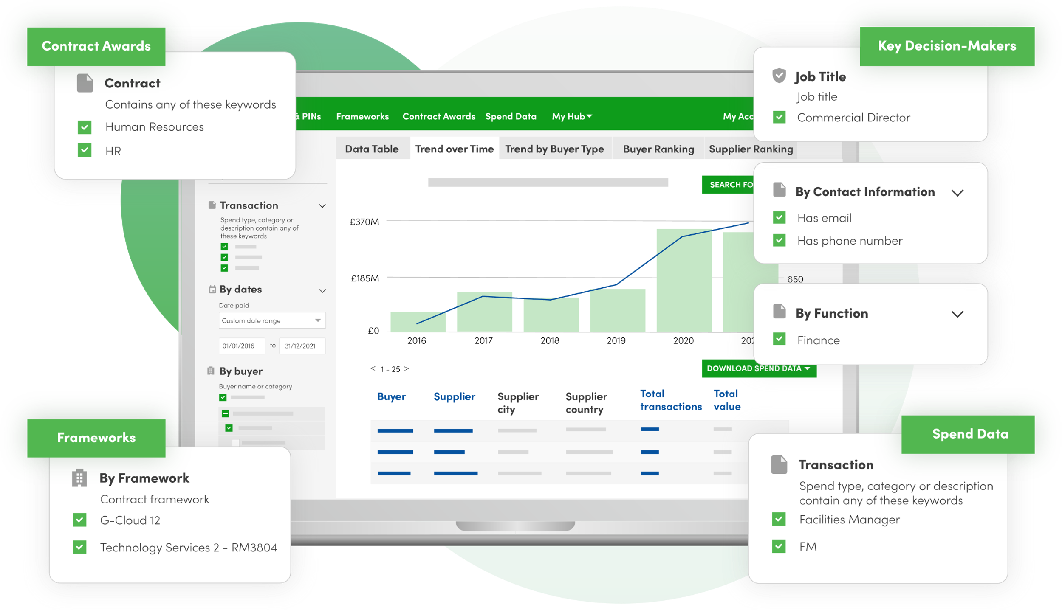
All the data in this report comes directly from Tussell’s online market intelligence platform
To learn more and see it in action visit tussell.com or email me at gus@tussell.com

