Slide 1
The Challenge of Delivering Data Maturity for UK Government
October 2023

Slide 2
Aim of the research
Who we surveyed: 400 civil servants across grades, with differences with senior grades emphasised
Aim of this presentation

Slide 3
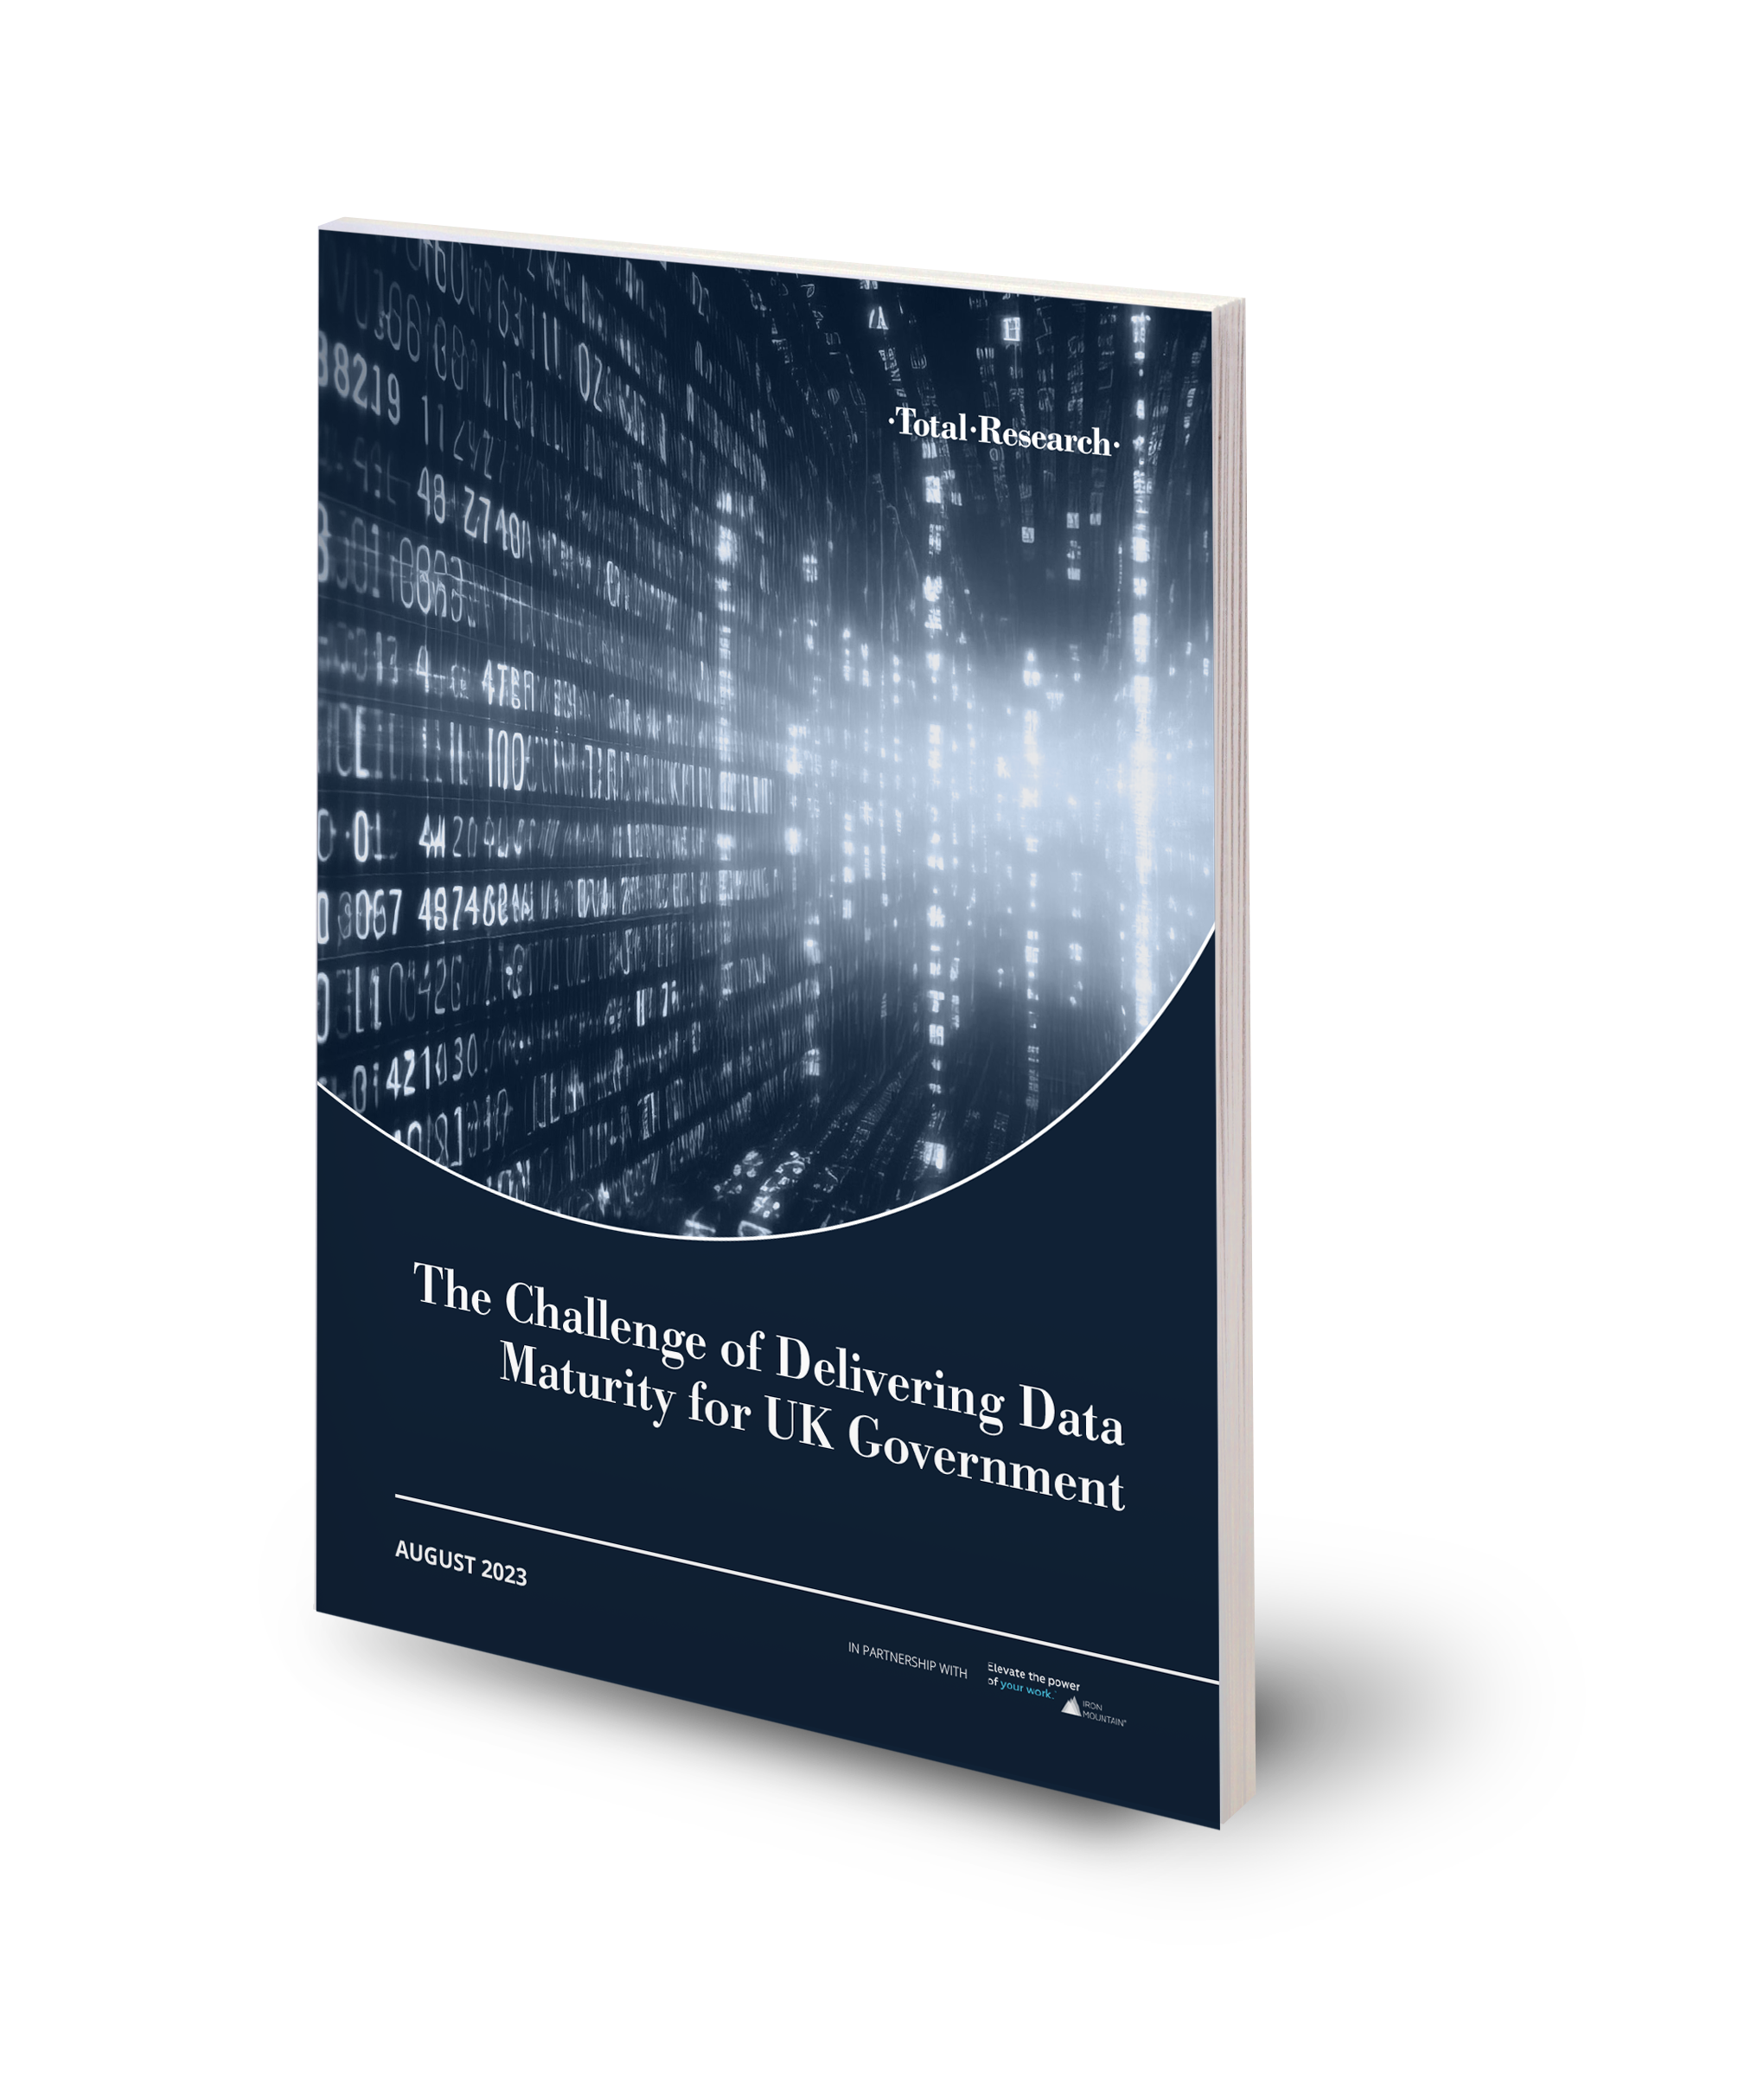
Government digitisation drives and reports:
Data Standards Authority Strategy 2020 to 2023
Challenges in using data across government
Data Maturity Assessment for Government

Slide 4
What data do you have and what do you do with it?

Slide 5
Awareness of the number of data repositories your organisation has access to
Q: Approximately, how many data repositories does your department/organisation use/have access to?

Slide 6
Method used by organisations to create, process and store data

Slide 7
Processing of citizen data
Q: How does your department/organisation process citizen data?

Slide 8
System migration to the cloud
Q: Approximately, how many of your department/organisation’s IT systems have migrated to the cloud from on-premises?

Slide 9
Joining datasets with other relevant departments
Q: Is your organisation looking at joining datasets with other relevant departments to improve processes and create seamless public service experiences for citizens?

Slide 10
Ease of cross-referencing information or joining up datasets for analysis
Q: Within your department/organisation, how easy is it to cross-reference information or join up datasets for analysis?

Slide 11
Top difficulties making use of data
Q: What are the top three difficulties faced by your department/organisation when making use of datasets?

Slide 12
Information Governance

Slide 13
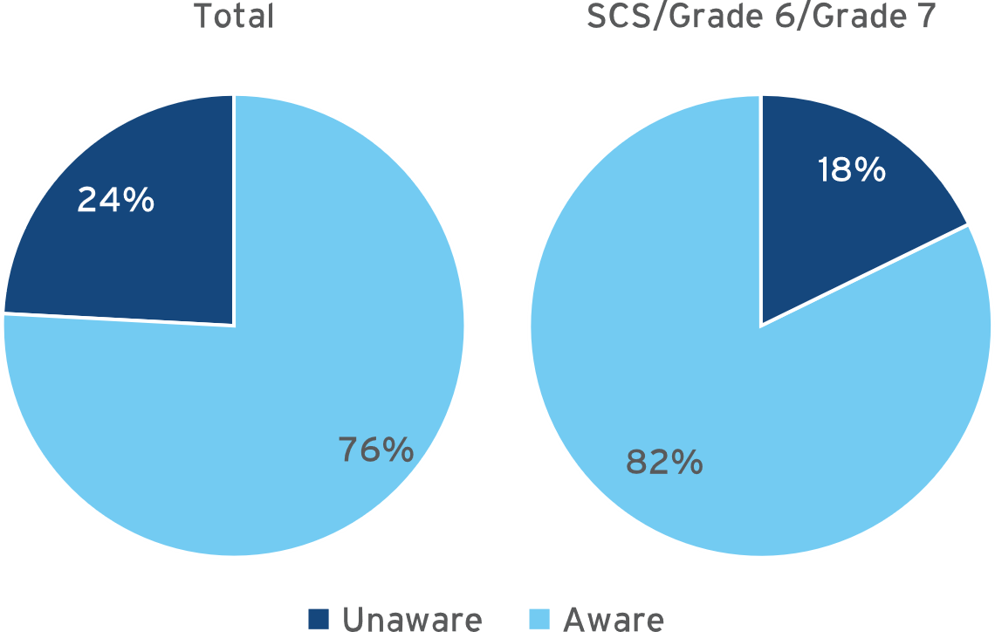
Awareness of organisation’s information governance policy & managament
Q: Are you aware of your department/ organisation’s information governance policy and how to implement it in your role?
Q: My department regularly performs thorough ROT (Redundant, Obsolete and Trivial) data-removal exercises
Only 39% agree…

Slide 14
‘Reasons why it doesn’t happen’
“Lack of resource, inability to understand completeness of requirement, and lack of senior management acceptance of risk.”
- Senior Executive Officer (SEO), HM Treasury
“There is never time to go back and review old files and records to determine which should be retained to help corporate memory, and which can be disposed of - we are always working on the next priority.”
- Grade 7, Department for Education
“Resources - People, Costs, and Time. Forgetting what ROT data we may have, and overlooking dealing with it appropriately.”
- Grade 7, HMRC
“No one takes the lead to drive removal. Staff probably have a fear of getting rid of data in case it is required again.”
- Higher Executive Officer (HEO), Home office
“Information is stored on too many different platforms and historical information has not been dealt with.”
- Executive Officer (EO), Department for Work & Pensions
“The volume of data is a challenge”
- Senior Executive Officer (SEO), Home Office

Slide 15
Other areas covered included data security, management of end-of-life assets, management of Subject Access requests and more

Slide 16
Recommendations
Reduce paper-based processes
Modernise legacy systems
Address data fragmentation
Improve data governance practices

Slide 17
Where does Iron Mountain fit in?
Range of services to support transition to digital working, streamlined data management, good information governance
Case studies
Come and see us at Stand 16 for a free copy of the full research report!

