Slide 1
Strictly Confidential
This document includes confidential and proprietary information of and regarding Climate Essentials Ltd. This document is provided for information purposes only. You may not use this document except for information purposes, and you may not reproduce this document in whole or in part, or divulge any of its contents without the prior written consent of Climate Essentials Ltd. By accepting this document, and continuing to read on, you agree to be bound by these restrictions and limitations.

Slide 2
Climate Essentials is a clean tech company enabling the transition to net zero for cities and private organisations.
Our award-winning Climate Intelligence Platform, uses data to plan, mobilise and action the decarbonisation strategy of different stakeholders across their entire value chain.
CONFIDENTIAL

Slide 3
Climate Essentials Platform
Climate Intelligence for Multiplicators
Provides bottom-up data analytics of SME emissions to Multiplicator organisations to inform carbon reduction policy/ initiatives
Data Analytics and Insights
Tailored support
and
engagement
>700 data points
Charging
points
Commute
needs
Heating
requirements
Utility bills
Delivers a tool that is simple to use and empowers SMEs to measure and reduce their carbon emissions
Employee data
Expenditure
Net-Zero Platform for Businesses
CONFIDENTIAL

Slide 4
Climate Essentials - The Components for Businesses
Measure
Track
Reduce
Report
CONFIDENTIAL

Slide 5
Carbon Analytics & Reporting
Data visualisation of your business ecosystem. Supporting CSR and ESG reporting. Quantifying the impact of your ecosystem carbon emissions, reductions, and net-zero strategies.
CONFIDENTIAL

Slide 6
Programme Impact & Testimonials
180
600+
90
SUPPORTED TO MEASURE AND REDUCE EMISSIONS
SMEs ACROSS LONDON WITH ACCESS
SMEs ON THE PROGRAMME SO FAR
4KT
2
66KT
CO₂e PLEDGED TO BE REDUCED
SMEs AWARDED 'HEROS OF NET ZERO' AT COP 26
CO₂e MEASURED IN FIRST PILOT
400%
5
2
SURPASSED THE CO₂e REDUCTION GOAL
ADDITIONAL CONTRACTS WON THROUGH THIS WORK
YEAR CONTRACT EXTENSION
CONFIDENTIAL

Slide 7
Purpose-Driven and Impact-Based
Read our 2022 impact report
1000+
17
14,000
organisations
business engagement programmes
tonnes CO2e
Have started measuring their emissions and devising a net-zero strategy using Climate Essentials
Delivered with local authorities and other multiplicators. Westminster City Council, Milton Keynes, and Bournemouth are some of our clients
Reductions achieved through our platform. This is equal to £292,000 worth of energy cost savings for 2022
“Net zero is the economic opportunity of the 21st century”¹
CONFIDENTIAL
¹Independent Review of Net Zero - Chair, Net Zero Review, MP Chris Skidmore

Slide 8
Team
Daniela Menzky
Steve Berry
Founder and Director
Director
Managing Director, HAVI Global Logistics
SVP HR and Strategy, Kodak
Founded and scaled several tech companies
35 years of experience in corporate finance
Prolific angel investor and mentor to several early stage companies
Serial Entrepreneur, 2 IPOs
Luca Zerbini
Dr. Garry Felgate
NED
Advisor
Venture capitalist focused on impact investing
ESG Operations Advisor - Advent International
Founder & CEO of Una Terra Fund, awarded Top Innovative Fund - World Economic Forum
Founder/ Director of the Carbon Trust
Deep expertise in clean energy
Co-founded and scaled energy company
Andrew Dakers
David van der Walt
Advisor
Advisor
Chief Executive of West London Business
Expertise and network in local government partnerships
Former CEO for Investec Bank
Several executive role across Investec Funds
Deep financial and economic sector expertise
CONFIDENTIAL

Slide 9
Team
Martina Colman
Anna Campbell
Head of Climate Science and Engineering
Head of Client Engagement & Delivery
Laura Mitchell
Dipesh Suralia
Client Delivery Manager & Investor Relations
Client Engagement Manager
Priyanka Dass Saharia
Lucy Coomes
Client Delivery Manager
Marketing & Communications Executive
Alexia Cammack
Khaled El Hariri
Commercial Development Executive
Climate Solutions Engineer
CONFIDENTIAL

Slide 10
Belfast:
Ormeau Baths, 18 Ormeau Ave, Belfast BT2 8HS
Bournemouth:
Barclays Eagle Labs Bournemouth,
300 Poole Rd, Westbourne,
Poole BH12 1AZ
Bristol:
2 Redcliffe Way, Redcliffe, Bristol BS1 6NL
London:
PopHub, 41 Whitcomb St, London WC2H 7DT
https://climateessentials.com
m.colman@climateessentials.com
CONFIDENTIAL

Slide 11
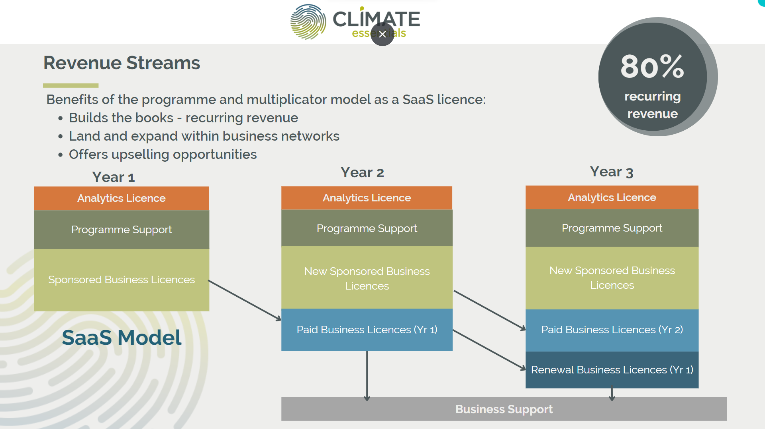
80%

Slide 12
Methodology and Approach
Reporting frameworks
Net-Zero Frameworks
Net-Zero Guidelines
Canada
UK
Europe
IWA 42:2022(en)
Net-zero guidelines
USA
China
14064-1:2018
India
Climate Essentials helps with:
South
America
Australia
South
Africa
Climate Essentials is translated into 6 languages and has functionality for 38 countries.
Developing functionality in multiple countries
Provide input data across energy, transport, products and services, and waste. Our unique carbon accounting methodology and estimation feature makes inputting easy and accessible.

