Slide 1
Data Strategy Unleashed:
Impactful Outcomes & Stakeholder Alignment
Neil McIvor, Chief Data Officer, Department for Education
Mohammad Syed, Principal Data Consultant, esynergy
October 2023

Slide 2
Speaker Introduction
01
Mohammad Syed
Principal Data Consultant
Neil McIvor
Chief Data Officer

Slide 3
What are Neil McIvor’s accountabilities as CDO?
02
Chief Data Officer
Head of Practice for Data
Accountable for reducing duplication and deriving full value from the Department’s data through: Data-driven design and seamless user journeys Provision of trusted data sets which are easily accessible Effective master data management Understanding and mapping the Departmental data estate Accountable for ensuring full Departmental compliance with the Data Protection Act
Accountable for developing the data professions (Data Architecture, Data Engineers, Data Operations)
Head of Profession for KIM
Accountable for developing the KIM professions
Senior Responsible Owner
CDO
Senior Information Risk Officer
Accountable for the delivery of Data Directorate’s projects, products and services, including: Data collections & data services Digital services Knowledge management
Accountable for managing legal and other risk around data and information, including: Data protection (DPIAs, GDPR, data sharing) Data governance (subject access requests) Data security Knowledge & information management (Information Asset Register)
Cross-Government Data Strategy Leadership
DDAT Function & Ops Group Leadership
Shared accountability for defining and implementing the DfE Digital, Data & Technology Strategy Jointly responsible for developing an effective cross- governmental data strategy.
Accountable for representing Data Directorate interests on: Digital, Data, & Technology Leadership Boards Co lead the DDaT functions across DfE Ops Group Leadership Boards
Key:
Governmental responsibilities
Departmental responsibilities

Slide 4
What We Do
03
Our Service Groups
Data Across the Department
Collection, Processing & Provision of Data
Insights & Analytics
Data Advisory
Knowledge and Information Management (KIM)
Data Compliance
Providing analytical and modelling capabilities to deliver data insights to internal and external data users.
Providing data users across the department with advice around best practice and standards in data engineering, data architecture, data protection and data governance.
Setting the standards, creating the policies, and monitoring the legal compliance against set standards (e.g. Data Governance) to ensure services are abiding to government regulations.
Managing the end-to-end process of data provision – from data collection and processing through to sharing, publishing, and providing the platform(s) to access the data and tools conduct any required analysis. Supported by service management and service development capabilities.
Advice and guidance on access to and collection of paper records (using offsite provider Restore), on management of digital knowledge and information content in shared areas in DfE and anywhere else that DfE records are held.

Slide 5
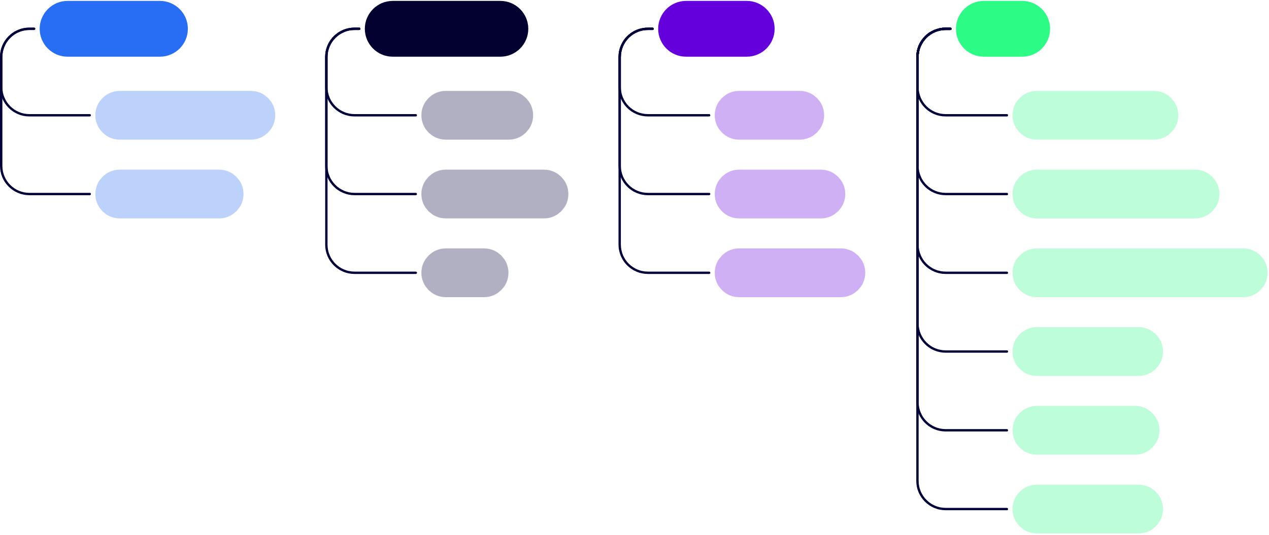
Partners on the Journey
05
Data Landscape 2023 Onwards
Outcomes
Compliance
People
Tech
Measurable outcomes are key to determine, as well as the owners Business users own the outcomes, not the Data Team Focus on things the business gets like Revenue, Cost, Compliance Capabilities are interesting, but not easy to explain Consider Product approaches to defining value
Value to citizens
Process
Culture
Ingesting data
Deliverables
Governance
Capability
Manufacturing data
GDS
Data literacy
Data products & analytics
Cost savings
Data quality
Use of cloud

Slide 6
Partners on the Journey
06
You will need friends that get the job done, work together and that you manage effectively
As a Data Leader, you need to ensure you have:
Strategy & Execution
Work to Primary Metrics (e.g. Revenue) that convince stakeholders to get on board- and get excited about future
Strategic advisors that you assess on deliverable impact, such as securing funding and getting business sponsors
Execution Partners that you assess on tangible delivery, such as new data platforms with X number of users
Capability & Talent partners that you assess on quality of staff & delivery metrics, such as data science capability
Capability & Talent
Technology & Platforms
Work to Primary Metrics (e.g. Revenue) that convince stakeholders to get on board- and get excited about future
Work to improve capabilities, enable delivery of portfolio and reduce total cost of ownership, as well as de- risk future projects.
Technology & Platforms partners that you assess on tech adoption, such as X number of users on new data tooling

Slide 7
Capability Over Time
07
We build clients capabilities so as the project progresses, we form an advisory service and the ability to deliver is in the hands of our clients
Fully owned delivery
Self sustaining
Level of input to sustain capability
Advisory role
Project progression - transition of capability
Key:
esynergy
Client

Slide 8
Deliver
08
Collaborating with the Crown Prosecution Service (CPS) build an innovative Case Management System
TIME SAVINGS
Developed an innovative Case Management System integration and application called Polaris that leveraged infrastructure-as-code principles and CI/CD processes. This saved users substantial time, with an estimated 112,000 hours in annual time savings.
“This development not only represents a technical advancement through Agile methodology at scale, but showcases a successful collaboration where we leveraged existing APIs to deliver a solution that meets our current needs, while providing a framework for future digital products and innovations."
SEAMLESS CUSTOM INTEGRATION
Leveraged data and APIs effectively by building a custom integration to seamlessly connect the new system to CPS's legacy systems. The API has been reused for other innovations.
Peter Haddock Head of Digital Solutions & Innovation, CPS
AUTOMATION AND BEST PRACTICE
Pioneered an agile, cloud-native architecture using automation and DevOps best practices. This enabled scalability, cost savings, faster delivery, and easier reuse of data and AI components.

Slide 9
Questions?

Slide 10
Thank you
Find us at the esynergy booth on the exhibitor floor to continue the conversation!

