Slide 1







Quantum Advantage Summit
October 18th, 2023
QE II Centre, London
Dr Michael N Cuthbert
Director – National Quantum Computing Centre
michael.cuthbert@stfc.ac.uk
Photo by Efe Kurnaz on Unsplash
© NQCC 2023

Slide 2
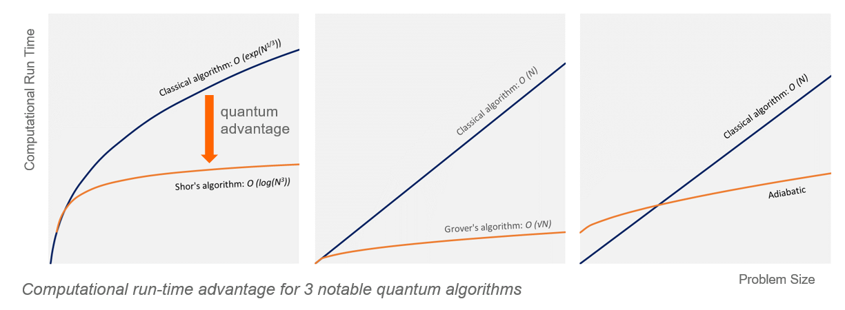
Quantum Advantage
Quantum advantage:
The threshold point when a quantum computer out performs a classical computer – especially when practically useful.
Quantum advantage depends on the algorithm, the number of qubits, the qubit connectivity and the system susceptibility to noise.
© NQCC 2023
Notes:
There are a number of ways in which the NQCC aims to do this.

Slide 3




Quantum Advantage – Problem Types
Quantum advantage:
The threshold point when a quantum computer out performs a classical computer – especially when practically useful.
Simulation Pharma: Drug discovery Aero: Fluid dynamics Chemicals: Catalysis Finance: Market scenarios Research: Bio-chemistry |  | Machine Learning Auto: Autonomous vehicles & AI Finance: Fraud detection Healthcare: Personal Diagnostics Technology: Search Engine & Ads Research: Particle Physics |  | Optimization Finance: Portfolio & Risk Mgt Telecoms: Network Resourcing Logistics: Routing Transport: Emissions Research: Engineered Materials |  | Cryptography Finance: Privacy & Security Security: Encryption Telecoms: Security Government: Resilience Research: Distributed resources
£21bn UK Pharma sector in 2019, employing 63,000 people in 610 companies |  | 47,000 Forecast accidents prevented in coming decade through driver assistance |  | £132bn UK Financial Services sector in 2019 Employing 1.1m people |  | 1,480 Cyber security companies in the UK
© NQCC 2023

Slide 4
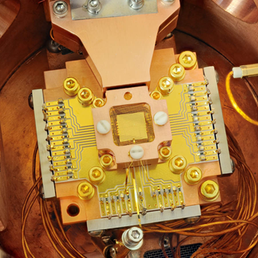
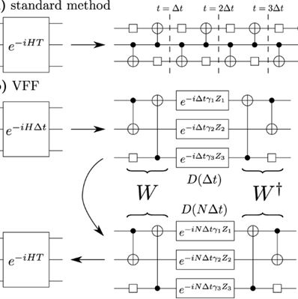


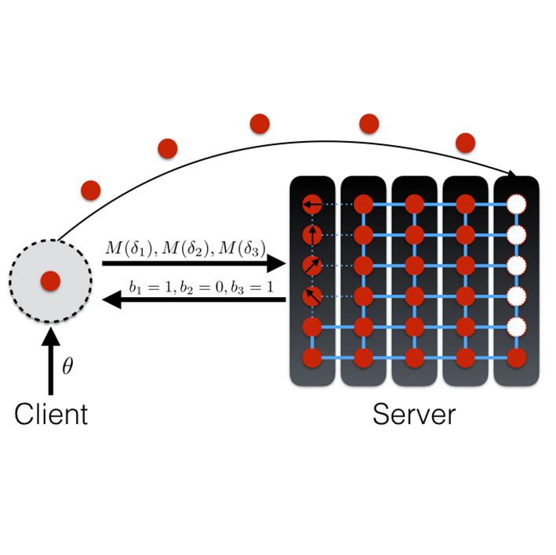
The quantum computing challenge & the opportunity
Boston Consulting Group: May 2019
Optimat Ltd: Mar 2018
Time | NISQ-era 3 – 5 years |  | Quantum Advantage 5 - 10 years |  | Universal Fault Tolerance 10 – 20 years
Use | Advanced Materials Financial Services | $2 – 5bn | Logistics Machine Learning Drug Discovery | $25 – 50bn | Structural Biology Carbon, Climate & Energy Cryptography | $450 – 850bn
Pathway
prototype devices
specialist tools
comms & crypto towards a quantum internet
HPC integration
user accessible systems
scalable cloud services
components
algorithms
architectures
scaling
new protocols
  What applications can we address as the technology scales?
  When will we see value?
© NQCC 2023
Notes:
The quantum computing roadmap is long and complex
Today we have modest scale prototype devices in the so called Noisy Intermediate Scale Quantum era
Over the next 2 decades the application areas we can approach will grow as will the potential market
Along the way as we move from prototype devices towards quantum safe communications , a quantum internet and scalable cloud services we need to tackle a critical task as we integrate quantum resources into high performance compute capabilities
The National Quantum Computing Centre is seeking to support this effort through our programmes focused on technology, infrastructure and workforce readiness

Slide 5



 |  | Technology readiness |  | Infrastructure readiness |  | Workforce readiness
£93m over 5 years Purpose: To address the challenge of scaling quantum computing Strategic intent: Provide assurance Catalyze Supply Chain Focus Development Enhance Skills Accelerate Scaling Drive User Adoption
 |  | OBJECTIVE: 100+ Qubit NISQ-era platform by 2025 Initial platform focus: Superconducting qubits Trapped ions Cold atom tweezer arrays Technology Readiness 4-7 |  | OBJECTIVE: Flagship facility by 2023 Design & Planning complete Construction Feb 2022 Handover Q4 2023 Commissioning Q1 2024 |  | OBJECTIVE: To build a UK QC user community by 2024 Eco-system participation Supporting skills for a future quantum workforce
© NQCC 2023
Notes:
The Programme has investment of £93m and we are in year 2 of an initial 5 year effort
At a high level our purpose is to address the challenge of scaling
And we seek to provide assurance, support the growing UK supply chain, focus the UK development effort, enhance skills, accelerate scaling and drive user adoption
We have 3 key goals to progress our technology, infrastructure and community building

Slide 6
 |  | Technology readiness |  | Infrastructure readiness |  | Workforce readiness
£93m over 5 years Purpose: To address the challenge of scaling quantum computing Strategic intent: Provide assurance Catalyze Supply Chain Focus Development Enhance Skills Accelerate Scaling Drive User Adoption
 |  | OBJECTIVE: 100+ Qubit NISQ-era platform by 2025 In-house development Project collaboration Government procurement |  | OBJECTIVE: Flagship facility by 2023 Development lab-space Co-location & investment Hosting QC Resources |  | OBJECTIVE: To build a UK QC user community by 2024 Skills & Training User access Technical Support Eco-system engagement
© NQCC 2023
Notes:
The Programme has investment of £93m and we are in year 2 of an initial 5 year effort
At a high level our purpose is to address the challenge of scaling
And we seek to provide assurance, support the growing UK supply chain, focus the UK development effort, enhance skills, accelerate scaling and drive user adoption
We have 3 key goals to progress our technology, infrastructure and community building

Slide 7

Technology Missions Fund – A Programme Case Study
£250m investment over 2 years
  Engineering Biology
  Artificial Intelligence
  Quantum Technologies
    £35m Positioning Navigation & Timing
    £35m Quantum Computing

Slide 8


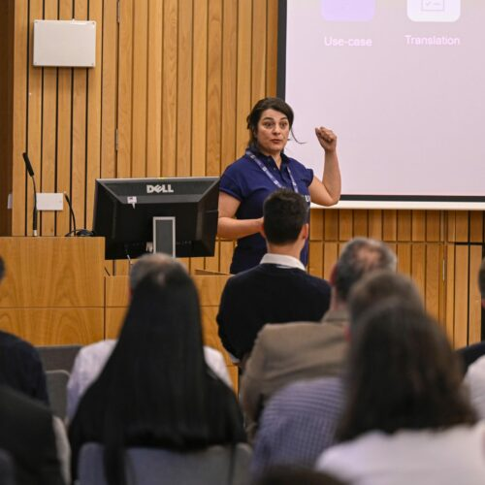

Technology Missions Fund – A Programme Case Study
£35m Quantum Computing
Goal: Demonstration of NISQ-era quantum advantage ensuring end user adoption and economic value
  Demonstration of one or more UK based small-scale NISQ-era hardware platforms
  Utilisation of cloud and hosted QC resources to demonstrate quantum advantage
  Acceleration of user adoption and associated essential skills
  Uncovering bottlenecks in understanding, technology readiness and systems performance
EPSRC: Software enabled quantum computation
Innovate UK: Industrial application feasibility studies
NQCC: Enhanced user adoption through SparQ
SBRI: Testbed platforms for sustained user access

Slide 9
Technology Missions Fund – A Programme Case Study
£35m Quantum Computing
Goal: Demonstration of NISQ-era quantum advantage ensuring end user adoption and economic value
  Demonstration of one or more UK based small-scale NISQ-era hardware platforms
  Utilisation of cloud and hosted QC resources to demonstrate quantum advantage
  Acceleration of user adoption and associated essential skills
  Uncovering bottlenecks in understanding, technology readiness and systems performance
EPSRC: Software enabled quantum computation
Innovate UK: Industrial application feasibility studies
NQCC: Enhanced user adoption through SparQ
SBRI: Testbed platforms for sustained user access

Slide 10




Applications Discovery – Quantum Readiness
A quantum-ready economy can take advantage of the opportunities presented by quantum computing to generate and retain value, leading to societal benefits, prosperity, and security.
Early adopters stand to gain expertise, market visibility, intellectual property and structural preparedness ahead of widespread adoption.
This is a long-term endeavor keeping pace with technology breakthroughs as new research and commercial platforms become available.
Energy
Materials
Finance
Logistics
Awareness
Engagement
Evaluation
Action
Advocacy
© NQCC 2023
Pharma
Crypto

Slide 11

Jan - Mar 2022
Bilateral conversations with end-users to understand barriers and needs
Applications Discovery – Quantum Readiness
TO DISCOVER AND DEVELOP APPLICATIONS FOR QC
TO ENHANCE QC LITERACY & UPSKILLING
TO FACILITATE NETWORKING AND IDEAS SHARING AND BUILD THE COMMUNITY
Mar 2022
End-user engagement workshop to gain feedback and validate plans
Access to quantum computing resources
Technical support and applications expertise
Learning resources
& skills development
May 2022
SparQ Programme launch
Workshops,
Hackathons, Networking
© NQCC 2023

Slide 12
Quantum Advantage – Financial Services Use Cases
Quantum advantage:
The threshold point when a quantum computer out performs a classical computer – especially when practically useful.
Simulation Derivative Pricing Risk Analysis Netting Requirements Collateralised Debt Obligations Economic Capital Requirements Crisis Prediction |  | Machine Learning Asset Pricing Fraud Detection Market Volatility Risk Clustering Natural Language Processing Credit Scoring Time Series Analysis Crisis Prediction |  | Optimization Portfolio Optimisation Hedging Swap Netting Arbitrage Credit Scoring Settlement Optimisation Crisis Prediction |  | Cryptography Data Security Transactional Security Quantum Secure Communications Encryption Multi-layer Security Protocols Protocol Testing Crisis Prevention
© NQCC 2023

Slide 13
Technology Missions Fund – A Programme Case Study
£35m Quantum Computing
Goal: Demonstration of NISQ-era quantum advantage ensuring end user adoption and economic value
  Demonstration of one or more UK based small-scale NISQ-era hardware platforms
  Utilisation of cloud and hosted QC resources to demonstrate quantum advantage
  Acceleration of user adoption and associated essential skills
  Uncovering bottlenecks in understanding, technology readiness and systems performance
EPSRC: Software enabled quantum computation
Innovate UK: Industrial application feasibility studies
NQCC: Enhanced user adoption through SparQ
SBRI: Testbed platforms for sustained user access

Slide 14
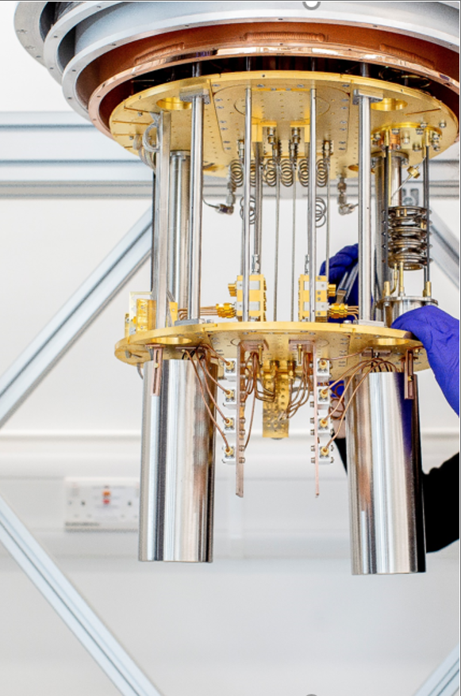

Testbed access for sustained user access
Access to a range of platforms
  evaluation and benchmarking of performance
Drive a twin-track approach
  in-house development
  evaluation of external platforms
Develop new processes, methodologies and expertise
  de-risk user-adoption technical milestones
Evaluate what can be delivered
  cost, timelines, performance
Enhance the UK’s quantum sector
  Government as a customer
  Government as a user

Slide 15
Structure of Testbed Activity
2024 |  |  |  |  | 2025 |  |  | 2026 |  |  |  | 2027
Q1 | Q2 | Q3 | Q4 | Q1 | Q2 | Q3 | Q4 | Q1 | Q2 | Q3 | Q4 | Q1 | Q2
SBRI Testbed Delivery
Post-project evaluation
Build & Commission
Delivery Lead: Contractor
Verification & Utilisation
Delivery Lead: NQCC
M1
M2
M3
Contractor
Innovate UK
Monitoring & Oversight
NQCC
Review & Appraise
Access
Benchmarking
Verification
Assurance
Use Case & Applications Discovery

Slide 16

Establishing a new National Lab - Learning
Establish a dedicated ramp up team – the technical leaders will need practical help
  HR, Finance, Facilities, Procurement, Legal, Programme Management …
Hire early – good people are hard to recruit, a brand new entity can look very exciting or very risky
Be clear of the mandate – what does the business case really say?
Understand the mechanisms for delivery
  Recruitment, procurement, legal, IP – some processes have a life of their own
Always be communicating
  Be clear on the message & be clear on the audience
  Don’t assume they heard you the first time
Identify some early wins – it will be harder than anyone thought
Find a way to build resilience in the team
  no-one can do it on their own
  All the other stuff is exhausting
© NQCC 2023

Slide 17


Engagement with the NQCC
Events
Organisation and hosting of events to support the UK community, help deliver the UK strategy and engage our stakeholders
Funding Support
Support & Collaborate on Industry-led projects (ISCF)
Endorse & Guide Academic-led grant applications (EPSRC/STFC)
Steer, inform & deliver UK quantum computing strategy
Design & Award cross Council POC & Feasibility Studies
Research Staff
Fund fellowships, secondments and joint positions
Embed resource with key partners around the UK
Co-locate at Harwell with collaborators
Provide technical consulting
Fund and co-supervise studentships
Support & mentor apprentices and graduates
Provide internships within NQCC laboratories
Training
Continuous professional development
On-line self directed
Application specific
Tools and techniques
Tackling Technical Challenges
Benchmarking & verification toolkits
Open quantum standards
Access to 3rd party QC resources
Access to testbeds
Development of standardized solutions
In-house & Collaborative R&D
Government procurement
Building an eco-system
Build research relationships with academic research
Support UK industry – suppliers, developers, users
Engage with International colleagues
Provide advice - government, industry and research
Build awareness & trust with the public
Notes:
The abstract pattern can be removed or repositioned if required. Be careful to ‘Send to Back’ so that it does not obscure any important information.

