Slide 1
Leveraging AI in Government: A Paradigm Shift towards Data-Driven Decision Making
Avinash Dixit
Head of Customer Success
Datavid Limited
Notes:
The public sector, with its vast amount of data, stands at the cusp of a transformation. By integrating Artificial Intelligence (AI), governments have the potential to revolutionise how decisions are made, fostering more efficient, transparent, and citizen-centric policies. This session explores few use cases which can benefit from knowledge graph and AI technologies and usher in a new era of data-driven policy and decision making in government.

Slide 2
Content
Introduction
What are Public Sector Ambitions
What are the Challenges that hinders the ambitions
Possible Solution to Challenges
Solving problem across public sector domains
Implementation – AI Powered Knowledge Discovery Platform
How one solution can address multiple use cases
Q&A

Slide 3
“Much like an elephant relies on its memory for the herd's survival, Public Sector Organisations depend on knowledge as resource for their evidence-based policy & decision making"
Notes:
What comes to your mind first, stability, strength, wisdom.
"an elephant never forgets" is a popular idiom that suggests elephants have excellent memories.

Slide 4
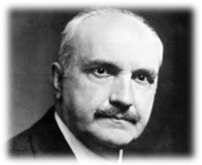
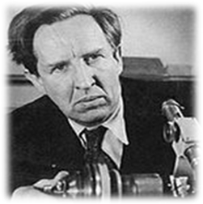
"Those who cannot remember the past are condemned to repeat it."
George Santayana
"Knowledge that is not being used for winning of further knowledge does not even remain, it decays and disappears."
John Desmond Bernal​
Notes:
George Santayana – Spanish American philosopher
John Desmond Bernal – Irish Scientist, X-ray, Crystallography in molecular biology

Slide 5
Public Sector Organisation Ambitions
Improved Decision Making
Enhanced Public Services
Transparency and Accountability
Economic Growth and Innovation
Enabling an insight-driven public sector that empowers data accessibility, speed to insight, and to remain forward-looking and agile to the changing needs of the society.
Notes:
Improved Decision Making
by use of advanced analytics and AI to enable efficient data analysis, leading to informed government decisions and prioritising societal needs.
Enhanced Public Services
AI can analyze large datasets to predict trends and patterns, allowing public services to be proactive rather than reactive.
Transparency and Accountability
by organizing data, automating reports, monitoring projects, and detecting fraud.
Economic Growth and Innovation
by optimizing operational efficiencies, reducing costs. Spurs innovation by the development of new services and enhancing public service delivery.

Slide 6
The challenges in Public Sector
Volume too great
Too busy
Changing workplace demographics
Data complexity
Ethical & Privacy
Legacy technologies
It’s getting harder
It's no longer manageable by "domain experts"
Poor decision making due to lack of knowledge, or insight from the past work.
Digital archaeology, digging back through time. Hundreds of hours spent in finding information.
No time to drive innovation leading to delays or inadequacies in policy formulation and execution.

Slide 7
A solution to Public Sector challenges
Energy level
required
Find valuable information buried
Lower the
energy demand
Spend far less time finding, far more time analysing information
Data
Enhance creativity to build and drive relevant policies
Insight
Knowledge Discovery
Innovation

Slide 8
Public Sector should consider 4 shifts : to achieve its ambitions
Simplify data access across public sector domains
Accelerate data driven decision making
Scale cutting-edge innovation
Collaborate, Operate Leaner, Faster & Agile
Implement decision making and service delivery methods that embody agile thinking and practices.
Government as a platform
Joining up government domains, thus ensuring greater coherence when moving towards the construction of a data-driven public sector.
Creating Trust
Ensuring that data initiatives and practices respect, and are in line with, citizens’ digital rights. Enabling ethical and transparent processing of data.
Harmonize Tools & Standards
Promote the development and adoption of common tools for greater data integration within and outside the public sector.
4 Shifts
Notes:
The need for public sector data governance is built on three premises: 1. Joining up government as a whole, thus ensuring greater coherence when moving towards the construction of a data-driven public sector. 2. Enabling government as a platform, to help improve the delivery of proactive and user-driven public services, and promote the development and adoption of common tools for greater data integration within and outside the public sector (e.g. cross-sector and cross-border data sharing) as well as collaboration with non-governmental actors. 3. Building greater trust in government (e.g. to ensure the trustworthy, ethical and transparent processing of data) by ensuring that data initiatives and practices respect, and are in line with, citizens’ digital rights

Slide 9
Problem statement
Objective
The UK public sector aims to make informed decisions by leveraging the vast amounts of data it collects. However, the sheer volume and complexity of this data necessitate advanced tools for efficient analysis and interpretation.
Implement an AI-powered Knowledge Discovery Platform to analyze, interpret, and provide insights from collected and processed data to assist decisionmakers in the public sector.
Notes:
Data value – novel, useful and significant pattern in data

Slide 10
Improving public sector performance through right Strategy
Knowledge is essential to solve complex societal problems
StatisticalStatistical
NER
Wisdom
Anticipatory
Knowledge Management
How & Why
(Leadership, Experience & Learning)
CIR
Visualisation
Knowledge
Decision Risk
Insight
Experience
Entity Recognition
Relevance
Context
Information Management
Standardisation
Harmonisation
Information
Classification
Metadata
Fact extraction
What
(Systems, Domain knowledge & Science)
Reactionary
Data Management
Financial
Crime & Justice
Research & Scientific
Operational
Cultural and Recreational
Economic
Geographic
Data
People
Regulatory
Communication
Education
Environmental
Transport
Weather
Statistical
Health
Infrastructure & Housing
Finable Accessible Interoperable Reusable
Notes:
Critical Insightful reasoning

Slide 11
Example of Knowledge Discovery Platform
is a system that employs data mining, machine learning, and AI techniques to unlock data value from vast and diverse data sources, accelerates insightful decisions, and securely delivers data agility
Search, Clustering
Contextual genAI
Integrated Applications
Grounded Analytics
Fact-Based Intelligence,
Semantics
CONNECT
CREATE
CONSUME
Knowledge Graph
Modelling
Fact Extraction
Classification
Single, Enriched
Data Resources
Any Data
Any Application
Any Architecture
Any Workflow
Unified Data Layer
Notes:
Data value – novel, useful and significant pattern in data

Slide 12
Example of Knowledge Discovery Platform…
Outcomes
Trusted AI | Smarter Decisions | Customer Experience | Product Innovation
Data Advantages
Data Context | Data Quality | Data Unity | Data Security | Data Governance
Data Hub
Knowledge Graph
Metadata
Generative AI
CONSUME
Unified Data Layer
Multi-model Data Layer
Semantic AI
(NLP, ML & LLM)
CONNECT
CREATE
Notes:
Creating system that transparent, accountable, & FAIR while also ensuring privacy and robustness. It is an iterative process – Collaboration, education, awareness and ethical consideration
T – explainability and openness (training methods and data set accessible)
A- Auditing, Regulation and compliance
F – Biases and diverse data training data
P – Anonymisation and secure computation

Slide 13
Data
sources
Unified Data Layer Blueprint
Data ingestion
Knowledge
Discovery
Metadata & data curation
Normalized & annotated
Enrichment & Context
Data Harmonisation & Standardisation
Entity extraction
Generative AI
(Part of speech, text classification, NER, fact extraction )
AI Techniques & ML Models
Taxonomy/ Ontology
Knowledge Graphs
Data Hub
Data Products
Data Analytics
Access Control
Notes:
LLMs have remarkable capabilities; they can craft letters, analyse data, orchestrate workflows, generate code, and much more. Companies such as Google, Apple, Amazon, Meta, and Microsoft are all investing heavily in this technology. Everything indicates that LLMs have enormous disruptive potential. However, there is a problem: they can hallucinate. So, how can serious businesses ever use their full power in production Ontologies provide a formal and structured way to represent knowledge within specific domains. Ontologies are also human-readable, editable, and auditable artefacts that can be kept under source control. The combination of LLMs and ontologies creates a powerful synergy. This synergy allows organisations to harness the capabilities of LLMs within the guardrails of a controlled structure. This collaborative partnership establishes a reinforcing feedback loop of continuous improvement. Ontologies provide context to prompts and validate the LLMs' responses, while the LLMs help extend ontologies with missing concepts. LLMs and Ontologies can be combined in a design pattern. In summary, Large Language Models represent not merely a passing fad but a paradigm shift that progressive organisations can ill afford to ignore. Ontologies offer a versatile yet disciplined framework, enabling organisations to move forward with LLMs while remaining in control.

Slide 14
Unified Data Layer Architecture
2. Semantically tag
private data
Knowledge Graphs
SME Knowledge Capture
User Queries
2
1. Ingest
content
3. Tag concepts in user queries
3
5. Final answer is genAI answer combined and validated with semantic knowledge
Data Hub
Semantically tagged private data
Orchestration
1
4
5
4. Generate customized prompt for
genAI using relevant private data from semantic search with the user query
Generative AI
Notes:
We start by condensing the question – an operation supported by openAI. The “condense“ term is a bit misleading in my view as actually the user’s input is many times expanded by deducing the intent of the question. Moreover, at this step the conversation history is taken into consideration to build more of a stand-alone question. Then we use the Semaphore instance we have configured to do the extraction of terms from the condensed question. However, we have noticed a limitation at this point as not every differentiation term can be contained in an ontology, hence we have employed a simple NLP task to extract the noun phrases
Then, the result of the 2 extractions is given to MarkLogic to execute a query which would retrieve best maching paragraphs of data together with their provenance (URI and paragraph ID)
At this point we have decided to give even more context by listing the synonyms as well; for example we have created a paragraph which was stating that covid-19 is a synonym for sars-cov2
And lastly we put together the extracted paragraphs, the synonyms paragraphs as context and pass the condensed question to OpenAI to generate an answer having controlled and limited information which will remain private/hidden to the world

Slide 15
Example Department Wide Semantic AI Search
Competency Questions?
Which supplier supplied windows of certain specification to Project A or Building B? Which other projects used the same supplier?
Show all documents related to funding for Cornwall spaceport project in 2018?
2. Automatically
Extract Organisation/Supplier
Extract People
Extract Places
Extract Address
Other Entities of Interest
User Queries
Knowledge Graphs
SME Knowledge Capture
2
1. Ingest
content
3. Tag concepts in user queries
3
5. Final answer is GenAI answer combined and validated with semantic knowledge
1
Data Hub
Semantically tagged private data
Orchestration
4
5
4. Feed data related to Supplier Delta to Gen AI Feed data related to Cornwall spaceport project to Gen AI
Private Data LLM
Contracts Data/Documents
Funding Data/Documents
Projects Data/Documents
Notes:
Contracts Data/Documents
Funding Data/Documents
Projects Data/Documents

Slide 16
Police & Law Enforcement Information Management System
Proactive identification of threat, harm, opportunity and risk
Faster, more informed decision-making, and better outcomes
Ensure safety of at-risk individuals in a secure/timely manner
Improve the security of, and access to, sensitive information
Social Media Feed
Person
Single point of truth across dispersed and disparate systems
Event
Object
1
Data Hub
Semantically tagged private data
Knowledge Graphs
Knowledge Capture
2
Location
Timeline
1. Ingest
content
2. Automatically Extract Person / Object / Location/Event (POLE) Extract Other Entities of Interest
ANPR/BWV/CCTV
Registers
Geo Spatial Data

Slide 17
Healthcare Covid 19 Research Hub
Research Activity
Promoting collaboration, centralizing information, and ensuring rapid and effective dissemination of crucial research findings
By centralizing research efforts and avoiding duplication, such hubs can lead to cost savings and more efficient use of research funds
Clinical Study
Vaccine Research
Clinical Trial
Vaccine Design
Symptoms
Disease
Meds
1
Data Hub
Semantically tagged private data
Knowledge Graphs
Knowledge Capture
Biochemistry
2
2. Automatically
Tag/Extract diseases
Tag/Extract symptoms
Tag/Extract medicines/treatment
Organism
1. Ingest
content
Covid 19 research articles
Anonymised EMR

Slide 18
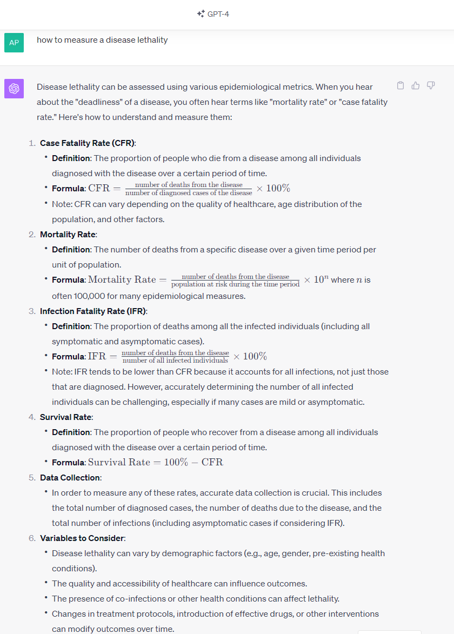
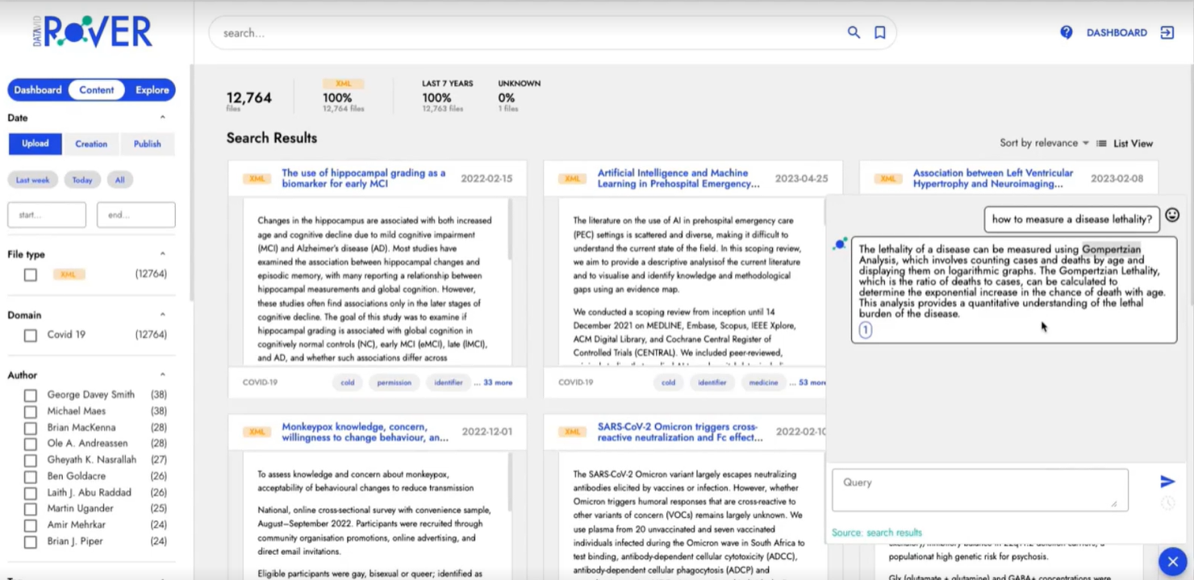
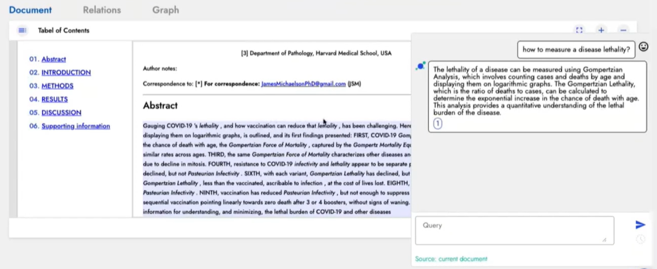
Example Use Case

Slide 19
Enabling Resilience, and Insight for Public Sector Organisation to be innovative, and proactive.
Resulting into informed decisions and prioritising societal needs.

Slide 20
“The winners of AI will be those who know how to use AI AND have private data”
Cathie Wood at ITK

Slide 21
Thank you for joining me today and for your interest in the exciting realm of knowledge discovery by leveraging AI in Public Sector
Please do visit us at Booth # 13 to arrange a private demo of use cases through
Datavid Rover

Slide 22
I’d be delighted to answer any questions you might have
Avinash Dixit
Head of Customer Success
Datavid Limited

