Slide 2
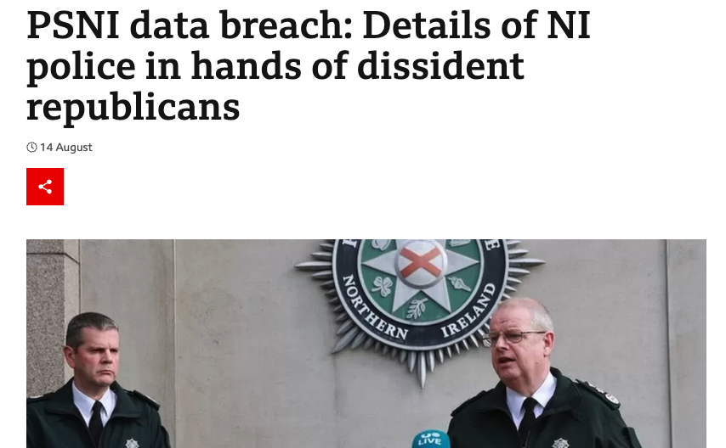
Notes:
An estimated 14,000 employees at a Liverpool NHS hospital trust have been informed that their data was leaked via email due to human error, according to reports.
A file containing sensitive payroll information was sent to hundreds of NHS managers and 24 external accounts, according to an apology letter to victims from trust chief executive, James Sumner, seen by the Liverpool Echo.
PSNI leak due to human error posting results of a FOI request on to a website. Results contained PII.

Slide 3
Prevent Mistaken Data Leaks With Automation and AI
Graham Lewis & Damian Lindley

Slide 4
Agenda
Why do Mistakes Happen?
How can Automation and AI help?
The Content Services Platform is Key

Slide 5
TODAY’S CHALLENGES
Notes:
Over the last decade, the main challenge when it comes to information management has been to get a handle on the information organisations have.
*We know that the content that you are storing on a day-to-day basis is the lifeblood of your organization and, in most cases, it is the most critical information you have.*
Let’s look at some of the more recent challenges we have seen over the last couple of years

Slide 6
Why Do Mistakes Happen?
Tsunami of digital content
You have to do more with less
Digital content needed anytime, anywhere, any channel
Legacy, disparate systems
No automation
Multiple (often competing) Regulations GDPR, FOI

Slide 7
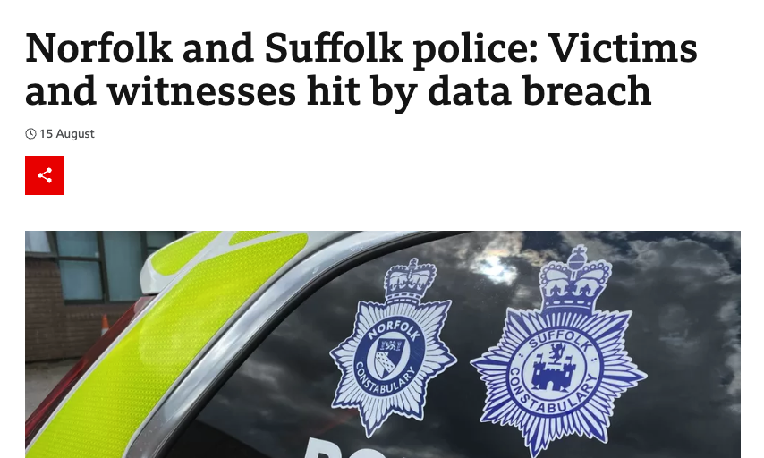
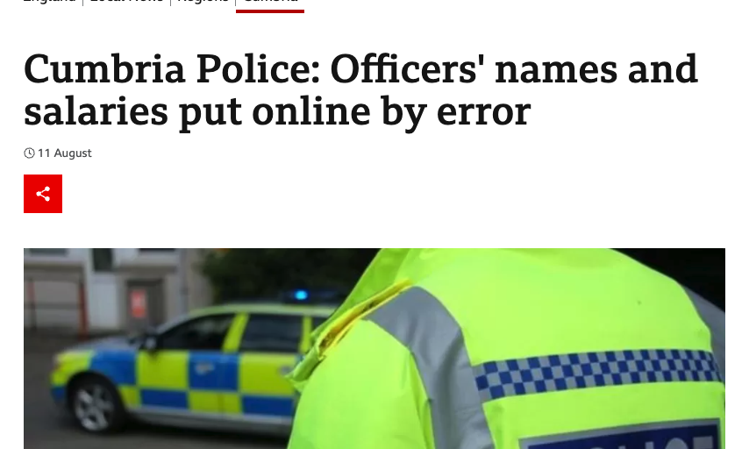
FOI Requests
Automatically check content BEFORE it is released
Notes:
Wouldn't it be great if there was an automated check before anything is released as part of an FOI?

Slide 8
Declaring Documents As Records is Boring
Manual Records Declaration:
•Inconsistent
•Time consuming
•Dull
Notes:
Colchester council’s IT contractor Capita held data insecurely

Slide 9
How can AI and Automation Help?

Slide 10
How Can AI Help?
EDRMS
Zero click records management
Notes:
With your content held securely in a Content Services Platform, or EDRMS if you prefer, don't leave it up to users to declare documents/videos/pictures as records. This can be automated.
How many organisations have a records policy that every one signs annually, but no one ever follows?
OK, but how does AI know what documents are records and how long they should be kept for?

Slide 11
From Generic AI
Predictions
hat
woman
jacket
shirt
clothing, outerwear, beauty, street fashion
Any professional adding these metadata?
Unlikely
Notes:
We could use the generic AI engines that exist today in Azure, AWS, Google. And they’re OK, up to a point.
But your data, your documents are going off into the cloud to be processed and maintained, where? How?
And it is only Generic. It’s not based on YOUR data, or your business needs.

Slide 12
To Business Specific AI
Predictions
hat
product: 32-j Vision Hat
woman
talent: Anna Nachaev
jacket
product: 58-7 Denim Jacket
shirt
product: 15-un Hatch Top
clothing, outerwear, beauty, street fashion
Lifestyle photo, single gender, background, outside
Any professional adding these metadata?
Very likely
Notes:
Business Specific AI takes your data, and once you have trained it, it it will keep recognizing data.
Once it’s been recognized, you can then set the automation.

Slide 13
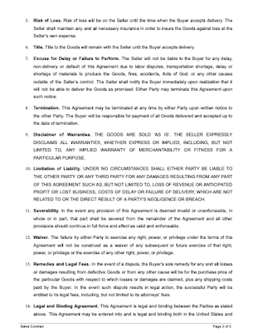
Also For Documents
keyphrase
renew date: 05-05-2031
adjective
Parties
pronoum
clause: Severities - PSub
location
clause: Wavers - restrictive
neutral, english
T-2a subscription contract
Notes:
It isn’t just for pictures.

Slide 14
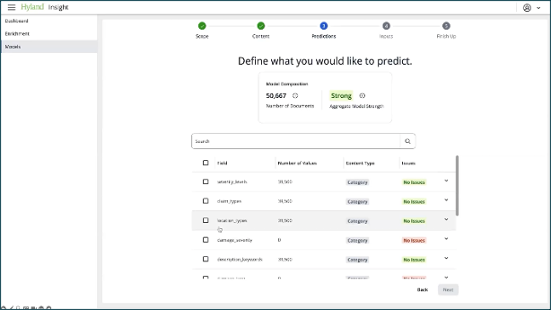
Train Your Model on Your Data…..
Without an army of Python programmers, and data scientists
Democratise the use of AI
No code interface – no expertise needed
Notes:
You need to be able to train your AI system just like you would train any new employee. Well, maybe not exactly like a new employee. But you shouldn’t need to get an army of Python programmers and Natural Language Processing experts. You should be able to hand the engine 50 examples of, say, supplier Contracts, for it to be sure that it will recognize a supplier contract that it’s never seen before.

Slide 15
...and all using a Content Platform

Slide 16
Delivering Value with a Modern Content Platform
Modern, scalable content services platforms and solutions
Security and compliance features that meet modern requirements
Find and manage content stored in disparate and legacy systems
Rapid application development platform to deliver modern solutions
Notes:
But the AI is only half the story. There’s no point in being able to recognize content if you don’t know where it all is, or if you can’t protect it properly because it’s on file shares or in SharePoint.

Slide 17
Delivering Value with a Modern Content Platform
Integrate to Any AI tool
Platform extensibility options give customers the power to meet their own unique requirements
Different technologies and tools for different use cases and business needs
Notes:
We don’t think that the AI engine will be part of the Content platform. They do different jobs. But you need these components to be able to integrate with each other easily.

Slide 18
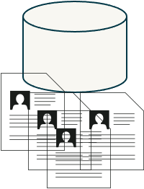
What Could it look like?
Build your Large Language Model
based on your content.
Hosted by you, in your choice
of cloud or datacentre.
AI Engine for
business users
Your Content Store
Notes:
Once you know where your content is, you can train your AI engine on your documents. You host the Large Language Model (LLM) so you know where the data is, and who has access.

Slide 19
What Could it look like?
4. System continually
learning
by human in
the loop
teaching.
2. Use your Large Language
Model to classify
And Tag the new
documents automatically.
3. Once classified and tagged,
automatically apply the correct retention and access rules.
1.New documents ingested in your Content Store
Notes:
This is so much easier once you have a proper Content Services Platform to store your documents.

Slide 20
What Could it look like for FOI requests?
Receive Request and store securely
Use AI to identify that it is FOI
Automatic search – add results to FOI Case
Send to Human for review
Create a FOI Case
Automatically flag documents with PII.
Before release use AI to automatically check again for PII.
If PII exists block the release until approval.
Notes:
We need to make it easy for folks to get on with their jobs, and difficult to make errors.

Slide 21
Question Time

