Slide 1
Unlocking the Potential: Generative AI's Role in the Public Sector
Steve Ellwood-Thompson & Tom Fowler
Data & Artificial Intelligence Practice

Slide 2
By 2035, we’ll see an AI-era government, supported by digital IDs and natively-digital
public services, all connected by a fluid data ecosystem.

Slide 3
The capabilities unlocked by Generative AI will allow governments to reorganise themselves around the needs of the citizen, breaking down the barriers between internal departments, as well as between local and national services, meeting citizens where they are.

Slide 4




Demystifying Terms
Artificial Intelligence
Machine Learning
Generative AI
Large Language Models
AI is the field of creating machines or software that mimic intelligence by performing tasks normally requiring humans such as writing a story, understanding an image or playing
a game.
ML is a field of AI which focuses on enabling systems to process data and ‘learn’ how to improve their outputs without the intervention of human programmers.
GenAI is a type of AI focused on creating human-like content, from text and images to audio and video.
A type of AI trained by processing vast amounts of text to capture context and semantic meaning of the words and learning how to generate the next ‘token’ (word fragment).

Slide 5



Automation
Giving software the human tasks that are tedious and could not be automated before
Generative AI can enable productivity gains and citizen experience improvements when used correctly
Augmentation
Giving humans step change in productivity to do their work more effectively
Acceleration
Extract and index knowledge to shorten innovation cycles enabling continuous learning

Slide 6







Generative AI tech is widely accessible today
You’ve probably seen and used these tools already
Amazon
Code Whisperer
Built on top of Large Language Models (LLMs) such as GPT-3.5, GPT-4, PaLM, LLaMA & others

Slide 7
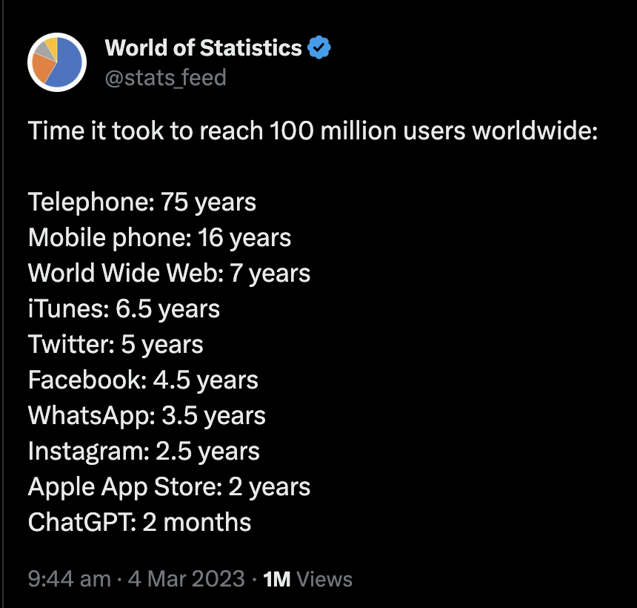
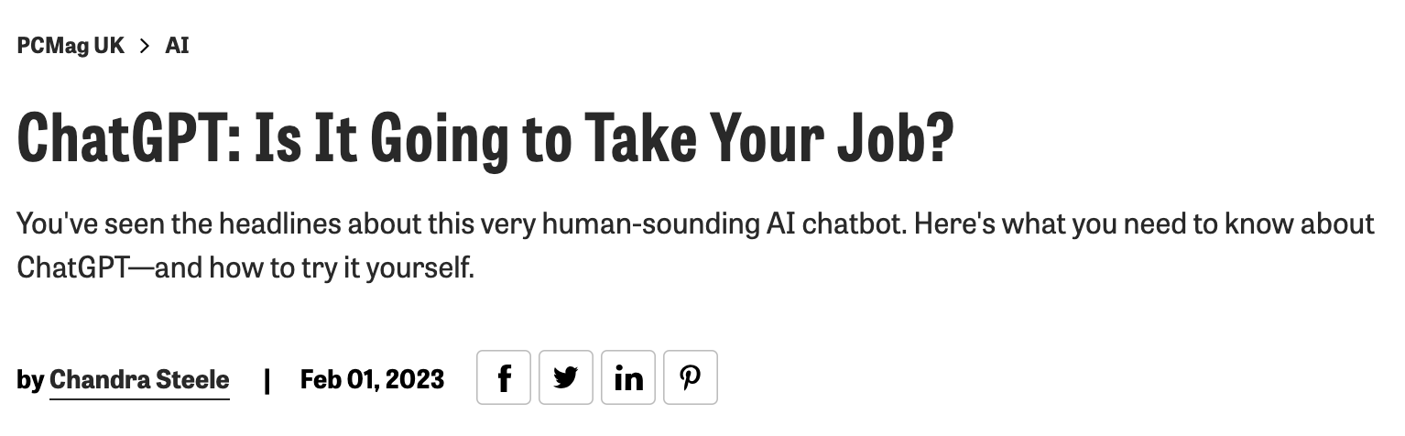

Hype, uptake, importance

Slide 8
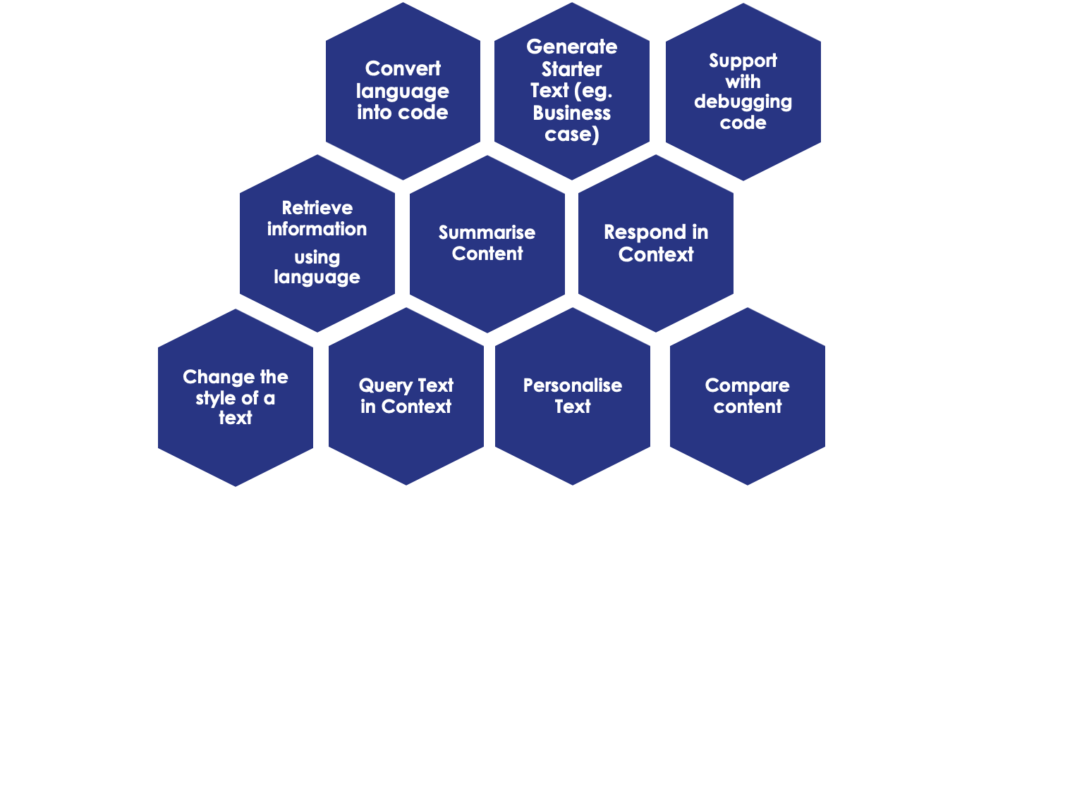
What are LLMs actually good at?
Powerful natural-looking text generation
Trained on multiple billions of data points
Can generate text, code and with some models images/audio/video
Able to summarise, reword and change tone of text
Can be prompted to give different kinds of response in different contexts
Can translate between languages including code
Good engineering needed to avoid ‘hallucinations’

Slide 9
How does it work?
If we gave the prompt text “The quick brown” to a LLM it would generate a result based on a weighting of the likelihood of the next word expected at each stage.
The reason why this is useful is because if we prompt ”Q: What is the capital of France?” you’re most likely to get back ”A: Paris”, giving the impression of the model answering questions or following instructions.
The
fox
(0.8)
jumps
(0.75)
sneaked
(0.25)
car
(0.2)
crashed
(0.5)
into
(0.6)
the
(0.9)
henhouse
(0.44)
over
(0.7)
the
(0.9)
lazy
(0.6)
dog
(0.9)
sloth
(0.1)
brown
quick
<end>
<end>
<end>
last
(0.3)
night
(0.8)
<end>
Notes:
Will

Slide 10
Engineering Acceleration
GitHub Copilot (and similar tools) offer a GenAI pair programmer integrated into development tools, making extensive auto-complete suggestions in response to prompts.
In example productivity challenges …
Kainos own experience has shown these tools to be a game changer for engineers.
Amazon
Code Whisperer
The group that used GitHub Copilot had a higher rate
of completing the task
(78%, compared to 70% in the group without Copilot).”
“Participants who used Amazon CodeWhisperer were 27%
more likely to complete tasks successfully and did so an average of 57% faster than those who did not use CodeWhisperer.”
“developers who used GitHub Copilot completed the task significantly faster–55% faster than the developers who didn’t
use GitHub Copilot”.

Slide 11
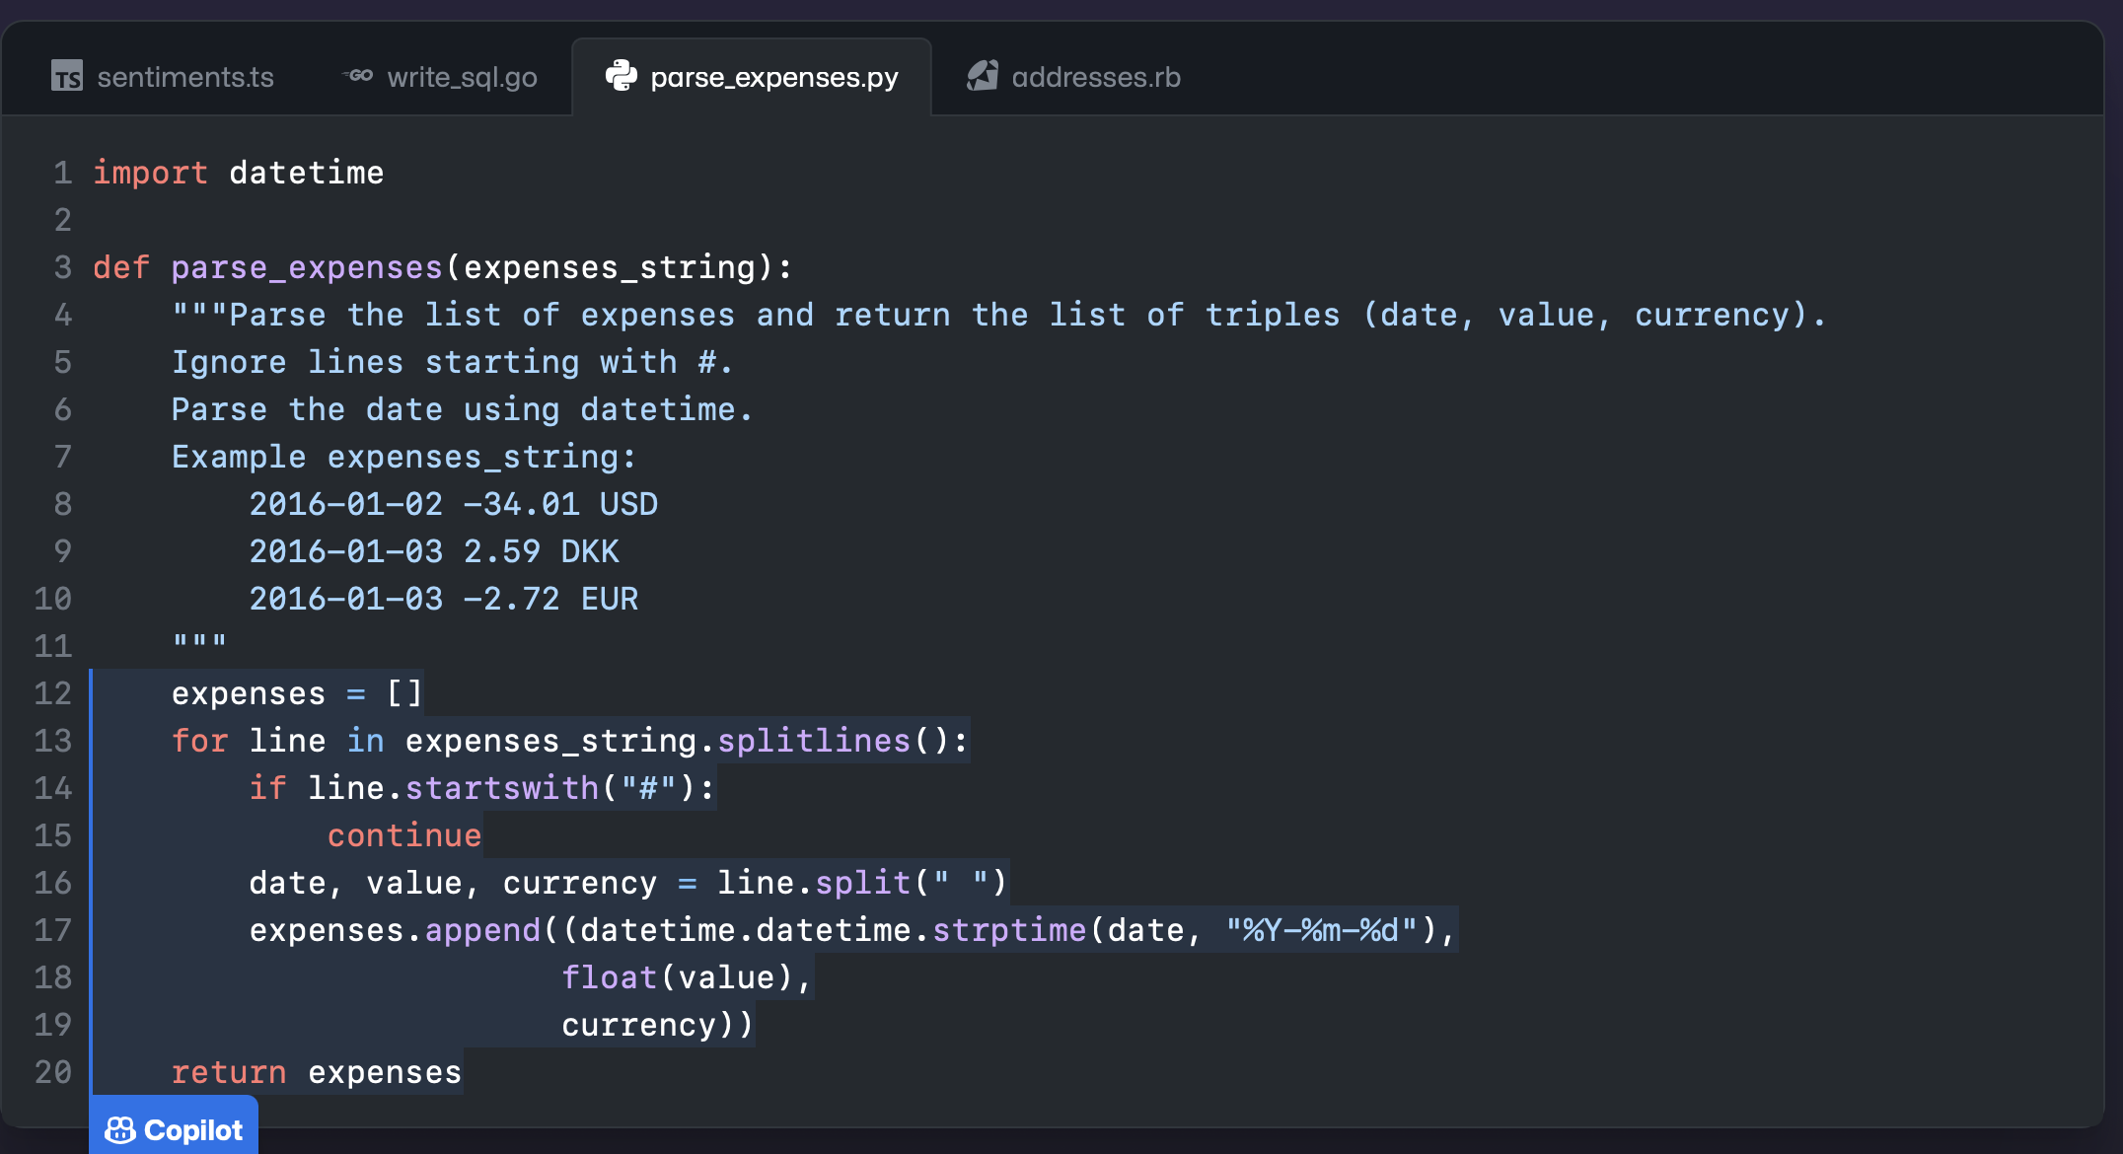
src: https://github.com/features/copilot

Slide 12
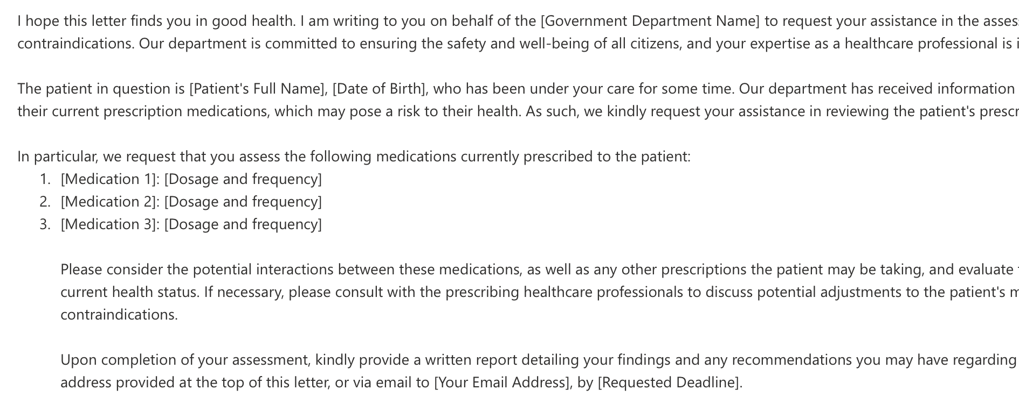
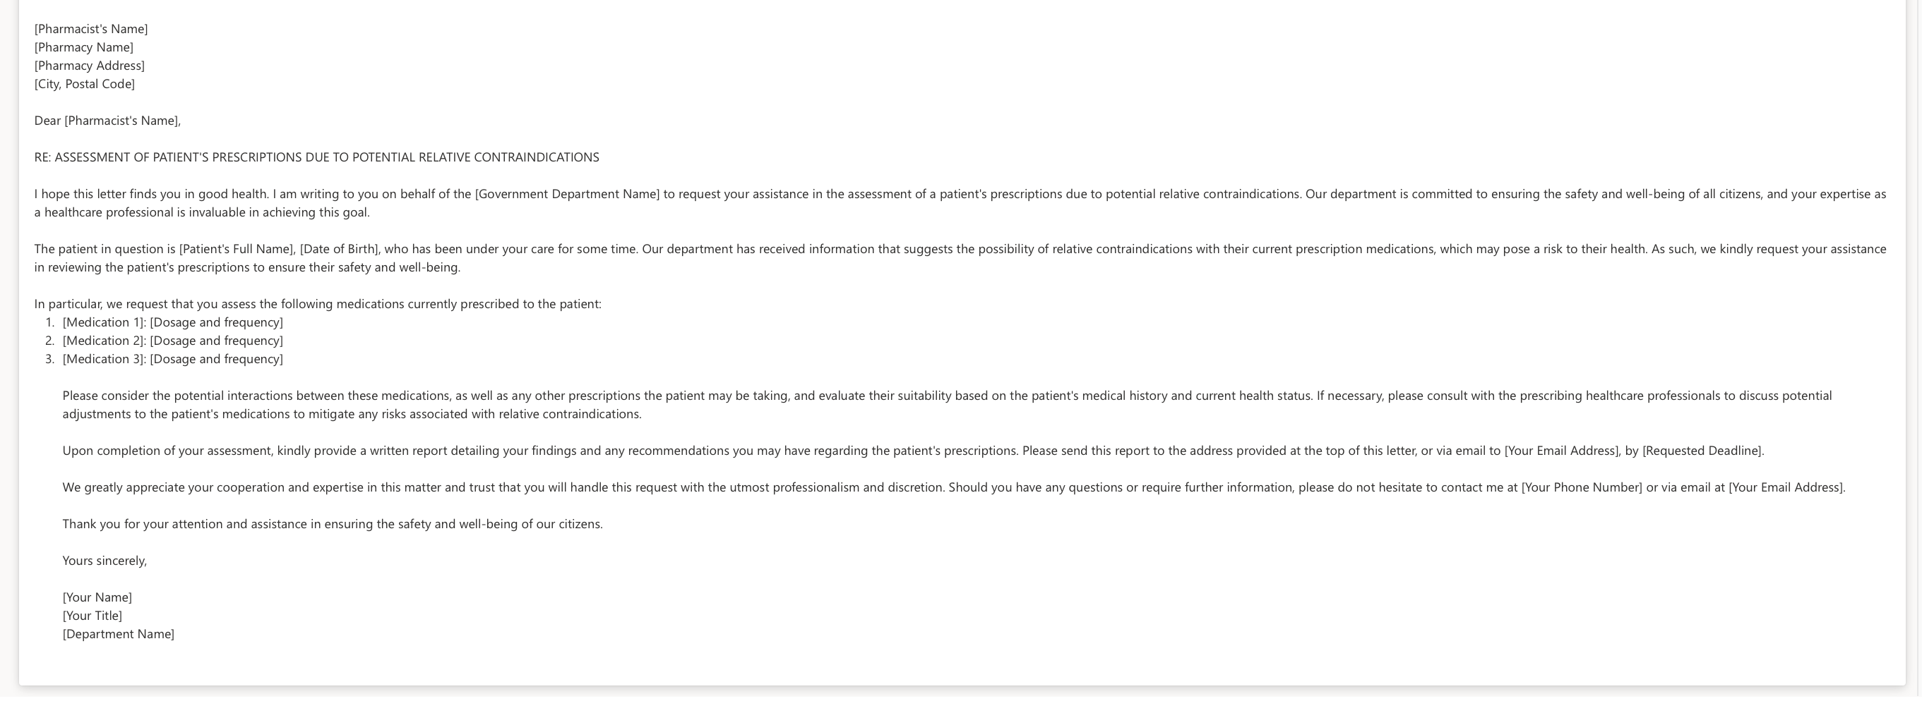
Accelerating Productivity

Slide 13

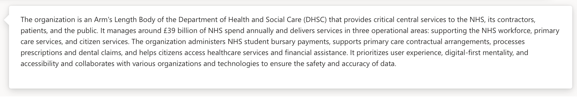
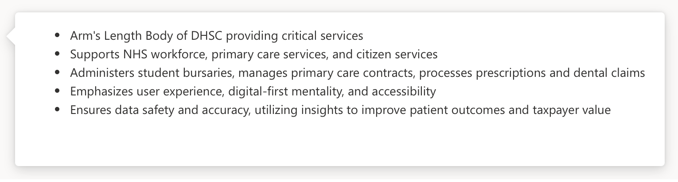
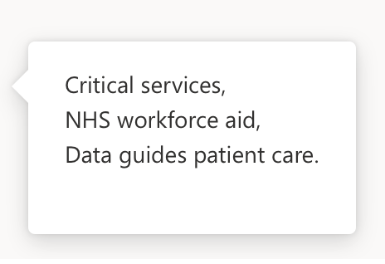
Accelerating Productivity

Slide 14


Accelerating Productivity
A global payments network …
… a London street scene

Slide 15
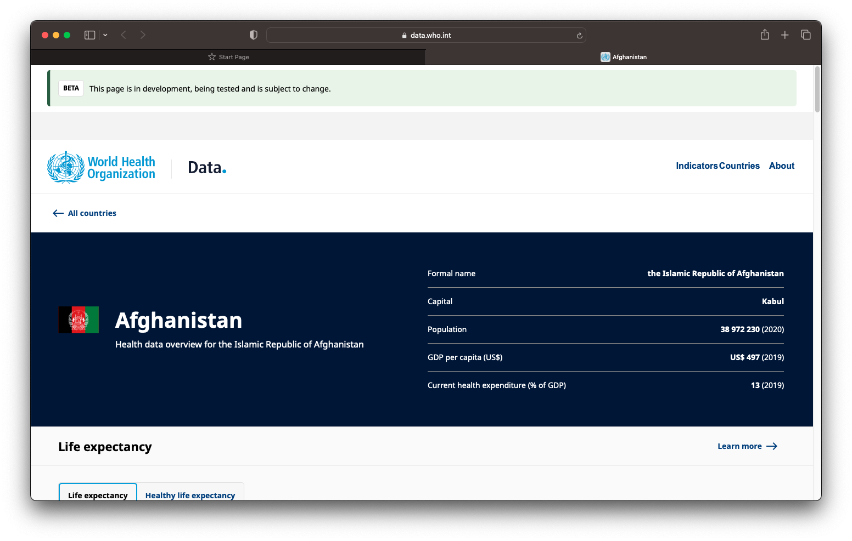
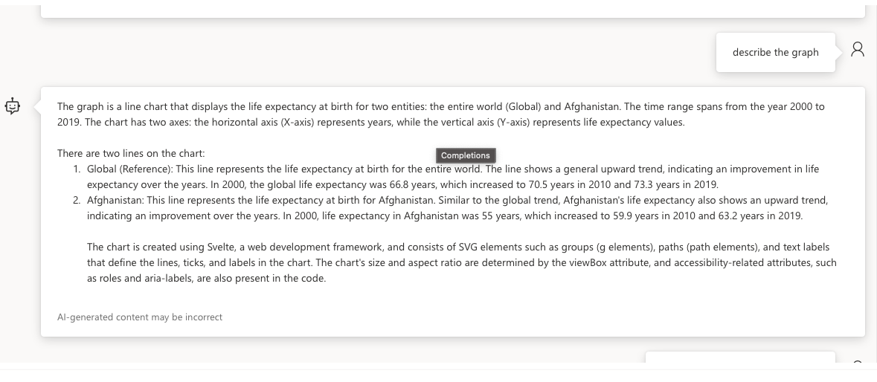
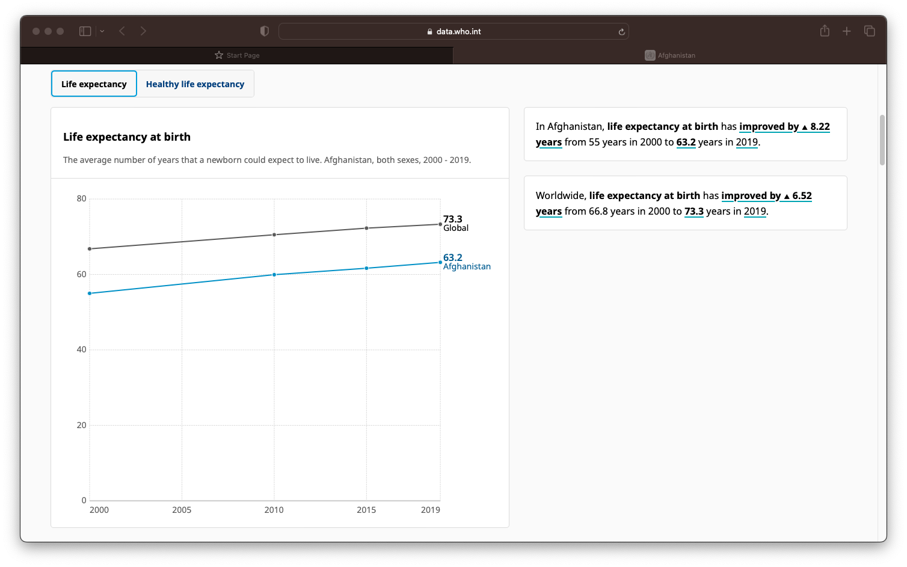
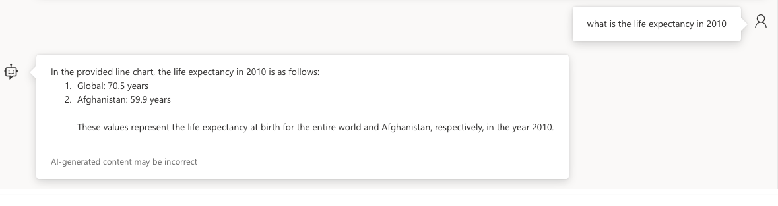

Slide 16






Some examples …
Enhancing Productivity
Supporting human review
Value from documents
Adopting Generative AI tooling for development …
Comparing findings to review and inspection criteria …
Insights from large and complex sets of document through Retrieval Augmented Generation …
Know your citizen
Talk to your data
Generating content
Assessing information to understand and build trust …
Democratising complex and structured data access for all …
Generating content or correspondence for human review …

Slide 17
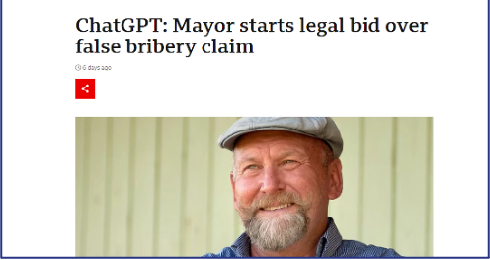
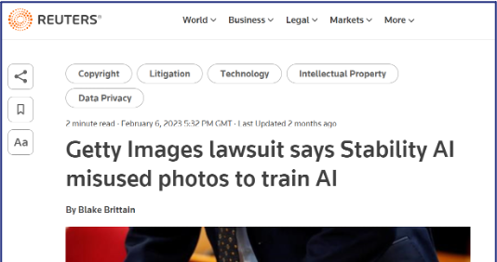
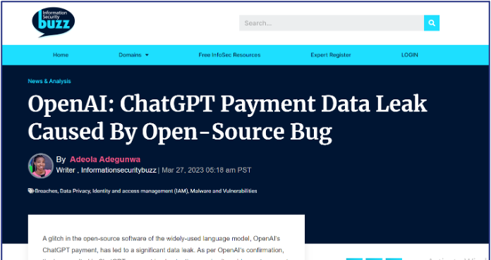
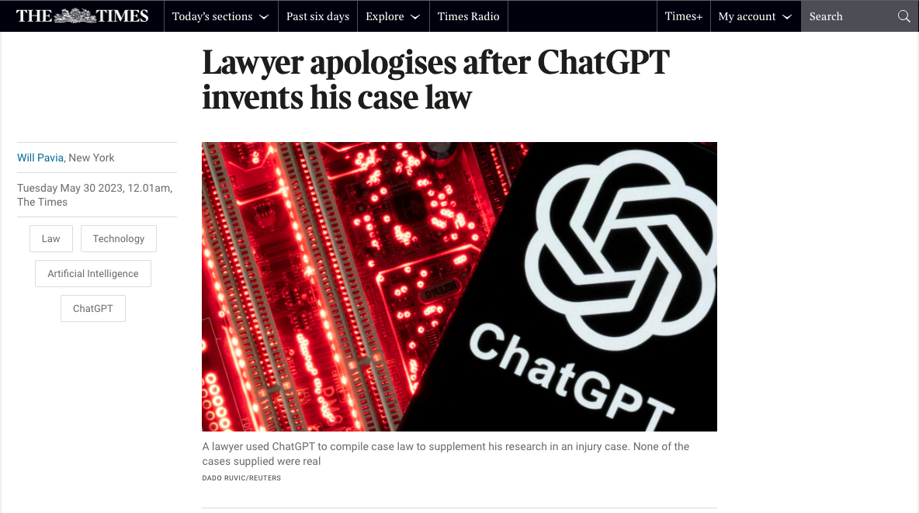

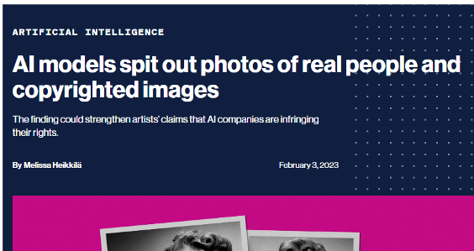
Rapidly developing landscape
17

Slide 18
Limitations, risks and delivering AI safely
Data privacy
Misinformation
Bias and Discrimination
Environmental impact
Trust
Intellectual property (IP)
Security
Explainability
& Reliability
Organisational impact
Worker displacement
Costs
Data Scope Limitations

Slide 19
Takeaways: Right use case & the Right controls
Choose the right use case, technically, functionally and ethically
Technical Controls
Technical Guard Rails
Prompt Engineering
Harms Assessment
Review and Improve
Fine Tuning & Training
Audit
Value Driven Models
Bias and Toxicity Awareness
'Ops'
Content checks
Mitigation in Plan
Expert in the Loop
Workflow and Process

Slide 20
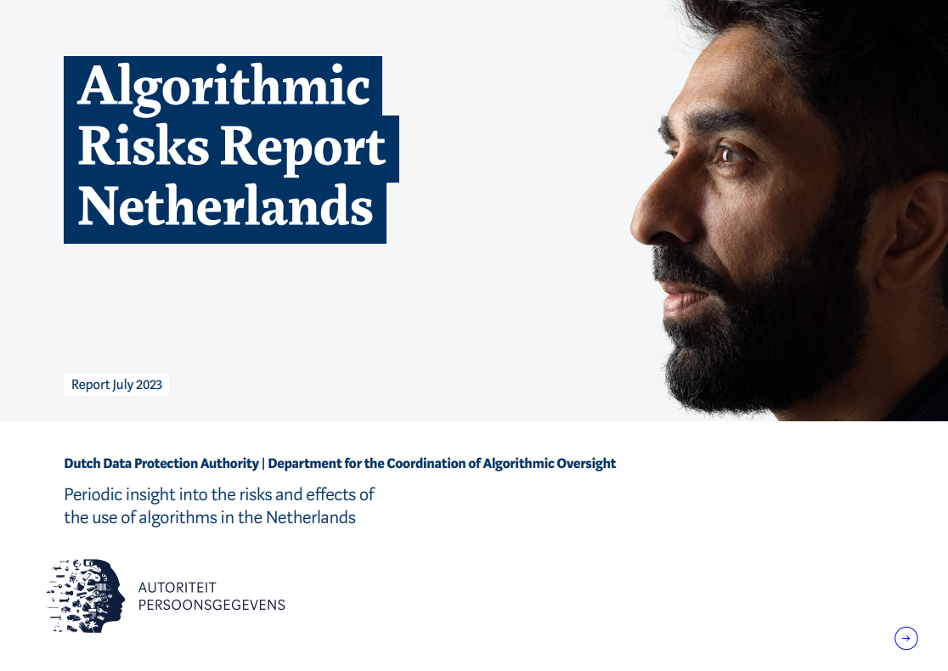
AI Governance
EU AI Act (upcoming)
UK white paper ‘A pro-innovation approach to AI regulation (in consultation)
China regulation on recommendation algorithms and deep synthesis (implemented)
  and more
Templates & Case Studies
Standards
Regulatory landscape
In a rapidly developing landscape, a data ethics framework helps to guide decision making and lay the groundwork for a governance system that is aligned with upcoming legislation, standards and good practice.
“The DCA strongly recommends incorporating the principles of impending laws and regulations in the development of systems and applications now.(…) If organisations do not act in anticipation of future legislation, they will be unable to meet society’s desire for innovation responsibly.”
- Algorithmic Risk Report Netherlands,
Dutch Data Protection Authority
ISO/IEC 23894 Guidance on AI risk management
ISO/IEC TR 24027 Bias in AI systems and AI aided decision making
IEEE Std 7001-2021 Standard for Transparency of Autonomous Systems
and more
AI Assurance Portfolio by CDEI
Model cards by Google
Data Ethics Canvas by ODI
and more

Slide 21
GenAI Workshop
Elevate customer and employee experience by innovating with generative AI.
We work to define pain points and use cases that generative AI can address and provide recommendations for your team.
We offer a free half-day workshop including preparation and analysis to build an understanding of your challenges, current state and any required outcomes.
Come to Stand 15 to discuss your requirements

Slide 22
Questions

