Slide 1
METADATAWORKS
Notes:
Hi. Adam. Founder. MetadadataWorks
Data Engineer. Any data Engineers?
Specialise in machines communicating – not necessarily as good at people communicating
Difference between introvert and extrovert data engineer is…..
Founded MDW to solve some of the people<>people problems on data projects – technical stuff we can solve

Slide 2
WE ARE ALL (SECRET) DATA USERS
10% OF ALL JOBS ALREADY REQUIRE HARD DATA SKILLS
BUT WE AREN’T ALL DATA ENGINEERS
I.E. EXPERTS EXTRACTING INSIGHT FROM BIG DATA
https://royalsociety.org/news/2019/05/data-science-skills-shortages/
Notes:
Why did I get into data engineering?
Moving data is important
Talk about my family. Hazy memory. 4-5 mother was ill. Royal Marsden. Given experimental MMM. ¾ months gone
Fast forward 6 years later. Living in Devon – Derriford hospital. Given CMF. Didn’t work. Records couldn’t be transferred.
Father physically drove to Royal Marsden, got a physical copy of the medical records. She was cancer free within 4-5 months again.
Obviously made an impression on my young mind and here I am working on moving health data around.
So today I’d like to talk about moving data around, some of the human problems and how to solve them

Slide 3
“WHAT IS THE BIGGEST BARRIER STOPPING DATA USERS USING HEALTH DATA”
RESEARCHERS, BIG PHARMA, NHS AND INDUSTRY SURVEYED
FINDING &
ACCESSING
DATA
UNDERSTANDING
DATA /
“READINESS”
70%
55%
“uniting the UK’s health data to enable discoveries that improve people’s lives”
Notes:
HDRUK is the UK’s health data research institute. UK has lifesciences, skilled people, universities, nhs dataset.
Conducted a survey across a wide range of data users in the health, social care and lifescience industries
They’d asked the questions “what is the biggest barrier stopping data user using healthcare data”
Two themes emerged. The first problem was finding and then getting access to healthcare data.
The second was understanding the content of data “chucked over the fence” and getting it “ready” for analysis.
We were tasked to deliver a national solution that would make data across the healthcare landscape in the UK more findable and more “ready” for analysis.
Asked to work with over 40 healthcare organisation across the UK to solve these issues.

Slide 4
MOVE FAST, ITERATE AND MAINTAIN MOMENTUM
Tooling
configured
Go-Live
Stakeholders engaged, trained and onboarded
Reporting requirements finalised
Metadata onboarding
accelerated
Additional integration (Open ID, DATACITE)
Automated Extraction
Week 1-2
Week 5-8
Week 11-12
General
Adoption
Additional Training
Continued Onboarding and Support
Data knowledge sharing and advanced adoption
Metadata onboarding
advanced
Issues identified and unblocked
Reporting implemented and socialised
Vanilla
Catalogue Deployed
Existing Assets Migration
Stakeholder Mapping and Requirements Gathering
Service Desk Integration
.
Week 3-4
Week 9-10
Notes:
MOVE FAST AND BREAK THINGS – silicon valley moto.
Step 1. Was move fast. We have a ready made product and made sure it was up-and-running by week 5.
Step 2. We iterated a metadata specification
Step 3. We engaged the stakeholders – monthly check in sessions
Step 4. Established reporting
Step 5. Created a service desk…….no more emails flying around

Slide 5
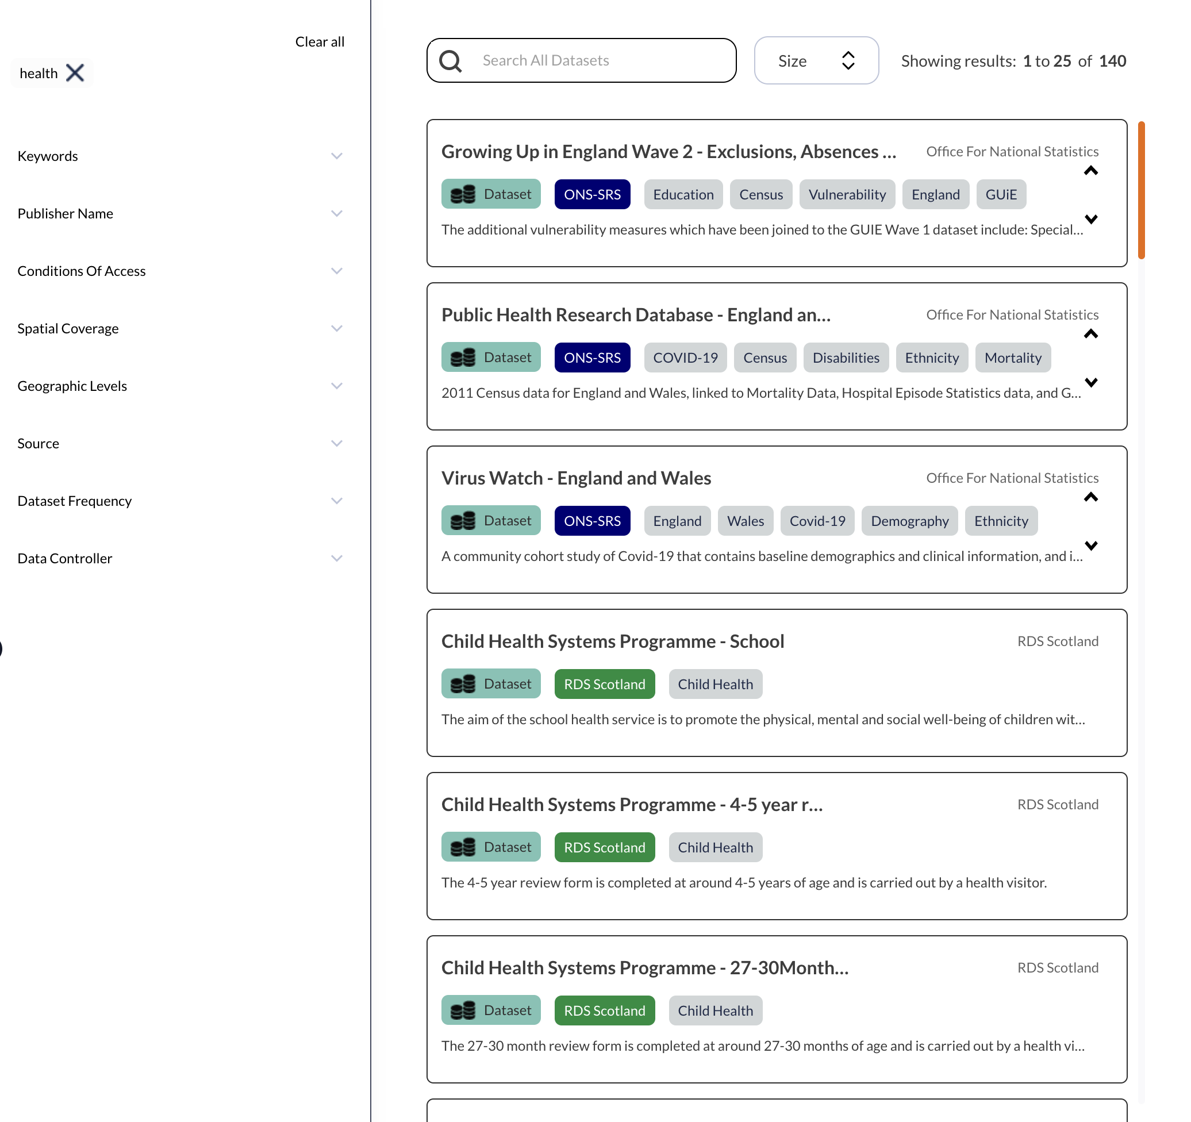
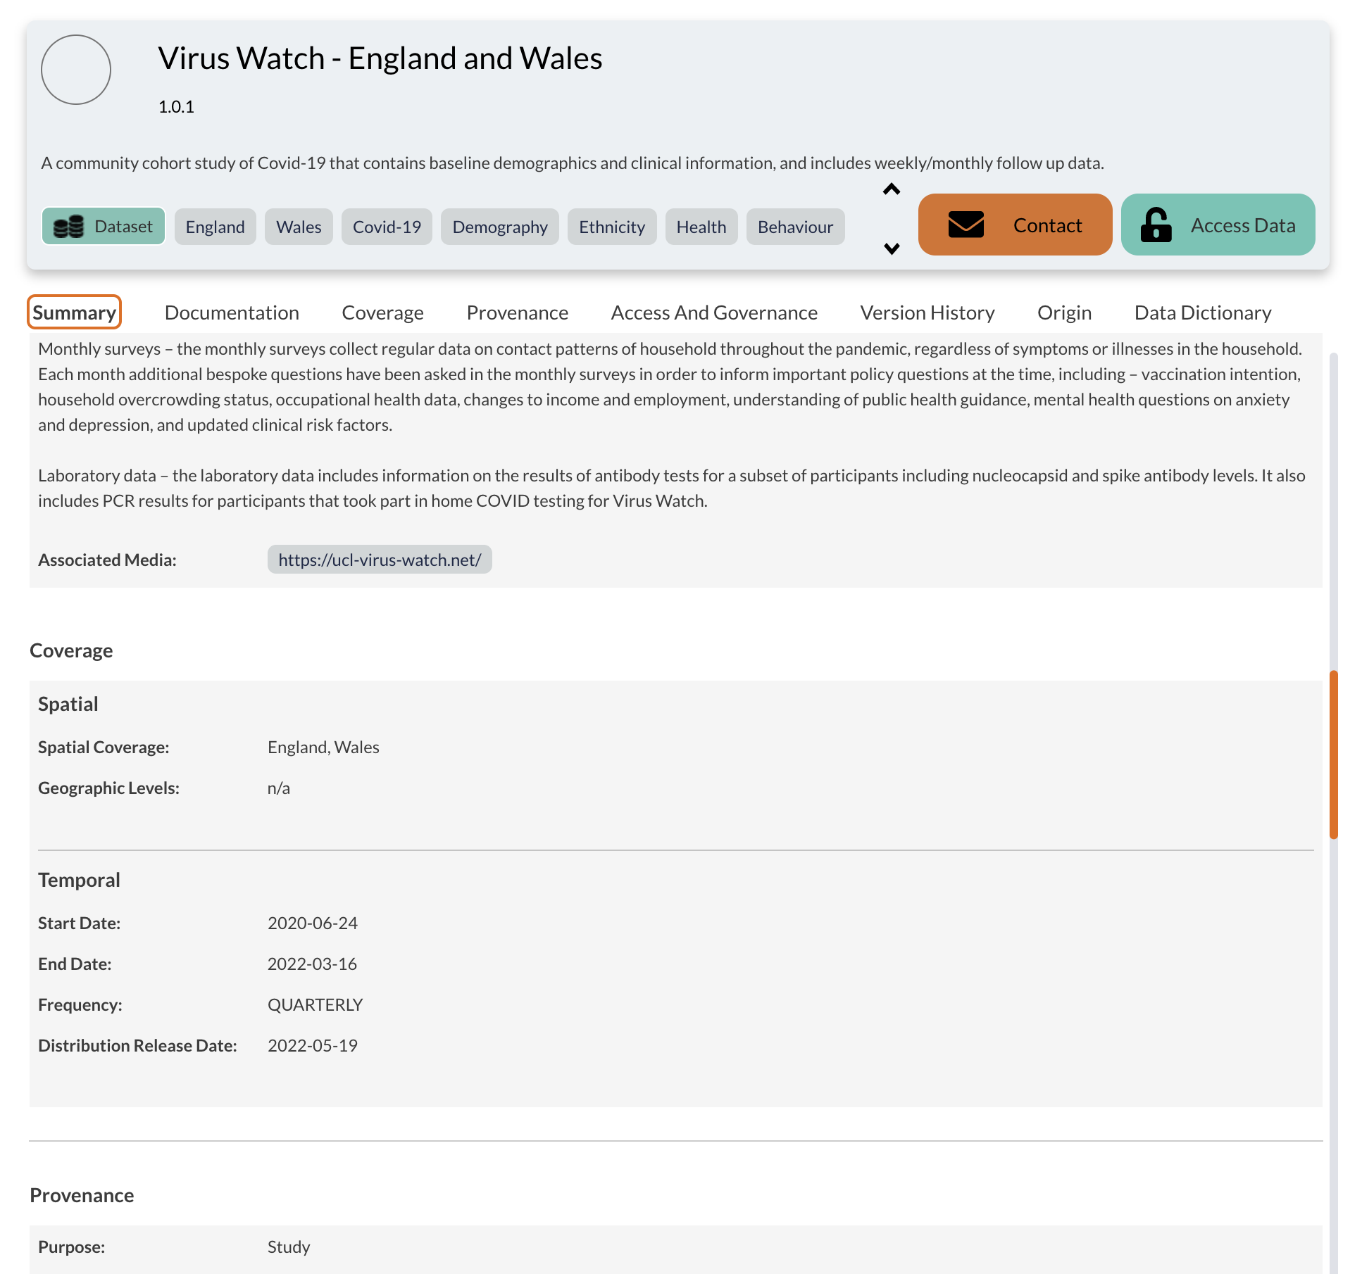
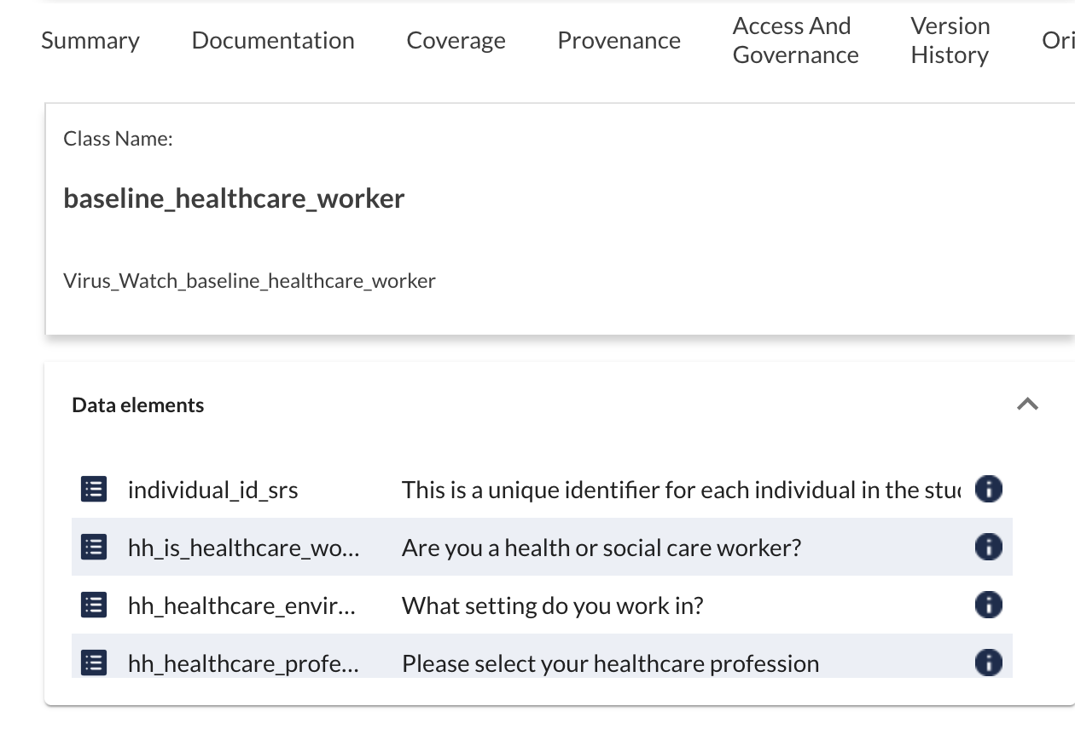
WHAT, WHY, WHEN, HOW, WHERE, WHO
Notes:
This allowed us to deploy a data catalogue quickly. Place you can search for data, explore descriptive info., div into the content itself.
We gave each organization their own area to onboard information
Followed KISS – keep it simple stupid – so most junior member of the team could start creating listings i.e. name, contact details, description for the dataset
Worked well…..BUT not enough data…..i.e. welsh national institute.

Slide 6
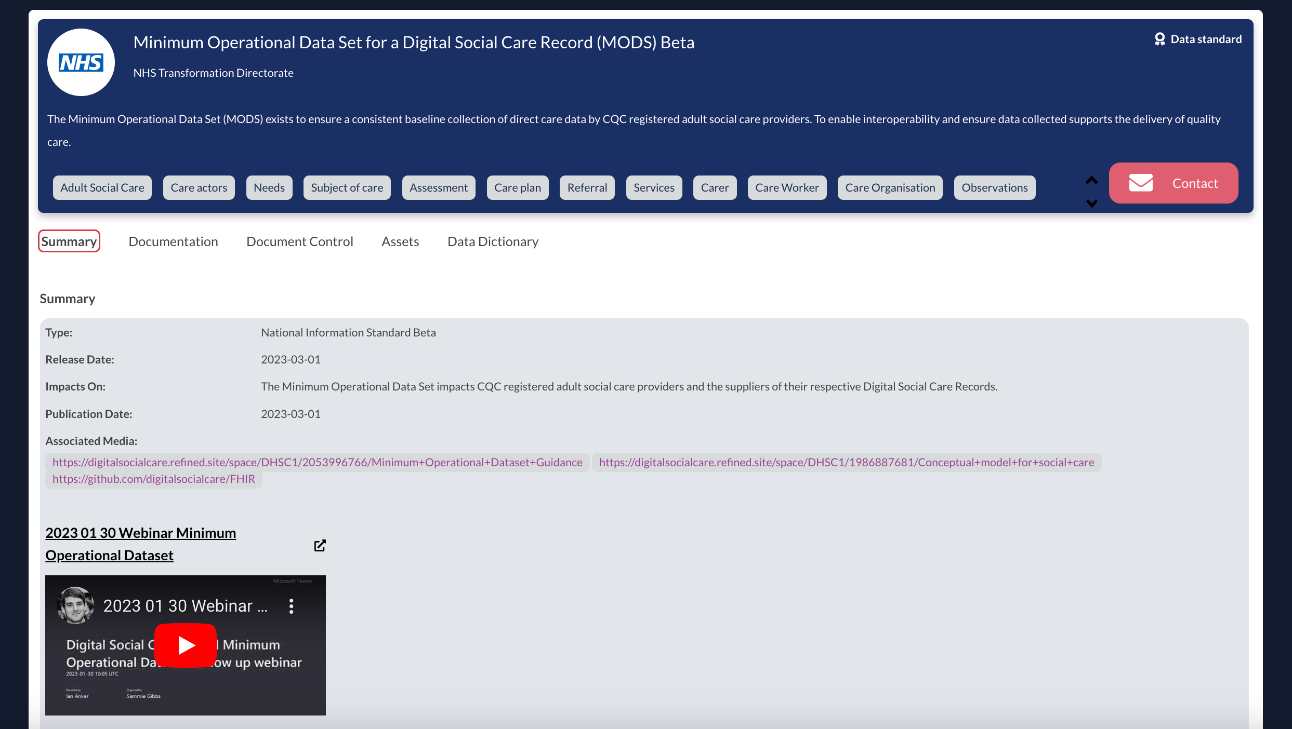
WHAT, WHY, WHEN, HOW, WHERE, WHO
Notes:
This allowed us to deploy a data catalogue quickly. Place you can search for data, explore descriptive info., div into the content itself.
We gave each organization their own area to onboard information
Followed KISS – keep it simple stupid – so most junior member of the team could start creating listings i.e. name, contact details, description for the dataset
Worked well…..BUT not enough data…..i.e. welsh national institute.

Slide 7
WHAT, WHY, WHEN, HOW, WHERE, WHO
Notes:
This allowed us to deploy a data catalogue quickly. Place you can search for data, explore descriptive info., div into the content itself.
We gave each organization their own area to onboard information
Followed KISS – keep it simple stupid – so most junior member of the team could start creating listings i.e. name, contact details, description for the dataset
Worked well…..BUT not enough data…..i.e. welsh national institute.

Slide 8
WHAT, WHY, WHEN, HOW, WHERE, WHO
Notes:
This allowed us to deploy a data catalogue quickly. Place you can search for data, explore descriptive info., div into the content itself.
We gave each organization their own area to onboard information
Followed KISS – keep it simple stupid – so most junior member of the team could start creating listings i.e. name, contact details, description for the dataset
Worked well…..BUT not enough data…..i.e. welsh national institute.

Slide 9
WHAT, WHY, WHEN, HOW, WHERE, WHO
Notes:
This allowed us to deploy a data catalogue quickly. Place you can search for data, explore descriptive info., div into the content itself.
We gave each organization their own area to onboard information
Followed KISS – keep it simple stupid – so most junior member of the team could start creating listings i.e. name, contact details, description for the dataset
Worked well…..BUT not enough data…..i.e. welsh national institute.

Slide 10
WHAT, WHY, WHEN, HOW, WHERE, WHO
Notes:
This allowed us to deploy a data catalogue quickly. Place you can search for data, explore descriptive info., div into the content itself.
We gave each organization their own area to onboard information
Followed KISS – keep it simple stupid – so most junior member of the team could start creating listings i.e. name, contact details, description for the dataset
Worked well…..BUT not enough data…..i.e. welsh national institute.

Slide 11
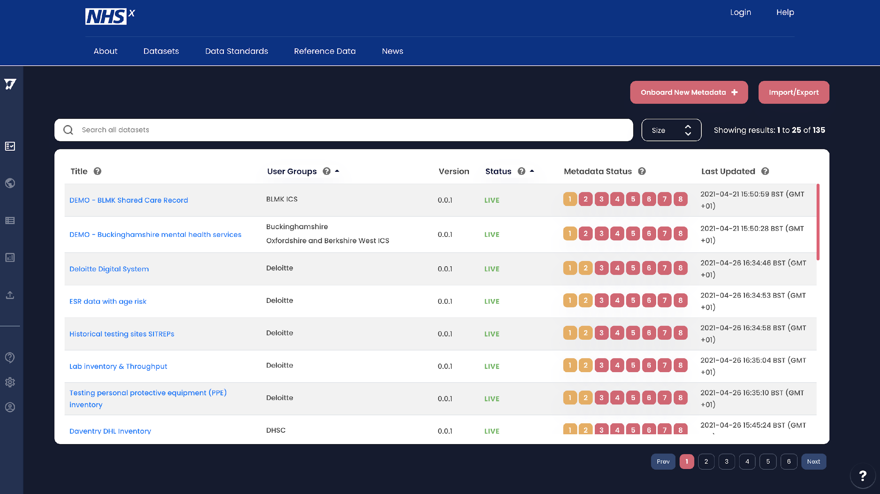
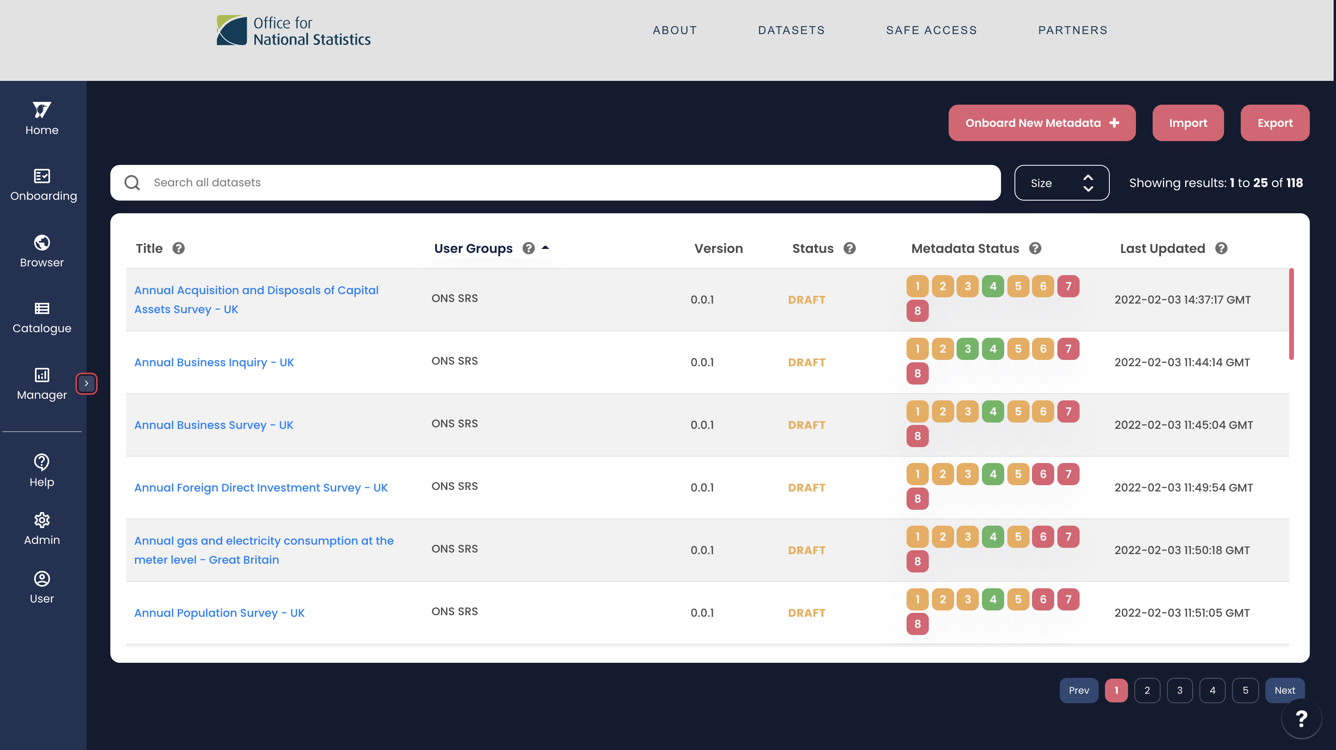
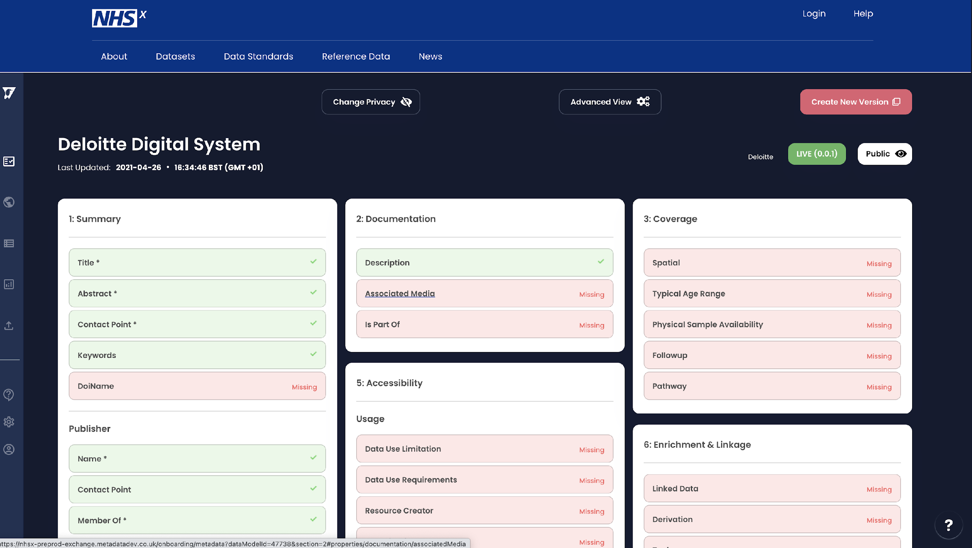
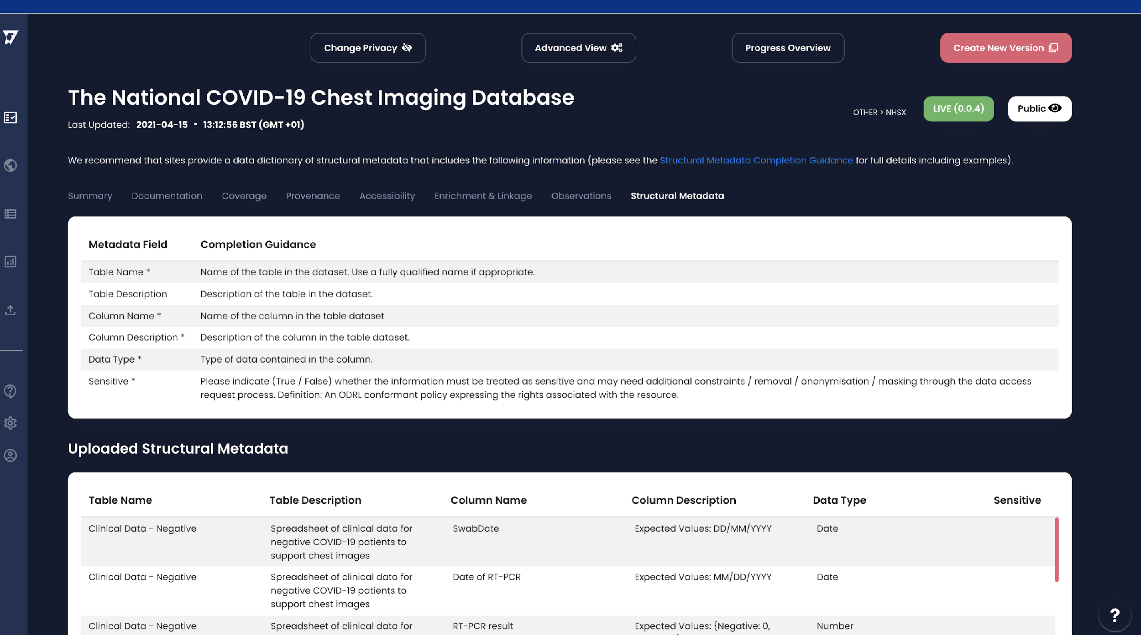
WHAT DATA DO WE HAVE?
AN ONBOARDING PLATFORM
CONNECTS PROVIDERS
INDEXES DATA SAFELY
IMPROVES DATA SUBMISSION
TO ACCELERATE DOWNSTREAM DATA PROCESSING
Notes:
The first question we asked was What data do you have………
OUR DATA ONBOARDING PLATFORM CONNECTS PROVIDERS & INDEXES DATA SAFELY TO CATALOGUE WHAT DATA EXISTS SO IT CAN BE FOUND AND ACCESSED

Slide 12
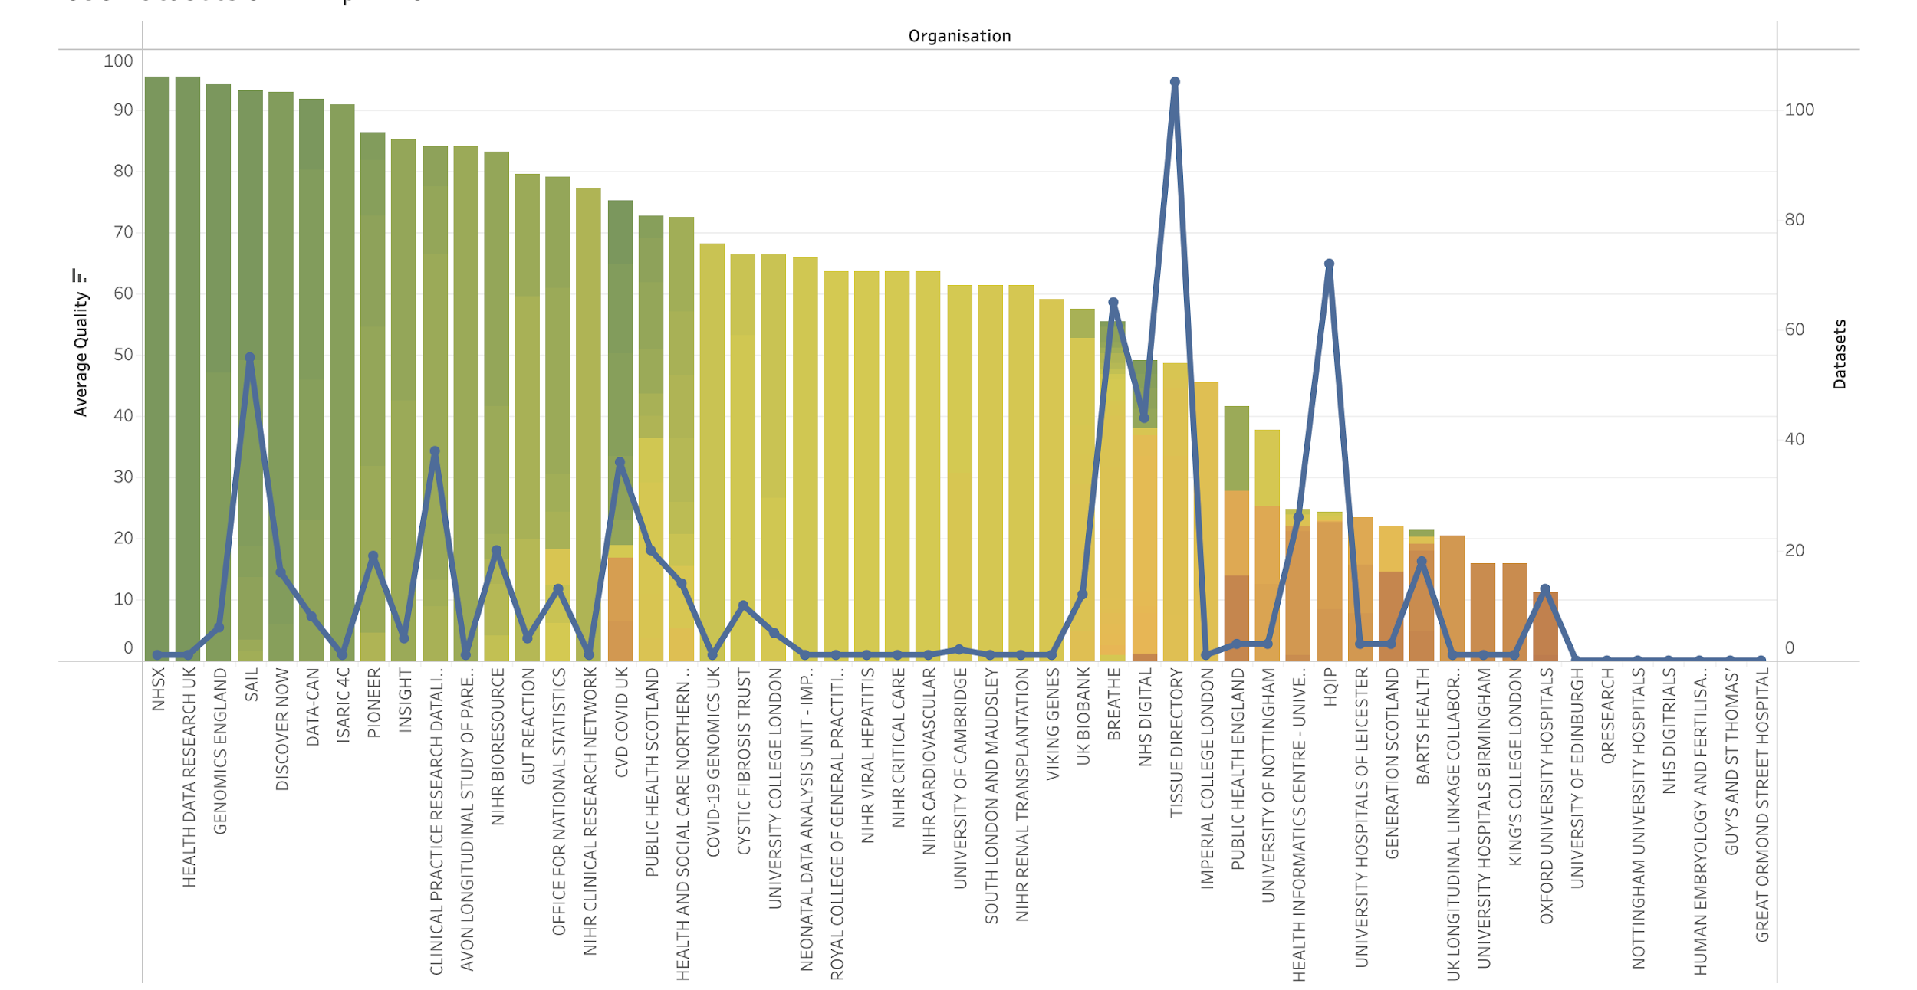
CARROTS, STICKS AND GAMIFICATION…
Notes:
So how to get people engaged. No stick. No Carrot.
But people want to win. So we created a league table.
Send it out every 2 weeks to CDO, CIO, CMO, Heads of research.
No matter how important you are no one want to be bottom of the league.
Showed number of datasets discoverable, quality of information provided about the data – good indicator of maturity and governance

Slide 13
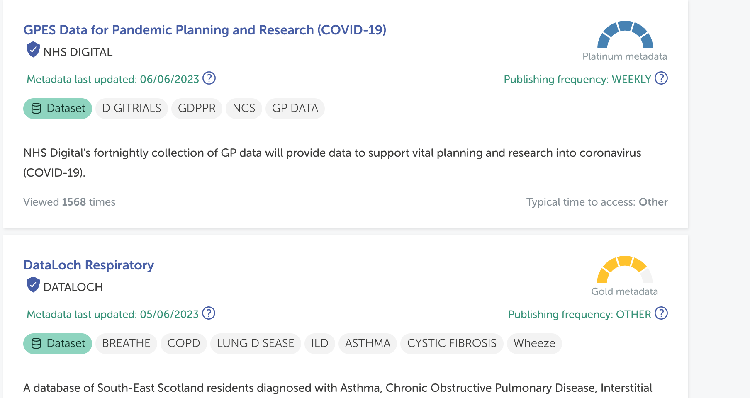
CARROTS, STICKS AND GAMIFICATION…
Notes:
So how to get people engaged. No stick. No Carrot.
But people want to win. So we created a league table.
Send it out every 2 weeks to CDO, CIO, CMO, Heads of research.
No matter how important you are no one want to be bottom of the league.
Showed number of datasets discoverable, quality of information provided about the data – good indicator of maturity and governance

Slide 14
IMPACT
Notes:
So then we brought people into the process but to keep them in the process we needed to understand impact of discoverability AND impact of a well curated dataset
CREDIT KEY – a good dataset can spawn 100’s of papers but often the data isn’t cited

Slide 15
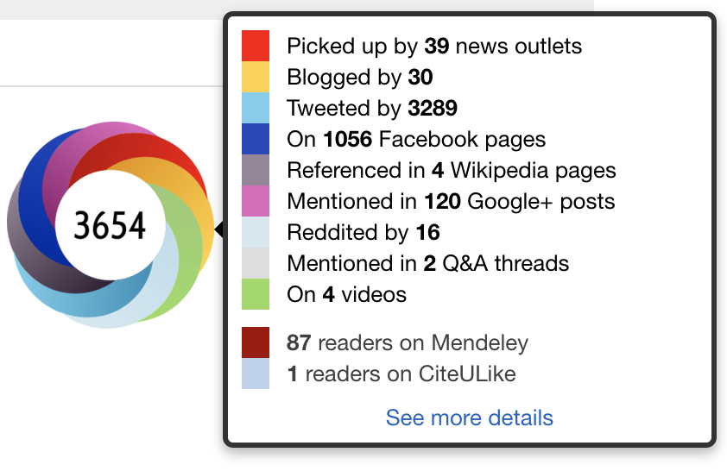
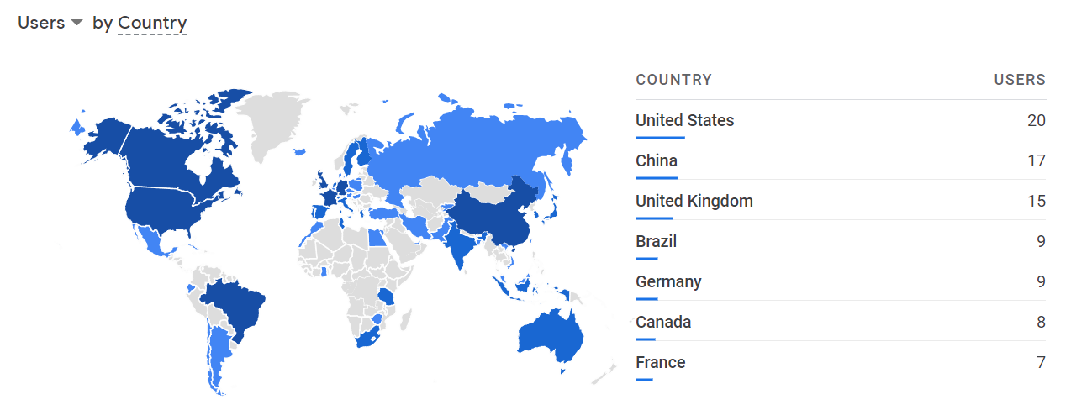
IMPACT
Requests
Notes:
So we track views
Data access requests
And generate DOIs so we can track citations – integrate with services like altmetric and plum analytics

Slide 16
30X MORE DATASETS IN 3 MONTHS
THAN INCUMBANT ONBOARDED IN 3 YEARS
BEFORE
METADATAWORKS
AFTER
“thank you for your time, effort and energy
….there is no way that we would have predicted in 2019 that we would be in a position of having 600+ datasets discoverable through the Gateway, covering all 4 nations of the UK.
Ben Gordon, Data Improvement Director
15
450+
DATASETS
3 YEARS
DATASETS
3 MONTHS
OUTCOMES
“We’ve had over 70 initial data requests which has meant it’s an effective front door to our service!”
Ian Farr, Senior Research Officer, SAIL
Welsh National Data Bank
1000+ PAPERS
90+ PROJECTS
NATIONAL COVID RESPONSE
Notes:
And the result of asking these questions through our platform was that we onboarded 30X more datasets in 3 years than the previous incarnation of HDR UK and the incumbent achieved in 3 years.
Outcomes include 1000 papers, 90 project. SAIL etc.
Now rolling out a federated version of this approach across the NHS, Administrative data, IPCC and beyond

Slide 17
MOVE FAST, ITERATE, KEEP IT SIMPLE
MOTIVATE, CROWD-SOURCE (FEDERATE )
CONTINUALLY MEASURE IMPACT
Notes:
3 takeaways.

Slide 18
METADATAWORKS.CO.UK
ADAM@METADATAWORKS.CO.UK
+44 (0)203 538 1719
linkedin.com/in/adam-milward
METADATAWORKS
Notes:
Thanks you, I’m Adam Milward from MetadataWorks. If you have any questions or want to get in touch please feel free to ping me on linked in or visit our website and talk to the team.

