Slide 1





Sustainable Finance regulation in Europe
Burden or Opportunity?

Slide 2
Sustainable Finance regulation: Why?
Tackle Greenwashing
  by establishing clear criteria
  by ensuring transparency
  by standardization/comparability
Make private funding available for sustainable economic activities
Make sure all market players do their share of work

Slide 3

EU/UK Regulatory frameworks:
Bird’s eye

Slide 4
EU Sustainable Finance framework
Companies:
(NFRD) CSRD
ESRS
Financial Institutions:
SFDR (PAI)
MiFID II
Stakeholders
Investors
Authorities
Consumers
General Public
EU TAXONOMY
Green bonds

Slide 5
UK Green Finance framework
Companies:
(TCFD)
SDR
Financial Institutions:
SDR
Stakeholders
Investors
Authorities
General Public
GREEN TAXONOMY
Green bonds

Slide 6

The frameworks:
A closer look

Slide 7
EU/UK Taxonomies
ELIGIBILITY
Identify eligible activities
SUBSTANTIAL CONTRIBUTION (Environmental objectives)
Climate change mitigation
DO NO SIGNIFICANT HARM (DNSH)
... To any of the other objectives
MINIMUM SAFEGUARDS (Social)
ALIGNMENT
Climate change adaptation
Sustainable use and protection of water and marine resources
Transition to a circular economy
Protection and restoration of biodiversity and ecosystems
Pollution prevention and control
OECD Guidelines for Multinational Enterprises
UN Guiding Principles on Business and Human Rights
ILO Declaration on Fundamental Principles and Rights at Work
International Bill of Human Rights
Percentage of total Turnover, CapEx (and OpEx)
TECHNICAL SCREENING CRITERIA (TSC)

Slide 8

Some Key ESG Milestones 2022 / 2023
ESG Risk Management
mandatory for all EU financial institutions (incl. Art. 3/6 SFDR)
MiFID 2 / IDD
Ask retail investors for their sustainability preferences
(PAI, sustainable investment SFDR, Taxonomy-alignment)
SFDR
Art. 8 / 9 pre-contractual / periodic disclosures in no given format
Art. 4 PAI disclosures in no given format but measuring PAI for 2023
Taxonomy
Taxonomy disclosures for the first 2 environmental goals
(climate change mitigation, climate change adaptation)
SFDR
Art. 8 / 9 pre-contractual / periodic disclosures in RTS templates*
Art. 4 PAI company disclosures in the RTS template* for 2022
Art. 7 PAI pre-contractual / periodic disclosures
Taxonomy
Taxonomy disclosures for the additional 4 environmental goals
(water, circular economy, pollution prevention, biodiversity)
20 Oct 2022
1 Jan 2023
* Amendment to existing templates
currently under discussion

Slide 9
Characteristics TCFD/CSRD/ESRS
TCFD | CSRD/ESRS
(Climate deep-dive) | E, S, and G
Guidance with four-pillar structure: Governance Strategy Risk Management Metrics & Targets (tbd by reporting organization) | Require description of Governance Strategy Risk resilience ... and prescribe metrics
... to identify impact of climate-related risks and opportunities on financial performance through: | ... to identify impact of sustainability risks and opportunities on financial performance AND on society and environment through:
→ materiality analysis | → materiality analysis (inward & outward)
→ target setting | → target setting
→ scenario analyses | → scenario analyses
→ transition plans | → action and transition plans ... including resource allocation and links to financial reporting

Slide 10
Characteristics: SFDR/PAIs
Prescribes disclosure requirements according to three types of financial products:
  Sustainability risks deemed not relevant („Art. 6“)
  Financial products promoting environmental or social characteristics („Art. 8“)
  Financial products with sustainable investment objectives („Art. 9“)
18 (14+2+2) mandatory and 46 additional indicators on E, S, and G topics
Requires disclosure of sustainability risks and adverse impacts:
  = not performance/positive impact, but „What could go wrong?“
Example:
  „Describe your (portfolio) companies‘ whistleblower protection mechanisms“
  % of portfolio companies without adequate whistleblower protection

Slide 11

The frameworks:
A common ground?

Slide 12
What do they have in common?
Requirement to...
Perform an inventory against a definition of „sustainable activities“
Integrate ESG considerations into business processes
Report against standardized metrics
Establish a link between ESG and financial reporting
Issue regular reports on performance
Result: lots of data collection, validation, and analysis

Slide 13

What data?

Slide 14
Overview of KPIs
EU Taxonomy | SFDR - PAIs | ESRS
Energy mix | Energy mix | Energy mix
GHG emissions | GHG emissions | GHG emissions
Manufacturing of harmful substances |  | Emissions into air/water/soil
Environmental Impact Assessment | Land use & biodiversity | Impact on biodiversity
 | Water usage & management | Water usage & management
Environmental Impact Assessment
 | Waste production & management | Waste production & management
Physical risks assessment
 | Raw materials consumption | Raw materials‘ provenance
 | Compliance with int. soc., labour, and gov. standards | Workforce data, training hours
 | Grievances mechanisms | Grievances mechanisms

Slide 15
Principal Adverse Impact KPIs (PAIs) =
Key Element of Sustainability Concepts
PAI as a stand alone SFDR requirement
Sustainable Investment SFDR
Contribution to an E or S objective
Good governance practices
Do Not Significant Harm (DNSH)
with PAI
=
+
+
Environmentally sustainable economic activity Taxonomy
Substantial contribution to a Taxonomy E objective
DNSH based on Taxonomy criteria
Minimum safeguards with PAI
=
+
+
MiFID 2 / IDD Sustainability Preferences
Sustainable Investment SFDR
Environmentally sustainable economic activity Taxonomy
PAI consideration
=
AND
OR
AND
OR
PAIs are part of the key regulatory sustainability concepts
AND can be also used for the ESG Risk Management!

Slide 16
What does this data tell us? - Examples
Topic | Significance | Risks
Energy mix | Diversification Renewables or conventional? Energy efficiency | Cluster risks Shortage of energy sources Rising costs
GHG emissions | Climate change driver or mitigator? | Carbon cost increases Physical risks
Emissions into air/water/soil | Harm to environment | Liability risks High employee turnover
Water usage & management | Proper resource management? | Liability risks Resource depletion
Raw materials consumption, provenance | Efficiency Supply chain robustness | Rising costs Resource depletion Supply chain failures
Workforce data, training hours | Robust staffing Potential harm to workforce | High employee turnover Low productivity Safety incidents
Grievances mechanisms | Communication with stakeholders | Interruptions of operation/construction Liability risks

Slide 17
PAIs in the Portfolio and Risk Management
Example: Scope 1 GHG Emissions = 1 t CO2e
ESG Risk
Impact
Standard
IRR reduced by
1.5% if a CO2 tax is
imposed in 2024
based on Greta Thunberg’s
proposal (Worst Case)
Significant Harm, because of the Implied Temperature Rise 3.8C > 2.0C based on the Paris Agreement
Not a Taxonomy aligned activity,
because the DNSH criterion is not fulfilled

Slide 18

Tools for data-based risk management

Slide 19
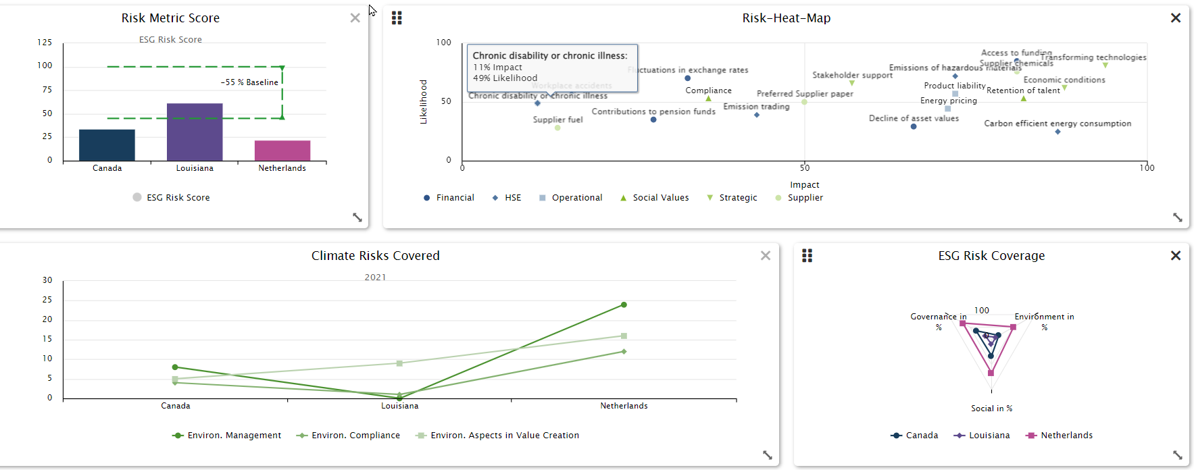
Risk visualization

Slide 20
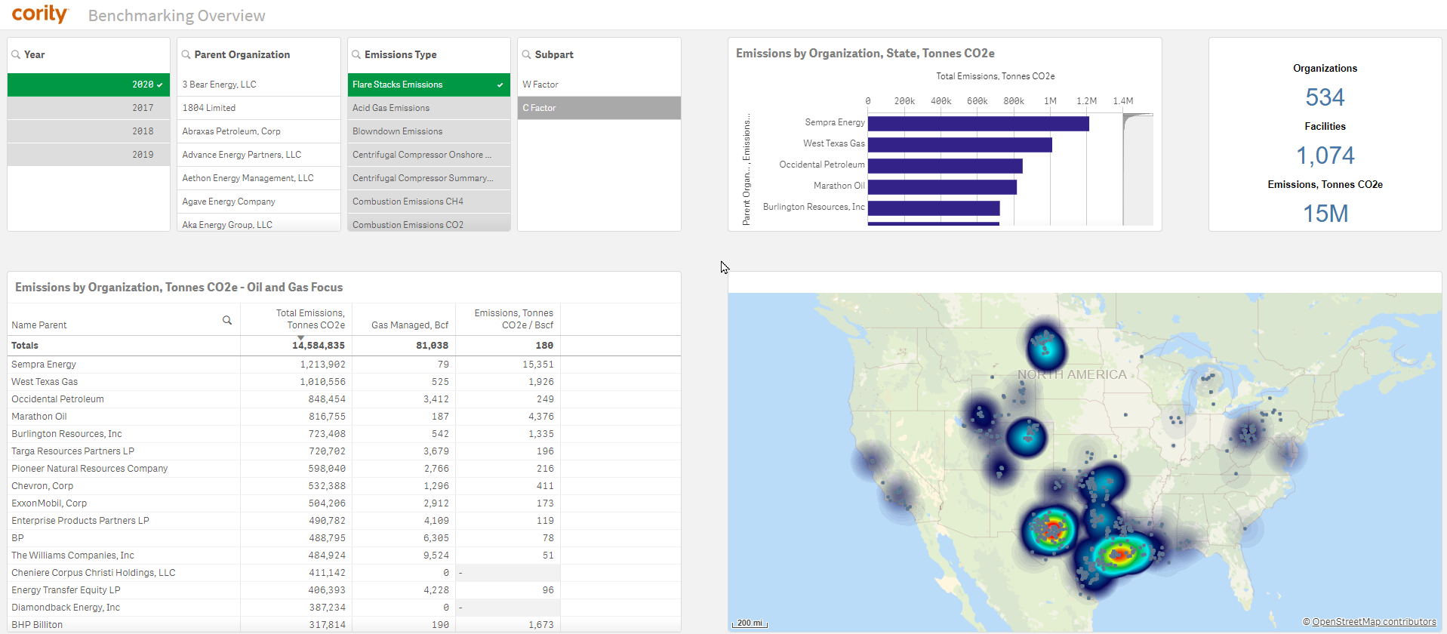
Benchmarking

Slide 21
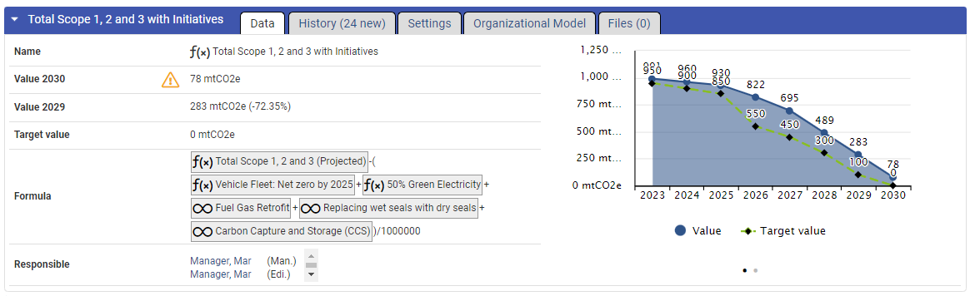
Target setting

Slide 22
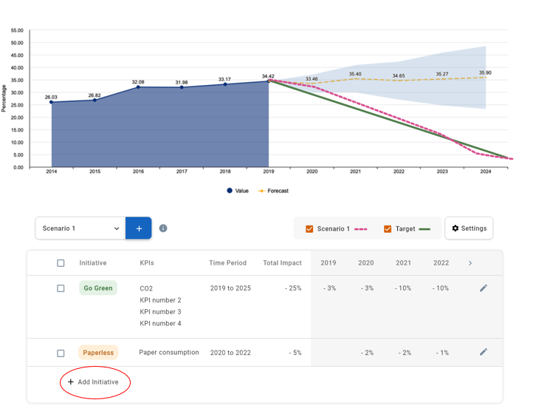
Scenarios

Slide 23

THANKS!

