Slide 1





THEATRE SPONSORED BY
The Future of UK Digital Services: Shaping a citizen-centric experience
Lord Francis Maude
Former Minister for the Cabinet Office, Chair, FMA
DigiGov Expo
DIGIGOVEXPO

Slide 2
The Future of UK Digital Services:
Shaping a citizen-centric experience
Notes:
Tom Read will speak in the morning about Proactive, Personalised and Joined-up: The next generation of government services.

Slide 3

THE FUTURE OF UK DIGITAL SERVICES
Francis Maude,
Rt Hon Lord Maude of Horsham
Founder & Co-Chair, FMA
Former Minister for the Cabinet Office,
UK Government

Slide 4

CURRENT STATE OF UK DIGITAL SERVICES
Citizen centricity has been at the heart of the UK digital government since the creation of GDS in 2011.
By transforming government to focus first on the needs of users, it has set a standard for service delivery across the UK government, and around the world.

Slide 5
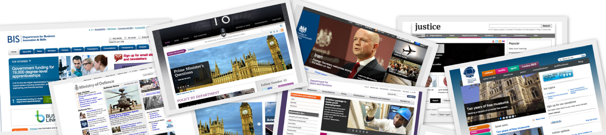
WHAT WE DID
Back in 2010, government websites were configured around the convenience of government structures rather than the needs of citizens.

Slide 6
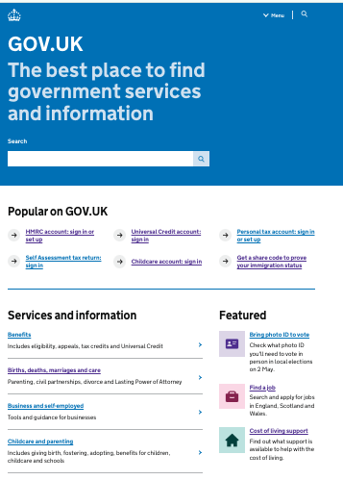
WHAT WE DID
By bringing government information and services together and focusing on user needs, GOV.UK has become a model that is standing the test of time.
© FMAP Ltd 2022

Slide 7



UK INTERNATIONAL REPUTATION FOR DIGITAL GOVERNMENT
UK remains a global leader in user-centric services
No 1 ranking in the user-driven dimension of the 2023 OECD Digital Government Index
No 5 ranking in The Oxford Insights 2022 Human-Centred Public Services Index
No 14 ranking in the UN 2022 Online Services Index (OSI)

Slide 8


SHAPING A CITIZEN-CENTRIC EXPERIENCE IN GOVERNMENT
But what does a citizen-centric experience look like
in 2024 and beyond?
PROACTIVE IN DELIVERY
TRANSPARENT IN INTENT
PERSONALISED IN FORM

Slide 9
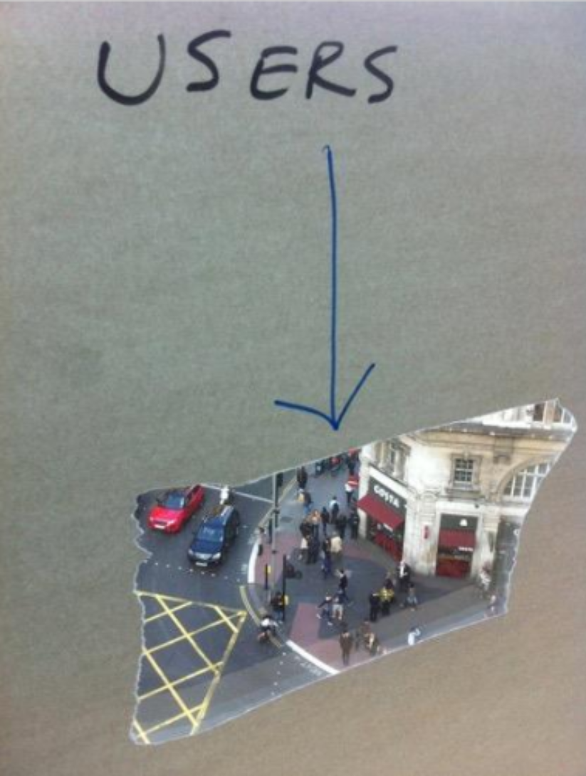
SHAPING A CITIZEN-CENTRIC EXPERIENCE IN GOVERNMENT
It continues to prioritise user needs, not government needs

Slide 10

SHAPING A CITIZEN-CENTRIC EXPERIENCE IN GOVERNMENT
How do we get there?
In 2024, the biggest challenges to shaping a citizen-centric experience are those that cross org boundaries, including:
Data exchange
Identity
Complex services requiring collaboration across departments

Slide 11
SHAPING A CITIZEN-CENTRIC EXPERIENCE IN GOVERNMENT
How do we get there?
But, too often, debates about government services continue to focus on technology.

Slide 12
SHAPING A CITIZEN-CENTRIC EXPERIENCE IN GOVERNMENT
Shaping a citizen-centric experience is not only - or even mostly - about technology.
Culture
Processes
Business models
Funding models
Transparency

Slide 13
SHAPING A CITIZEN-CENTRIC EXPERIENCE IN GOVERNMENT
It is about what made the UK digital government successful in the first place:
MANDATE
Without a strong mandate you will not attract or retain the right leader
LEADERSHIP
Without the right leader you will not attract or retain the right capability
CAPABILITY
Without the right capability the mandate will be attacked or eroded

Slide 14
SHAPING A CITIZEN-CENTRIC EXPERIENCE IN GOVERNMENT
Digital transformation is never finished.
Government infrastructure, culture and outputs must continually evolve to keep pace with the changing expectations and needs of citizens.
Always a work in progress: there is no steady state.

Slide 15
Thank you

